Slide 1
Web-Applications:
TurboGears II
BCHB524
Lecture 28
BCHB524 - Edwards

Slide 2
Last time…
We made the empty Hoya Taxa website
  and learned how to make minor changes,
  and send dynamic content to template.
We added a “taxa” information page with:
  Clickable Parent link
  (Variable number of) clickable Children links
  (Variable number of) names (other than sci name)
  Taxonomic lineage
BCHB524 - Edwards

Slide 3
Start web-app and check
Check that the web-application is working...
Start a web-browser and access by urls:
http://localhost:8080/
http://localhost:8080/taxa/9606
http://localhost:8080/taxa?taxid=9606
cd ~/hoyataxa
./tgserve.sh
BCHB524 - Edwards

Slide 4
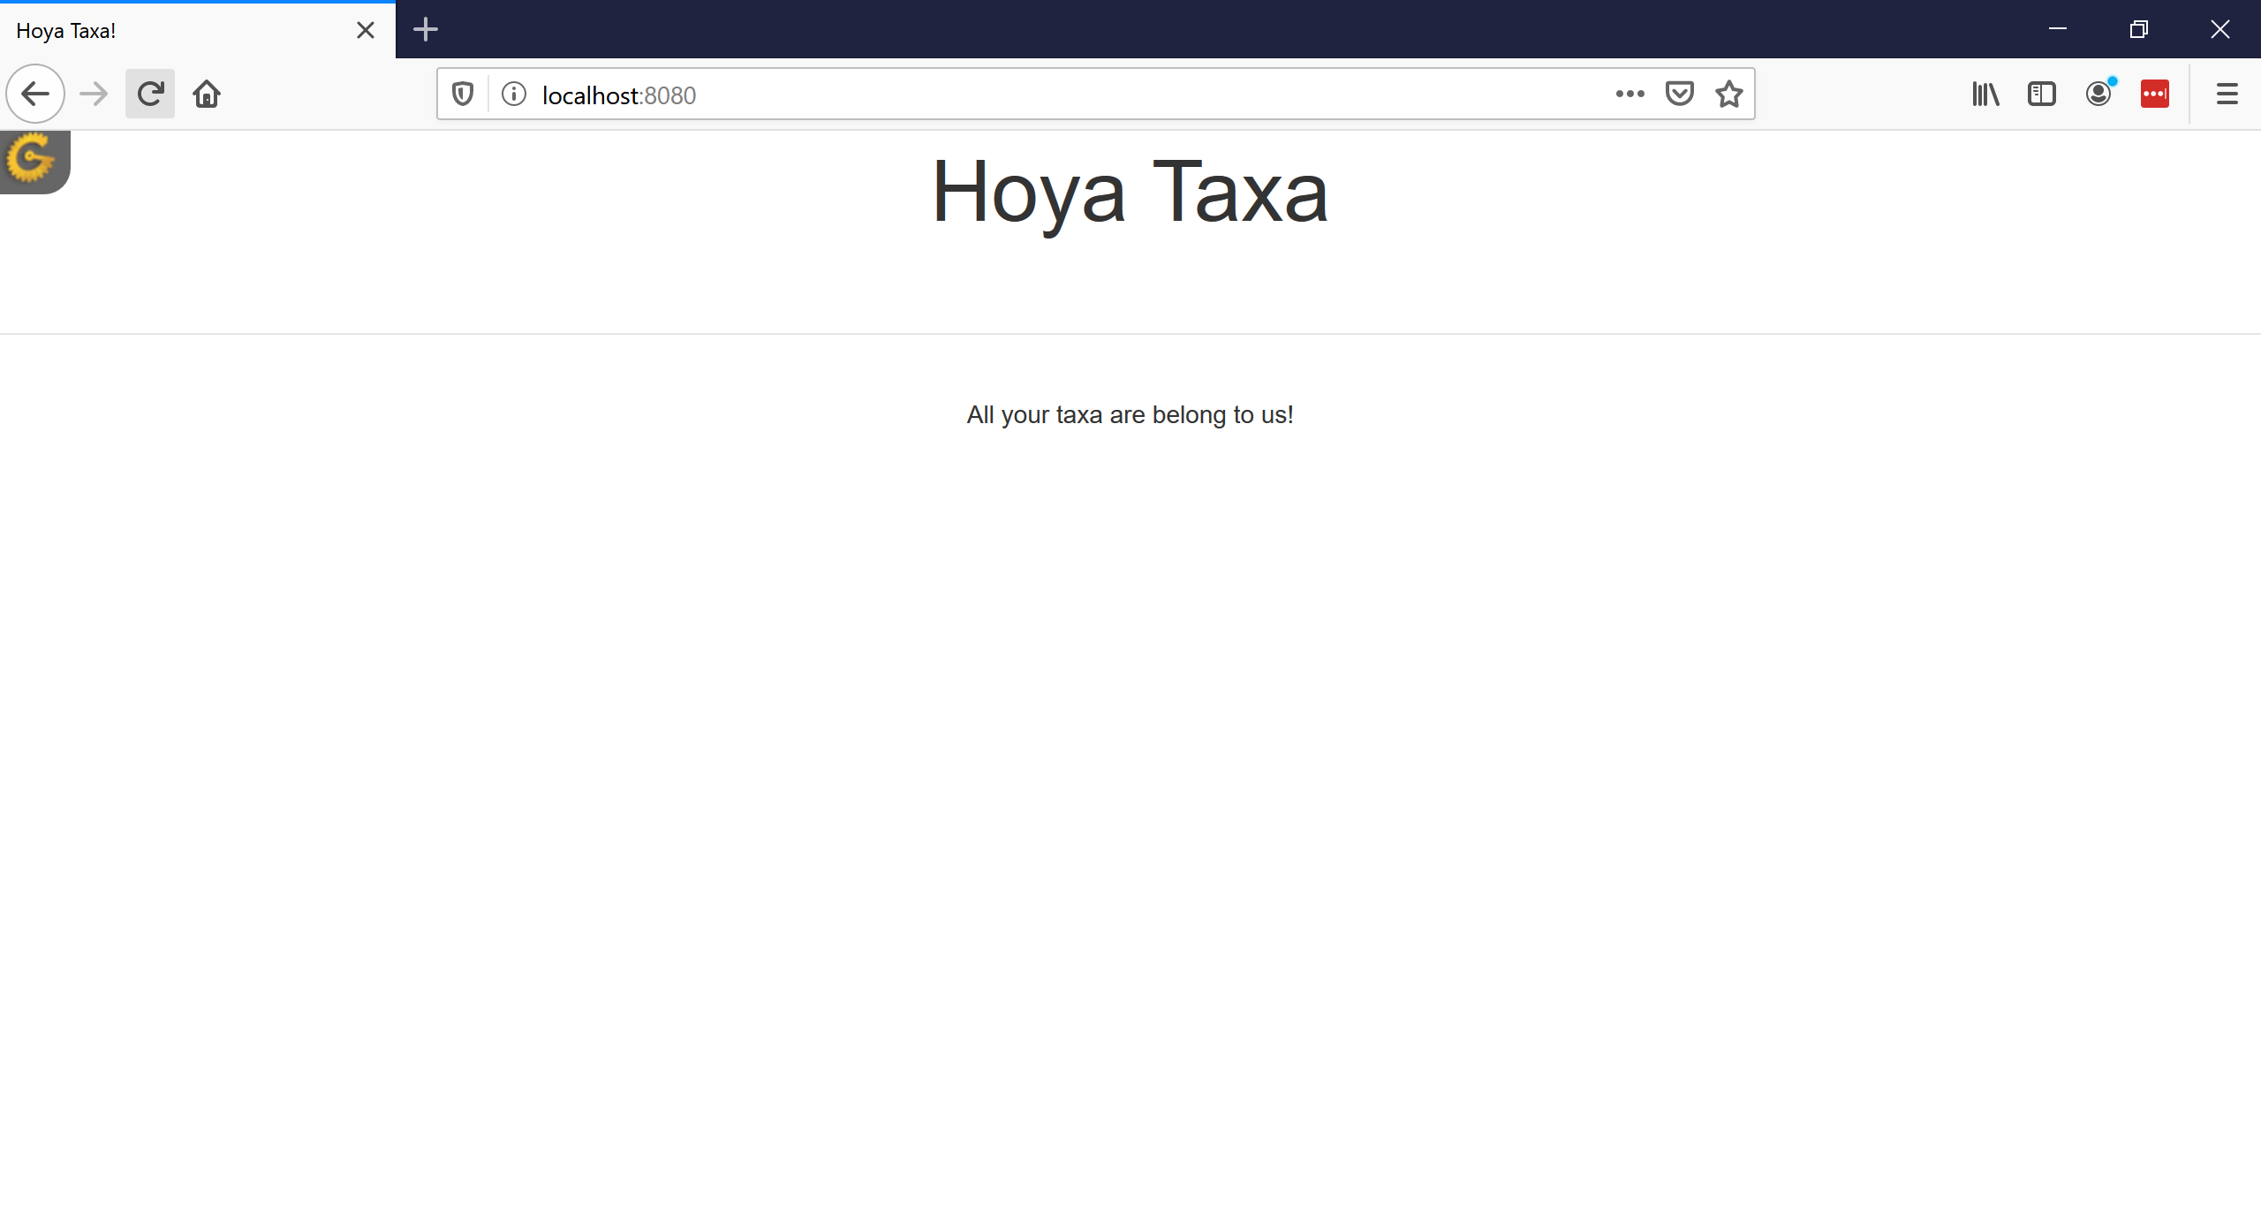
Empty landing page
BCHB524 - Edwards

Slide 5
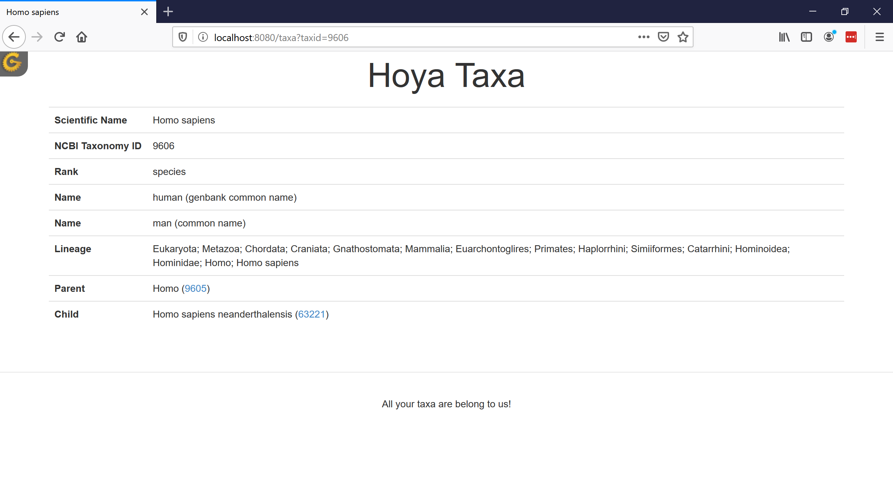
Taxonomy page
BCHB524 - Edwards

Slide 6
Tour the primary files
The files we modified in the hoyataxa folder:
Controller:
  hoyataxa/controllers/root.py
    Clear out the index method
    Add the taxa method to lookup and return Taxonomy given taxid
(Data) Model:
  hoyataxa/model/taxa.py
    SQLObject classes
  devdata.sqlite
    download (or populate) the data in the sqlite database
View / Template:
  hoyataxa/templates/welcome.html
    Remove all but the dynamic title
  hoyataxa/templates/master.html
    Change header and footer, remove menus
  hoyataxa/templates/taxa.html
    Set-up the taxa page layout
BCHB524 - Edwards

Slide 7
Empty landing page
BCHB524 - Edwards

Slide 8
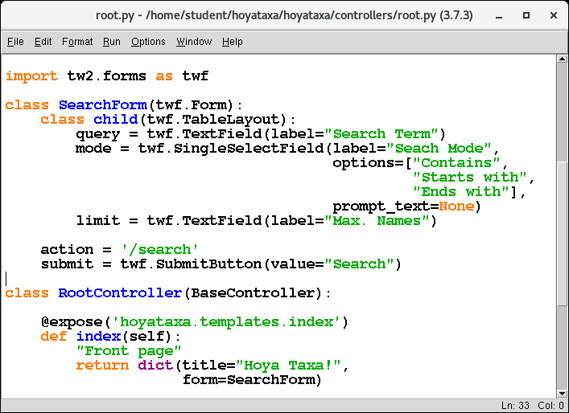
Set up search form
In controllers/root.py, define a class for the form and its fields
BCHB524 - Edwards
Notes:
import tw2.forms as twf
class SearchForm(twf.Form):
class child(twf.TableLayout):
query = twf.TextField(label="Search Term")
mode = twf.SingleSelectField(label="Seach Mode",
options=["Contains",
"Starts with",
"Ends with"],
prompt_text=None)
limit = twf.TextField(label="Max. Names")
action = '/search'
submit = twf.SubmitButton(value="Search")

Slide 9
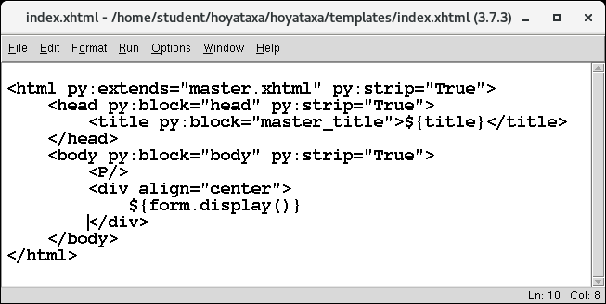
Set up search form
Place the form in templates/index.html
BCHB524 - Edwards
Notes:
<P/>
<div align="center">
${form.display()}
</div>

Slide 10
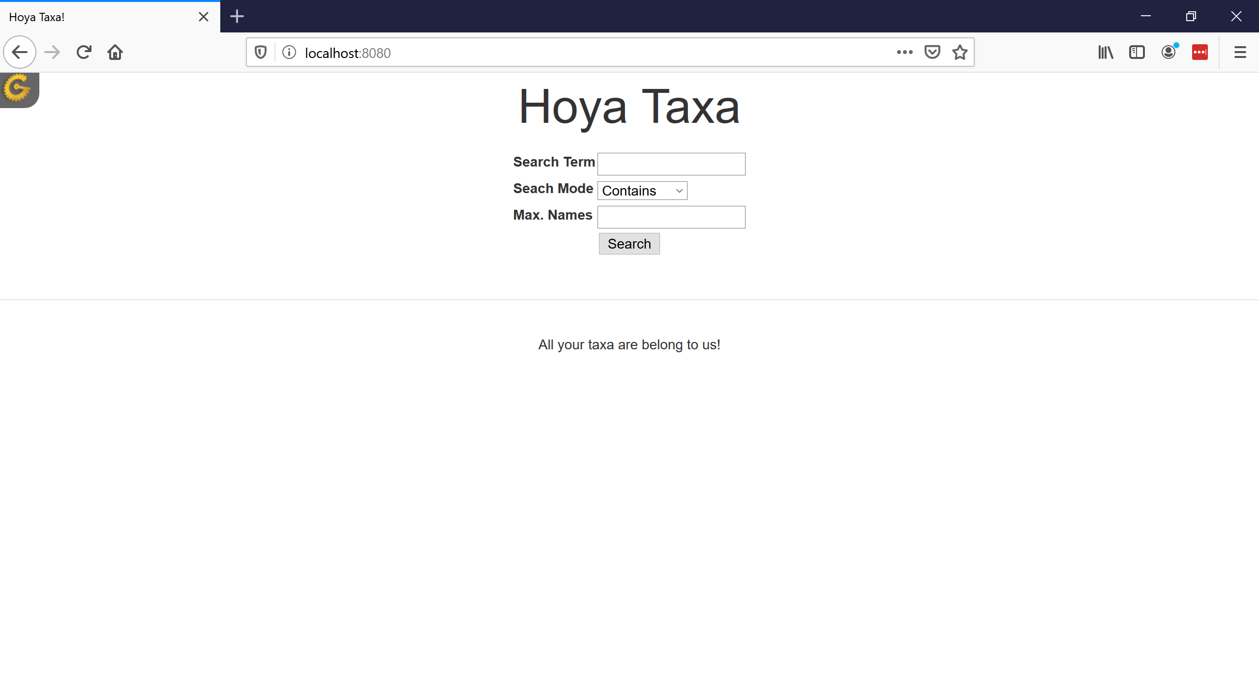
Set up search form
BCHB524 - Edwards

Slide 11
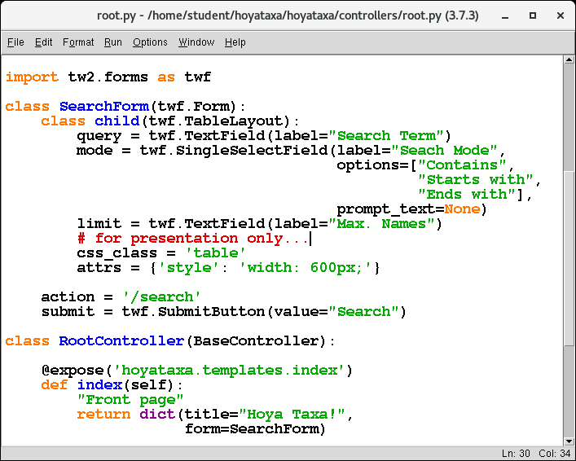
Tweak the form layout
In controllers/root.py, define a class for the form and its fields
BCHB524 - Edwards
Notes:
# for presentation only...
css_class = 'table'
attrs = {'style': 'width: 600px;'}

Slide 12
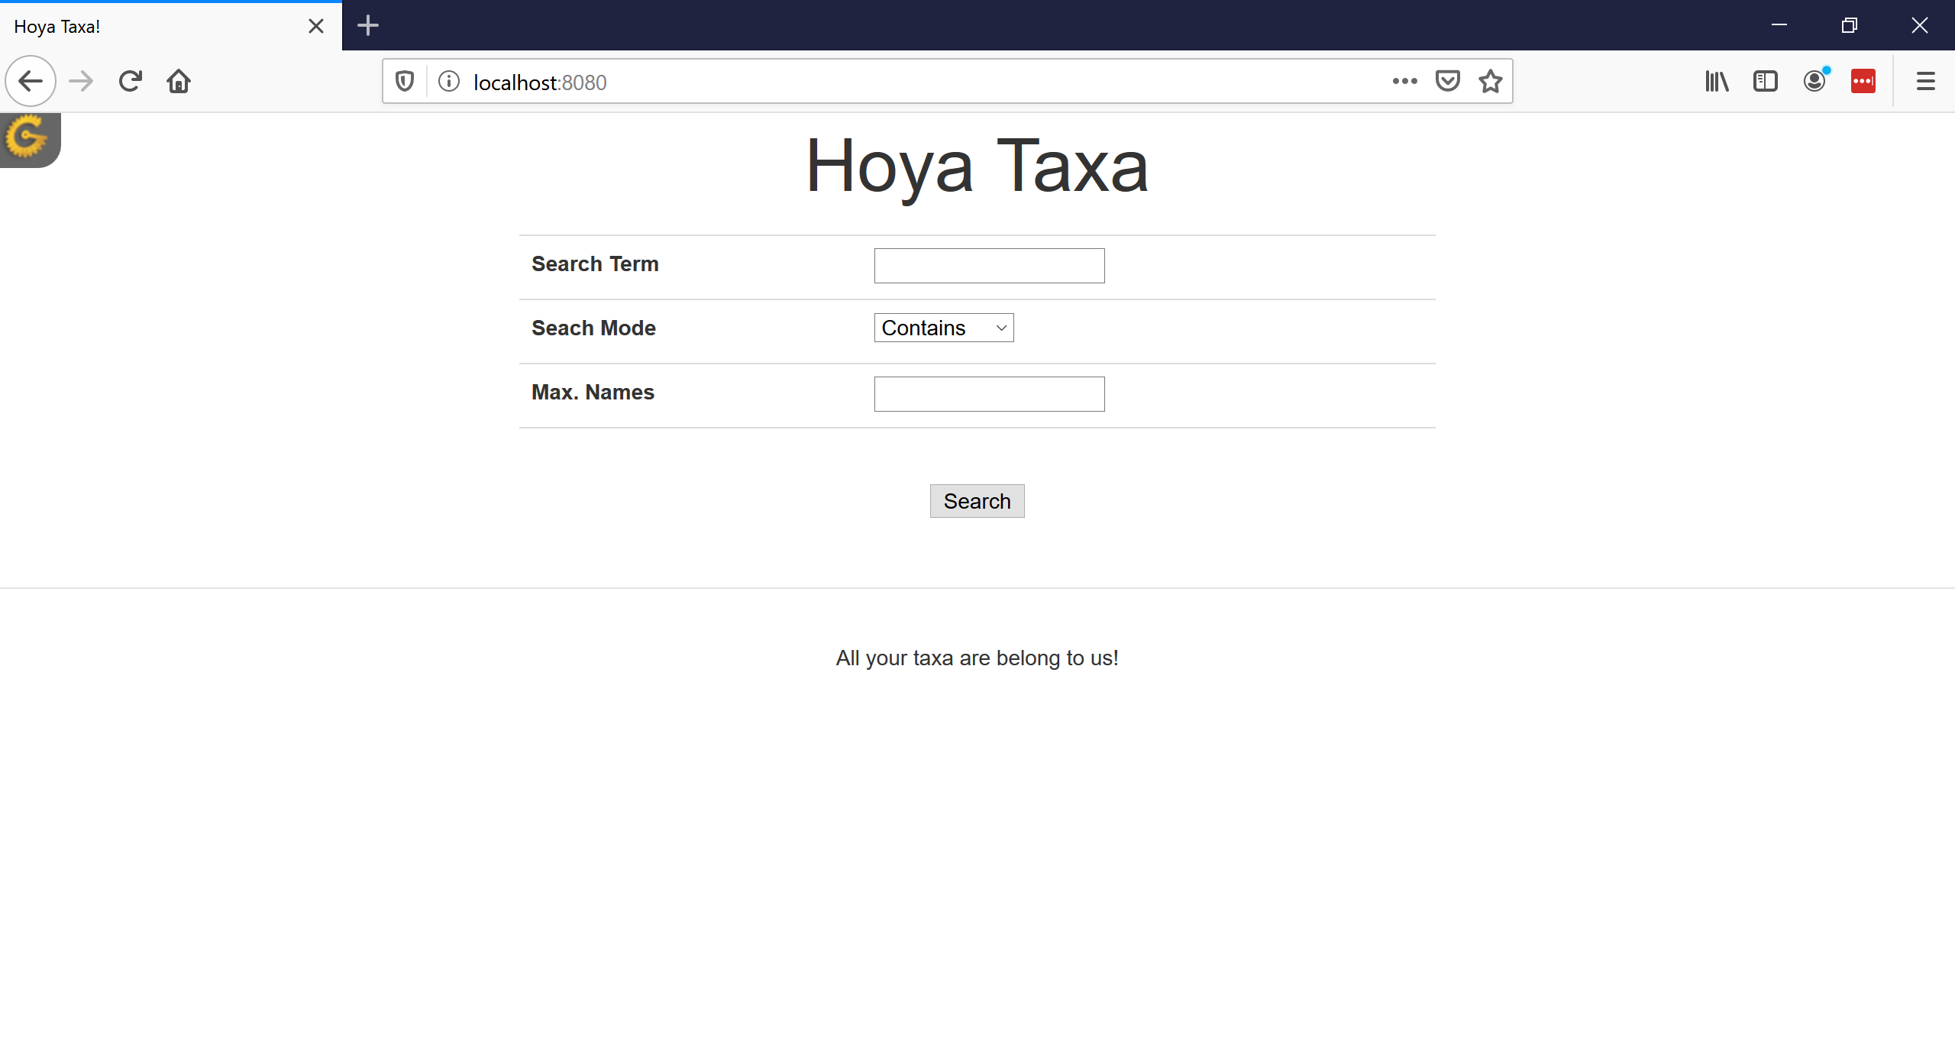
Set up search form
BCHB524 - Edwards

Slide 13
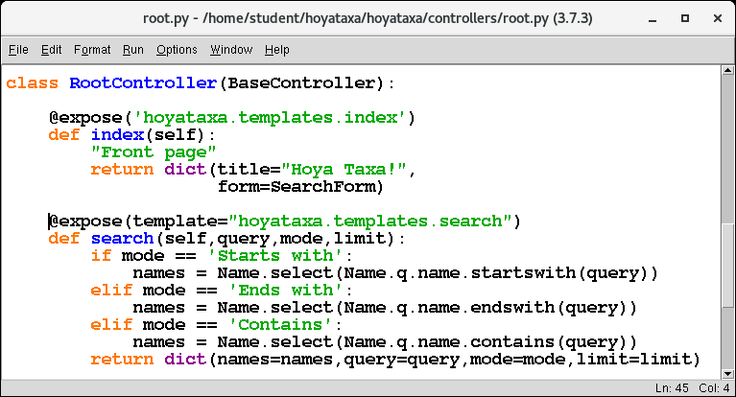
Handle the search request
In controllers/root.py, add the search method
BCHB524 - Edwards
Notes:
@expose('hoyataxa.templates.search')
def search(self,query,mode,limit):
if mode == 'Starts with':
names = Name.select(Name.q.name.startswith(query))
elif mode == 'Ends with':
names = Name.select(Name.q.name.endswith(query))
elif mode == 'Contains':
names = Name.select(Name.q.name.contains(query))
return dict(names=names,query=query,mode=mode,limit=limit)

Slide 14
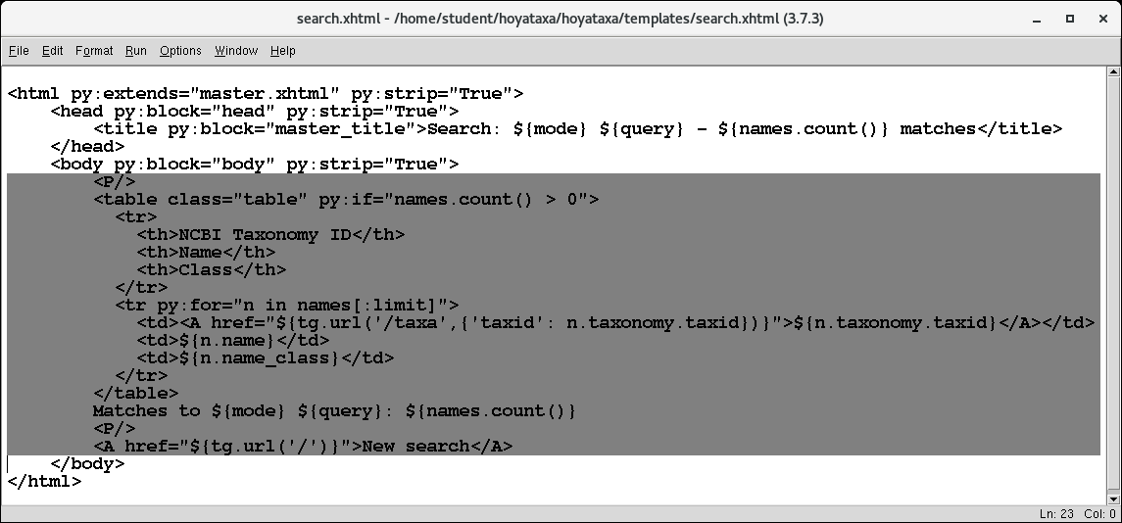
Handle the search request
Save templates/taxa.html as templates/search.html and modify
BCHB524 - Edwards
Notes:
<P/>
<table class="table" py:if="names.count() > 0">
<tr>
<th>NCBI Taxonomy ID</th>
<th>Name</th>
<th>Class</th>
</tr>
<tr py:for="n in names[:limit]">
<td><A href="${tg.url('/taxa',{'taxid': n.taxonomy.taxid})}">${n.taxonomy.taxid}</A></td>
<td>${n.name}</td>
<td>${n.name_class}</td>
</tr>
</table>
Matches to ${mode} ${query}: ${names.count()}
<P/>
<A href="${tg.url('/')}">New search</A>

Slide 15
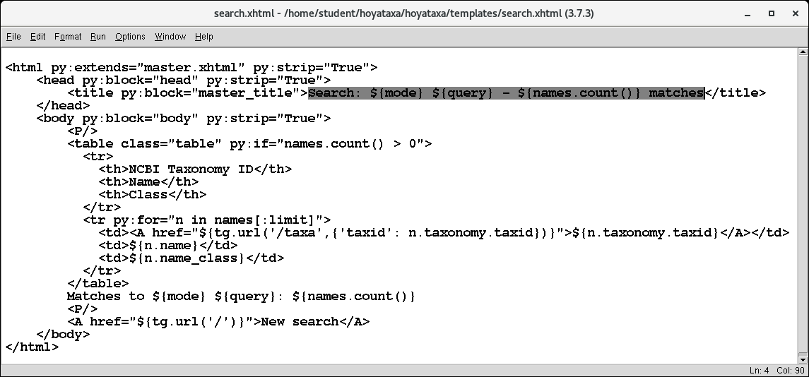
Handle the search request
Save templates/taxa.html as templates/search.html and modify
BCHB524 - Edwards
Notes:
Search: ${mode} ${query} - ${names.count()} matches

Slide 16
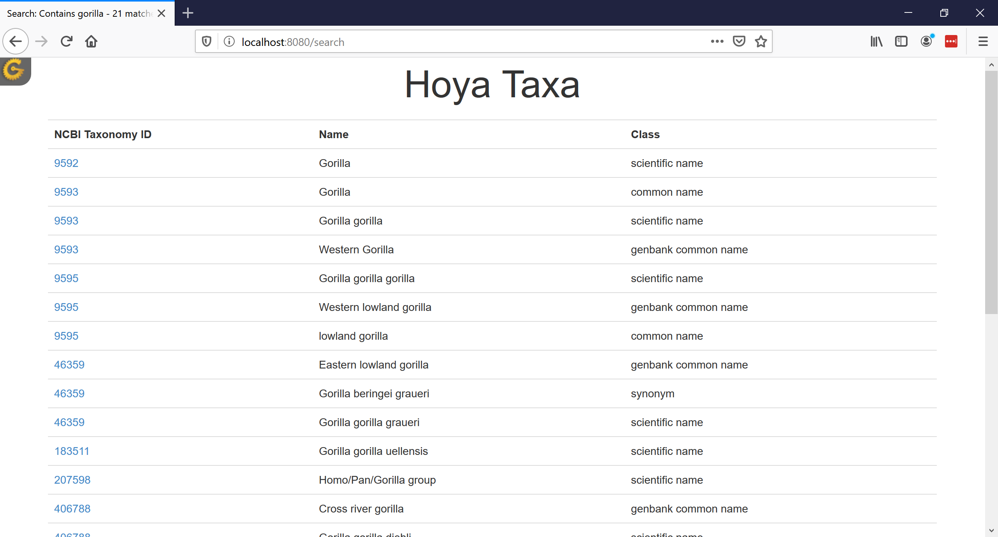
Search for name: gorilla
BCHB524 - Edwards

Slide 17

Search for name: gorilla
BCHB524 - Edwards

Slide 18
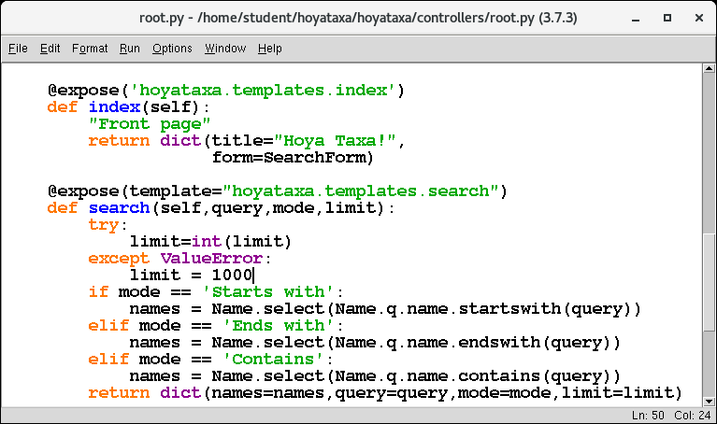
Handle the search request
In controllers/root.py, add the search method
BCHB524 - Edwards
Notes:
@expose(template="hoyataxa.templates.search")
def search(self,query,mode,limit):
try:
limit=int(limit)
except ValueError:
limit = 1000
if mode == 'Starts with':
names = Name.select(Name.q.name.startswith(query))
elif mode == 'Ends with':
names = Name.select(Name.q.name.endswith(query))
elif mode == 'Contains':
names = Name.select(Name.q.name.contains(query))
return dict(names=names,query=query,mode=mode,limit=limit)

Slide 19
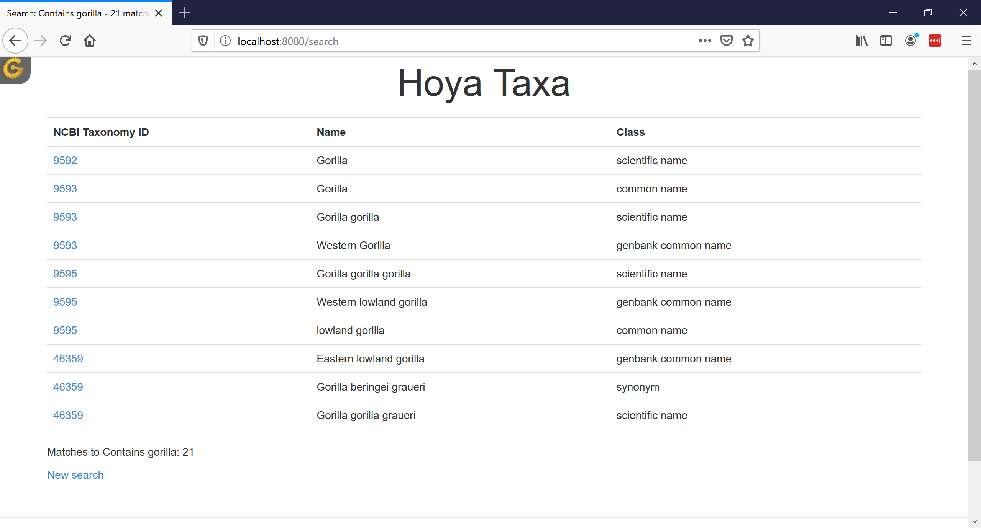
Search for name: gorilla
BCHB524 - Edwards

Slide 20
But…
There is a problem.
  What to do about bad input?
    Too short, spaces at beginning or end…
TurboGears provides validators to check values in the fields to make sure they are OK
Nice integration with form widgets
  Users get error messages so they can fix the error
BCHB524 - Edwards

Slide 21
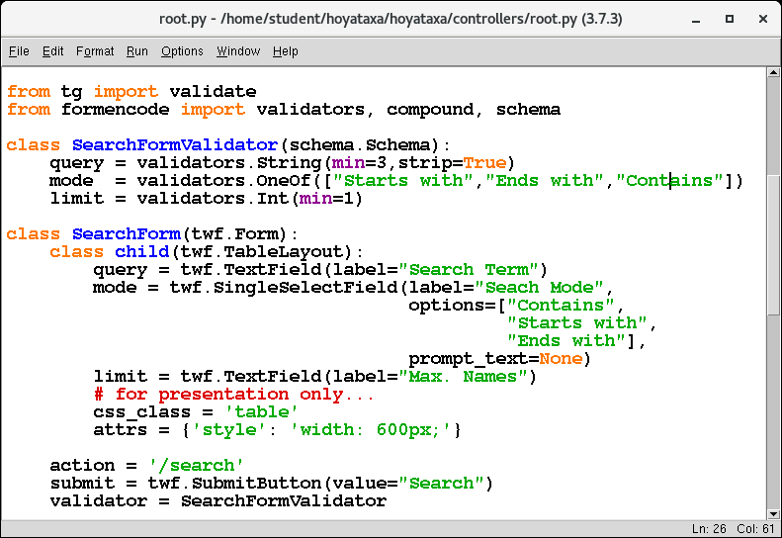
Validation “Schema”
BCHB524 - Edwards
Notes:
from tg import validate
from formencode import validators, compound, schema
class SearchFormValidator(schema.Schema):
query = validators.String(min=3,strip=True)
mode = validators.OneOf(["Starts with","Ends with","Contains"])
limit = validators.Int(min=1)

Slide 22
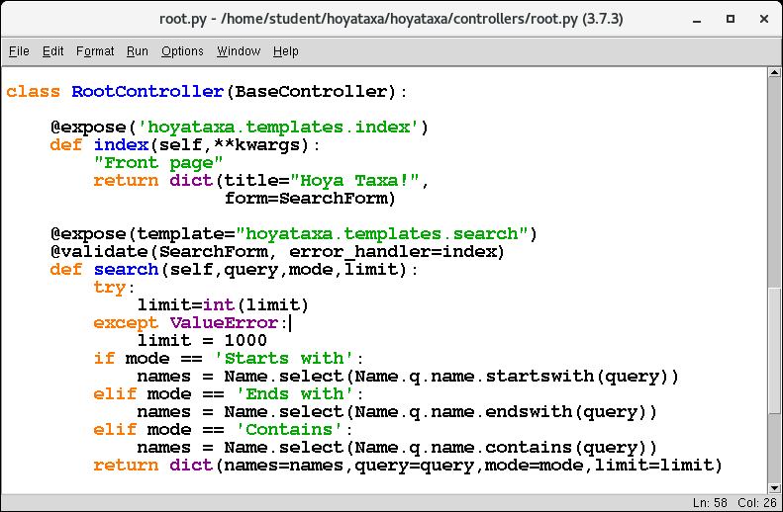
Handle errors in search parameters
BCHB524 - Edwards
Notes:
@validate(SearchForm, error_handler=index)

Slide 23

Problem is communicated to user
BCHB524 - Edwards

Slide 24

Problem is communicated to user
BCHB524 - Edwards

Slide 25
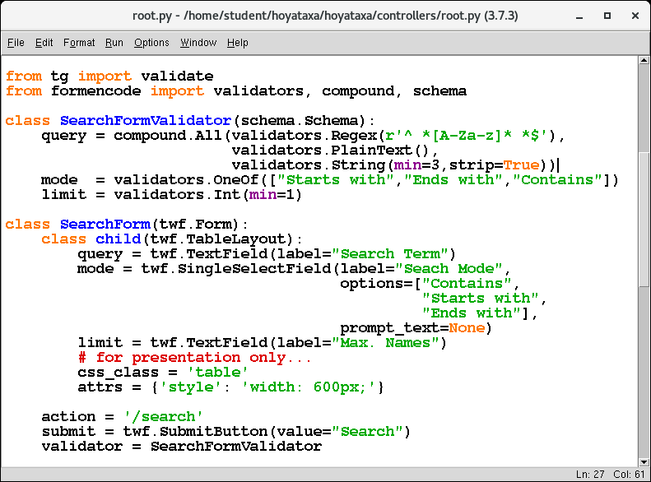
Validators can be quite complicated
BCHB524 - Edwards
Notes:
query = compound.All(validators.Regex(r'^ *[A-Za-z]* *$'),
validators.PlainText(),
validators.String(min=3,strip=True))

Slide 26

Problem is communicated to user
BCHB524 - Edwards

Slide 27
Setup for use by web-services
Our web-site can now be accessed programatically…
  …as we did with urllib.urlopen in python
Access:
  http://localhost:8080/taxa?taxid=9606
  http://localhost:8080/search?query=hum&mode=Contains&limit=10
However, we usually don’t want to parse HTML.
  Programs want to parse “easy” no-frills formats.
BCHB524 - Edwards

Slide 28
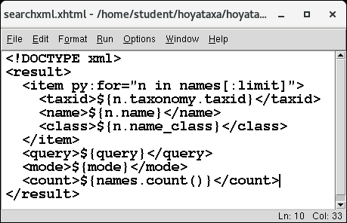
Let’s provide XML output format
We need a new output template for search: templates/searchxml.xhtml
BCHB524 - Edwards
Notes:
<!DOCTYPE xml>
<result>
<item py:for="n in names[:limit]">
<taxid>${n.taxonomy.taxid}</taxid>
<name>${n.name}</name>
<class>${n.name_class}</class>
</item>
<query>${query}</query>
<mode>${mode}</mode>
<count>${names.count()}</count>
</result>

Slide 29
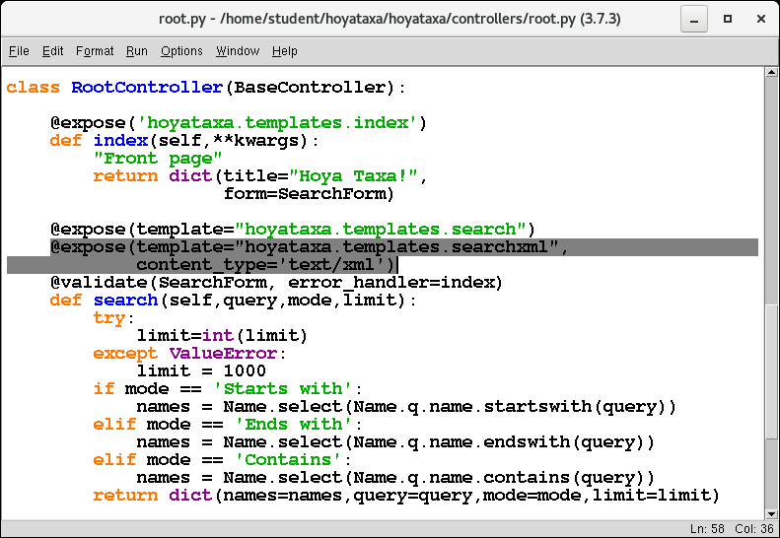
XML output format
Next we need to tell the search method when to use it…
BCHB524 - Edwards
Notes:
@expose('hoyataxa.templates.searchxml',
content_type='text/xml')

Slide 30
XML Output Format
For XML, add .xml to the method
http://localhost:8080/search?query=hum&mode=Contains&limit=10
http://localhost:8080/search.xml?query=hum&mode=Contains&limit=10
BCHB524 - Edwards

Slide 31
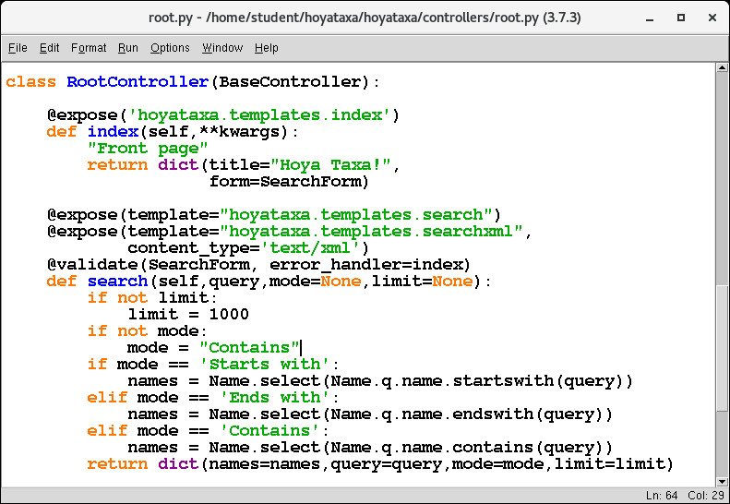
Simplify the URL query
BCHB524 - Edwards

Slide 32
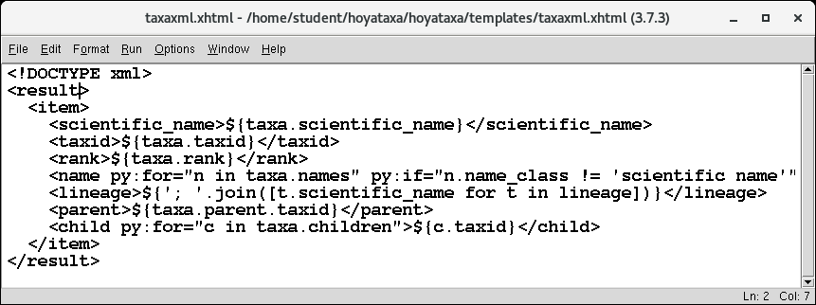
Similarly for the taxa page
BCHB524 - Edwards
Notes:
<!DOCTYPE xml>
<result>
<item>
<scientific_name>${taxa.scientific_name}</scientific_name>
<taxid>${taxa.taxid}</taxid>
<rank>${taxa.rank}</rank>
<name py:for="n in taxa.names" py:if="n.name_class != 'scientific name'">${n.name} (${n.name_class})</name>
<lineage>${'; '.join([t.scientific_name for t in lineage])}</lineage>
<parent>${taxa.parent.taxid}</parent>
<child py:for="c in taxa.children">${c.taxid}</child>
</item>
</result>

Slide 33
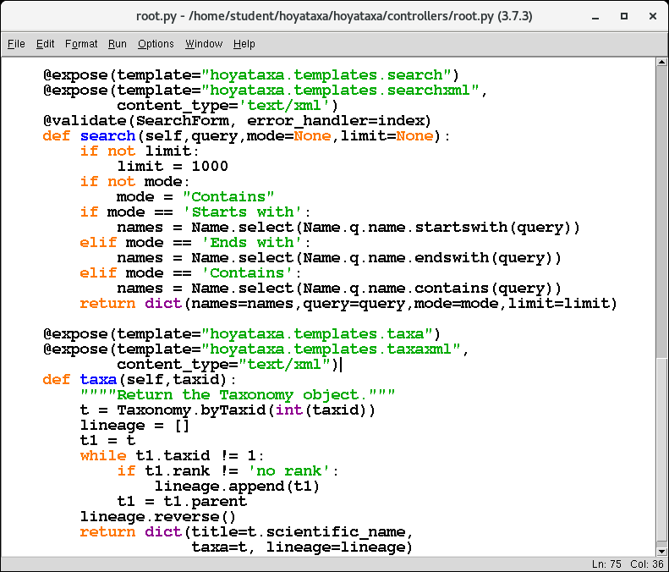
Similarly for the taxa page
BCHB524 - Edwards
Notes:
@expose('hoyataxa.templates.taxaxml',
content_type='text/xml')

Slide 34
XML Output Format
For XML, add .xml to the method.
http://localhost:8080/taxa?taxid=9606
http://localhost:8080/taxa.xml?taxid=9606
BCHB524 - Edwards

Slide 35
All done…
We can now display a taxonomy record nicely if the user types a URL
  ...and then navigate about its heirachy.
Can search the names based on a user query.
  Search form, list of matching results, etc...
XML output for web-services.
BCHB524 - Edwards

Slide 36
End of stage 2
Bring all files up to the end of this lecture:
cd ~/hoyataxa
./hoyataxa.sh --stage 2
BCHB524 - Edwards

Slide 37
TODO…
If only one matching search result – jump straight to taxa page…
  Even if only one taxa matches?
Search/lookup by taxid too?
Make pages and tables prettier
  Center and position tables on page
  Alternate row colors
BCHB524 - Edwards

