Slide 1
Introduction to Python
BCHB524
Lecture 1
BCHB524 - Edwards

Slide 2
Outline
Why Python?
Installation
Hello World
Simple Numbers
BCHB524 - Edwards

Slide 3
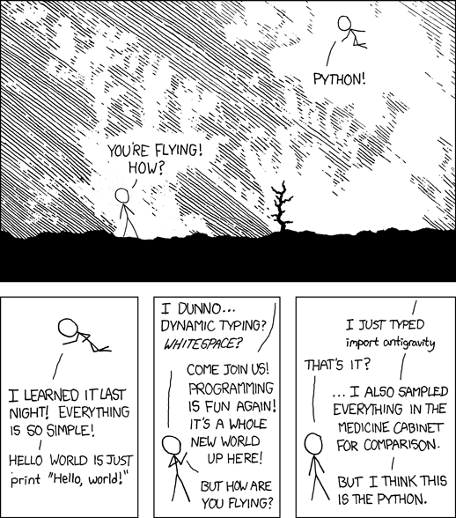
Why Python?
Free
Portable
Object-oriented
Clean syntax
Dynamic
Scientific, Commercial
Support libraries
Extensible
Interactive
Modern
BCHB524 - Edwards
http://xkcd.com/353/

Slide 4
Why Python for Bioinformatics?
Good with
  Strings
  Files and Formats
  Web and Databases
  Objects and Concepts
BioPython
  Good support for bioinformatics data-formats
NumPy, SciPy, Matplotlib
  Good support for scientific computing
BCHB524 - Edwards

Slide 5
Programming Environment
VirtualBox
  Virtual machine “player”
  Installers for Windows, iOS, Linux provided
BCHB524 Linux (Fall 2019) “Appliance” (.ova)
  Use File -> Import Appliance in VirtualBox
  Account: student/password
Anaconda Python Distribution
  Python 3.7 (Python 2.7 also installed)
  Python with scientific computing packages
IDLE Python Editor
  Consistent across platforms, simple
Command-line Execution
BCHB524 - Edwards

Slide 6

Programming Environment
)
BCHB524 - Edwards

Slide 7
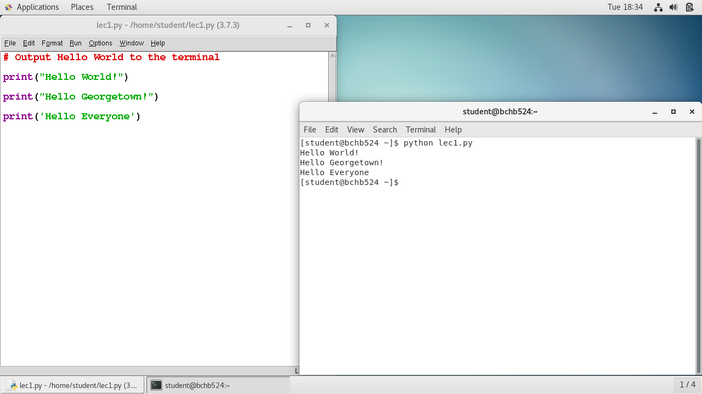
Programming Environment
BCHB524 - Edwards

Slide 8
Hello World!
Paste “special” (Alt-V) into IDLE, save as “lec1.py”
# Output Hello World to the terminal
print("Hello World!")
print("Hello Georgetown!")
print('Hello Everyone')
BCHB524 - Edwards

Slide 9
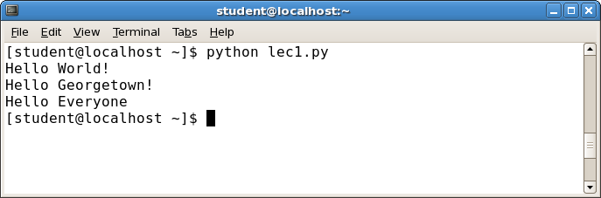
Hello World!
Start the terminal, type “python lec1.py”
BCHB524 - Edwards

Slide 10
Experiment with Hello World
Quotes: single or double? mixed?
How to change the order of output?
What does the red line do?
How to change what is printed? Add or remove?
What happens if you misspell print?
What happens if you forget a quote?
What happens if you forget a #?
Do the blank lines matter?
BCHB524 - Edwards

Slide 11
Lessons
Statements are executed from top to bottom
Single or double quotes – either works as long as they match
Comments (#) are ignored, so use to explain
Syntax error means something is wrong
  Sometimes the colors will help
  But not necessarily at the exact position indicated.
Blank lines don’t matter, so use them for readability
BCHB524 - Edwards

Slide 12
Simple Numbers
# Program input
cars = 100
people_per_car = 4
drivers = 30
passengers = 90
# Compute the dependent values
cars_not_driven = cars - drivers
cars_driven = drivers
carpool_capacity = cars_driven * people_per_car
average_people_per_car = ( drivers + passengers ) / cars_driven
people_in_last_car = ( drivers + passengers - 1 ) % people_per_car + 1
# Output the results
print("There are", cars, "cars available.")
print("There are only", drivers, "drivers available.")
print("There will be", cars_not_driven, "empty cars today.")
print("We can transport", carpool_capacity, "people today.")
print("We have", passengers, "to carpool today.")
print("We need to put about", average_people_per_car, "in each car.")
print("There are", people_in_last_car, "people in the last car.")
BCHB524 - Edwards

Slide 13
Experiment with Simple Numbers
What names can we use to store values?
What values can we store?
What happens if we change a “variable” name?
What happens if we change the statement order?
How do we print out numbers? By themselves?
What happens if we change the input values?
What is the difference between / and // ? What does % mean? When are decimals shown?
Why is “people in last car” so complicated?
Are there values that produce strange answers?
BCHB524 - Edwards

Slide 14
Lessons
Variables store values for later use
  We can use whatever name makes sense
  Letters, numbers, and _
Can store explicit numbers or the result of arithmetic
If you change the name in one place, you have to change it everywhere.
You must store a value before you use the variable.
BCHB524 - Edwards

Slide 15
Exercises
Get the programming environment set up.
Make sure you can run the programs demonstrated in lecture.
BCHB524 - Edwards

