Slide 1
Python Modules and Basic File Parsing
BCHB524
Lecture 11
BCHB524 - Edwards

Slide 2
Outline
Python library (modules)
  Basic stuff: os, os.path, sys
  Special files: zip, gzip, tar, bz2
  Math: math, random
  Web stuff: urllib, cgi, html
  Formats: xml, .ini, csv
  Databases: SQL, DBM
BCHB524 - Edwards

Slide 3
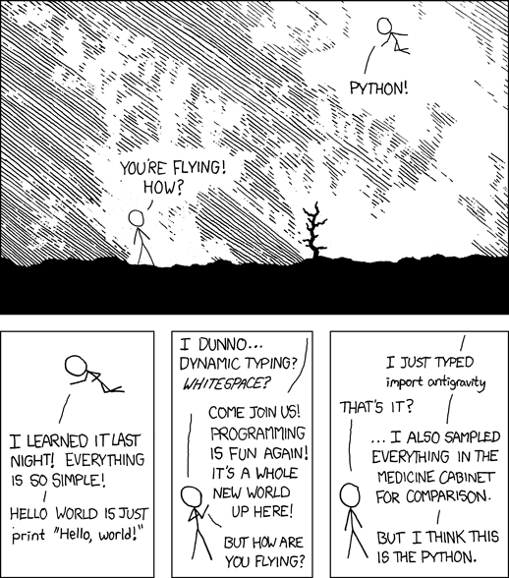
Python Library & Modules
The python library contains lots and lots and lots of extremely useful modules
  “Batteries included”
Many things you want to do have already been done for you!
BCHB524 - Edwards
http://xkcd.com/353/

Slide 4
Basic modules: sys
Use in just about every program!
sys.argv list provides the “command-line” arguments to your script
sys.stdin, sys.stdout, sys.stderr provide "standard" input, output, and error file handles
sys.exit() ends the program, now!
BCHB524 - Edwards

Slide 5
Basic modules: sys
import sys
data = sys.stdin.read()
if len(sys.argv) < 2:
print("There is a problem!", file=sys.stderr)
sys.exit(1)
filename = sys.argv[1]
more_data = open(filename,'r').read()
results = compute(data,more_data)
print(results, file=sys.stdout)
c:\> test.py cmd-line-arg1 < stdin.txt > stdout.txt
BCHB524 - Edwards

Slide 6
Basic modules: os, os.path
os.getcwd() gets the current working directory
os.path.abspath(filename)
  Full pathname for filename
os.path.exists(filename)
  Does a file with filename exist?
os.path.join(path1,path2,path3)
  Join partial paths
os.path.split(path)
  Get the directory and filename for a path
BCHB524 - Edwards

Slide 7
Basic modules: os, os.path
# Import important modules
import os
import os.path
import sys
# Check for command-line arguement
if len(sys.argv) < 2:
print("There is a problem!", file=sys.stderr)
sys.exit(1)
# Get the filename
filename = sys.argv[1]
# Get the current working directory
cwd = os.getcwd()
print(cwd)
# Turn a filename into a full path
abspath = os.path.abspath(filename)
print(abspath)
BCHB524 - Edwards

Slide 8
Basic modules: os, os.path
# make the home directory path
homedir = '/home/student'
print(homedir)
# Check if the file is there
if os.path.exists(filename):
print(filename,"is there")
else:
print(filename,"does not exist")
# Check if the file is in the current working directory
new_filename = os.path.join(cwd,filename)
if os.path.exists(new_filename):
print(new_filename,"is there")
else:
print(new_filename, "does not exist")
# Check if the file is in home directory
new_filename = os.path.join(homedir,filename)
if os.path.exists(new_filename):
print(new_filename,"is there")
else:
print(new_filename, "does not exist")
BCHB524 - Edwards

Slide 9
Special files: zip
Open various types of compressed and archival file-formats
import zipfile
import sys
zipfilename = sys.argv[1]
zf = zipfile.ZipFile(zipfilename)
for filename in zf.namelist():
if filename.startswith("A2"):
print(filename)
print()
ncore = 'M3.txt'
thedata = zf.read(ncore)
print(thedata)
thedata = thedata.decode()
print(thedata)
BCHB524 - Edwards

Slide 10
Special files: gz
gzip format is very common for bioinformatics files (Extention is .gz)
  Use the gzip module to read and write as if a normal file (not an archive format like zip)
import gzip
zf = gzip.open('sprot_chunk.dat.gz')
for i,line in enumerate(zf):
line = line.decode()
print(line.rstrip())
if i > 10:
break
zf.close()
BCHB524 - Edwards

Slide 11
Math: math, random
math.floor(), math.ceil() round up and down
random.random() random float between 0 and 1
random.randint(a,b) random int between a and b
import math
print(math.floor(2.5))
print(math.ceil(2.5))
import random
print(random.random())
print(random.randint(0,10)) #inclusive of 0 and 10!
BCHB524 - Edwards

Slide 12
Web stuff: urllib
Open a url just like a file
import urllib.request
url = 'http://edwardslab.bmcb.georgetown.edu/' + \
'teaching/bchb524/2019/data/standard.code'
print("The URL:",url)
handle = urllib.request.urlopen(url)
for line in map(bytes.decode,handle):
print(line.rstrip())
handle.close()
filename = 'standard.code'
print("The File:",filename)
handle = open(filename)
for line in handle:
print(line.rstrip())
handle.close()
BCHB524 - Edwards

Slide 13
File formats: CSV
Comma separated values
  Can be read (and written) by lots of different tools
Easy way to format data for Excel
First row is (sometimes) "headings" or names
Other rows list the values in each column
import csv
f = open('data.csv')
rows = csv.reader(f) # No headers
# Iterate through the rows
for r in rows:
# access r as a list of values
print(r[0],r[1],r[2])
f.close()
BCHB524 - Edwards

Slide 14
File formats: CSV
Most powerful with headings
import csv
f = open('data.txt')
# Headers, and tab-separated-values
rows = csv.DictReader(f,dialect='excel-tab')
# Iterate through the rows
for r in rows:
# access r as a dictionary - headers are keys
print(r['TUMOUR'],r['R00884'])
f.close()
BCHB524 - Edwards

Slide 15
Exercise 1
Write a program that reads the microarray data in “data.csv” and computes the mean and standard deviation of the expression values of a specific gene overall, and within each sample category.
  Get the name of the microarray datafile from the command-line.
  Get the name of the gene from the command-line.
BCHB524 - Edwards

