Slide 1
SP-β group bacteriophage communication system influences the lytic/lysogenic cycle decision
Michael Chambers
MICB-619
April 16th, 2019

Slide 2

Significance
Phages are the most common and diverse entities in the biosphere
Phages exhibit the capacity to drive gene regulation in host
Phages offer an alternative to antibiotic therapy
Shkoporov et al., 2019

Slide 3
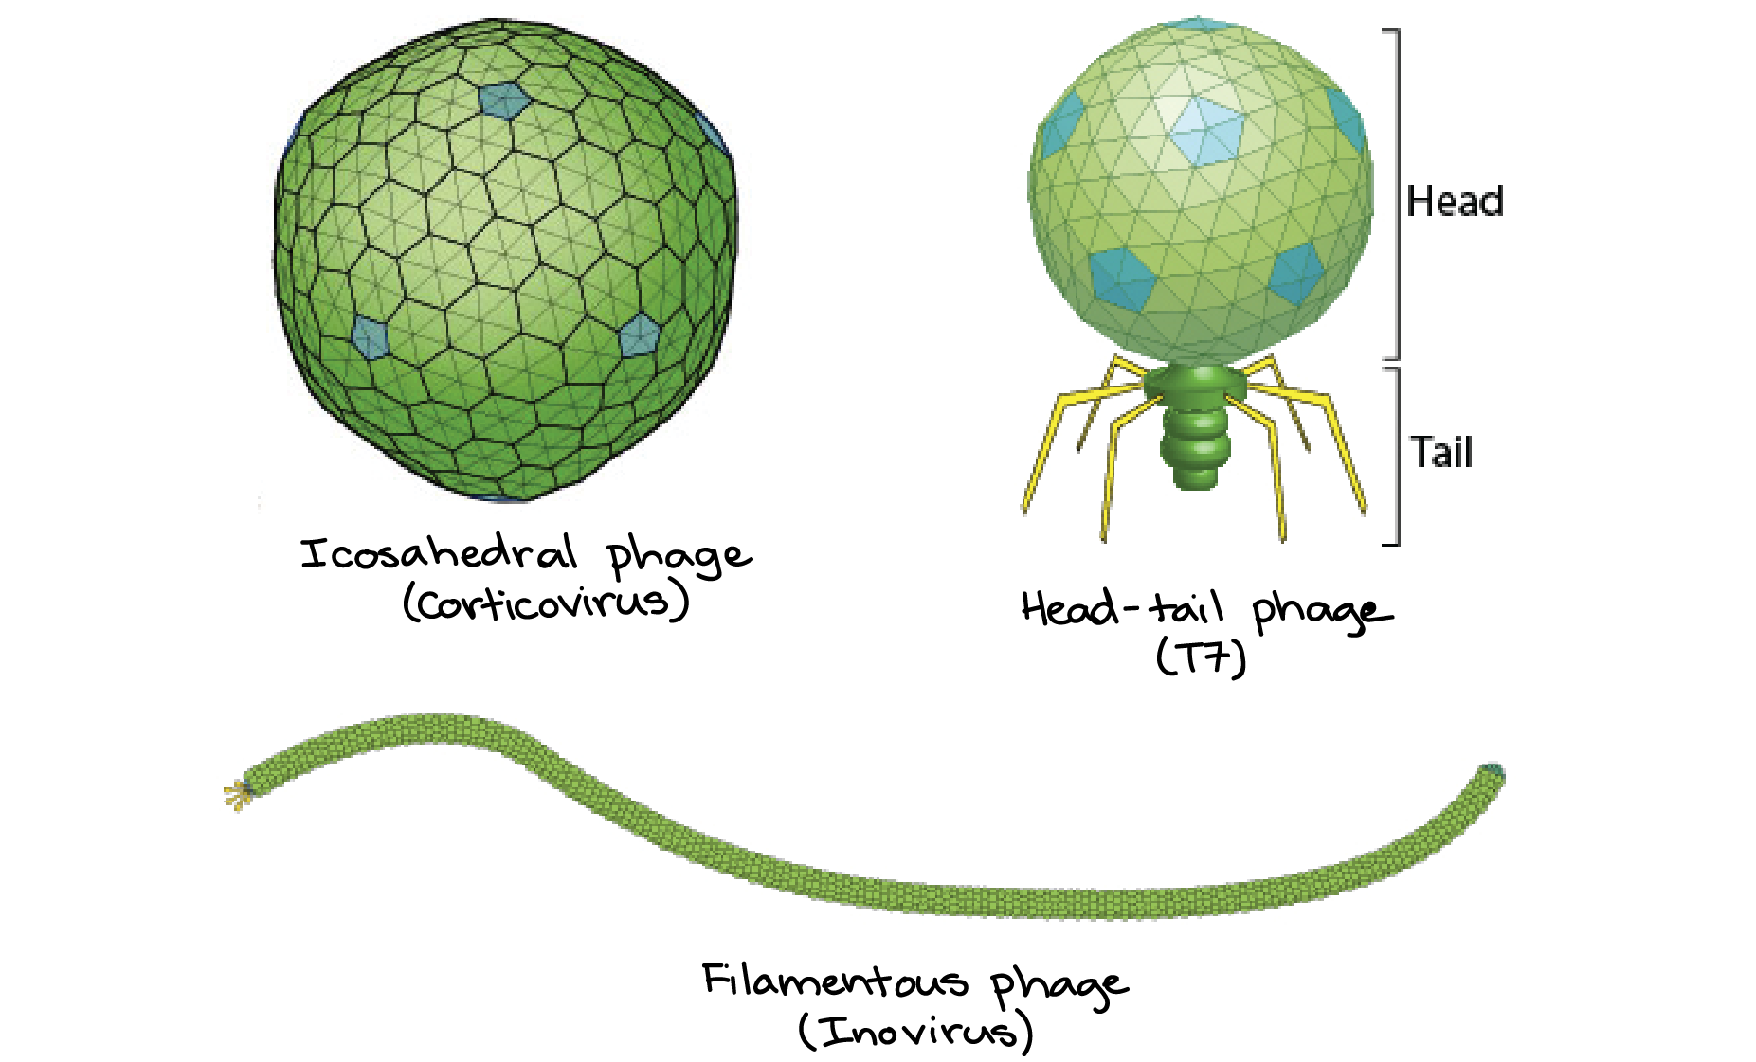
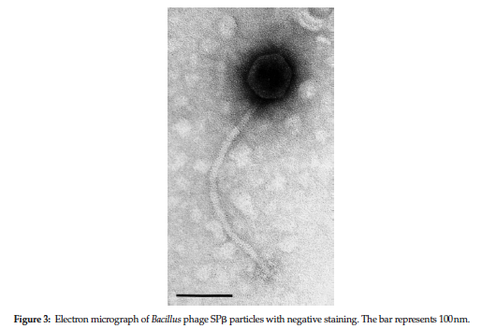
Bacteriophage characteristics
Virus that infects and replicates in bacteria and archaea
19 families
Genome:
DNA or RNA
Single or double stranded
Circular or linear genomes
4 to hundreds of genes
Structure:
Icosahedral
Helical/Filamentous
Head-Tail
100 nm
Adams et al., 2012; Bradley, 1967; Khun et al., 2019
Notes:
Lytic – phage infects bacterium, hijacks, makes loads of phages, cell lyses to release infectious virions

Slide 4
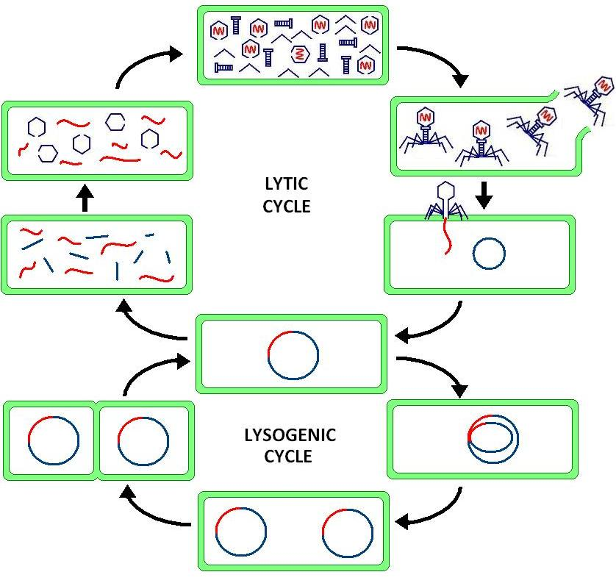
Bacteriophage replication cycles
How does the virus choose which cycle to use?
Notes:
Virulent Phages - Lytic Cycle
Immediate replication of phage
Hydrolysis of host DNA
Prokaryote destroyed
Temperate Phages – Lytic/Lysogenic Cycle
Integration of genome (prophage) into host
Replicon in cytoplasm
Imbedded in bacterial genome
Bacteria continues to live
Brendan: gain of function
Passed on to daughter cells (lysogens) – passive replication
Spread of phage genome via prokaryotic replication
Lysogens can remain in lysogenic cycle or switch to lytic cycle via induction
Host DNA not hydrolyzed
E.g. Lambda phage

Slide 5
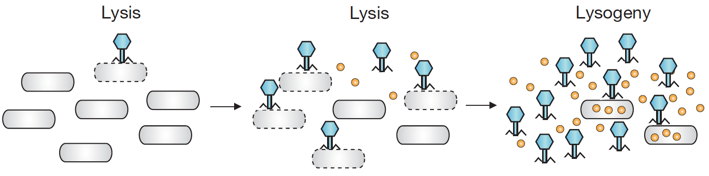
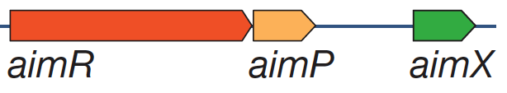
SP-β phage communication
3 Component Communication System:
AimP = signal peptide
AimR = intracellular signal receptor
AimX = lytic/lysogenic regulator
Erez et al., 2017
Notes:
Arbitrium system – enables descendant phage to communicate with predecessors
Accident: bacteria secrete communication to alert other bacteria of phage infection
Phage: Spbeta (4 phages, phi3T)
Host: Bacillus subtilis strain 168
Peptide Signal: 6 aa
Low = lytic cycle
High = lysogenic cycle
Genes:
aimP – peptide signal
aimR – intracellular peptide receptor
aimX – negative regulator of lysogeny

Slide 6
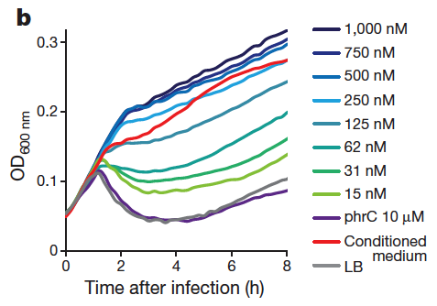
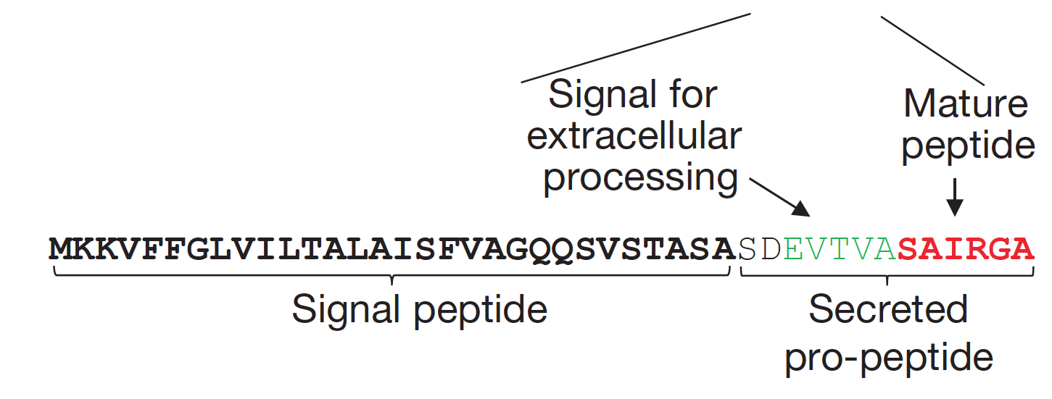
AimP – The Signal Peptide
Signal induces lysogenic cycle
Signal peptide – localizes AimP to the membrane
Pro-peptide – secreted from cell and cleaved by external protease
Mature peptide – 6 AA active signal
Erez et al., 2017
Notes:
We found three open reading frames (ORFs) that were predicted
to have an N-terminal signal peptide, suggesting that they are
secreted or membrane-localized. Although two of these genes seemed
irrelevant (an integral membrane protein and a large nuclease), the third
gene exhibited features reminiscent of Bacillus quorum sensing peptides
(Fig. 2a). Peptides belonging to the Phr family of quorum sensing
systems in B. subtilis are typically processed from a pre-pro-peptide
that contains an N-terminal signal sequence, which is recognized by
the secretion (Sec) system and cleaved upon secretion4. Once outside
the cell, the pro-peptide is further processed by B. subtilis extracellular
proteases to produce the mature short (5–6 aa) peptide that is typically
found on the C-terminal end of the pro-peptide4. Our candidate gene
encoded a short ORF (43 aa), and displayed both an N-terminal signal
sequence and the consensus cleavage site for peptide maturation at its
C terminus (Fig. 2a, Extended Data Table 1). If this phi3T-encoded
protein is secreted and matured extracellularly, then the predicted
mature communication peptide after pro-peptide cleavage would be
Ser-Ala-Ile-Arg-Gly-Ala (SAIRGA).
These effects were specific to that peptide, and were not
observed for shorter versions of the peptide (SAIRG or AIRGA), or for
PhrC, a known quorum sensing peptide of B. subtilis (Fig. 2b, Extended
Data Fig. 4).
To test whether the predicted mature peptide is indeed the arbitrium
molecule that influences the phage lysogeny decision, we infected
bacteria with phi3T in Luria–Bertani (LB) medium supplemented
with increasing amounts of synthesized SAIRGA peptide. A clear
concentration-dependent effect on the phage infection dynamics
was observed, such that reduced culture lysis was apparent when the
medium contained higher concentrations of the synthesized peptide
(Fig. 2b).
We found
consistently elevated lysogeny in the presence of the SAIRGA peptide,
such that 48% (Å} 7.9%) of the bacteria were lysogenized at 60 min after
infection, as compared to 18% (Å} 3.3%) of bacteria grown without the
addition of the synthesized peptide (Fig. 2c).

Slide 7
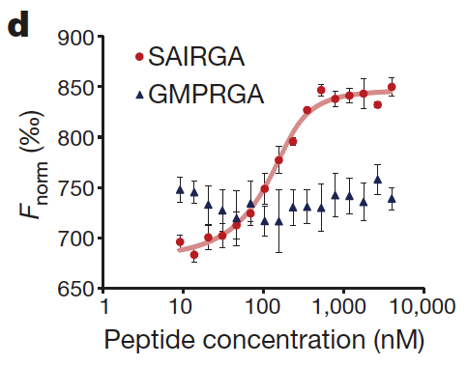
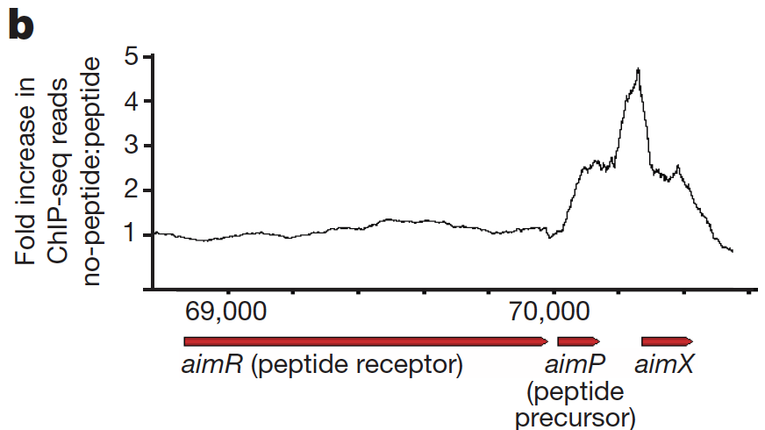
AimR – The Signal Receptor
HTH
AimR homodimer activates AimX transcription
HTH region – binds AimP as monomer
AimP binds AimR and inhibits AimX activation
Erez et al., 2017
Notes:
To examine whether AimR
binds the phage DNA in vivo, we engineered a His-tagged aimR gene
into a B. subtilis 168 strain in which CRISPR interference technology22
was used to silence the expression of the phage AimR gene, but not the
cloned His-tagged AimR (Methods). We then performed a ChIP–seq
assay 15 min after phage infection with and without the presence of
the arbitrium peptide. Sequencing of the DNA bound to AimR clearly
showed that AimR binds a single site in the phage genome, directly
downstream of the aimP gene (Fig. 5a, b). Moreover, this binding only
occurred when the arbitrium peptide was lacking from the medium,
suggesting that binding of the arbitrium peptide to its AimR receptor
leads to dissociation of the receptor from its binding site on the
phage DNA.
Microscale thermophoresis analysis of the binding
between purified AimR and synthesized SAIRGA or GMPRGA peptides.
Average and s.e. of three replicates. Fnorm, normalized fluorescence.

Slide 8
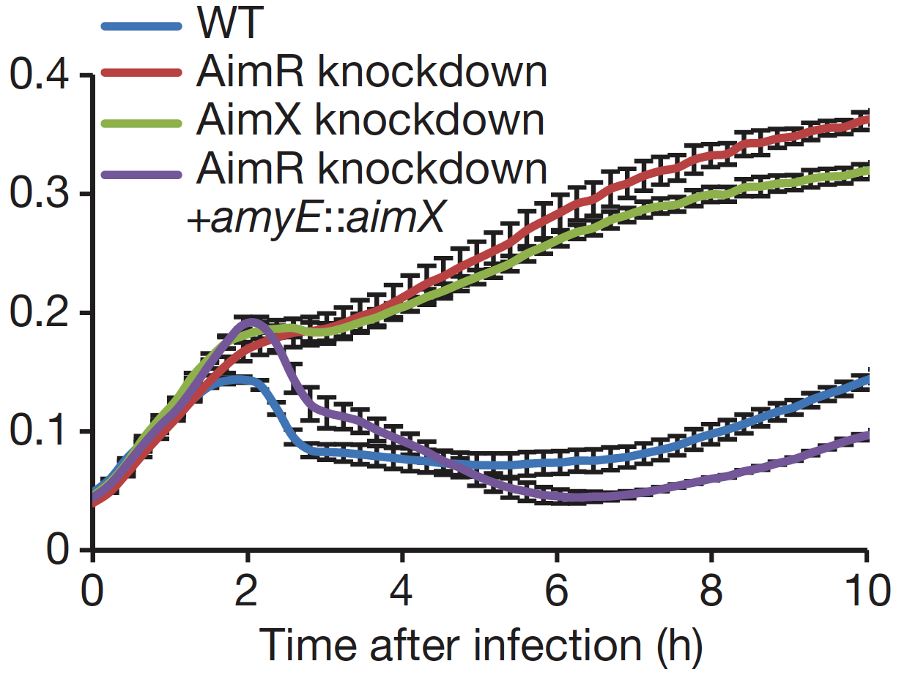
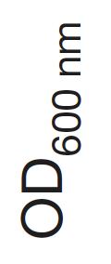
AimX – The Master Regulator
AimX works downstream of AimP-AimR communication system
Unknown action:
Inhibits lysogenic cycle
Activates lytic cycle
May operate as a non-coding RNA
Erez et al., 2017

Slide 9
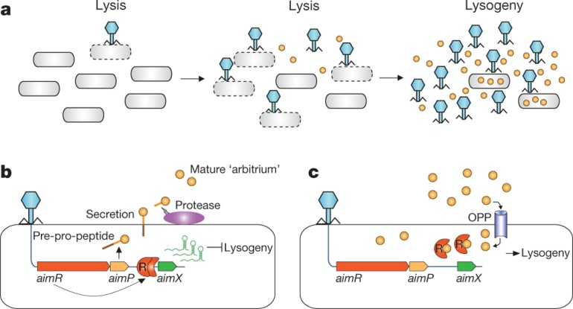
Summary
Few Phages: Lytic Cycle Induced
AimP released at low levels
AimR dimer activates AimX to induce the lytic cycle
Many Phages: Lysogenic Cycle Induced
AimP signal at high concentrations
AimP binds AimR, inhibits AimX to induce the lysogenic cycle
Notes:
In a sense, the communication
mechanism we describe allows a descendant phage to ‘communicate’
with its ancestors, that is, to measure the number of predecessor
phages that completed successful infections in previous cycles.
when a single
phage encounters a bacterial colony, there is ample prey for the
progeny phages that are produced from the first cycles of infection,
and hence a lytic cycle is preferred. In later stages of the infection
dynamics, the number of bacterial cells is reduced to a point that
progeny phages are at risk of no longer having a new host to infect.
Then, it is logical for the phage to switch into lysogeny to preserve
chances for viable reproduction.
The arbitrium system provides an
elegant mechanism for a phage particle to estimate the amount of
recent previous infections and hence decide whether to employ the
lytic or lysogenic cycle.
Accumulation of aimP increases likelihood of inducing lysogenic cycle,
but it occurs at 50%, and still appears to be stocastic
Together, our results point to the following model: on initial infection
of a bacterial culture, phi3T expresses the early genes AimR and
AimP. AimR, as a dimer, activates the expression of AimX, which, in
turn, blocks the pathway to lysogeny and/or promotes the lytic cycle
in a manner that is as yet unknown. At the same time, AimP is secreted
into the medium and processed into the mature arbitrium peptide.
After several cycles of infection, arbitrium peptides will accumulate
in the medium. Thereafter, when a phage particle infects an as-yet uninfected
bacterium, the concentration of the arbitrium peptide,
which is internalized into the bacteria by the OPP transporter, will
be high enough to bind the AimR receptor. Upon binding, the AimR
receptor changes its oligomeric state from the active dimer to the inactive
monomer, silencing the AimX lysogeny-inhibitor and leading
to lysogeny (Fig. 6).
The biological logic behind this strategy is clear: when a single
phage encounters a bacterial colony, there is ample prey for the
progeny phages that are produced from the first cycles of infection,
and hence a lytic cycle is preferred. In later stages of the infection
dynamics, the number of bacterial cells is reduced to a point that
progeny phages are at risk of no longer having a new host to infect.
Then, it is logical for the phage to switch into lysogeny to preserve
chances for viable reproduction. The arbitrium system provides an
elegant mechanism for a phage particle to estimate the amount of
recent previous infections and hence decide whether to employ the
lytic or lysogenic cycle.

Slide 10
Future Directions
AimX component must be further characterized
Inhibits lysogeny OR promotes lytic cycle?
Exerts its function as a non-coding RNA or protein?
Accumulation of AimP increases likelihood of inducing lysogenic cycle, yet still a stochastic event
Lysogenic cycle still occurs in absence of AimP signal
Other viruses using this communication system?
Phages
Eukaryotic viruses

Slide 11
References Cited
Adams, M. J., Heinze, C., Jackson, A. O., Kreuze, J. F., Macfarlane, S. A., & Torrance, L. (2012). Virus taxonomy: ninth report of the International Committee on Taxonomy of Viruses. Family virgaviridae. Elsevier, San Diego, 1139-1162.
Bradley, D. E. (1967). Ultrastructure of bacteriophage and bacteriocins. Bacteriological reviews, 31(4), 230.
Erez, Z., Steinberger-Levy, I., Shamir, M., Doron, S., Stokar-Avihail, A., Peleg, Y., ... & Amitai, G. (2017). Communication between viruses guides lysis–lysogeny decisions. Nature, 541(7638), 488.
Kuhn, J. H., Wolf, Y. I., Krupovic, M., Zhang, Y. Z., Maes, P., Dolja, V. V., & Koonin, E. V. (2019). Classify viruses—the gain is worth the pain.
Shkoporov, A. N., & Hill, C. (2019). Bacteriophages of the Human Gut: The “Known Unknown” of the Microbiome. Cell host & microbe, 25(2), 195-209.

Slide 12
Essay Question
Briefly describe the lytic and lysogenic cycles of bacteriophages, as well as the roles of AimP, AimR, and AimX in the arbitrium communication system.
How would this communication strategy be considered advantageous for the virus?

