Slide 1
IEM Fundamentals: walkthrough
Tommy Sprague
SICN 2022

Slide 2
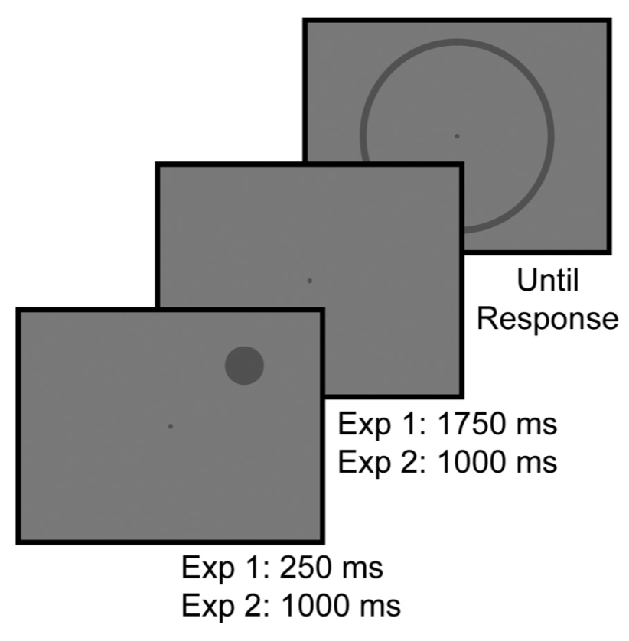
Foundational finding: alpha power tracks WM location
Joshua Foster
U Chicago
Time
Can IEM techniques be applied to EEG data to recover information in WM?
Foster et al, 2016, Journal of Neurophysiology
Full dataset available at: https://osf.io/bwzfj/

Slide 3
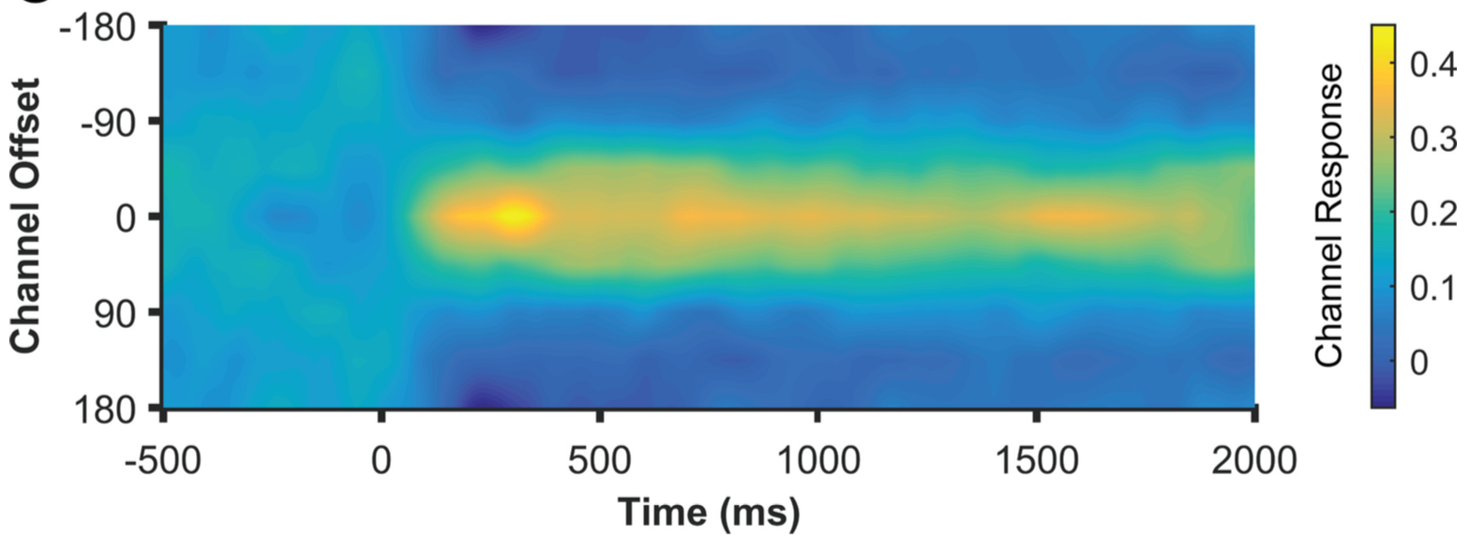
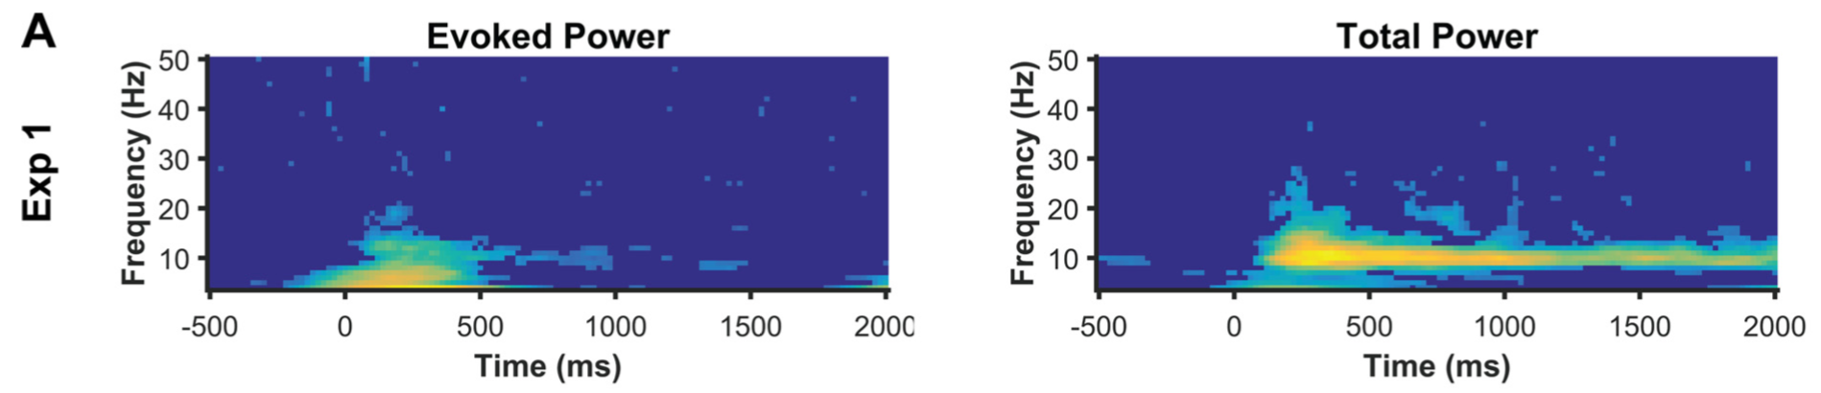
Foundational finding: alpha power tracks WM location
Joshua Foster
U Chicago
20 channels of EEG recorded, epoched and artifacts identified
Time
Foster et al, 2016, Journal of Neurophysiology
Full dataset available at: https://osf.io/bwzfj/

Slide 4
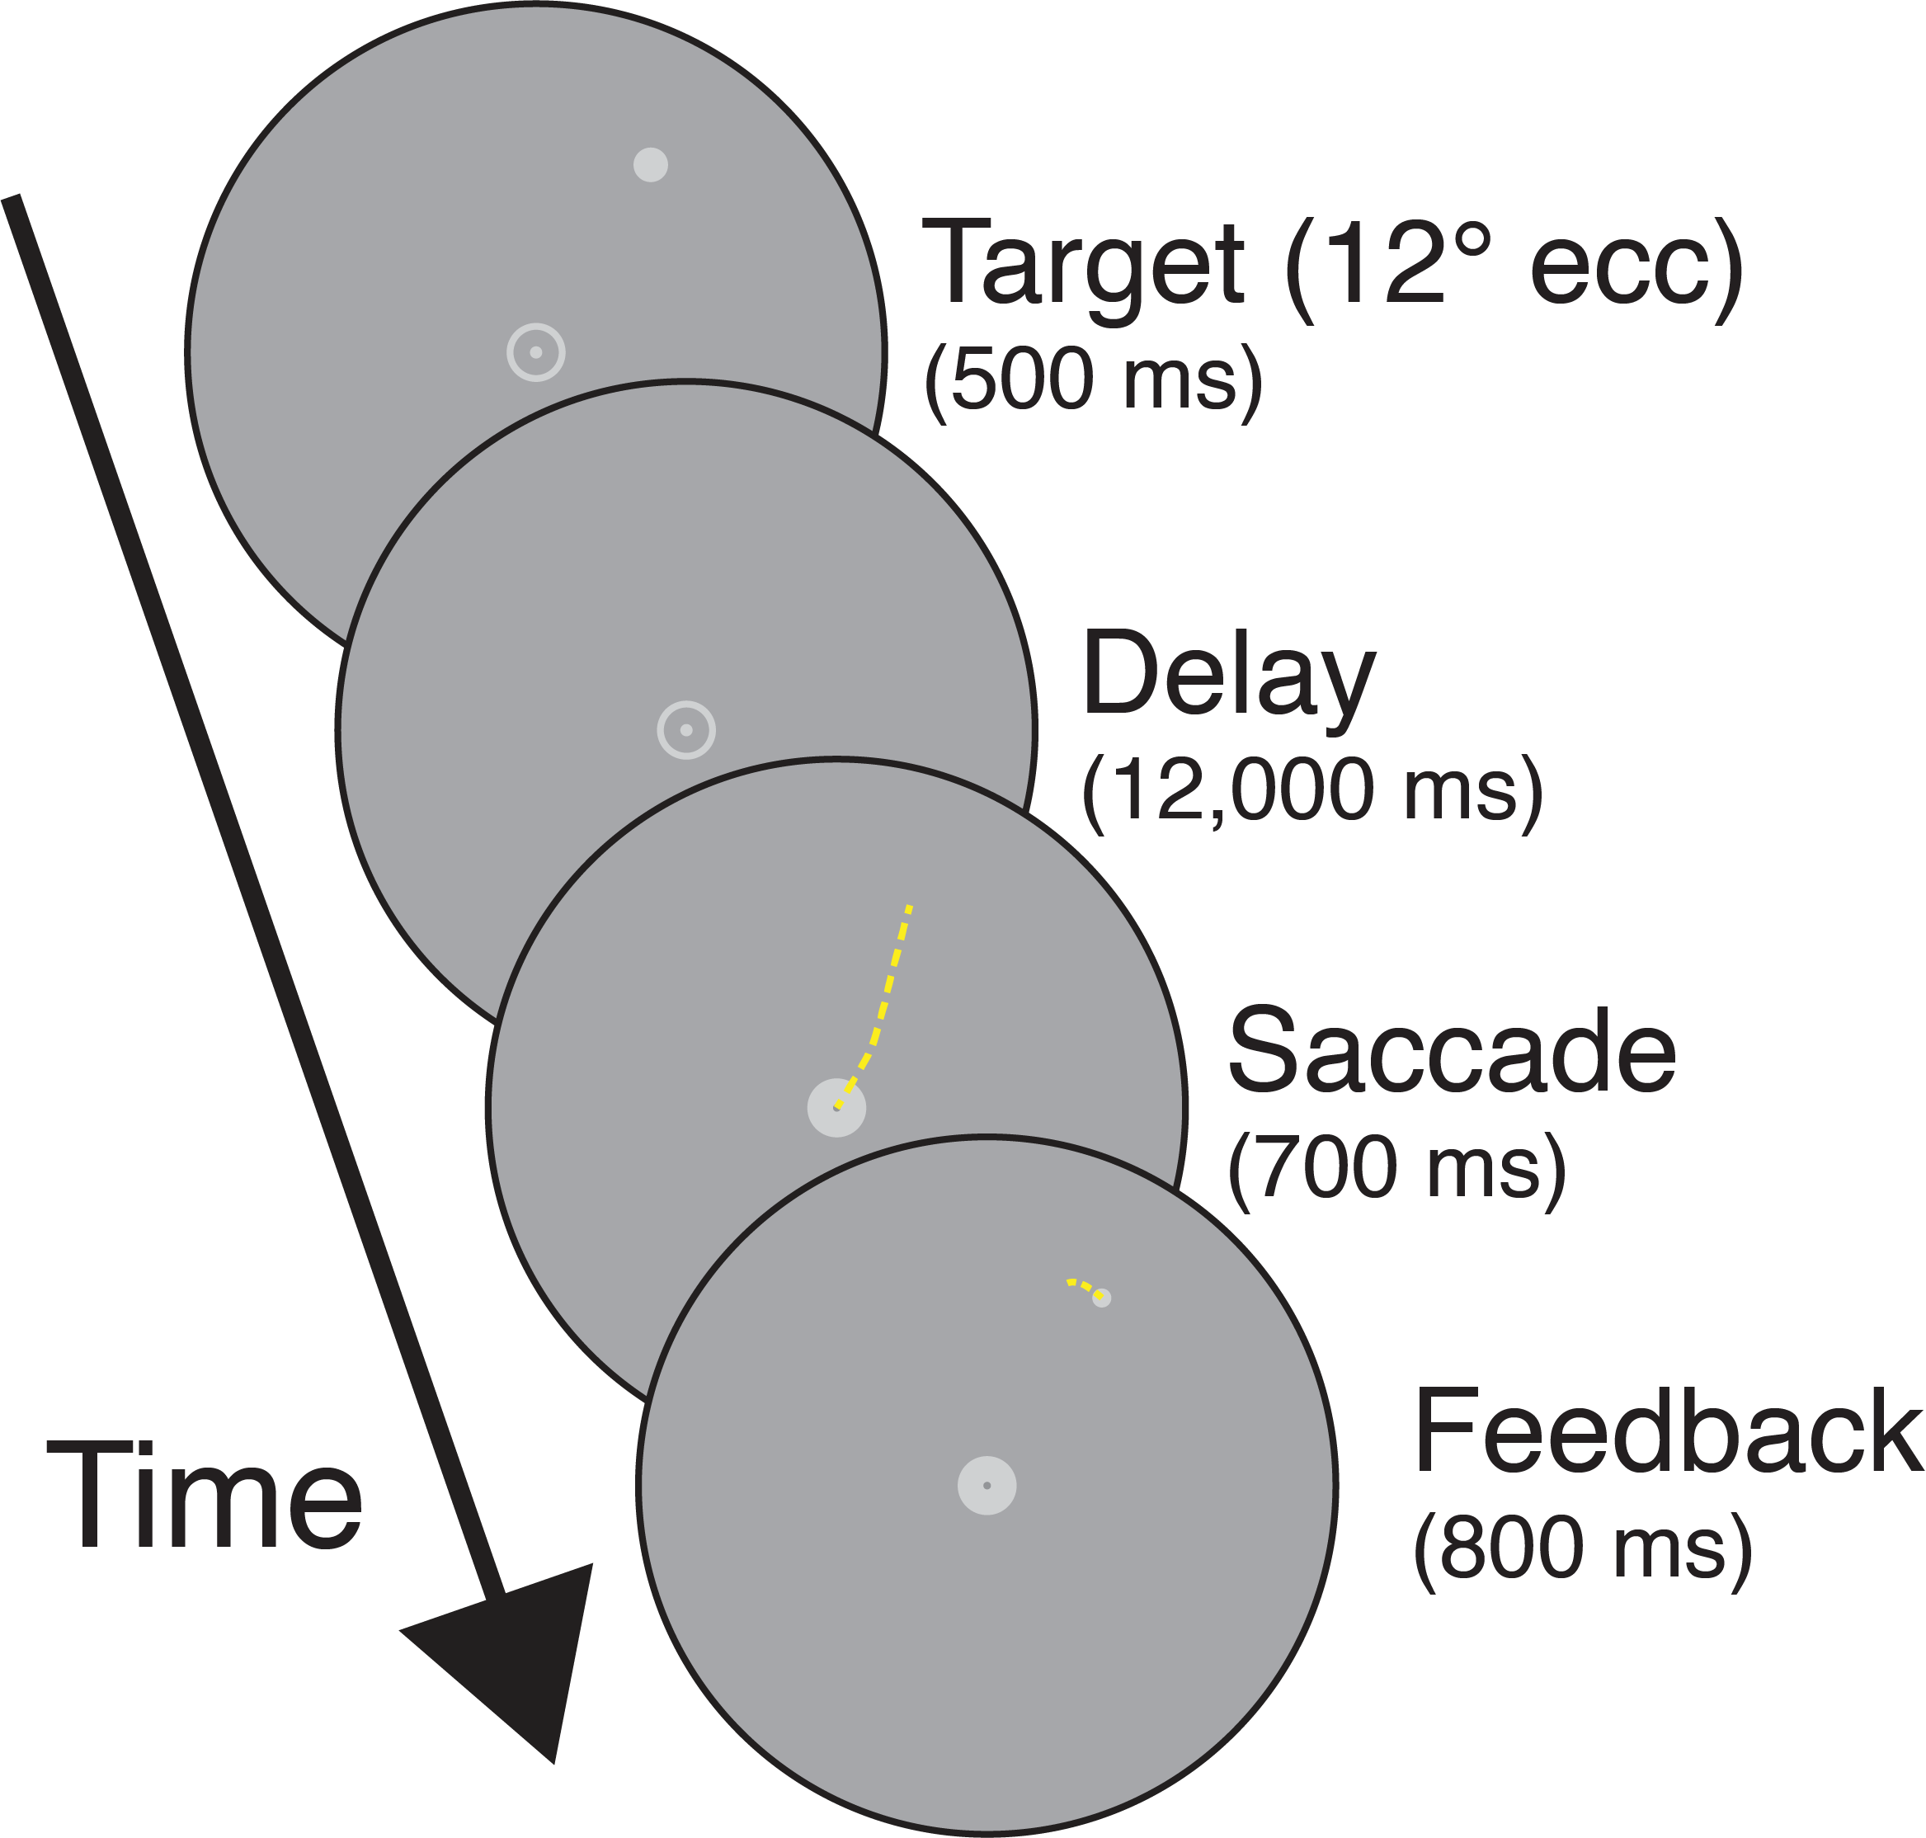
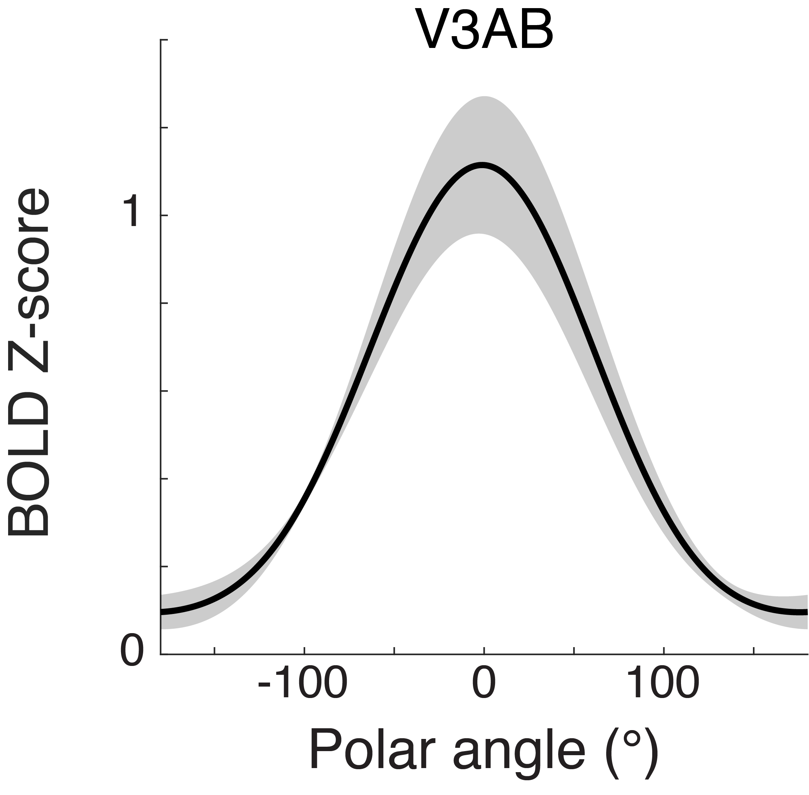
Another cool finding: BOLD signal tracks remembered location
Sprague et al, 2014; Sprague et al, in prep (VSS 2018; SFN 2018)

Slide 5
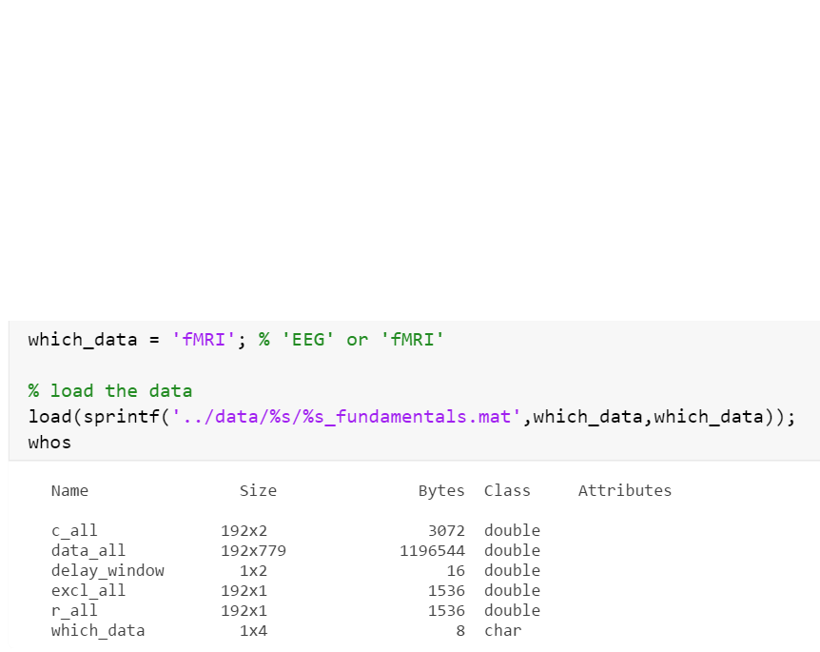
Hands-on tutorial: EEG or fMRI during spatial WM
20 channels of EEG recorded, epoched and artifacts identified
OR
~780 voxels of fMRI data, averaged over delay period
Time
Foster et al, 2016, Journal of Neurophysiology
Full EEG dataset available at: https://osf.io/bwzfj/

Slide 6
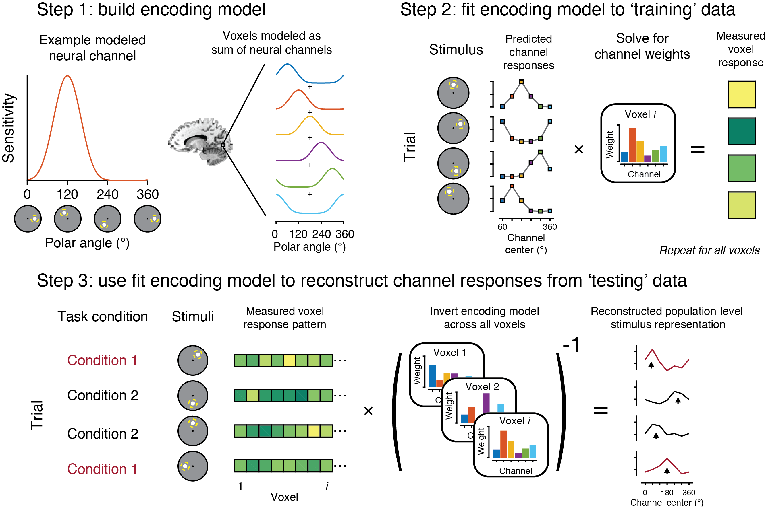
Hands-on tutorial: IEM fundamentals
STEP 1: build encoding model
STEP 2a: predict channel responses
STEP 2b: fit encoding model
Open IEM_tutorial_fundamentals.mlx
STEP 3: invert encoding model to reconstruct channel responses
or follow along at:
tommysprague.github.io/IEM_tutorial_SICN2022

Slide 7
Hands-on tutorial: IEM fundamentals
STEP 1: build encoding model
STEP 2a: predict channel responses
STEP 2b: fit encoding model
Open IEM_tutorial_fundamentals.mlx
STEP 3: invert encoding model to reconstruct channel responses
or follow along at:
tommysprague.github.io/IEM_tutorial_SICN2019

Slide 8
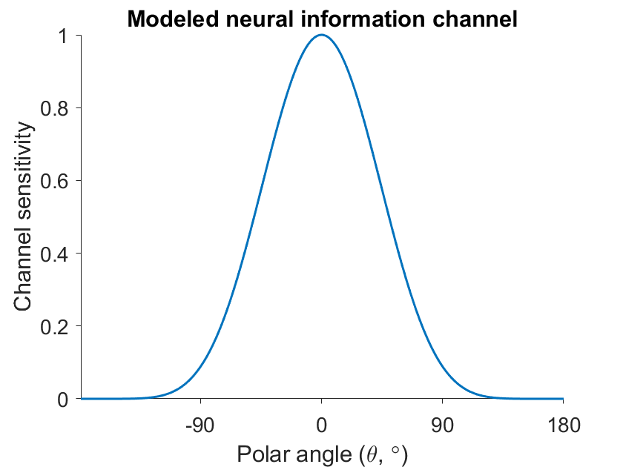
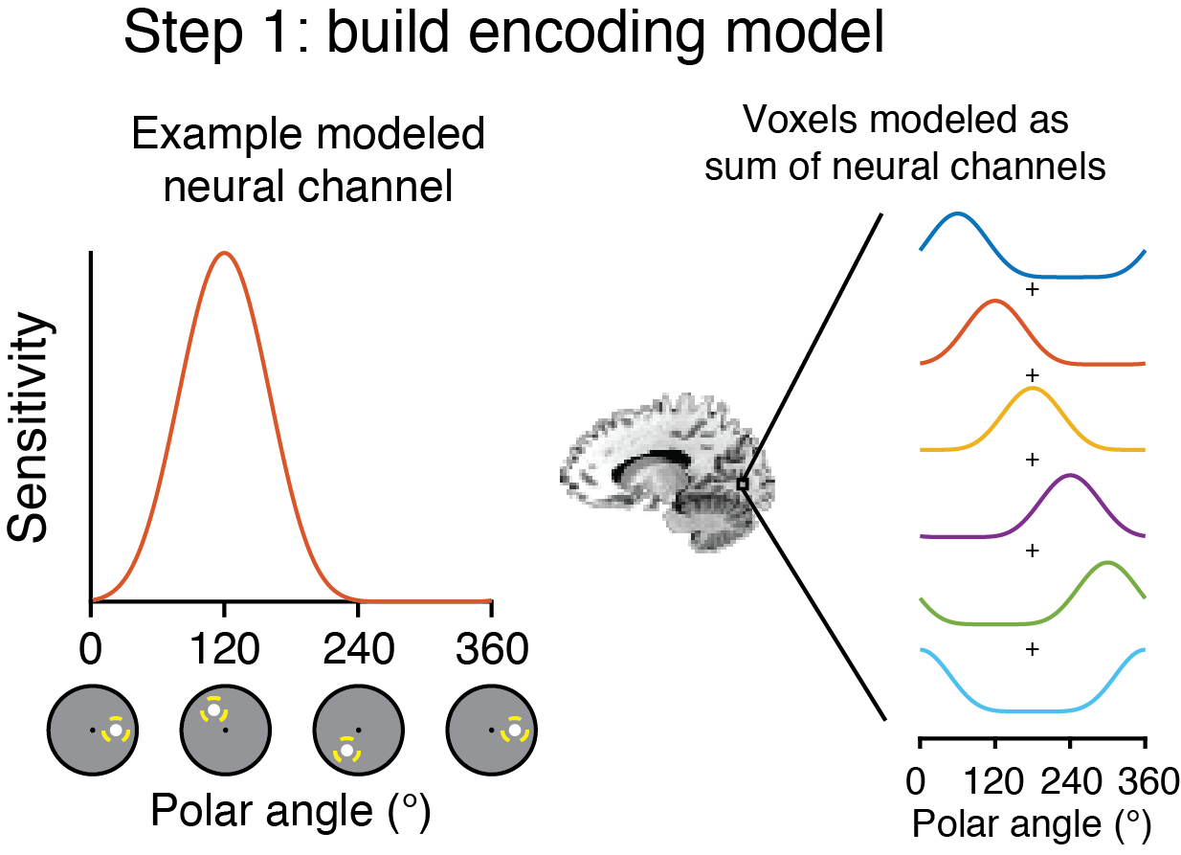
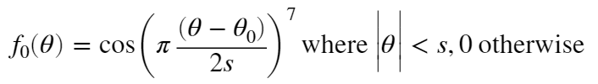
Hands-on tutorial: IEM fundamentals
STEP 1: build encoding model
STEP 2a: predict channel responses
TRY:
Changing preferred tuning of channel
Changing width of channel
STEP 2b: fit encoding model
STEP 3: invert encoding model to reconstruct channel responses

Slide 9
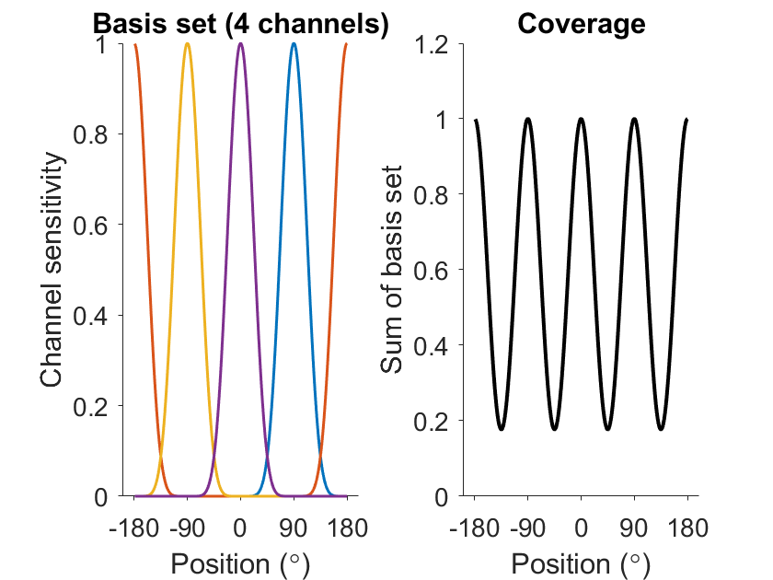
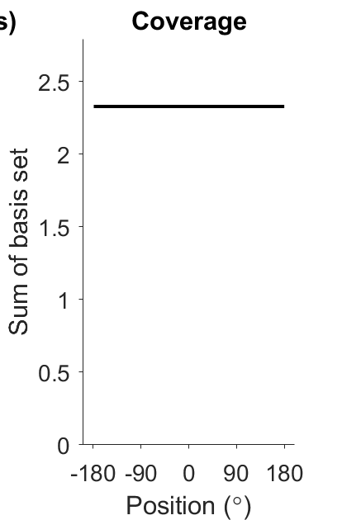
Hands-on tutorial: IEM fundamentals
STEP 1: build encoding model
Our encoding model has multiple channels
Important:
The model should evenly represent all parts of feature space.
Plot the ‘coverage’ – the sum of channel sensitivities
STEP 2a: predict channel responses
STEP 2b: fit encoding model
Try manipulating:
n_chans
chan_width
What happens to the ‘coverage’?
STEP 3: invert encoding model to reconstruct channel responses

Slide 10
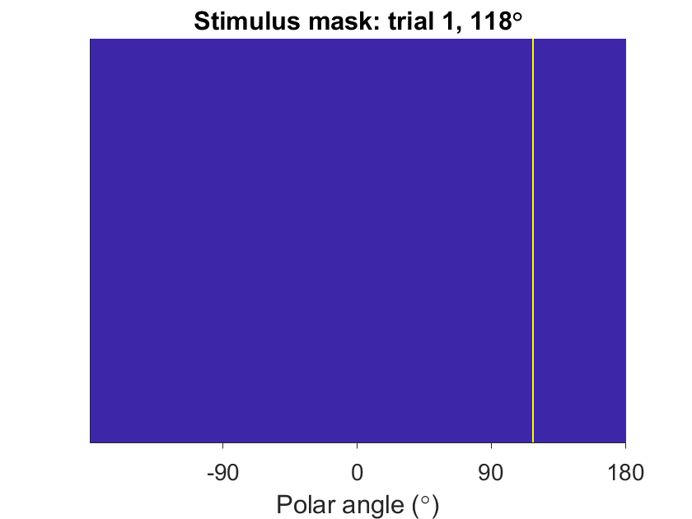
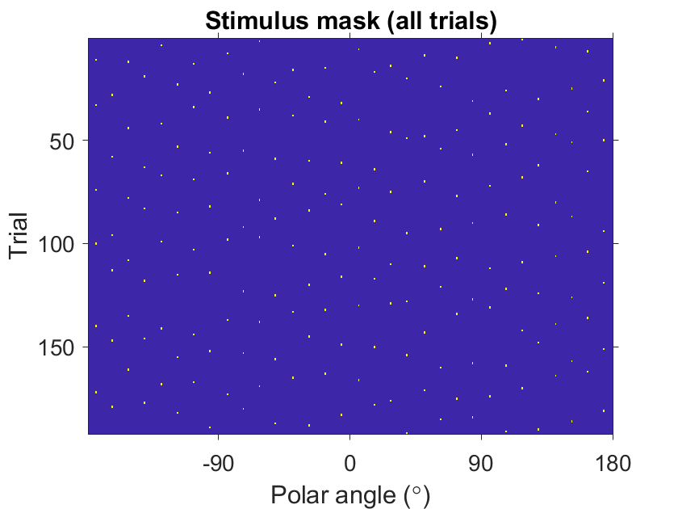
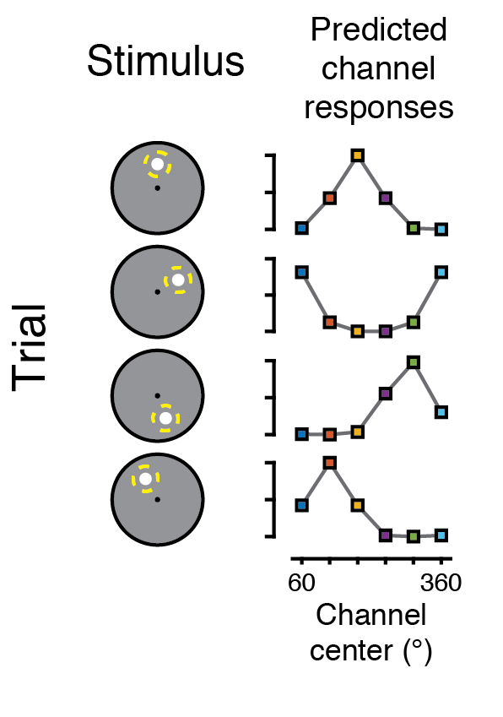
Hands-on tutorial: IEM fundamentals
STEP 1: build encoding model
STEP 2a: predict channel responses
EXERCISE:
Use computed ‘stimulus mask’ and encoding model (basis set) to compute predicted channel responses
STEP 2b: fit encoding model
STEP 3: invert encoding model to reconstruct channel responses

Slide 11
Hands-on tutorial: IEM fundamentals
STEP 1: build encoding model
STEP 2a: predict channel responses
STEP 2b: fit encoding model
STEP 3: invert encoding model to reconstruct channel responses
What happens if you change the encoding model properties? (n_chans, chan_size)

Slide 12



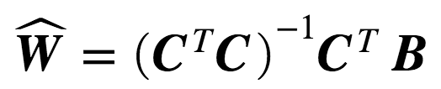
Hands-on tutorial: IEM fundamentals
STEP 1: build encoding model
Linear regression!
STEP 2a: predict channel responses
=
*
Weights
STEP 2b: fit encoding model
STEP 3: invert encoding model to reconstruct channel responses
n_trials x n_signals
n_trials x n_channels
n_channels x n_signals

Slide 13
Hands-on tutorial: IEM fundamentals
STEP 1: build encoding model
Linear regression!
STEP 2a: predict channel responses
=
*
Weights
STEP 2b: fit encoding model
STEP 3: invert encoding model to reconstruct channel responses
n_trials x n_signals
n_trials x n_channels
n_channels x n_signals
What are the constraints on model estimation?
Notes:
Try:
Estimating model with fewer trials
Estimating model with only trials from a single bin

Slide 14
Hands-on tutorial: IEM fundamentals
STEP 1: build encoding model
Brief aside: avoiding common pitfalls
There are fundamental mathematical constraints on estimating encoding models (solving for W):
Cannot estimate more channels than unique stimulus values
Try using ‘binned’ positions and > 8 channels – what happens? (‘Brief aside’ section)
Stimuli must span the modeled information space
Could you estimate a channel weight for a channel that’s never ‘stimulated’?
Imagine a channel tuned behind your head
STEP 2a: predict channel responses
STEP 2b: fit encoding model
STEP 3: invert encoding model to reconstruct channel responses
Notes:
Many of these constraints can be addressed before running the experiment!
And note that this means using an old dataset for an IEM analysis requires the data from that dataset conform to these assumptions!
Note – if short on time, skip this…

Slide 15
Hands-on tutorial: IEM fundamentals
STEP 1: build encoding model
Linear regression!
STEP 2a: predict channel responses
=
*
Weights
STEP 2b: fit encoding model
EXERCISE:
Solve for W for all signal dimensions
STEP 3: invert encoding model to reconstruct channel responses
n_trials x n_signals
n_trials x n_channels
n_channels x n_signals
Notes:
Try:
Estimating model with fewer trials
Estimating model with only trials from a single bin
NOTE: the matrix notation here is transpose of what’s used in the Gardner tutorials – it’s the same result! B = CW matches B’ = W’C’ (matrix identities)

Slide 16
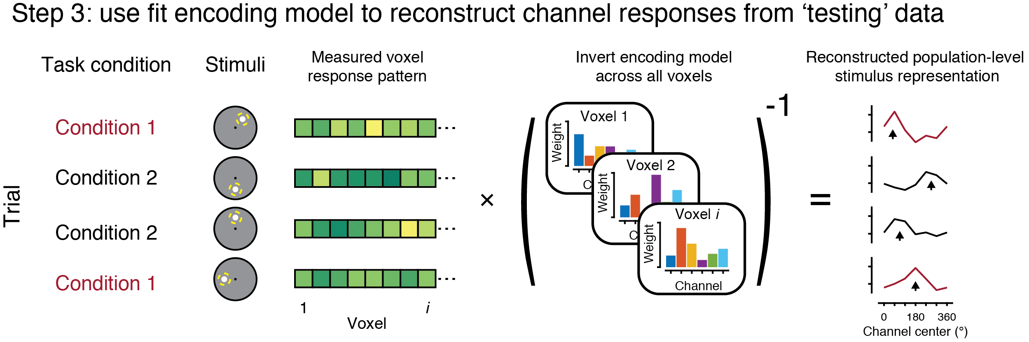
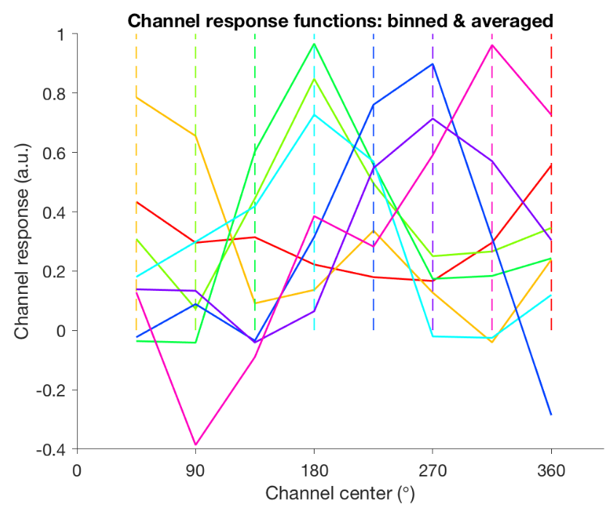
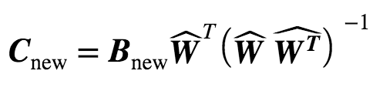
Hands-on tutorial: IEM fundamentals
STEP 1: build encoding model
EXERCISE:
Invert the encoding model (W) to solve for C_{new}
STEP 2a: predict channel responses
STEP 2b: fit encoding model
STEP 3: invert encoding model to reconstruct channel responses
Important: Must estimate encoding model and reconstruct channel responses with separate datasets!

Slide 17
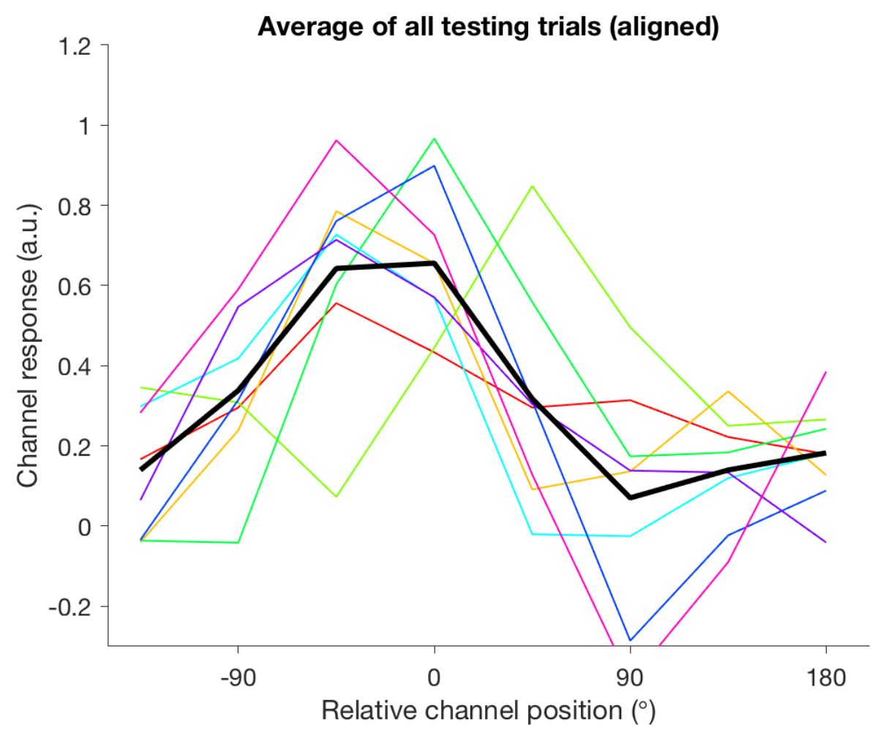
Hands-on tutorial: IEM fundamentals
EXERCISE:
Try changing the channel width – what happens to channel response profiles?
STEP 1: build encoding model
Aligning channel response functions across trials
STEP 2a: predict channel responses
STEP 2b: fit encoding model
STEP 3: invert encoding model to reconstruct channel responses
Notes:
Discussion question: does stimulus used on trials you’re reconstructing need to match that of the stimulus used on training trials?
What restrictions apply to dataset used for reconstruction?

