Slide 1
Python Open Room Correction (PORC)
(https://github.com/zzzzrrr/porc)
Mixed-Phase Filtering Results
(Preliminary, 23NOV2012)
Mason A. Green
(mag at maglab dot us)

Slide 2
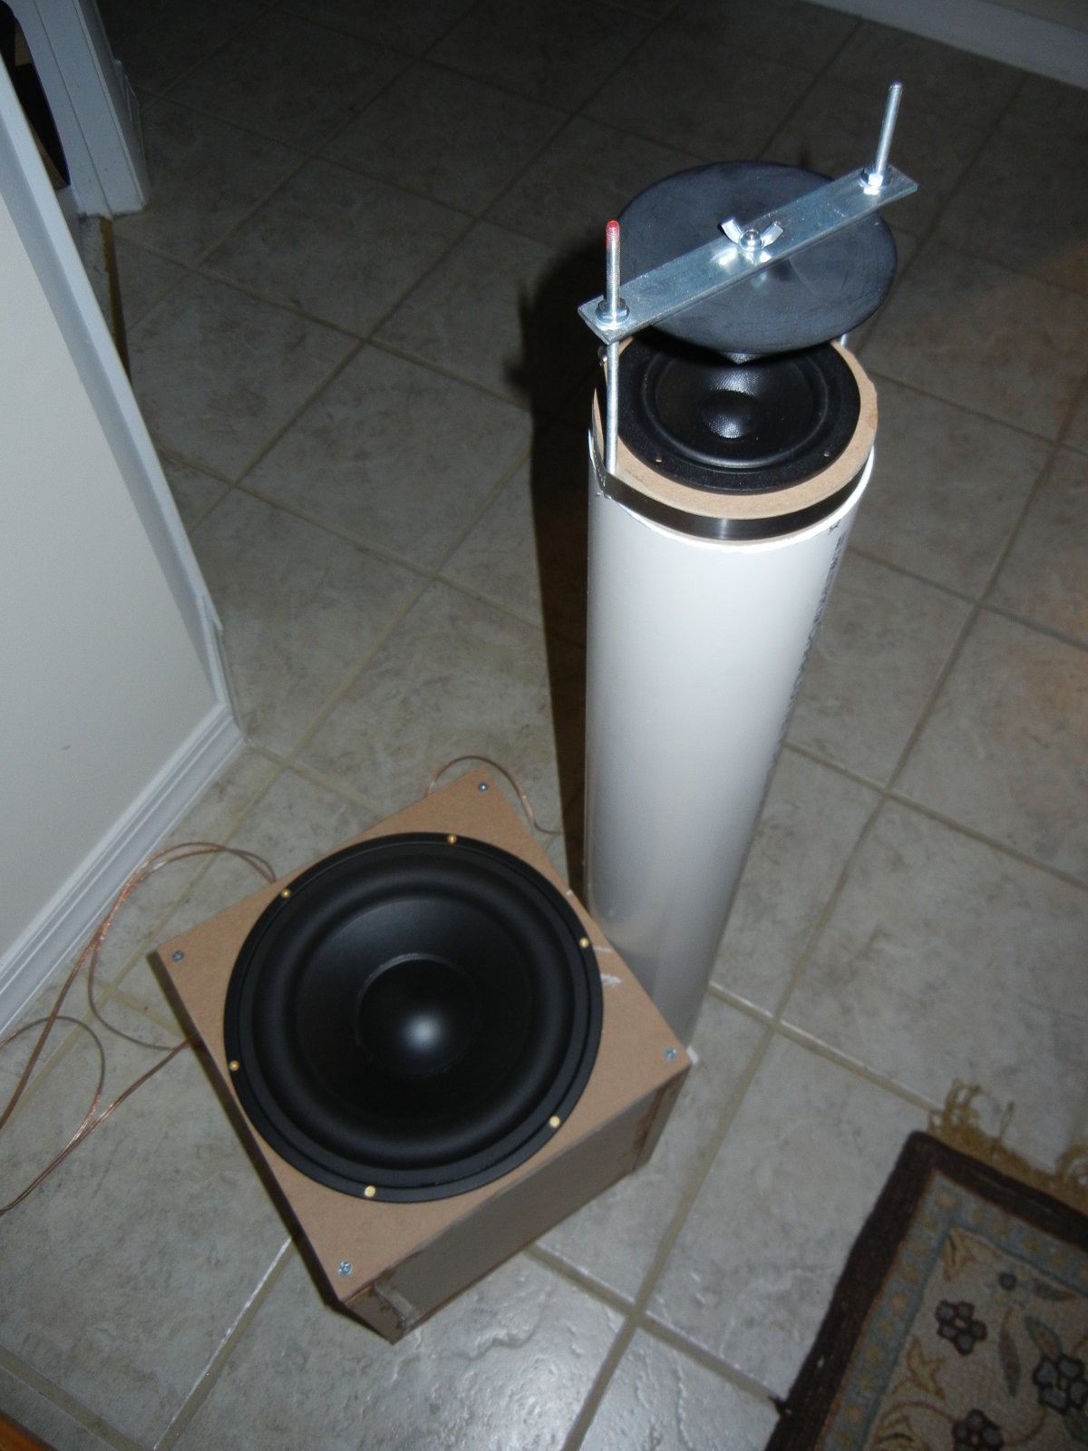
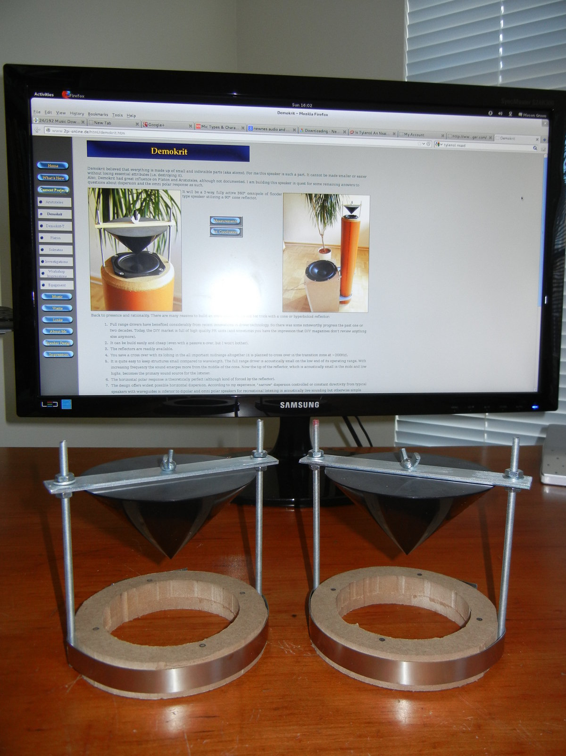

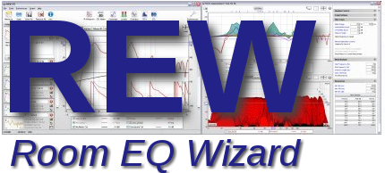
Loudspeaker and Measurement Setup
Demokrit - http://www.2pi-online.de/html/demokrit.htm
Measured with constant directivity, omni-directional loudspeakers
Calibrated Dayton Audio EMM-6 Mic.

Slide 3
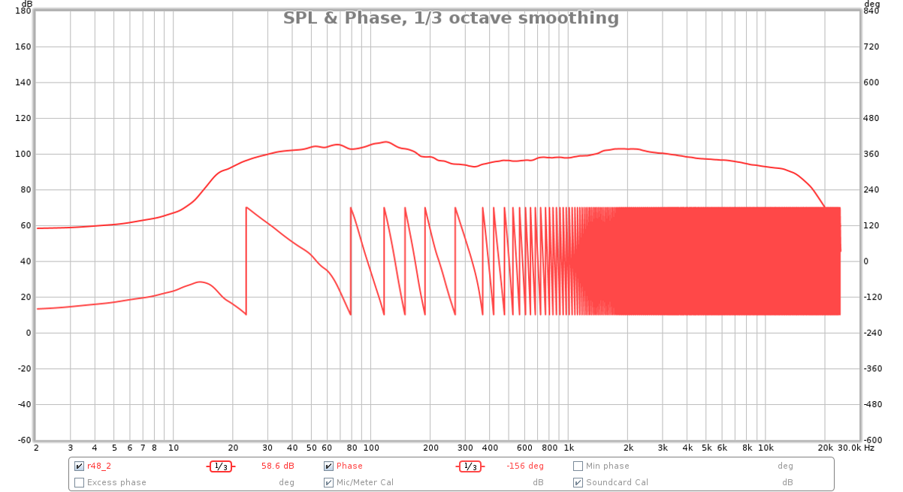
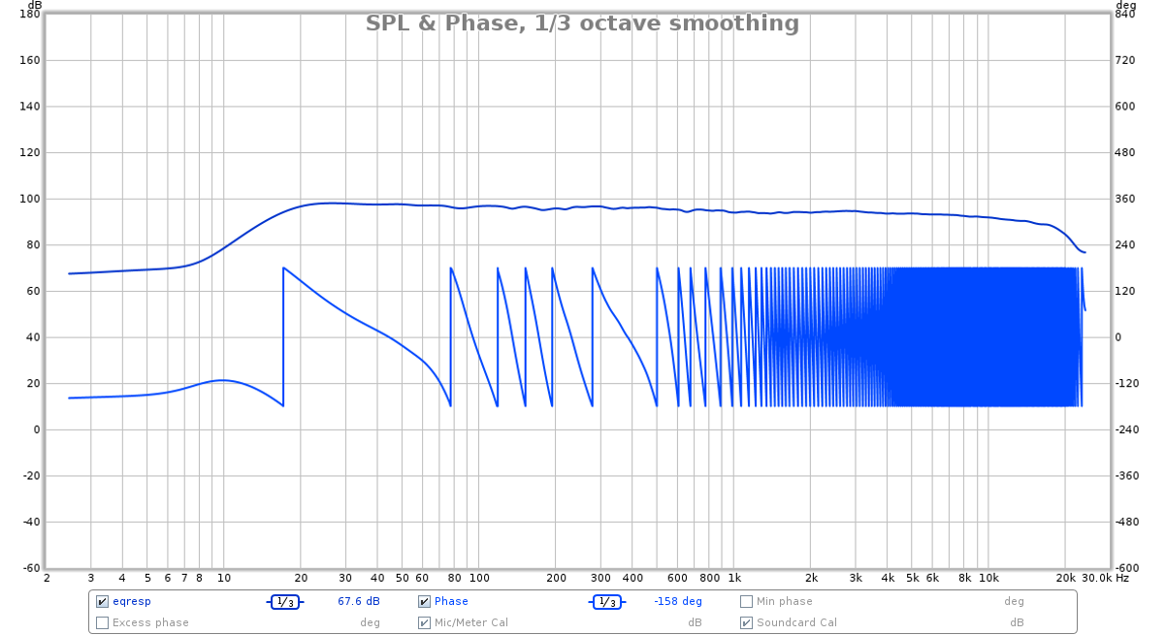
SPL & Phase
UNEQUALIZED
EQUALIZED
Equalization targets a downward trending slope

Slide 4
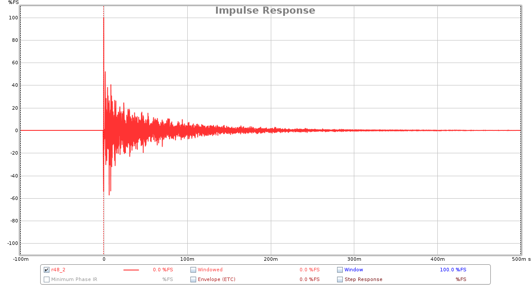
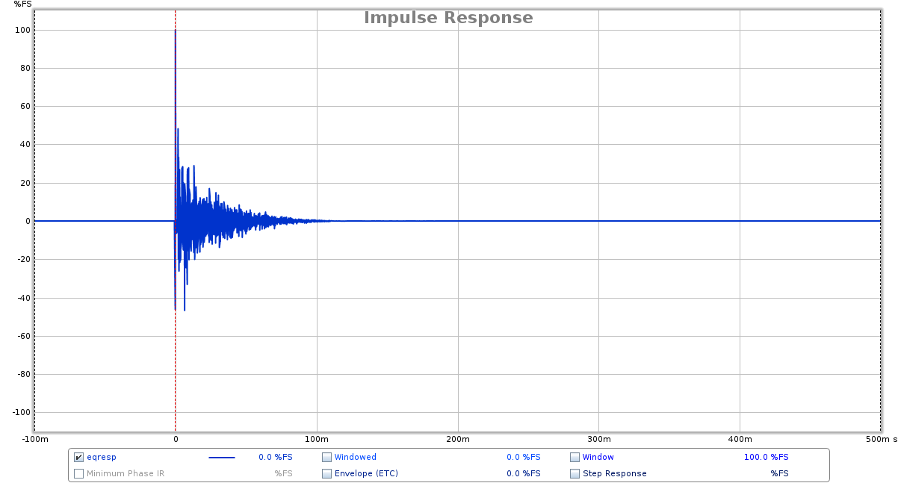
Impulse Response
UNEQUALIZED
EQUALIZED

Slide 5
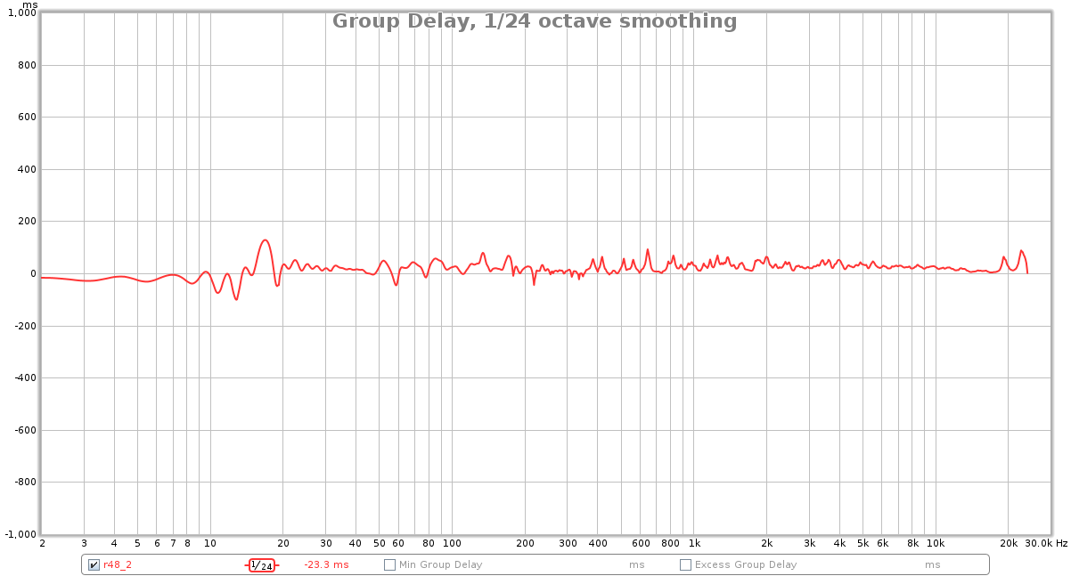
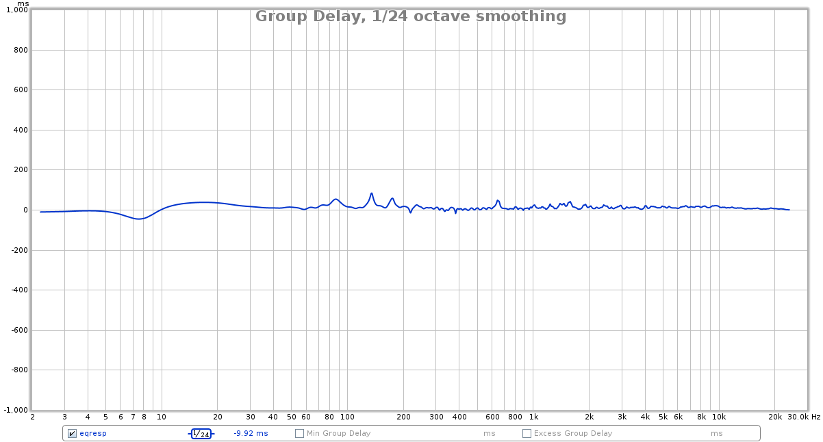
Group Delay
(1/24 Octave Smoothing)
UNEQUALIZED
EQUALIZED

Slide 6
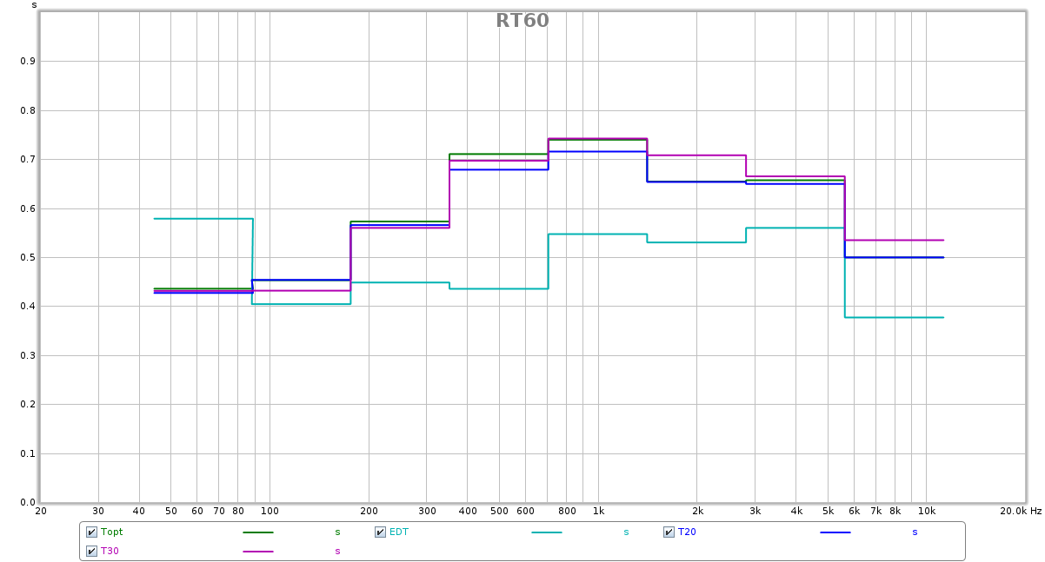
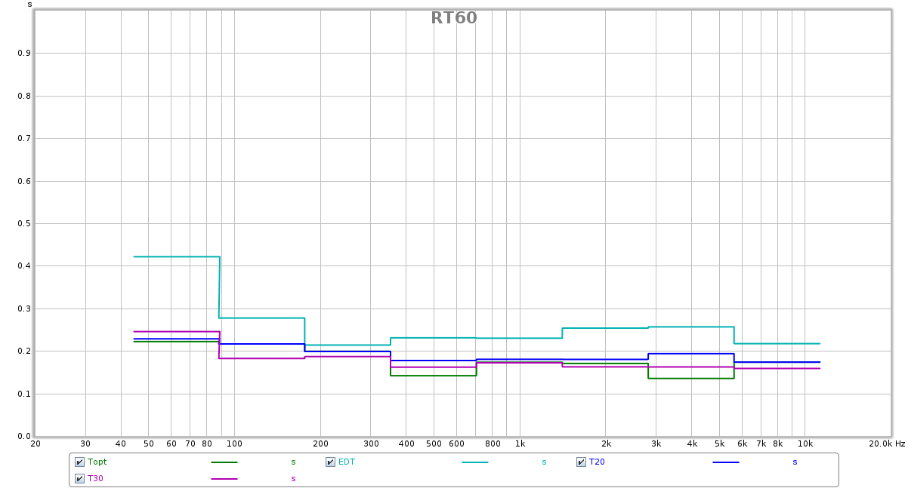
RT60
700ms
UNEQUALIZED
EQUALIZED
200ms

Slide 7
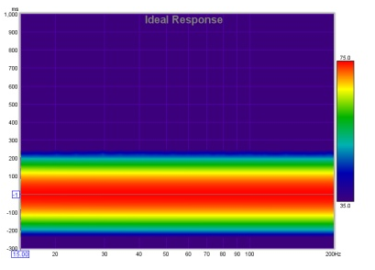
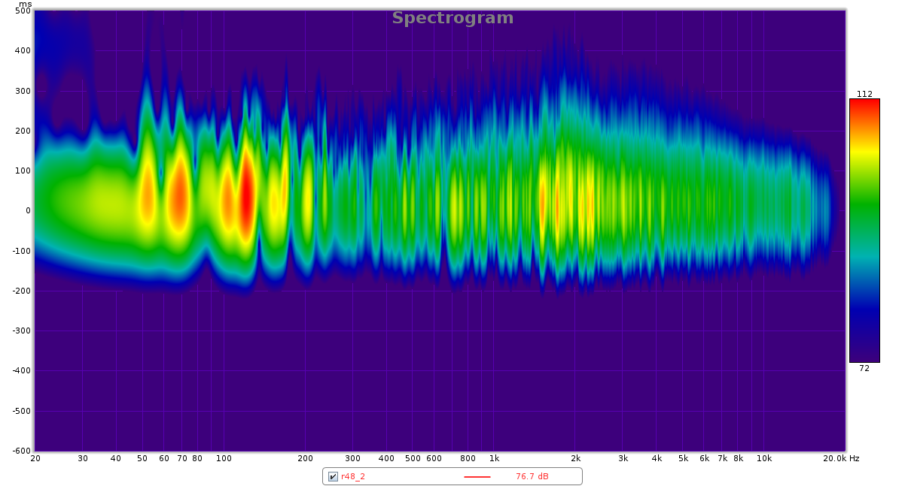
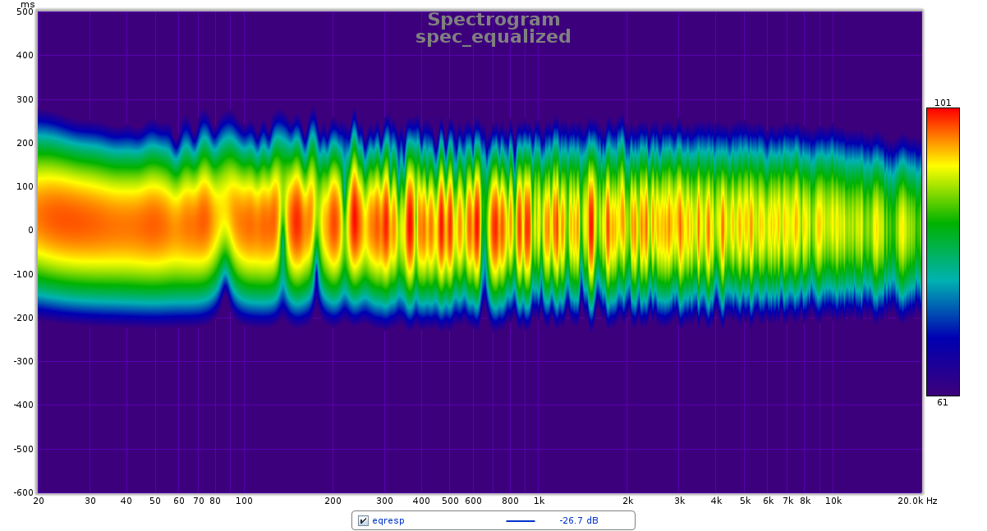
Spectrogram
Ideal
(from Room EQ Wizard)
UNEQUALIZED
EQUALIZED

Slide 8
References
Balazs Bank. “Audio Equalization with Fixed-Pole Parallel Filters: An Efficient Alternative to Complex Smoothing.” AES 128th Convention, London, UK, 2010 May 22–25.
Alberto Carini, et al. “Mixed Time-Frequency approach for Multipoint Room Response Equalization.” AES 45th International Conference, Helsinki, Finland, 2012 March 1-4.
G. Defrance and J.-D. Polack. “Measuring the mixing time in auditoria.” Acoustics 08 Paris.
D. Preis. “Phase Distortion and Phase Equalization in Audio Signal Processing – A Tutorial Review.” AES 1982.
Rodney Kennedy and Biljana Radlovic. “Nonminimum-Phase Equalization and Its Subjective Importance in Room Acoustics.” IEEE Nov. 2000.
John Mourjopolous and Matti Karjalainen. “About Room Response Equalization and Dereverberation.” IEEE Oct. 2005.

