Slide 1
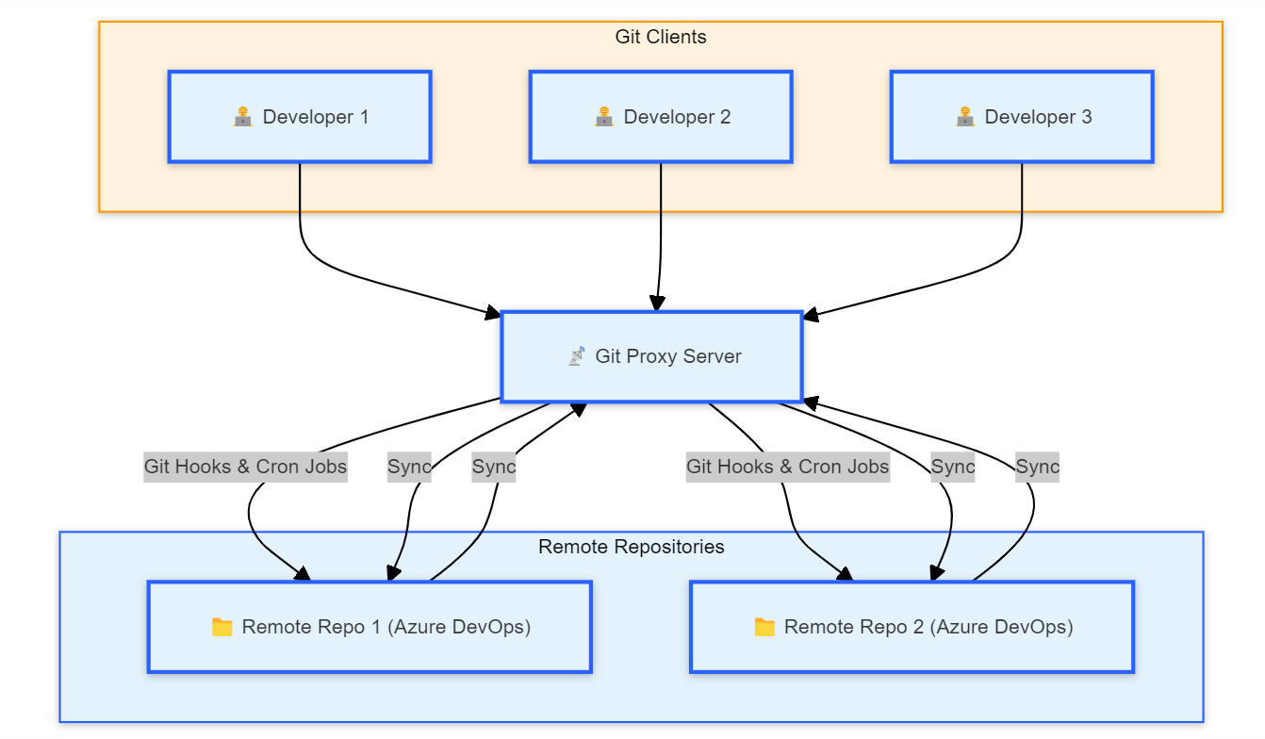
Advantages:
Customizable Workflow:
With the proxy server in place, the workflow can be customized with scripts, hooks, for secrets check and pattern verification
This allows for advanced automation, like linting, testing, or deployment triggers before code reaches the remote repositories.
Disadvantages:
Single Point of Failure:
The Git Proxy Server introduces a potential single point of failure. If the proxy server goes down, developers will be unable to push or pull code, halting the workflow.
Sync Conflicts and Latency:
there may be some latency between when a change is made in one repository and when it is synced to the other, which could cause problems in time-sensitive workflows.
Even though sync automation is in place, there could be a delay in pushing changes across repositories. This delay could cause misalignments between developers who work with one remote repository while others work with the second.
Overhead and Performance Bottlenecks:
The Git Proxy Server may become a bottleneck if the number of developers or the volume of code changes increases significantly.
The server may require additional resources (CPU, memory, storage) to handle the load of multiple developers and the synchronization processes efficiently.
Increased Maintenance of Sync Automation:
Any errors in sync automation could result in repositories falling out of sync, which would require manual intervention to resolve.

Slide 2
Disadvantages:
Single Point of Failure:
The Git Proxy Server introduces a potential single point of failure. If the proxy server goes down, developers will be unable to push or pull code, halting the workflow.
Mitigating this risk would require redundancy or high availability configurations, adding to the complexity.
Increased Complexity in Setup and Maintenance:
This model introduces additional infrastructure complexity, as administrators now need to configure and maintain the Git Proxy Server, set up Git Hooks, and manage cron jobs for synchronization.
The more complex the automation, the higher the potential for errors or bugs in sync scripts, leading to data inconsistencies between repositories.
Sync Conflicts and Latency:
While the proxy server automates the synchronization between repositories, there is still a risk of conflict during simultaneous updates from different repositories.
Additionally, there may be some latency between when a change is made in one repository and when it is synced to the other, which could cause problems in time-sensitive workflows.
Overhead and Performance Bottlenecks:
The Git Proxy Server may become a bottleneck if the number of developers or the volume of code changes increases significantly.
The server may require additional resources (CPU, memory, storage) to handle the load of multiple developers and the synchronization processes efficiently.
Increased Maintenance of Sync Automation:
Over time, the cron jobs or sync scripts (Git Hooks) may need updates or debugging due to changes in the repositories, workflows, or external services.
Any errors in sync automation could result in repositories falling out of sync, which would require manual intervention to resolve.
Latency in Reflecting Changes Across Repositories:
Even though sync automation is in place, there could be a delay in pushing changes across repositories. This delay could cause misalignments between developers who work with one remote repository while others work with the second.

