Slide 1
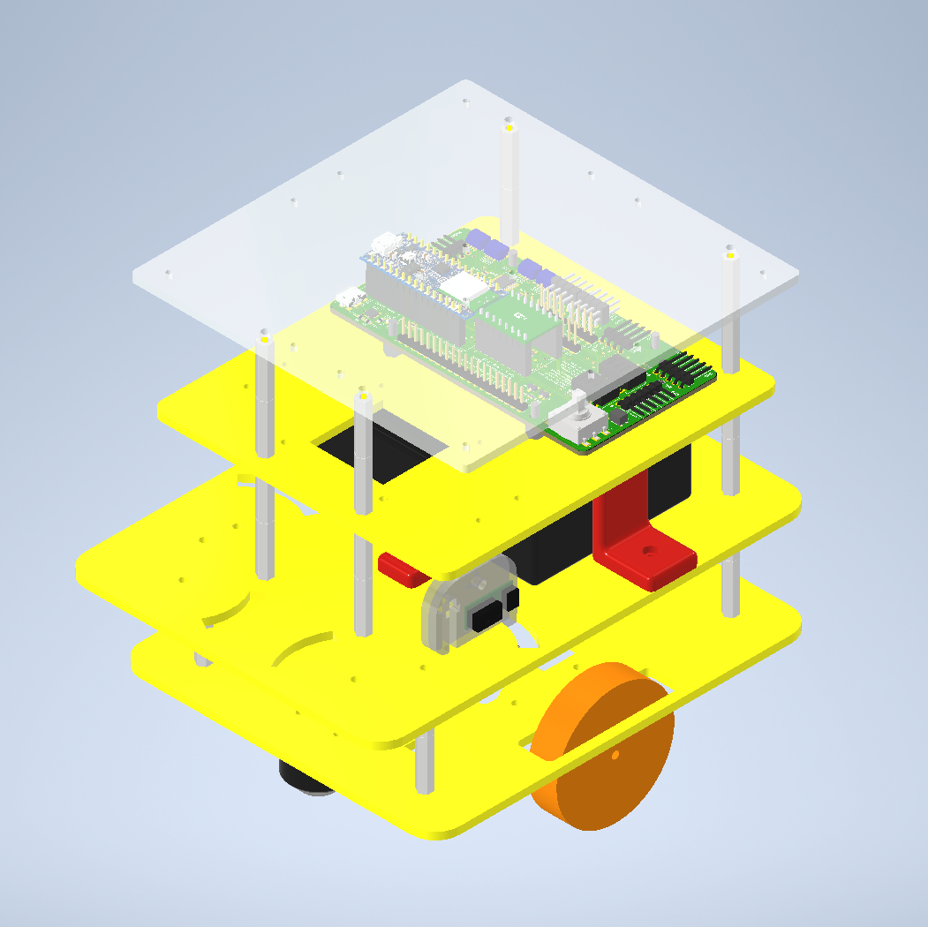
GEOFF
Ben Wiltshire

Slide 2
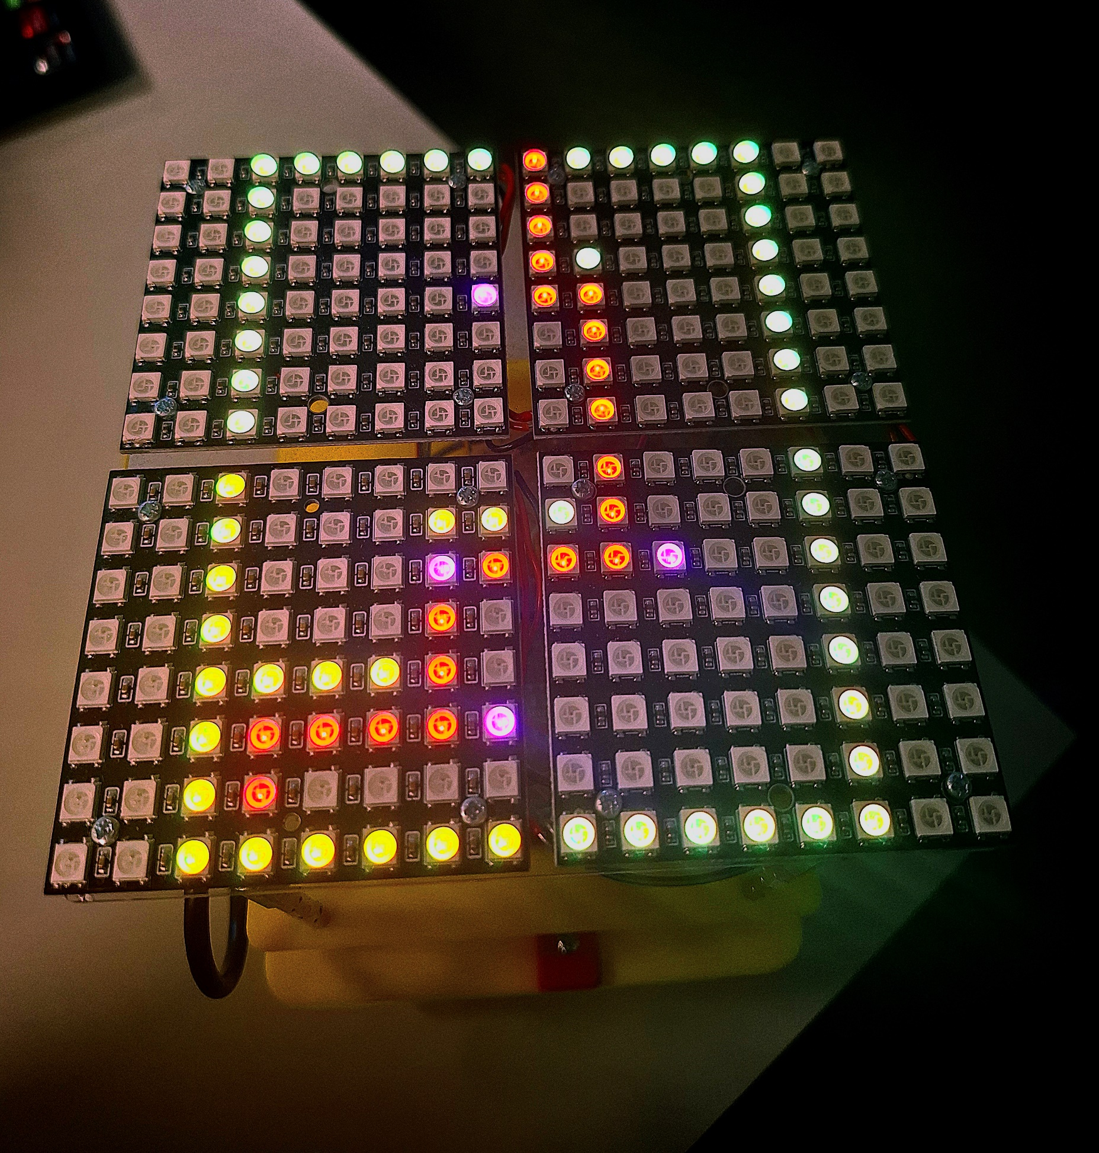
LED Matrix
16x16 NeoPixel array
Single pin programming
Requires level shifter due to 5V signal
Visualise maze solving in real time
Blue: Current Location
Red: Path Taken
Green: Obstacles
Purple: Direction

Slide 3
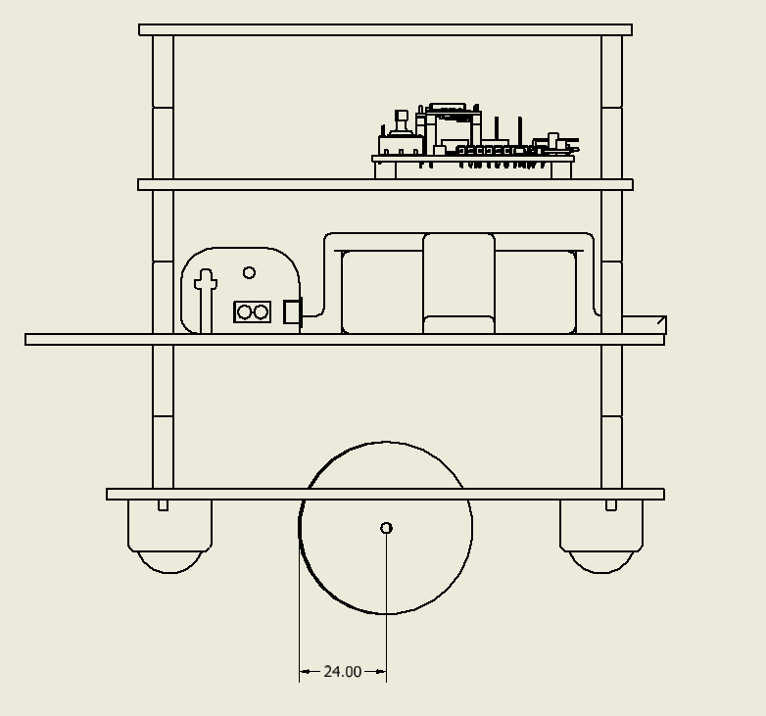
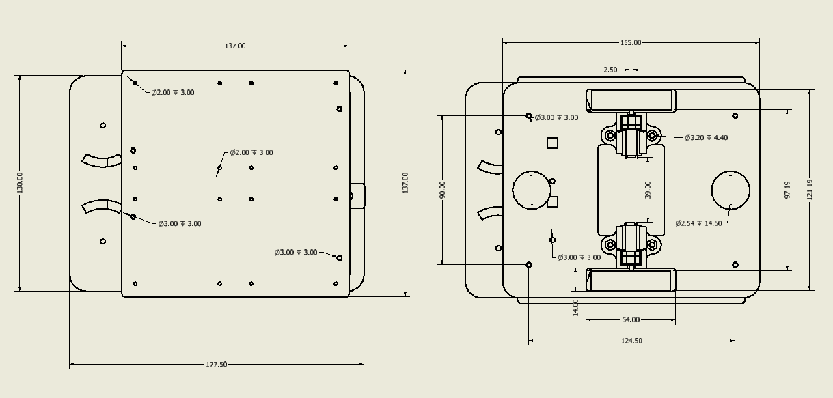
Design
4 levels
Minimum size is determined by the LED matrix
Sensors on swivels
Bottom IR not on swivel to keep wall aligning precise
Cover over IR to prevent light interference
Cable routing
Optional slots for front ultrasonics

Slide 4
Maze Solving
Turn to face the finish
Drive towards the finish until an obstacle is reached
Take measurements and take the best route around the obstacle
Shuffle along wall until it can move forward, towards the finish
If stuck in a dead end, navigate out

Slide 5
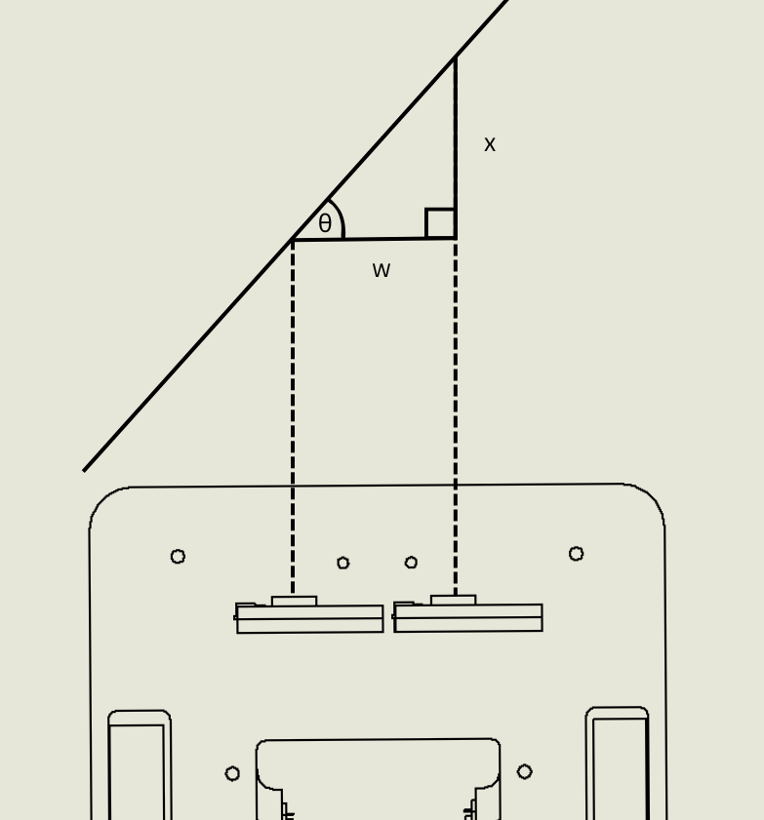
Wall Aligning
Trigonometry

Slide 6
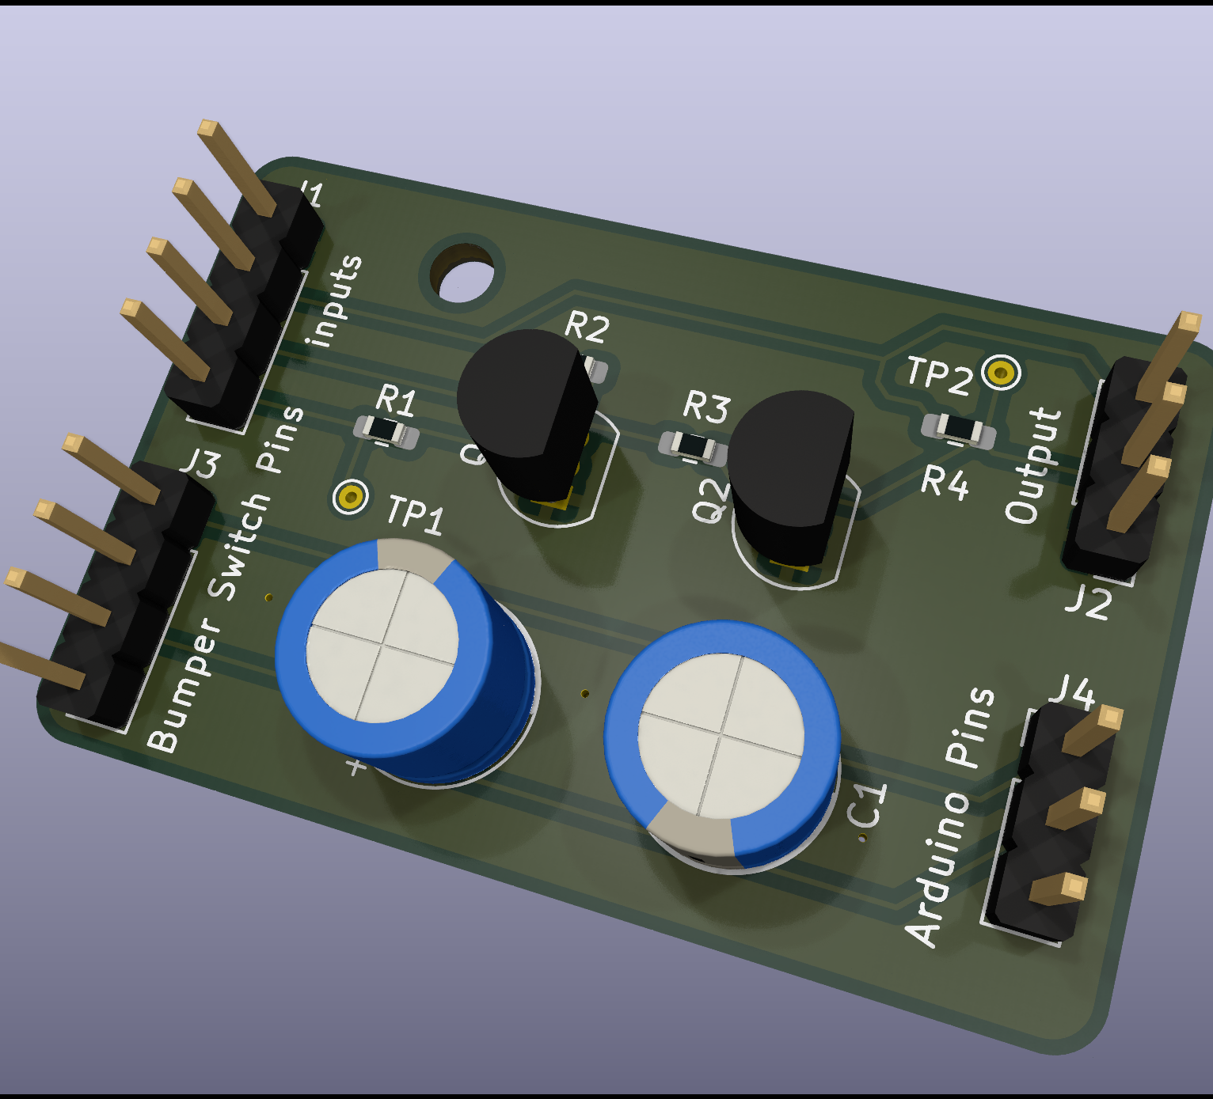
PCB
LED Matrix Level Shifter
Bumper Debouncing

Slide 7
Next Steps…
Higher resolution occupancy grid
Calculating location of surrounding objects with side sensors after each move
Each bumper causing the robot to react differently

