Slide 1
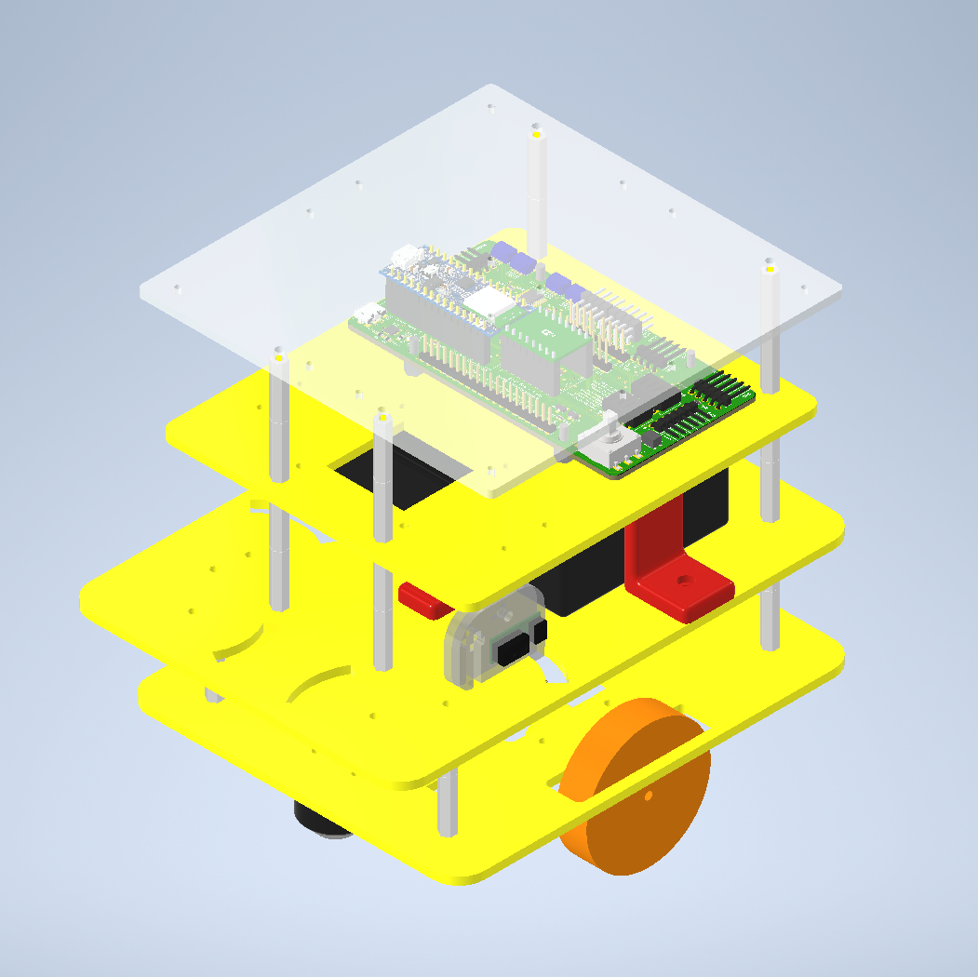
GEOFF

Slide 2
LED Matrix
Single pin programming
Level shifter

Slide 3
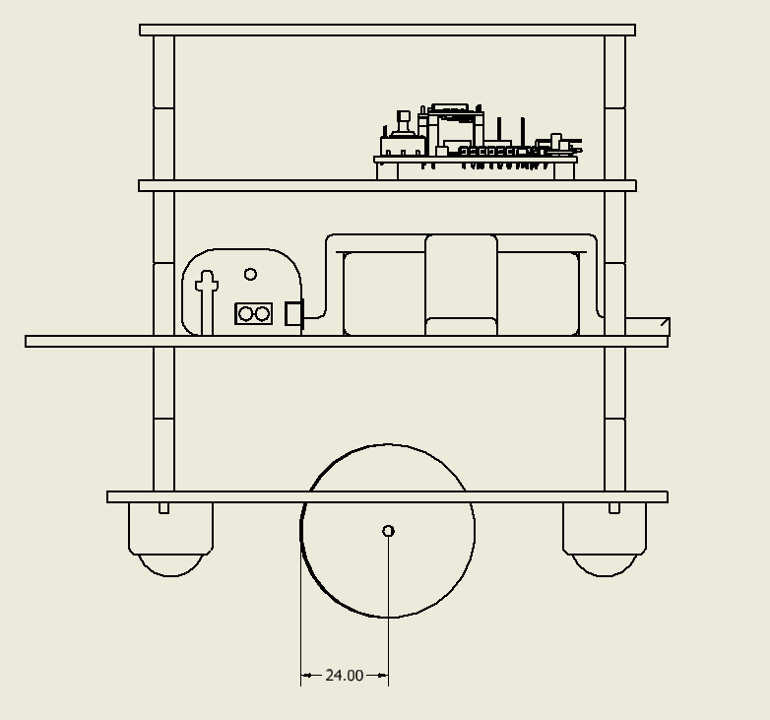
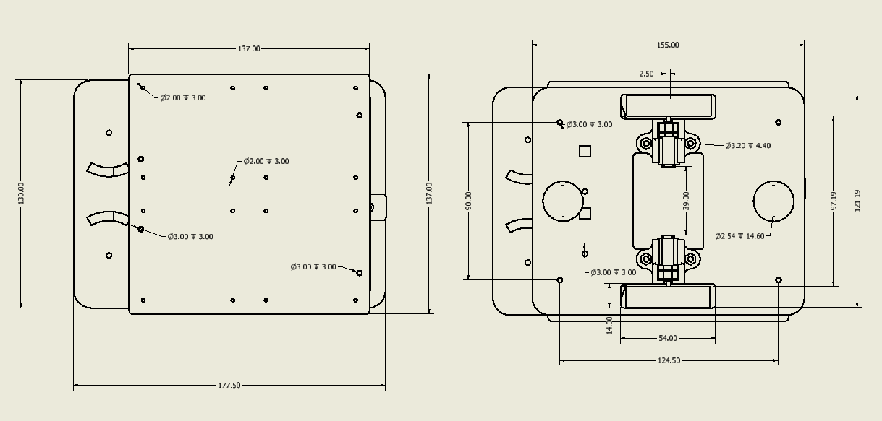
CAD
4 levels
Minimum size is determined by the LED matrix
Cable routing holes
Sensors on swivel
Cover over IR to prevent interference

Slide 4
Maze solving
Constantly turning to face the finish
Drive towards finish until an obstacle is reached
Take measurements and take the best route around the obstacle
Shuffle along wall until it can move forward, towards the finish
If stuck in a dead end, navigate out

Slide 5
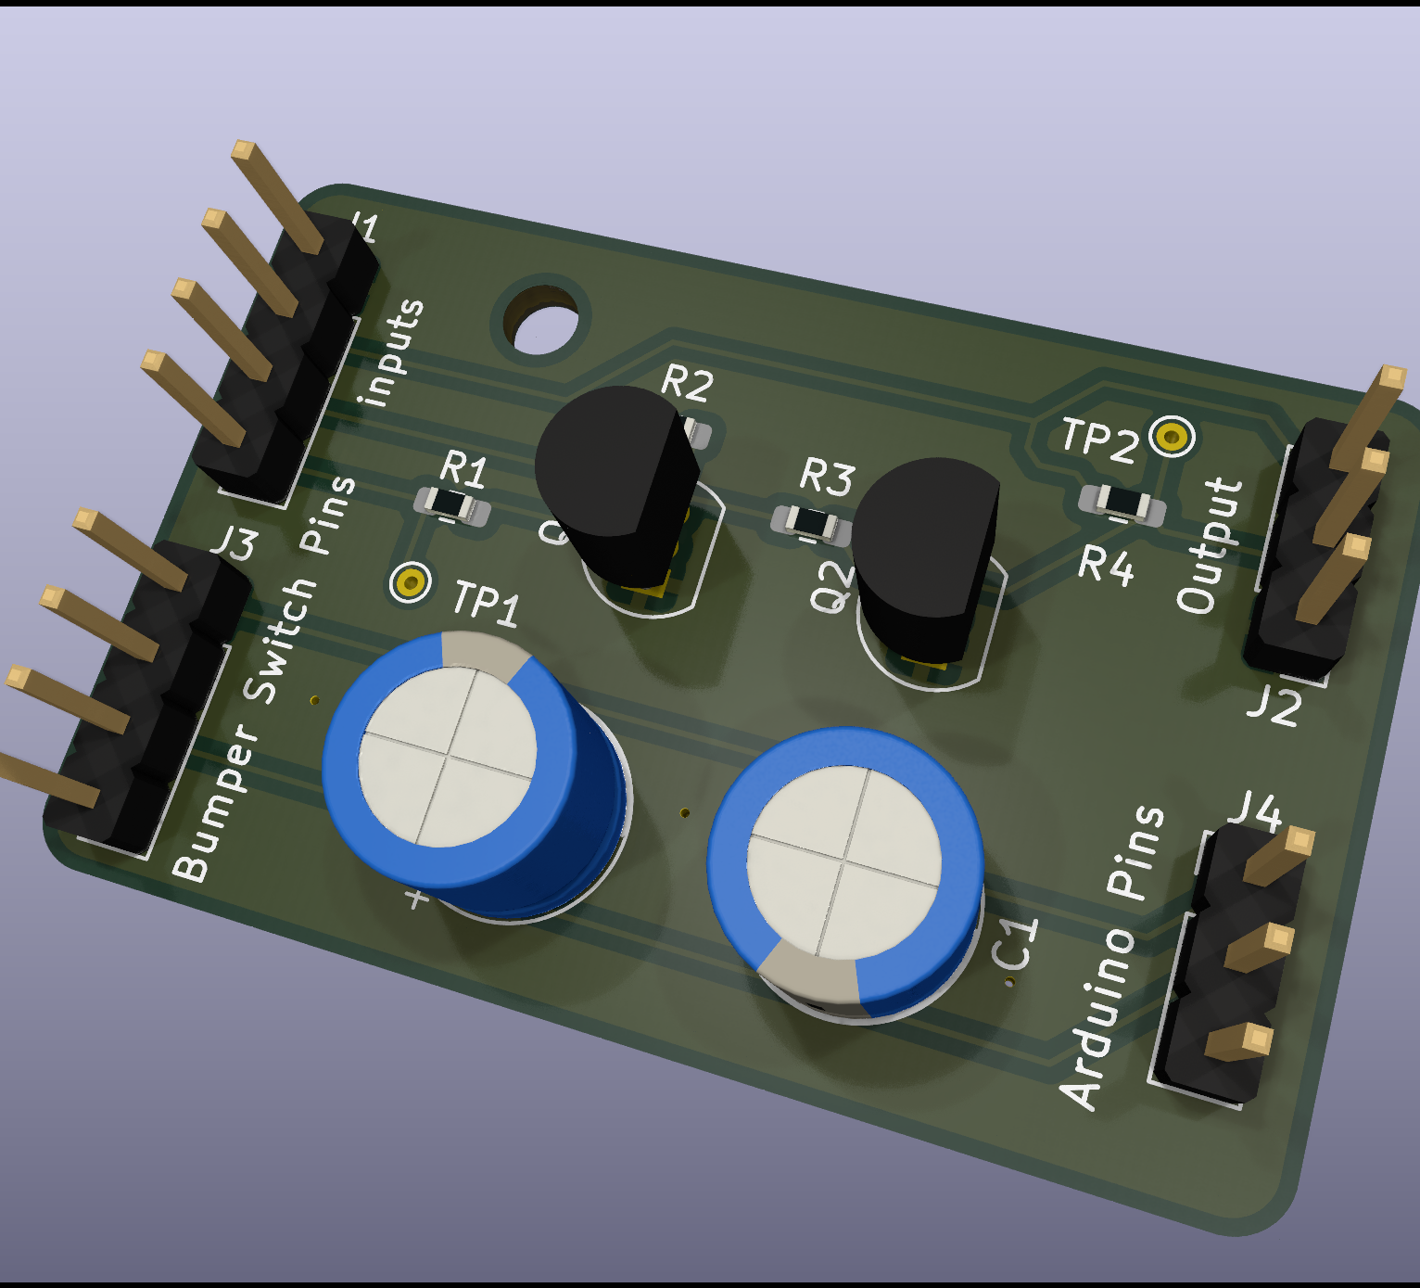
PCB
Bumper debouncing
LED matrix level shifter

Slide 6
Wall aligning
Trigonometry

Slide 7
Next Steps…
Wire
Higher resolution occupancy grid
Calculating location of objects with side sensors after each move
Each bumper causing the robot to react differently

