Slide 1
WASM, from server to mobile agents
Web ASseMbly
WASM is a cool word.
Assembly language was the lowest human level communication to the computer above HW.
Now the Internet makes WASM the lowest level to HW.

Slide 2
Web ASseMbly
What is it use for?
Why is it so much faster?
How to create WASM?
Examples of WASM.

Slide 3
WASM, What is it?
It is compiled C, C++ or Rust library compiled to binary that runs in the browser.
There is a WASM Virtual Machine in every browser that creates a sandbox to run the binary.
It is used just like JavaScript module.
It runs about 20% slower than native machine code.
And about 10X faster than JavaScript
Using Rust, the WASM is memory safe with no races.

Slide 4
WASM is Fast
WASM is compiled code using C, C++, Rust.
The code is optimizes in development not run time
WASM is binary, making parsing faster.
In future, WASM can run in HW
WASM is smaller the JS

Slide 5
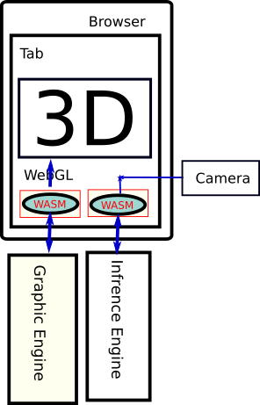

Web ASseMbly
WASM can run WebGL
Optimized for graphic engine
Can Interface camera to Convolution Neural Net Engine
WASM is sandboxed

Slide 6
Stages of WASM
int add(int a, int b) {
return a + b;
}
Type start=0x0000000e end=0x00000015 (size=0x00000007) count: 1
Function start=0x0000001b end=0x0000001d (size=0x00000002) count: 1
Table start=0x00000023 end=0x00000027 (size=0x00000004) count: 1
Memory start=0x0000002d end=0x00000030 (size=0x00000003) count: 1
Global start=0x00000036 end=0x00000037 (size=0x00000001) count: 0
Export start=0x0000003d end=0x0000004d (size=0x00000010) count: 2
Code start=0x00000053 end=0x00000060 (size=0x0000000d) count: 1
000059 func[0] <add>:
00005a: 20 01 | local.get 1
00005c: 20 00 | local.get 0
00005e: 6a | i32.add
00005f: 0b | end
module
(table 0 anyfunc)
(memory $0 1)
(export "memory" (memory $0))
(export "add" (func $add))
(func $add (; 0 ;) (param $0 i32) (param $1 i32) (result i32)
(i32.add
(get_local $1)
(get_local $0)
)
)
)

Slide 7
WASM Links
https://webassembly.org/
https://www.rust-lang.org/what/wasm
https://github.com/WebAssembly

