Slide 1




Application Overview

Slide 2
Presentation Overview
SAM’s Purpose & Operating Modes
Transaction Life-Cycle
Transition To SAM
Electronic Training
SAM Public Website
SAM Interfaces
Questions

Slide 3
SAM’s Purpose
Overview
Web-based application that facilitates the process of validating or deriving TAS/BETC data.
Single touch point for Enterprise Reference Data (ERD)
      Agency Location Code data
      TAS/BETC data
      ABA data

Slide 4
SAM’s Functionality
Overview
Validation – Verifies TAS/BETC information is valid per the CARS Master Reference Data listing
Translation – Unique data passed to SAM is translated to a corresponding TAS/BETC prior to posting in CARS
Default – Transactions that contain no TAS/BETC or C-Key data or invalid data will post to a predefined default TAS

Slide 5




Transaction Life-Cycle
Where SAM Fits
Collections
CARS/GWA
CAFE
Account Statement
C-Key or TAS/BETC
Transaction
With TAS/BETC
IPAC
C-Key or TAS/BETC
Valid
TAS/BETC
TAS/BETC
Payments
C-Key or TAS/BETC
SAM

Slide 6
Transition To SAM
Transition

Slide 7
Transition
SAM Set Up
  Step 1 Finalize Access Group Structure
  Step 2 Create Cash Flow Profile
  Step 3 Submit User Authorization Form
  Step 4 Provision Additional Users
  Step 5 Establish Default Rules
  Step 6 Upload Cash Flow Profile

Slide 8
Transition
SAM Access Group
A grouping of one or more ALCs, either in terms of business commonality (e.g., similar accounting rules, business practices, etc.) or for security reasons, to which SAM Users are granted permission.

Slide 9
Transition
Cash Flow Profile (CFP)
A grouping of business activities with a common set of central accounting rules
Serves as a crosswalk of an FPA’s collections, RITS and TRACS transactions within SAM
Contains C-Key Name and C-Key Value which point to a TAS/BETC combination

Slide 10
Transition
SAM’s CFP Analysis
Define Classification Keys (C-Keys) in order to map collections transactions to corresponding TAS/BETC
SAM Team analyzes the collections process for each ALC via conference call
  Identify collection mechanisms
  Define TAS/BETC for each collection mechanism C-Key
  Use data gathered to complete Cash Flow Profile

Slide 11
Transition
C-Key Examples
Mechanism C-Key Name C-Key Value
Credit Card Merchant ID 4445000123456
PAYGOV PAYGOV ALC+2 9999999901
TRACS ALC 99999999

Slide 12
Transition
Sample Cash Flow Profile
Cashflow
Name | ALC 99999999 - Paygov
Description | This is a PAYGOV Cash Flow Profile
System Type | Collection
Access Group Path | Access Group Name
ALCs | 99999999
Mechanism | PAYGOV
C-Key Name | PAYGOV ALC+2
Description | This is a PAYGOV C-Key
C-Key Value | Description | DIST Rule | SP | ATA | AID | BPOA | EPOA | A | MAIN | SUB | BETC | %
9999999901 | Off Site Location | Credit |  |  | 099 |  |  | X | 4521 | 000 | COLL | 100
9999999901 | Off Site Location | Debit |  |  | 099 |  |  | X | 4521 | 000 | COLLAJ | 100

Slide 13
Transition
SAM User Roles
Users are defined and granted permission by Access Group
Mandatory SAM Users
Primary Local Security Administrator (PLSA)
  Provision SAM users
  Add descendent access groups
  One PLSA per Access Group
Cash Flow Administrator (CFA)
  Create and manage Cash Flow Profiles
  Select Access Group Default Rules
  Multiple CFAs permitted

Slide 14
Transition
SAM User Roles
Optional SAM Users
Local Security Administrator (LSA)
  Provision SAM users
  Multiple LSAs permitted in an Access Group
Agency Viewer (AV)
  View Cash Flow Profiles and Access Group Default Rules
Data Download (DD)
  Download CARS Master Data

Slide 15
Transition
Things To Consider
Who will be your PLSA and CFA(s)?
Is your ALC’s Access Group finalized?
Have you worked with the SAM Team to create your Cash Flow Profile?
When will your ALC be ready to become a CARS pilot reporter?
Your agency’s CFA is required to maintain your Cash Flow Profile once you become a CARS reporter.
Any additional collection mechanisms added after becoming a CARS reporter will require a new Cash Flow Profile in SAM.
If you use a fiscal year TAS, you will need to update your Cash Flow Profile in SAM at year end to include your new TAS for the upcoming year.

Slide 16
Additional SAM Benefits
Reference Data

Slide 17
Web Based Training
Electronic Training
SAM offers electronic training modules to help assist users with navigating the system
Step-by-step video tutorials based on the user role and application functionality

Slide 18
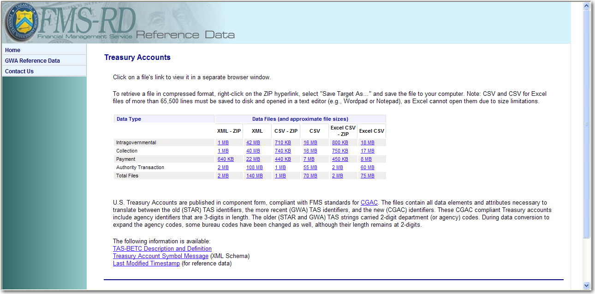
SAM Public Website
Reference Data
https://www.sam.fms.treas.gov/sampublic/

Slide 19
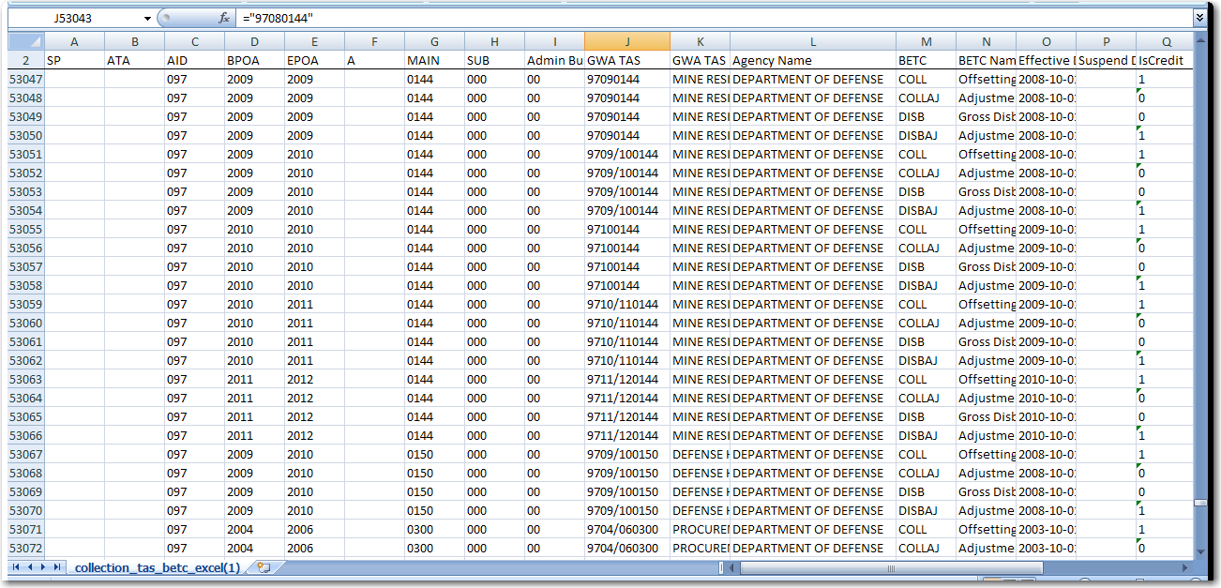
Reference Data
Listing of Valid TAS/BETC

Slide 20
Reference Data
Crosswalk String TAS to Standard Component TAS

Slide 21
Reference Data
Enterprise Reference Data
SAM provides Enterprise Reference Data (ERD) to Business Partners
  SAM receives nightly file from CARS with ALC and TAS/BETC data
  SAM sends ALC, TAS/BETC and ABA data to Business Partners
  For more information please download the Trading Partner Integration Guide at the following link - http://fms.treas.gov/sam/ent_ref_data.html
SAM sends ERD via:
  Email
  File Drop
  Message Queue
  Web Service (preference)

Slide 22
SAM Team Members
SAM Contact Information
Harold Grice (314) 444.4238
Ryan McCluskey (314) 444.3736
Tammy Oslica (314) 444.0919
FMS Website:
SAM Website:
Public Website:
Shared Email:
http://fms.treas.gov/sam/
http://sam.fms.treas.gov/
http://sam.fms.treas.gov/sampublic/
sam.conversion@stls.frb.org

Slide 23


Questions?

