Slide 1
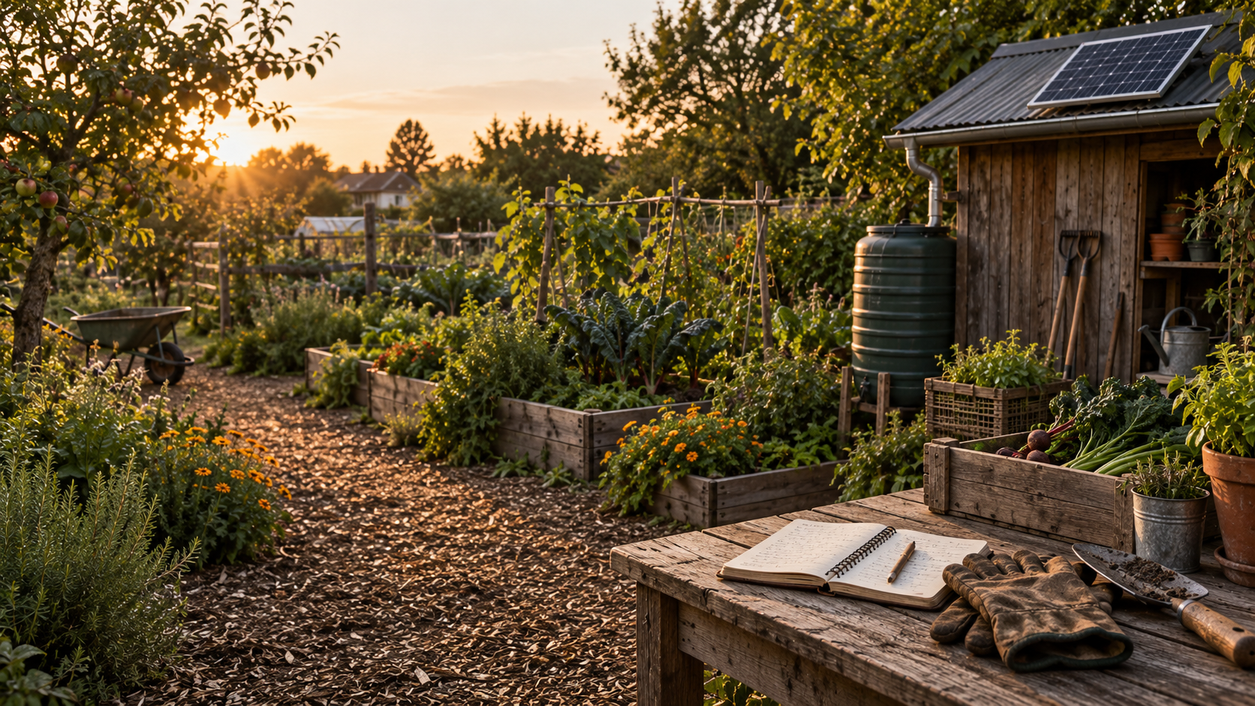

Green Goods
Land care
within reach
Affordable tools for land stewards to learn
from one another, coordinate support and
keep sovereignty over their knowledge.
Conceptual scene
Notes:
Green Goods helps communities caring for land and each other access useful tools at a low cost, learn from one another and coordinate support while retaining sovereignty over their knowledge.
Our global vision is that every community, regardless of economic circumstances, can access the tools, infrastructure, knowledge and support to care for land and each other. Local language, governance, ability, connectivity and time matter alongside money. Green Goods is the product, protocol and ecosystem. The proposed OS is a workspace within that wider offer.
Affordability and practical sovereignty are commitments to deliver and test. They are not measured savings or a promise of control over copies already shared. The four agreed pillars are Accessibility, Sovereignty, Trust and Reciprocity, with Privacy, Interoperability and Verifiability essential throughout.
Sources: user-supplied proposition and accepted direction, 8 October 2026 Pacific; .plans/ideas/green-goods-os/pitch-revision.md. Design references: https://github.com/greenpill-dev-guild/green-goods/blob/0350b1bd287db542d6b4d07a662ba28c744e203b/DESIGN.md and https://github.com/greenpill-dev-guild/green-goods/blob/0350b1bd287db542d6b4d07a662ba28c744e203b/packages/client/DESIGN.browser.md.
Image: newly generated fictional concept using the website's hero-home.webp as a visual reference, with no people or faces. It depicts no identified community, customer, pilot or measured outcome. Created with the built-in image tool on 8 October 2026 Pacific. Full prompts and provenance accompany this file.
Typography and copy, decided 9 October 2026 Pacific, 10 October UTC: Fraunces Medium 500 upright title at 50 pt with 54 pt leading, Land care in charcoal and within reach in the website accent green 1A7544, upright, no italic. Regular 400 was rendered alongside and not chosen. Inter Regular 20 pt subtitle over three lines carries the subtitle chosen from measured shorter options on 9 October 2026 Pacific, 10 October UTC: Affordable tools for land stewards to learn from one another, coordinate support and keep sovereignty over their knowledge. Composition C1 keeps the v2 linen panel on the left and the conceptual garden scene on the right. The title weight is settled at Medium 500. Source: .plans/ideas/green-goods-os/artifacts/visual-direction-v3/README.md.
The title face is Fraunces Medium, a static 500 instance fetched from Google Fonts on 10 October 2026 UTC under the SIL Open Font License 1.1; the wordmark stays Fraunces Regular and supporting copy stays Inter Regular.

