Slide 1
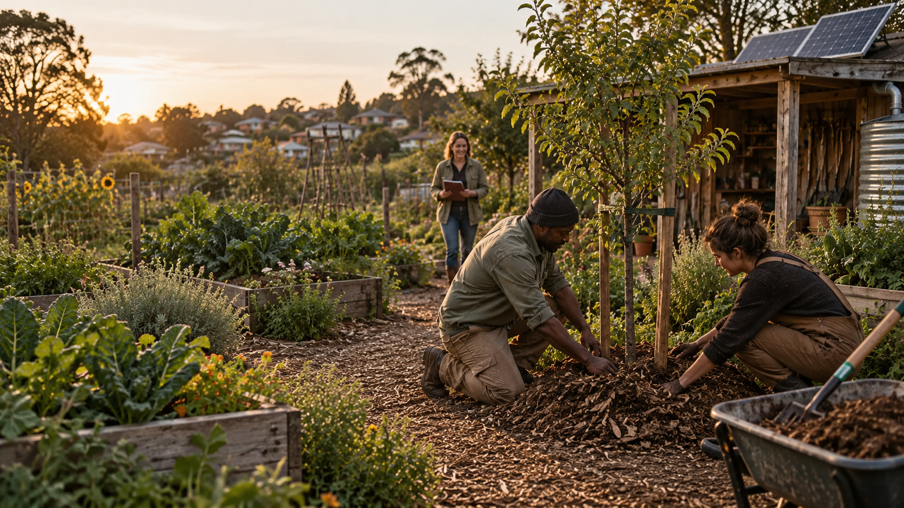

Green Goods
The tools to care
for land should be
within everyone's
reach
Green Goods helps communities caring for land and each other access useful tools at a low cost, learn from one another and coordinate support while retaining sovereignty over their knowledge.
For communities worldwide, regardless of economic status
Conceptual scene
Notes:
Green Goods helps communities caring for land and each other access useful tools at a low cost, learn from one another and coordinate support while retaining sovereignty over their knowledge.
Our global vision is that every community, regardless of economic circumstances, can access the tools, infrastructure, knowledge and support to care for land and each other. Local language, governance, ability, connectivity and time matter alongside money. Green Goods is the product, protocol and ecosystem. The proposed OS is a workspace within that wider offer.
Affordability and practical sovereignty are commitments to deliver and test. They are not measured savings or a promise of control over copies already shared. The four agreed pillars are Accessibility, Sovereignty, Trust and Reciprocity, with Privacy, Interoperability and Verifiability essential throughout.
Sources: user-supplied proposition and accepted direction, 8 October 2026 Pacific; .plans/ideas/green-goods-os/pitch-revision.md. Design references: https://github.com/greenpill-dev-guild/green-goods/blob/0350b1bd287db542d6b4d07a662ba28c744e203b/DESIGN.md and https://github.com/greenpill-dev-guild/green-goods/blob/0350b1bd287db542d6b4d07a662ba28c744e203b/packages/client/DESIGN.browser.md.
Image: newly generated fictional concept using the website's hero-home.webp and hero-garden.webp as visual references. It depicts no identified community, customer, pilot or measured outcome. Created with the built-in image tool on 8 October 2026 Pacific. Full prompts and provenance accompany this file.

Slide 2
Unequal access makes
regenerative work harder
Cost
Complexity
Disconnected knowledge
Equipment, connectivity
and support can exceed
available budgets.
Setup and maintenance ask
for scarce time and skills.
Experience is hard to find,
carry forward and adapt.
Less time for the land.
Fewer chances to learn together.
Problem hypothesis informed by FAO regional evidence; local validation pending.
Notes:
Cost, complex setup and disconnected tools can leave communities spending scarce time managing systems. Useful experience can be hard to find, carry forward and adapt elsewhere.
FAO's Near East and North Africa regional overview identifies affordability, connectivity, skills, infrastructure and fragmented digital-solution markets as barriers. This supports investigating these mechanisms; it does not quantify their prevalence among Green Goods users or establish a global rate. The consequences shown are a problem hypothesis for participant discovery, not customer testimony or observed product savings.
Different tools are not inherently a problem. The concern is where inaccessible services, incompatible records or missing context create avoidable effort. Existing notebooks, conversations and community practices may work well and should remain part of the comparison. Discovery should establish which task matters, what people already use and who does setup and maintenance.
Source, accessed 9 October 2026 UTC: https://www.fao.org/neareast/main-topics/action-areas/digital-transformation/ (P07). No financial, market-size or impact statistic is asserted.

Slide 3
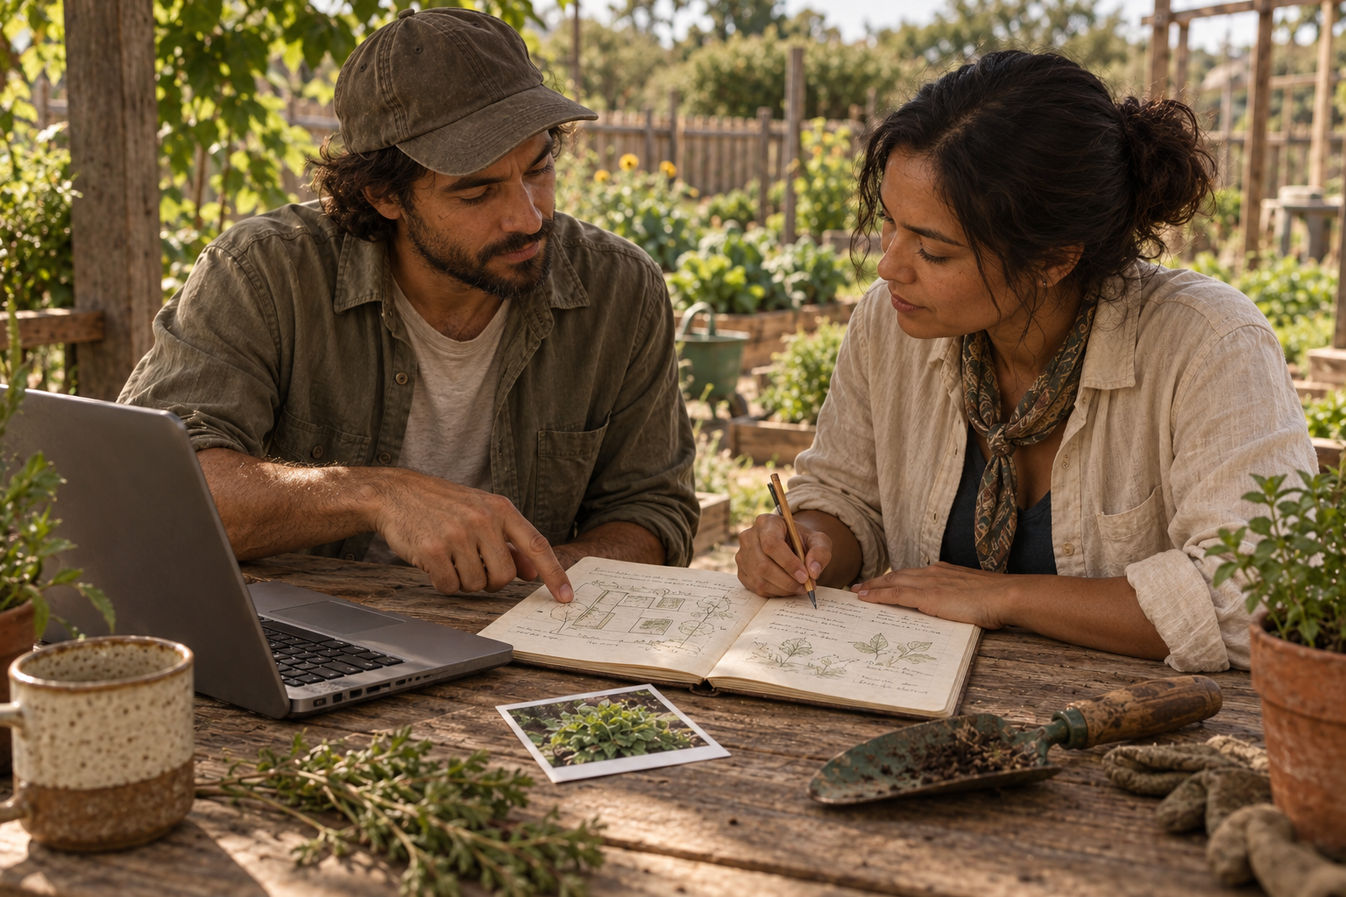
Green Goods connects tools,
knowledge and support
Access useful tools
A browser workspace on existing hardware,
with optional sensors and local AI.
Learn with others
Keep local context. Share experience.
Bring useful feedback home.
Coordinate support
Connect reviewed work with skills,
commitments and funding.
Conceptual scene
Keep sovereignty over your knowledge and choose what to share.
Proposed direction, building on existing Green Goods capabilities
Notes:
Green Goods brings practical tools, shared learning and coordinated support into one product and ecosystem. The proposed OS is an accessible browser workspace, with optional capture, local assistance and bounded sensor/import integrations. Manual participation must remain useful without new hardware, AI or public sharing.
The intended participant experience is to keep a useful observation, find and review its context, decide what to share, learn from another community and coordinate needed support. Financial, social, intellectual, cultural and experiential value can all matter. These forms of value are not automatically interchangeable or tokenized.
Current foundations: the inspected Green Goods capability ledger and work modules describe Garden records, work capture/review and support paths with availability limits. Proposed extensions: the connected OS workspace, source-linked local assistance, deliberate knowledge exchange and compatible infrastructure services. Later gated work: broader mesh behavior and expanded protocol integration. The commitment-pooling ledger distinguishes deployed infrastructure from an available product flow. No guarantee of ecological outcome, principal, yield or funding follows.
Sovereignty means meaningful permissions, community authority, portability, recovery and exit. The sharing decision must show exactly what leaves the private workspace. Supporters receive only deliberately shared material; their funding does not confer ownership or AI-training permission.
Sources inspected in the research package: https://github.com/greenpill-dev-guild/green-goods/blob/0350b1bd287db542d6b4d07a662ba28c744e203b/docs/docs/community/green-goods-claims.generated.mdx ; https://github.com/greenpill-dev-guild/green-goods/blob/0350b1bd287db542d6b4d07a662ba28c744e203b/packages/shared/src/modules/work/submit-work-command.ts ; https://github.com/greenpill-dev-guild/green-goods/blob/0350b1bd287db542d6b4d07a662ba28c744e203b/packages/shared/src/modules/work/work-confirmation.ts . The current checkout is source evidence, not fresh live deployment certification. Proposed requirements and limits: .plans/ideas/green-goods-os/spec.md and research.md.
Image: newly generated fictional learning scene using hero-actions.webp and hero-garden.webp as style references. It is not a screenshot, customer or field outcome. Full prompts accompany the file.

