Slide 1
FRAGMENT BASED DRUG DESIGN OF ANTHELMINTIC USING GENETIC ALGORITHM
Nikil Krishna
126010091

Slide 2

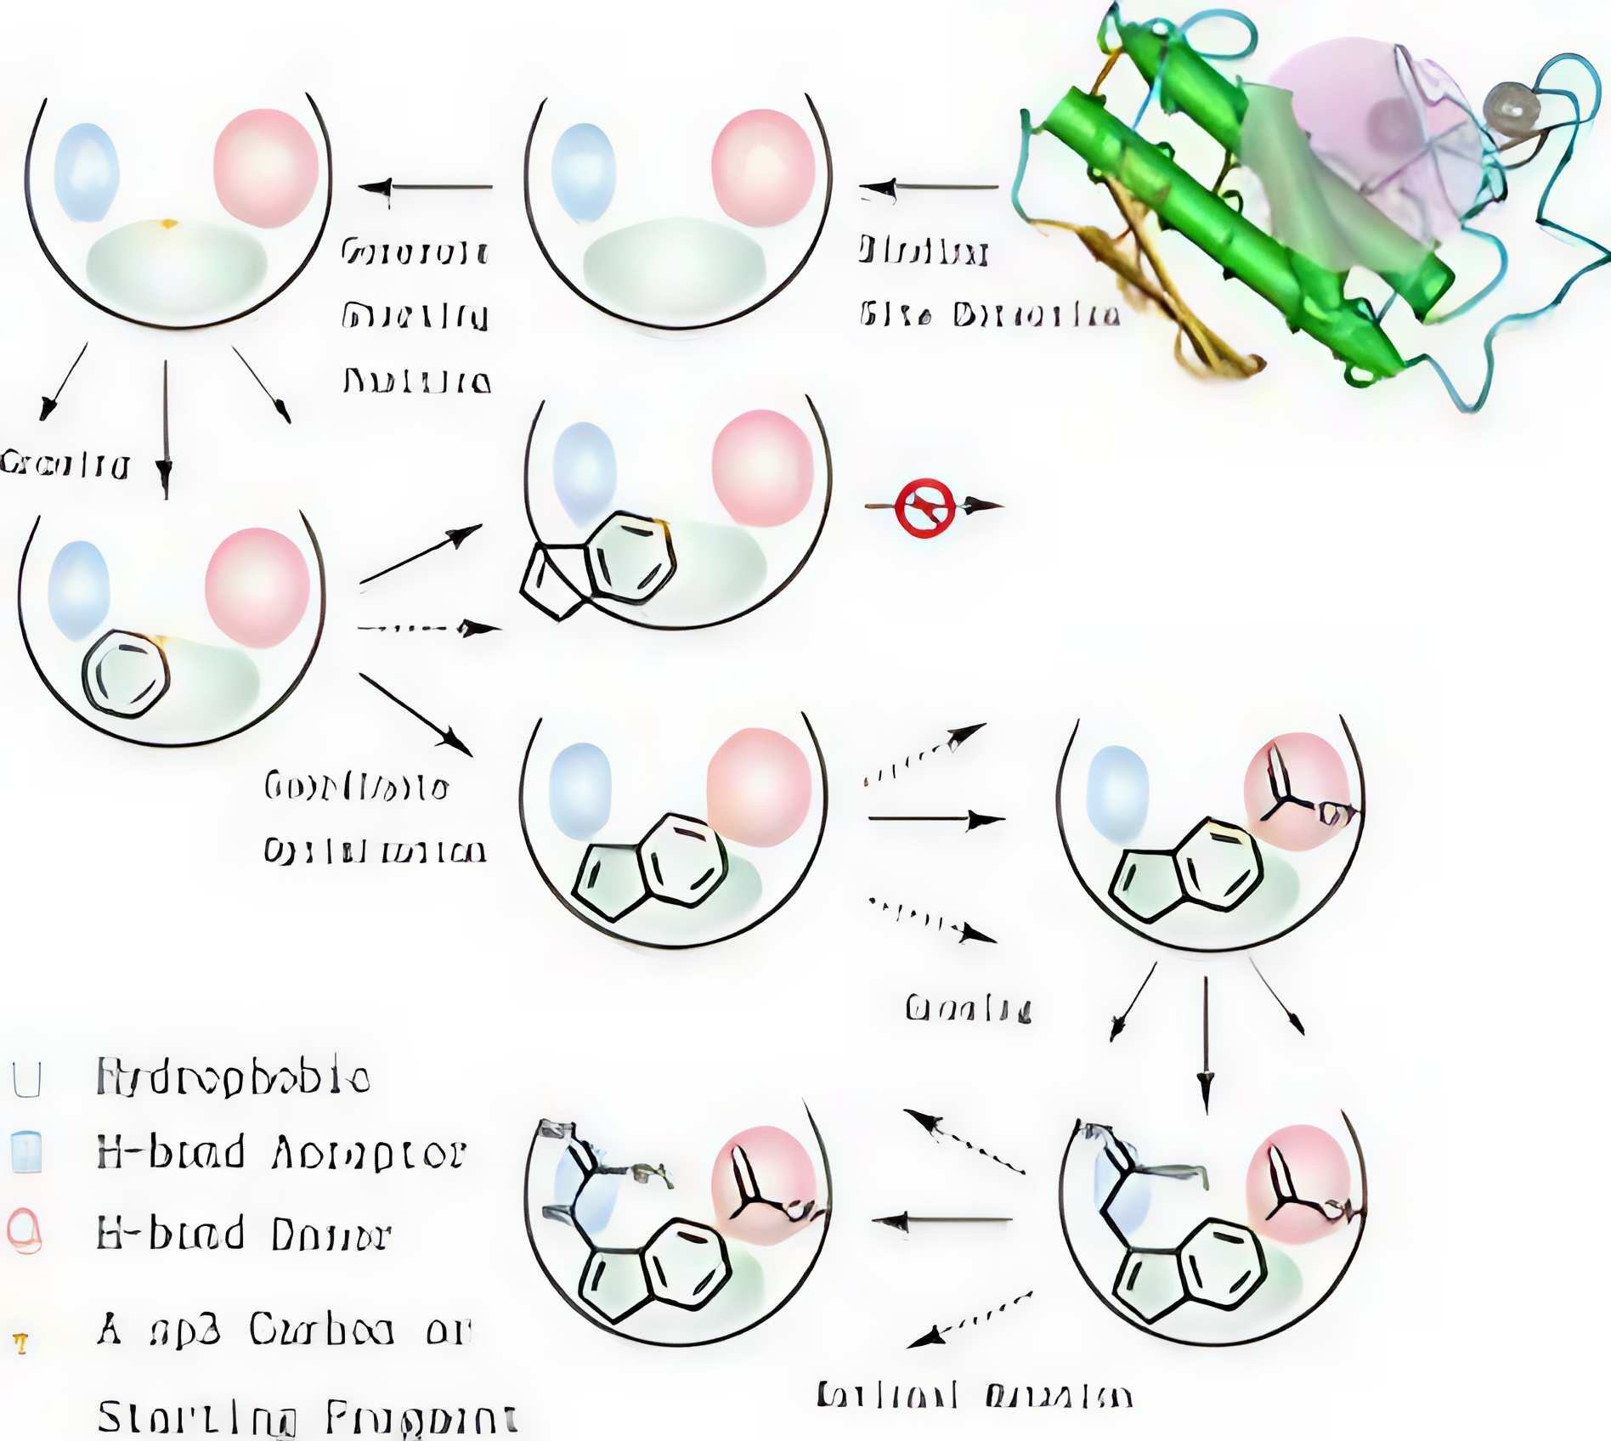
FRAGMENT BASED
Highly Specific and customized
Novel scaffolds
Exploration of the chemical space
De-novo design

Slide 3
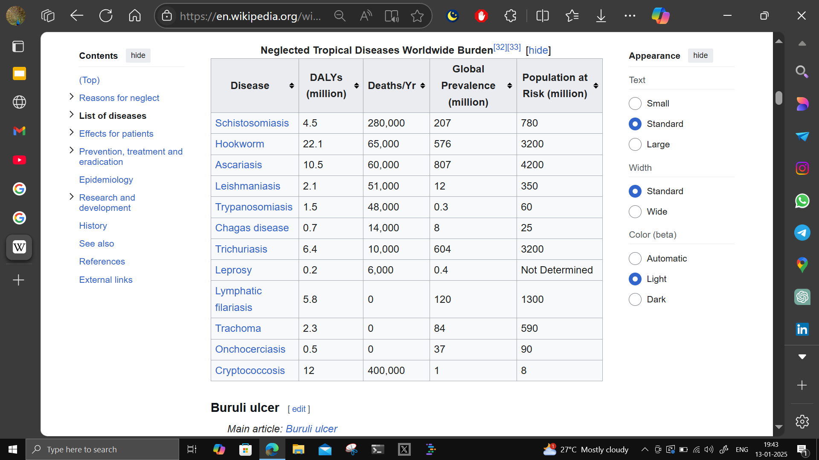
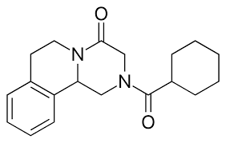
DRUG DESIGN OF ANTHELMINTIC
Major Impact in Real World
Antiparasitic drug to treat worms
MDA (Mass Drug Administration)
High Burden in underdeveloped countries
Unresolved mechanism of Praziquantel
Albendazole ❌ Ivermectin ❌

Slide 4
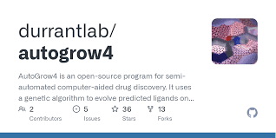
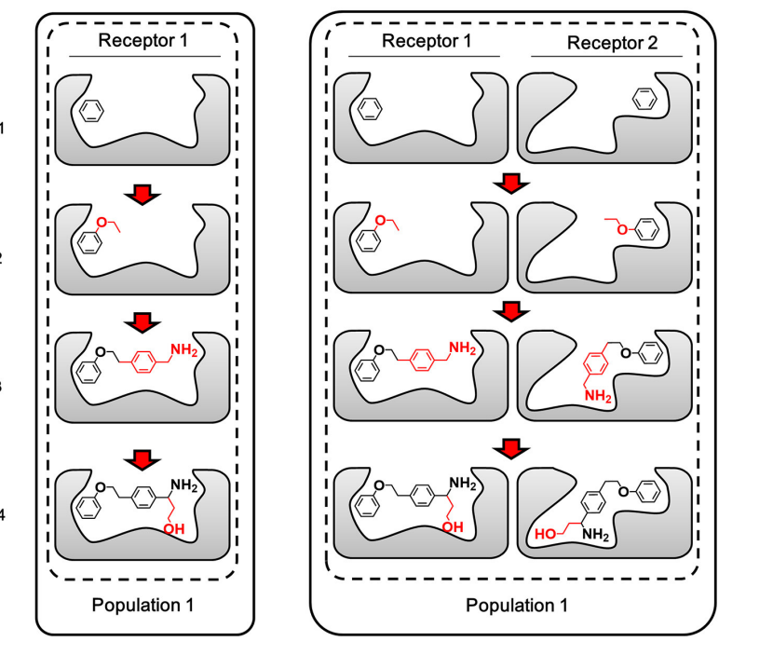
USING GENETIC ALGORITHM
Mutations and Crossover
Evolution - Selection of the fittest
Gradient Descent to the perfect match to the binding site
Notes:
jtosguibivahagrbvuoabgiouhocinew

Slide 5
WORKPLAN
Method Discovery
FBDD , GA
Lead Optimisation
Using Genetic Algorithm
(Week 10)
Scaffolding
Using FBDD
(Week 6)
Target Discovery
Schistosomiasis
Schistosoma Mansoni
Protein Target
Identification
(Week 2)
SAR Analysis
Preliminary ADMET

Slide 6
THANK YOU

