Slide 1
CS50 Week 7
Sam Green ’17
samuelgreen@college.harvard.edu
646-457-2340

Slide 2
Agenda: Transition to Web Programming
File Permissions & chmod
HTML & CSS
TCP/IP/HTTP
Problem Set 6

Slide 3
File Permissions
Files in the file system are differently visible to different users.
Examine permissions: ls –l
Permission flags: d, r, w, x

Slide 4
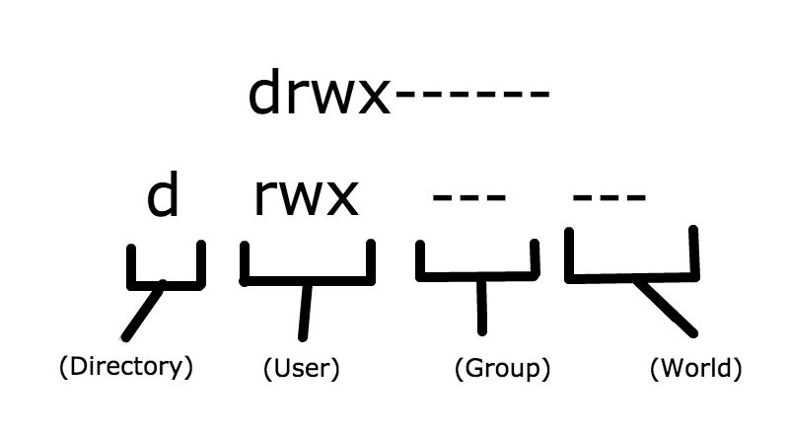
Permissions: detail

Slide 5
chmod
chmod is a unix utility for changing file permissions.
Chmod takes 2 args:
A change or a setting
A target (file, set of files, dir, set of dirs)

Slide 6
chmod examples
chmod a+r file.txt
chmod 711 direcotry
chmod file.txt
chmod 600 file.php
Notes:
These examples are guidelines for how files should be chmoded when they live in a file that will be made accessible via a web server. What does each of these mean? Why do we care?

Slide 7
chmod examples
chmod a+r file.txt
chmod 711 direcotry
chmod file.txt
chmod 600 file.php
Takeaway: boring but important!
Notes:
These examples are guidelines for how files should be chmoded when they live in a file that will be made accessible via a web server. What does each of these mean? Why do we care?

Slide 8
HTML
Hypertext Markup Language
Once you know HTML syntax, you know HTML.
Every tag that gets opened must get closed.

Slide 9
HTML Tips & Tricks
Use the W3 Validator (http://validator.w3.org/)
Reference these cheatsheets:
html
css

Slide 10
Crash Course on CSS Selectors
Tag selectors are applied to all elements of a certain type (p, h1, span, etc.)
Class selectors are applied to all elements with that class
ID selectors are applied to the element with that id (bad practice to give more than 1 the same ID!)

Slide 11
CSS: Select by Tag
p {
text-align: center;
}

Slide 12
CSS: Select by Class
<p class=“ppg”></p>
.ppg {
font-size: 100;
}

Slide 13
CSS: Select by ID
<p id=“name”>Sam</p>
#name {
color: orange;
}

Slide 14
TCP/IP
TCP: Transmission Control Protocol, used to guarantee that every message that needs to get somewhere gets there.
IP: Addressing system.
Reference the lecture notes for the things you need to know.

Slide 15
Problem Set 6
Lots to read!
String manipulation
File I/O

