Slide 1
CS50 Section 2
21 September 2015
Sam Green ’17
samuelgreen@college.harvard.edu
(646) 457 - 2340

Slide 2
Agenda
Intros
Norms and Expectations
Arrays
Functions
Command-Line Arguments
Problem Set Review

Slide 3
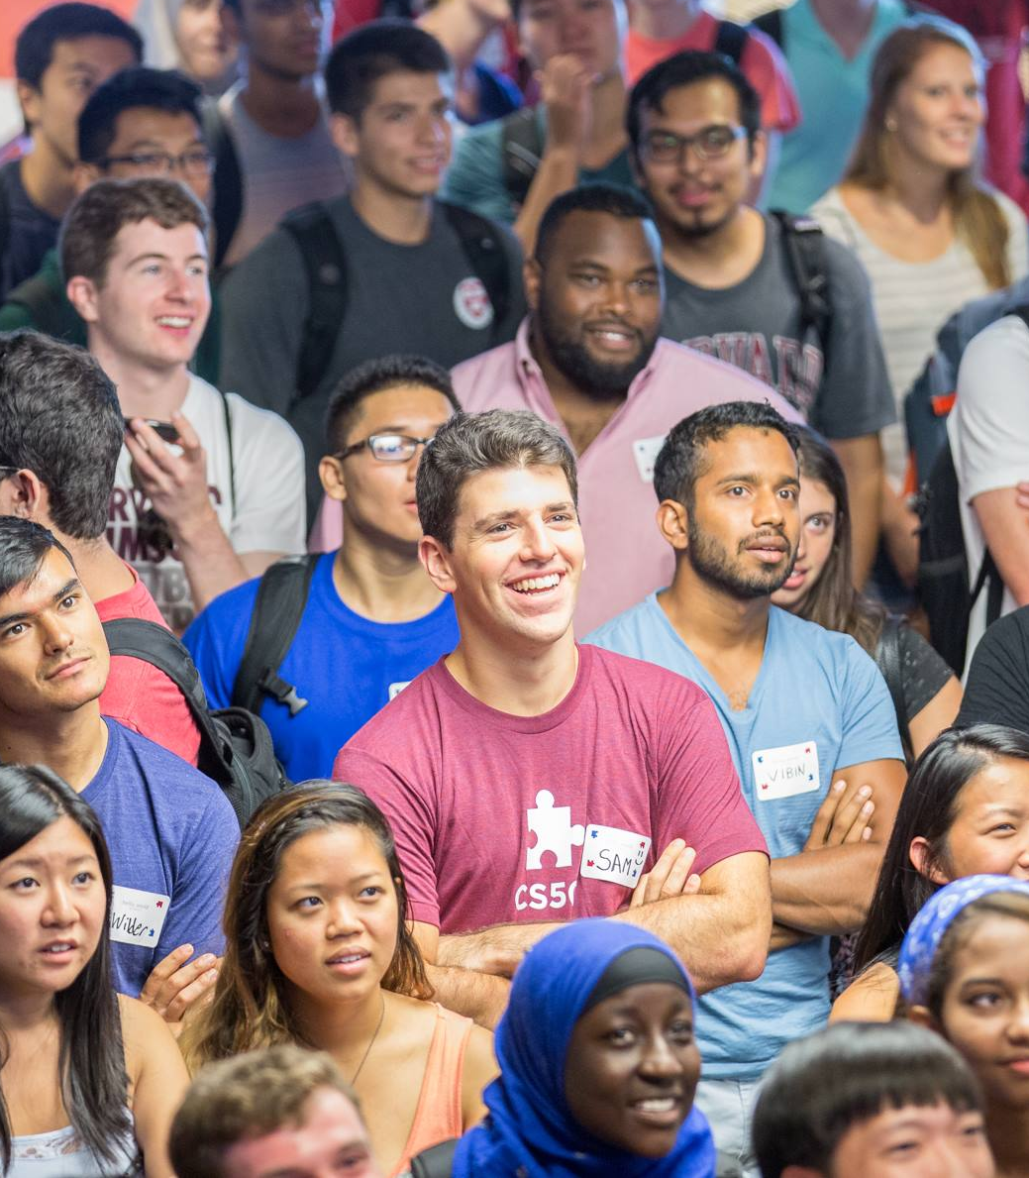
Introduction
Sam Green
Junior (2017)
Cabot House (quad life!)
Computer Science & Statistics joint concentrator.
Returning TF to CS50
Former member of the heavyweight crew team, now enjoying a life of freedom.

Slide 4
Norms & Expectations
From me:
From you:
Support
Availability
High expectations
Clear feedback
Meeting in the middle
Reading the pset spec before section
Reading comments on your problem sets!
Participate ☺
Notes:
Meeting in the middle:
tell me when you’re confused, tell me if you’re having trouble. I’ll do my best to do what I can.
-- make use of all of the available resources: read the specs, watch the videos, use all of the things that are available: and then come to me!

Slide 5
Warmup (1)
Write a program to print “SLG” on 10 times.

Slide 6
Warmup (2)
What is a data type?
What is typecasting?
Convert 01101 to decimal (what’s decimal?)
Any other questions?
Notes:
Answer: 13

Slide 7
Arrays (1)
Structure: <datatype> <name[<size>]
Examples:
char alpha[26]
int score[5]
Notes:
Introduce arrays as a way to store a “block” of data of the same type. Arrays have a certain number of “slots” that the computer gives us depending on how many we ask for. Just like variables, arrays are typed.

Slide 8
Arrays (2)
“Initialize” aka set up in two ways:
int score[2];
score[0] = 0;
score[1] = 1;
or:
int score[] = {1,2,3,4,5};

Slide 9
Arrays (3)
We can “index into” akas access an array using:
int score[] = {1,2,3,4,5};
int num = score[3];

Slide 10
Exercise: Arrays (1)
Write a program that creates an array of strings, and then prints out the array’s members each on its own line.

Slide 11
Exercise: Arrays (2)
a) Write a program that creates an int array of size 10, fills it with the numbers 10-19, and then prints these out.
b) Now change it to a string and print out each character!

Slide 12
Functions
Take Something In
Do Something
Spit out an answer aka “return a value”
Why functions?

Slide 13
Functions (2)
Important things to know:
Return types
Name of functions
Parameter types
Prototypes
Scope
Notes:
Look at scope.c in the IDE.

Slide 14
Exercise: Functions (1)
Write a function that takes in a string “name” from the user and prints out “Hi <name>, this is my first function.”

Slide 15
Exercise: Functions (2)
Write a program with a function

Slide 16
Command-Line Arguments
Command Line Arguments are passed into the main function of the program when it runs.
int main(int argc, string argv[])
What is argv[]?
What is argc?

Slide 17
Exercise: command-line arguments
(1) Write a program that prints out the program’s name.
(2) Write a program that prints out the first character of every command line argument passed to it.

Slide 18
Exercise: Synthesis
Write a program that calls 1 function if the command line argument “one” is passed in, calls another function if the command line argument “two” is passed in, and does nothing otherwise. The functions can do whatever you want!

Slide 19
Review of Today
Arrays
Functions
Command-line Arguments
Questions?

Slide 20
PSet Review
Initials
Caesar
atoi function
Tips: start by writing a program that rotates each letter by one, and then change it to the full cipher.
Vigenere’
Start with your Caesar program and notice the similarities.
Every week has the same hint: tackle the problem sets in small steps!

