Slide 1
CS50 Week 6
Sam Green ’17
samuelgreen@college.harvard.edu
646-457-2340

Slide 2
Agenda: Data Structures
Linked Lists
Hashtables
Stacks
Queues

Slide 3
Linked Lists (1)
List data structure
Supports dynamic changes in length
Gives up random access

Slide 4
Linked List (2)
Example Struct
typedef struct node
{
int i;
struct node* next;
}

Slide 5
Linked List (3)
As an exercise, let’s draw:
Create
Insert
Lookup/Iterate
Delete
for a linked list.

Slide 6
Linked List (4)
Let’s look at some code.

Slide 7
Linked Lists (4)
Key Takeaway: Pointer Hygiene.
If you can draw a clear picture of the linked list you need to work with, coding it will be easy!

Slide 8
Hashtables (1)
Main Idea: More Pointer Hygiene
Chaining vs. Linear Probing
Hash Functions
Notes:
Why Hashtables: remediate the fundamental problem of linked lists – take an O(n) problem and make it into an O(1) problem, or closer to it. Make sense?

Slide 9
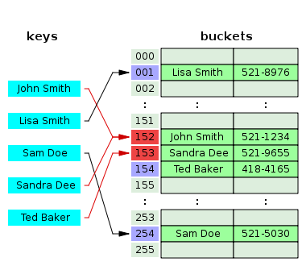
Hash Tables (2)

Slide 10
Hash Function
Think of a hash function as a sorter.
Give it a value.
It gives you back where that value should go.
Let’s think back to the address book analogy.
What makes a hash function good?

Slide 11
Hash Tables
What happens after hashing?
Let’s think back to our address book example.
2 options: separate chaining, or linear probing.

Slide 12
Hash Tables: Takeaway
Separate chaining is a good strategy for this week’s problem set. Once you understand linked lists, you’re already 75% of the way done!
One last thing: what are the run times involved?

Slide 13
Tries
Tries are a second approach, based on trees, to solving this pset. Based on the struct below:
typedef struct t_node
{
bool is_word;
struct t_node* children[27];
} t_node;
What are the tradeoffs?

Slide 14
Stacks & Queues
Questions about them?

