Slide 1
Intro to git
CS51 Code Review 1
Sam Green 2017
samuelgreen@college.harvard.edu

Slide 2
Intro and Norms
About me
Sam Green
Junior, Cabot House (2017)
CS and Statistics concentration
Former rower. Happily retired.
Fun fact: I’ve bicycled across the United States, from SF to DC.
Email me: samuelgreen@college.harvar.d.edu
I’ll be there for you if you’re there for me.
I expect you to come to section prepared with your questions about last week’s problem set and/or lab. I also expect you to have read the next problem set.
In return, you can expect me to show up to section ready to answer your questions.
Code review will (on all days but today) be discussion-based. Your participation is key.

Slide 3
git
/git/: noun - an unpleasant or contemptible person.

Slide 4
What is git?
Version Control System (VCS)
Make and backup checkpoints, revert to old versions, keep a log of your work.
Terse but concise interface
Easy to use, hard to use well (welcome to CS51)

Slide 5
Repositories
git is based on code repositories.
There are local repositories and remote repositories. One power of git comes from linking the two.
BitBucket and GitHub are popular remote repository hosts. GitHub is objectively more popular, but we use BitBucket in this course, so we’ll teach that.

Slide 6
Creating a repo
Create a local repo
Create a remote repo
Link them
Let’s do a demo.
Key command: git clone <remote> [dest]

Slide 7
Change it up
The whole point of git is to make and track changes to your code.
Now that you have a repo, make some changes.
Suggestions: open a text file, type your name, and save it inside your repository.

Slide 8
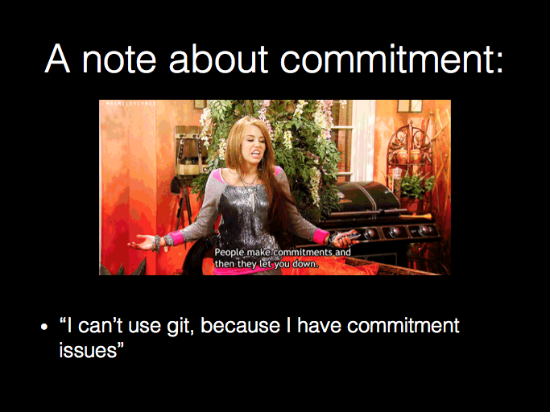

Slide 9
Saving, git style
Snapshots of code in git are called commits.
They mark the current state of your code, assigning a “checkpoint” marker.
git also allows you to associate messages with your commits.
Key command:
git commit [-a] [-m] [message]

Slide 10
Like any good relationship…
Commitment is key.
Commit frequently. This is save, without autosave.
Don’t have commitment issues.
Use commit messages. They will save your life. Be descriptive.
Let’s practice. Commit the changes you made a minute ago.

Slide 11
Tracking
git doesn’t automatically track files in our repository directories.
This is a feature, not a bug. You don’t always want all your files in the repository.
We have to declare files explicitly for tracking.
Key commands:
git add <file[s]>
git add .

Slide 12
git-ing confused?
Because git is a cli, it’s easy to get confused about what’s going on.
git has the answer, though.
Key commands:
git status
git log
git show

Slide 13
Back it up
All changes so far have been local.
We need to send them to the remote repository. Why?
Create a remote version in case of crisis.
Coordinate between collaborators (like your pset partners!)
Key commands:
git push
git pull

Slide 14
“Those are the basics.”
–Sam Green and maybe someone else, but I didn’t check

Slide 15
Advanced git
forking, branching, merging
What? Why?
Let’s draw a quick picture.
Key command:
git merge <source> [dest]

Slide 16
merging
git is filled with conflict and commitment issues.
When you pull in changes, things sometimes get conflicted. The fix: git will identify problems, and you fix them manually, and then commit.
git is smart, but this still happens frequently.

Slide 17
git-ing it done
Exercise:
Find a partner, and ask for their remote repo URL.
Clone their repository.
Make a change. Commit it. Push it to your own remote repository.
On BitBucket, send your partner a pull request.
Approve your partner’s pull request.
Profit.

Slide 18
That’s g(it)
Time for your questions about OCaml. I know they’re there. :)
option types
Pattern matching
Email me for any reason at any time. I’m compulsive.
For section-specific stuff, email me at samuelgreen@college.harvard.edu
For course-wide/admin stuff, please still email me at cs51heads@gmail.com

