Slide 1
Crime Scene
Investigations
With a Forensic Approach
for First Responders
By
Lum Farr

Slide 2
Crime Scene Investigations
Lum Farr
  12 Years as Criminal Investigator with the Union Parish Sheriff’s Department – Union Parish, Louisiana (1981 – 1993)
  Retired Chief of Police – Marion, Louisiana (July 1994)
  Director – Criminal Justice Institute – Weatherford College – (1993-2000)

Slide 3
Crime Scene Investigations
Education:
  Graduate – Marion High School – 1967
  Northeast Louisiana University:
    Associate of Arts Degree – Criminal Justice
    Bachelor of Arts Degree – Criminal Justice
    Master of Arts Degree – Criminal Justice

Slide 4
Crime Scene Investigations
  Professor of Criminal Justice – Weatherford College – Weatherford, Texas
  (1993 – Present)
  Department Chair – Criminal Justice Department – Weatherford, Texas
  (2005 – Present)

Slide 5
Crime Scene Investigator
Publications:
Co-author, “Crime Scene Investigations; Behind the Yellow Tape”
Co-authored with Professor Erin MacKenzie – Professor – Microbiology
Forensics is Fun: Texas Forensics – Texas Association of Forensic Science Educators and Criminalists

Slide 6
Crime Scene Investigations
Co-Founder and developer of the Forensic Science Department – Weatherford College.
This was the first Forensic Science degree program in the state of Texas for a Community College.

Slide 7
Crime Scene Investigations
Professor of Forensic Science
Forensic Science Lab Coordinator
Certified Medicolegal Death Investigator
Recognized by Who’s Who among National Teachers 2004-2005
Licensed by the Texas Commission on Law Enforcement.
Founder, editor of the “Justice Journal” a Law Enforcement Newsletter for the state of Texas.

Slide 8
Crime Scene Investigations
Associations Continued:
  Member: International Association of Identification
  Member: National Association of Neuropsychology.
  Member: National Association of Forensic Science

Slide 9
Crime Scene Investigations
Associations Continued:
Life Member – National Association of Professional Police Investigators
Member – National Associations of Chief’s of Police
Member – Louisiana Association of Chief’s of Police

Slide 10
Crime Scene Investigations
Into. To Physical Evidence
The key, and the greatest importance to any crime scene is the approach and the initial crime scene observation followed by the facts obtained during the crime scene analysis.

Slide 11
Crime Scene Investigation and Reconstruction
Reconstruction of the crime scene is one of the MAJOR purposes for the collection of physical evidence.
  This may be a single event or
  May involve the determination of the sequence of a series of events such as interpretation of bloodstain patterns at a crime scene.

Slide 12
Crime Scene Investigation and Reconstruction
Reconstruction of a crime scene frequently allows the investigator to determine the accuracy of statements from witnesses, a suspect, or victim.
The statements can be shown to be true or false as related to the crime scene facts.

Slide 13
Crime Scene Investigation and Reconstruction
EVIDENCE:
  Direct Evidence
  Circumstantial Evidence
  Testimonial Evidence
  Physical Evidence

Slide 14
Crime Scene Investigation and Reconstruction
Direct Evidence:
  Evidence that proves a fact without the necessity of an inference or a presumption, that, when true, conclusively establishes that fact.
Example:
  Testimony by a completely credible witness that proves the fact stated in the testimony.

Slide 15
Crime Scene Investigation and Reconstruction
Circumstantial Evidence:
  Evidence that involves a series of facts that, although not the fact at issue, tends, through inference, to prove a fact at issue.
  Usually a chain of circumstances from which a fair assumption can be made as to the validity of the fact at issue.

Slide 16
Crime Scene Investigation and Reconstruction
Testimonial Evidence:
  Evidence given by lay or expert witnesses.
  The principle test for this type of evidence is the credibility of the witness.

Slide 17
Crime Scene Investigation and Reconstruction
  The trier of fact (judge or jury) in a court proceeding determines the credibility of the witness and thus the believability of the testimony given by the witness.
  Not credible – testimony is often overlooked/ignored by the trier of fact.

Slide 18
Crime Scene Investigation and Reconstruction
Physical Evidence:
  Evidence that consists of physical objects that are linked to the commission of a crime or tort.
  Virtually any type of physical object can become physical evidence in a criminal investigation.

Slide 19
Crime Scene Investigation and Reconstruction
Value of physical evidence:
  Can be defined as physical objects associated with a crime or a tort.
  It is critical that the physical evidence be recognized as potential evidence, collected in an appropriate manner, and preserved properly for transmittal to the laboratory

Slide 20
Crime Scene Investigation and Reconstruction
Failure to recognize, collect, or preserve the physical evidence may compromise or destroy the evidence, thereby impeding the investigation.
Worse case scenario:
  An erroneous conviction of an innocent person.
  Or the inability to convict a guilty person.

Slide 21
Crime Scene Investigation and Reconstruction
The Primary Roles of Physical Evidence in the investigation of crimes include:
A. Reconstruction of the crime scene:
  The major purpose for the collection of physical evidence.
  Allows the investigator to determine the accuracy of statements from witnesses.

Slide 22
Crime Scene Investigation and Reconstruction
B. Determine whether or not a crime occurred:
  The physical evidence at the crime scene may help to determine whether or not a crime occurred.

Slide 23
Crime Scene Investigation and Reconstruction
C. Link an Individual with another Individual or with a Crime Scene:
  These types of evidence are commonly referred to as “linkage” or “associative” or “transfer” evidence.

Slide 24
Crime Scene Investigation and Reconstruction
  This type evidence tends to show a contact between individuals that resulted in a transfer of evidence between the individuals involved or a transfer of materials from an individual to a crime scene or vice versa:
  “Linkage Triangle”
      Hairs
      Fibers
      Bloodstains

Slide 25
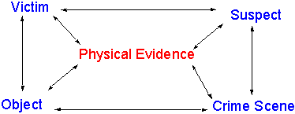
Crime Scene Investigation and Reconstruction
Linkage Triangle:

Slide 26
Crime Scene Investigation and Reconstruction
“Locard Exchange Principle”
  Contact between individuals results in an exchange of materials between the two individuals.
  Any type of evidence left at a crime scene or any evidence taken from the crime scene can link a suspect to the victim or crime scene.

Slide 27
Crime Scene Investigation and Reconstruction
D. Provide Investigative Leads to Investigators:
  An important function of the crime scene investigation is to provide investigative leads to the detectives and other investigators charged with the responsibility of investigating the crime.
      Hair (color or racial group)

Slide 28
Crime Scene Investigation and Reconstruction
E. Provide facts to a jury that may assist
in the Determination of the Guilt or Innocence of an Accused Person:
  Frequently in homicide and sexual assault cases, the analysis of physical evidence provides evidence of the guilty or innocence of an accused person.
      Hair – Semen – Latent Fingerprints
      Can exonerate the innocent and convict the accused.

Slide 29
Crime Scene Investigation and Reconstruction
F. Provide evidence to link Serial Homicide or Rape Cases:
  In serial homicide or serial rape investigations the physical evidence is often the strongest link between the series of crimes and the perpetrator.
    In serial rape cases, both trace evidence and semen typing (particularly DNA typing) may link the perpetrator to each of the crimes.

Slide 30
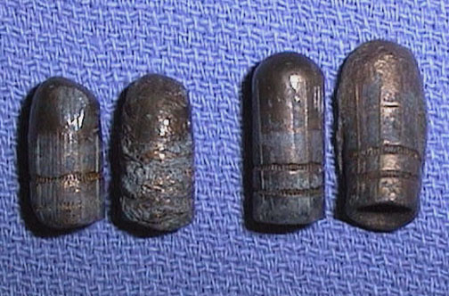
Crime Scene Investigation and Reconstruction
Some Advantages of Physical Evidence:
  Physical evidence over Testimonial Evidence:
  1) Physical evidence provides a tangible object for the jury to see.

Slide 31
Crime Scene Investigation and Reconstruction
  2) The physical evidence can be taken into the jury room.
  3) The defendant cannot distort the physical evidence.
  4) Some cases cannot be solved without the physical evidence.
  5) Physical evidence is not subject to memory loss.
  6) The defendant can have the evidence tested by an independent expert of the defendant’s choosing.

Slide 32
Crime Scene Investigation and Reconstruction
Major Categories of Physical Evidence:
  Physical Nature:
    (blood, latent prints, firearms evidence)
  Types of Examinations
    (microscopic, macroscopic, or instrumental)
  Branch of Examiners
    (forensic chemist, document examiners, firearms examiner)

Slide 33
Crime Scene Investigation and Reconstruction
The majority of jurisdictions classify physical evidence according to:
  Fingerprints (friction ridge evidence)
  Firearms (firearms, discharge residue, fired components)
  Biological (blood, semen, other types)
  Trace (microscopic, transfer)
  Document (questioned handwriting, typewriting, papers, inks, etc)

Slide 34
Crime Scene Investigation and Reconstruction
  Physical matching (matching of items that have been broken apart)
  Toxicology (drugs, poisons in body fluids and tissues)
  Drug evidence
  Other types (various evidence types not included in the preceding listing)

Slide 35
Crime Scene Investigation and Reconstruction
It is not unusual for an investigator to investigate many different types of evidence in order to investigate a major criminal case:
  Witness testimony
  Criminal profiling
  Victimology
  Physical evidence
  Suspect interrogation
  Polygraph testing, etc.

Slide 36
“Class and “Individual” Characteristics of Physical Evidence
The concept of “class” and “individual” characteristics must be understood by the crime scene investigator in order to interpret reports from the crime laboratory.
“Class Characteristics”
  Shared by all members of a class.

Slide 37
“Class and “Individual” Characteristics of Physical Evidence
Class characteristics cannot be identified to a single source.
  Example:
  Fibers from a garment would have only “class characteristics” since the fibers used to produce the garment are produced in very large quantities.

Slide 38
“Class and “Individual” Characteristics of Physical Evidence
Class evidence is best used to conclusively eliminate a suspect source.
Example:
  (Reddish blond hair could not have come from a specific Asian individual having only black hair).

Slide 39
Individual Characteristics
Identity is defined as:
  “The collective aspect of the set of characteristics [emphasis added] by which a thing is definitively recognizable or known.”
  Includes all class characteristics (patterns) of an item plus those individual characteristics that serve to set the object apart from all other objects in its class.

Slide 40
Individual Characteristics
Thus:
  The pattern of class and individual characteristics establishes the individuality of a specific object.
  Individualization: When an object has class and individual characteristics unique to only one member of a class.

Slide 41

Individual Characteristics
Process of Individualization:
  Being able to match class and individual characteristics of the unknown found at a crime scene to:
  A known piece of evidence recovered from the suspect.

Slide 42
Individual Characteristics
Transfer of Individualization:
  Sometimes the set of class and individual characteristics of an object are transferred to an evidence item.
  Example:
  Class and individual characteristics of a firearm’s barrel interior are transferred to the bullet as it travels down the barrel.

Slide 43
Individual Characteristics
Latent Fingerprints:
  An example of a physical evidence type that can be individualized.
  The minutia of each print is class evidence.
  The combination of the occurrence and the spatial relationship of the minutiae are considered to establish a unique pattern for a given area of friction ridge skin. This allows for the individualization of the latent print.

Slide 44
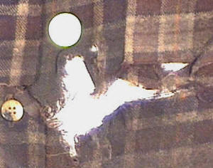
Individual Characteristics
Another type of evidence with individual characteristics consist of “physical matching” evidence.
Involves an object that is torn or broken apart. “Jigsaw puzzle” style to illustrate the matching of the fractured or torn edges.

Slide 45
Individual Characteristics
Examples of Physical Evidence Matching:
  Paint
  Glass fragments
  Adhesive tapes
  Broken pry bars

Slide 46
Individual Characteristics
Some types of Class Evidence can be individualized through other means:
  Hair that has been pulled from a scalp may have the fleshy portion analyzed for DNA typing.
  If there is no fleshy tissue adhering to the root, the hair may still be analyzed for Mitochondrial DNA.

Slide 47
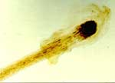
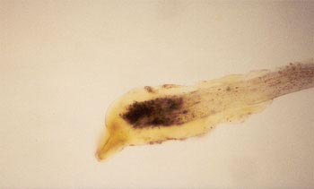
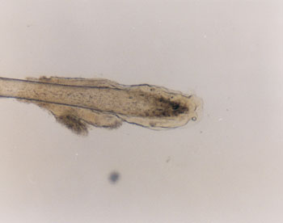
Individual Characteristics
Hair Analysis with fatty tissue
  Hair Follicle or Hair Tissue

Slide 48
Laboratory Analysis of Physical Evidence
The usual purpose of the laboratory analysis is to individualize the physical evidence.
This process usually involves the comparison of the questioned item to a known item.

Slide 49
Results of the Comparison Process
The laboratory comparison may reveal one of the following observations:
The questioned item “matches” the exemplar.
The questioned item has some similarities to the exemplar.
The questioned item has no similarity to the exemplar.

Slide 50
Results of the comparison process
When a “match” is determined, this means the examiner is indicating that all the “class characteristics” of both the known and questioned items are the same;
AND

Slide 51
Results of the comparison process
The similarities in the “individual characteristics” outweigh any dissimilarities noted.
There is no such thing as a perfect match.

Slide 52
Comparison Standards and Controls
The quality of the questioned item with the known item depends on the quality of the collection and submission of the proper standards and controls for each item submitted.
The term questioned item refers to an item with an unknown source.

Slide 53
Legal Requirements
Search and Seizure Laws:
  First Rule: All search and seizure of physical evidence must meet all the legal requirements for the seizure of the evidence.
  In some cases a search warrant is needed.
  Be absolutely certain of the legality of any search at a crime scene prior to searching.

Slide 54
Documentation of the Crime Scene
Second Legal Requirement:
  Provide proper documentation of the crime scene and the collection of evidence.
  Involves:
    Adequate Notes
    Photographs
    Sketches

Slide 55
Documentation of the Crime Scene
Documentation must be able to re-create the crime scene in the mind’s eye of investigators, attorneys and the judge and jury in any judicial proceeding.
Documentation is an ongoing process throughout the investigative process.

Slide 56
Identification of Physical Evidence Collected
Third Legal Requirement:
  Each item collected at the crime scene must be properly identified with sufficient information to ensure that the item can be identified by the collector at any time in the future.

Slide 57
Identification of Physical Evidence Collected
Standard Identification Data:
  Case number for investigator’s agency
  Date/Time of collection
  Item number (in order of collection and documentation)
  Initials of collector (or personalized logo)
    Print the collector’s last name – do not use initials or logo except in extreme cases.

Slide 58
Chain of Possession
(Chain of Custody)
Fourth Legal Requirement:
  The introduction of physical evidence in the courtroom.
  The item must be identified as the same item collected at the scene.
  The item must not have been altered in any significant fashion.
  “Chain of evidence” must be intact.

Slide 59
Scientific Requirements
As important, today, as the legal requirements.
Preventing Contamination of the Evidence
  Proper protection of the evidence at the crime scene.
  Limit access to only those individuals of the investigative team with a legitimate need to enter the scene.

Slide 60
Scientific Requirements
Preserving the Condition of the Evidence as Found:
  Use proper collection and packaging techniques.
  Ensure evidence is properly stored until transmittal to the lab.
  Refrigerated items must be clearly marked to indicate the type of storage required.

Slide 61
Scientific Requirements
Collection of Adequate Comparison Standards:
  The comparison standards collected should be adequate and appropriate for the anticipated laboratory examinations.
  The lab exam depends heavily on the quality of the comparison standards collected by the investigator.

