Slide 1
Biological Fluid Stain Evidence: Blood and Semen
Lum Farr
Department Chair – Criminal Justice
Weatherford College Professor
Forensic Science & Criminal Justice
Author
Forensic Investigation: behind the yellow tape
Co-Founder and President
AMERICAN CRIME SCHOOL

Slide 2
Biological Fluid Stain Evidence: Blood and Semen
Biological Material must be considered hazardous!!!
Always follow Universal Precautions for handling stains.

Slide 3
Blood and Semen Evidence
Precautions used to collect biological evidence:
  Wear latex gloves, surgical masks, and full coverage gowns.
  Eye-coverings are needed for collecting liquid samples.
  Keep hand out of areas that are hidden.
  Label all blood samples

Slide 4
Blood and Semen Evidence
  Package dry samples in bags, as well as stained clothing.
  Add a note of precaution if biohazards like AIDS or hepatitis are suspected.
  Decontaminate all non-disposable items.
  Destroy tags, forms, or reports splashed with blood.
  Clean up hands with diluted bleach, and dispose of contaminated clothing.

Slide 5
Biological Fluid Stain Evidence: Blood and Semen
The term Universal Precautions means:
One must assume that any biological material is contaminated with biological pathogens such as HIV, Hepatitis B, or others.
  Always use protective clothing, eyewear, respirator masks, latex gloves, etc.

Slide 6
Nature of Blood Evidence
Blood may be encountered as physical evidence in:
  Homicides
  Sexual Assault
  Vehicular hit-and-run
  Burglary
  Other crimes

Slide 7
Bloodstain Characteristics
Traditional steps to follow in trying to describe various tests conducted:
  Is the sample blood?
  Is the sample animal blood?
  If animal blood, from what species?
  If human blood, what type?
  Can the sex, age, and race be determined?

Slide 8
Preliminary Considerations
It is essential to document, collect, and preserve blood evidence.
Improperly collected and preserved blood evidence can weaken or destroy a potential source of facts in a case.

Slide 9
Preliminary Considerations
Properly collected and preserved blood evidence can establish a strong link between an individual and a criminal act.
Blood evidence or the lack of blood evidence can bolster or contradict a witness statement or any statements the suspect may have made.

Slide 10
Preliminary Considerations
Blood evidence can point the investigator in the right direction for investigative purposes
If the evidence is collected and stored suitably, it can be presented to a judge or jury several years from the time of the criminal act.

Slide 11
Preliminary Considerations
Perhaps the most powerful application of blood evidence is the ability to absolutely eliminate a person as a potential suspect in a crime.

Slide 12
Preliminary Considerations
Communication is the key to effectively processing blood evidence.
Clear and open communication must exist between a crime scene’s first responding officer, the case detective, the crime scene investigator, the forensic scientist analyzing the evidence and the assistant district attorney handling the case.

Slide 13
Preliminary Considerations
A crime scene investigator should know the crime lab’s capabilities, the methods of blood collection and preservation preferred by the crime lab, the investigative information relevant to the forensic scientist, and the type of reference samples required by the crime lab.

Slide 14
Preliminary Considerations
This information can and will change periodically as technology changes, lab policies change, lab personnel change, or lab administrations change.
The preference of forensic scientists also very from lab to lab.

Slide 15
Preliminary Considerations
In the early 1970’s most crime labs relied upon the ABO blood grouping system to characterize bloodstains.
This meant that the blood could have come from 4 to 49% of the population.

Slide 16
Preliminary Considerations
In the 1990’s, most crime labs starting relying on DNA analysis to characterize bloodstains.
A blood source can now be statistically narrowed down to one person out of several million or even several billion.

Slide 17
Preliminary Considerations
A crime scene investigator should know which method or methods of bloodstain analysis are available from his or her crime lab, the FBI lab, and private labs in the community.

Slide 18
Preliminary Considerations
Currently bloodstain analysis falls into three broad categories:
1) Conventional Serological Analysis:
  Analysis of the proteins, enzymes, and antigens present in the blood.

Slide 19
Preliminary Considerations
  These substances are more susceptible to degradation than DNA and this type of testing usually requires a “large” (quarter size) sample in good condition for optimal results.
  This type of testing is rarely statistically individualizing.

Slide 20
Preliminary Considerations
2) Restriction Fragment Length Polymorphism (RFLP) DNA Analysis
  Direct analysis of certain DNA sequences present in the white blood cells.
  DNA is much less susceptible to degradation than proteins, enzymes, and antigens.

Slide 21
Preliminary Considerations
  RFLP DNA testing is commonly statistically individualizing (one out of several million or billion) and it has withstood rigorous court challenges on its validity.
  This method also usually requires a “large” sample size to obtain significant results.

Slide 22
Preliminary Considerations
3) Polymerase Chain Reaction (PCR) DNA Analysis:
  Analysis of certain DNA sequences that have been copied multiple times to a detectable level.
  PCR based testing works well on degraded samples and “small” samples (pinhead size).

Slide 23
Preliminary Considerations
  Currently, it is not as statistically individualizing as RFLP analysis.
  PCR based technologies have also withstood rigorous court challenges on its validity.
  Recently there has been some concerns over the possibility of incidental contamination giving false results.

Slide 24
Preliminary Considerations
  Following PCR protocols should help eliminate contamination thereby, eliminating false results.
  The only way that false results were reduced during studies, was by direct cross contamination of wet samples.

Slide 25
Preliminary Considerations
Presently, the courts do not recognize blood evidence as evidence that can be absolutely linked to an individual, such as fingerprints, bite marks, broken fingernails, and handwriting.
If DNA analysis is utilized, then blood evidence falls into the category of evidence that can be linked to an individual with a very high degree of probability.

Slide 26
Preliminary Considerations
RFLP DNA Analysis has been given the misnomer “DNA Fingerprinting.”
The courts have since ruled that a DNA results can only be given in statistical terms.

Slide 27
Preliminary Considerations
A Forensic Scientist cannot testify that a bloodstain came from a specific individual.
  He/she can testify that based on population studies, only one person in several million or billion has a particular DNA profile.
  He/she can then testify if the suspect or a victim has that DNA profile.

Slide 28
Preliminary Considerations
Before a crime scene investigator begins documenting and collecting blood evidence, he/she must recognize the value of blood evidence and how it fits in the overall events associated with the crime.

Slide 29
Preliminary Considerations
The most common applications of blood evidence are:
  Finding blood with the victim’s genetic markers (ABO blood type, DNA profile, etc) on the suspect, on something in the suspect’s possession, or something associated with the suspect (such as the suspect’s fingerprints).

Slide 30
Preliminary Considerations
  Finding blood with the suspect’s genetic markers on the victim, on something in the victim’s possession, or something associated with the victim.

Slide 31
Preliminary Considerations
Occasionally, investigator’s blindly collect blood samples from a scene without any thought about the facts they are trying to establish or the tests that will be forthcoming with the blood evidence.
The CSI must make an effort to collect the evidence that is going to provide the most useful information in establishing the facts about a crime scene.

Slide 32
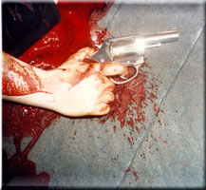
Bloodspatter

Slide 33
Preliminary Considerations
The CSI should concentrate on collecting samples of “peripheral” bloodstains.
  Blood away from the body and the main area of action.
  Blood spatter patterns that differ from the majority of the blood spatter patterns.
  Blood trails leading away from the scene.

Slide 34
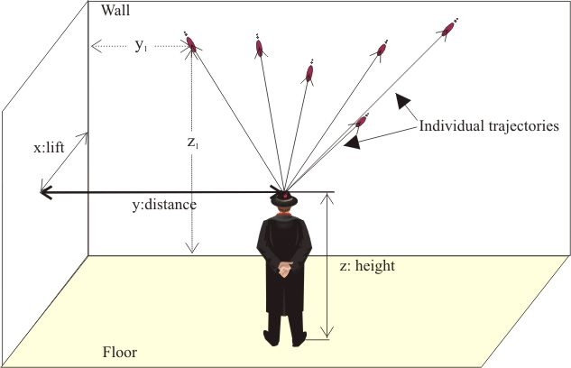
Peripheral Bloodstains Away from Body

Slide 35
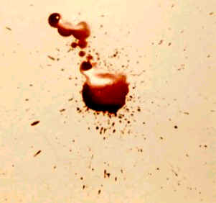
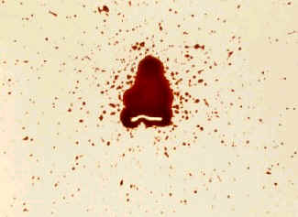
Bloodspatter patterns that look different at the crime scene

Slide 36
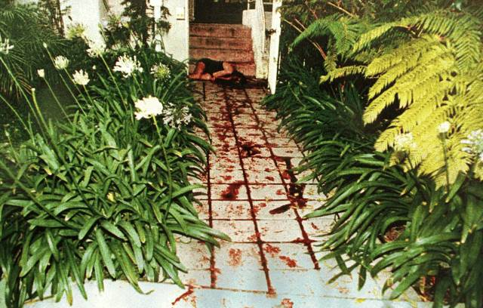
Blood Trails Away From Body

Slide 37
Preliminary Considerations
Because blood analysis is a comparison analysis, reference blood samples are needed from the victim and suspect.
A comparison must be made between the genetic markers in the victim’s blood and the suspect’s blood.
The blood samples from the crime scene can then be analyzed for genetic markers that are different in the suspect and victim.

Slide 38
Preliminary Considerations
Suitable reference samples must be collected from all involved and sent to the crime lab.
An unsuitable reference sample is bloody clothing or some other bloody item.

Slide 39
Preliminary Considerations
These are unsuitable because of the questionable histories of the stains and there may be factors present on the items that will give misleading results.
Samples must be collected in suitable “Vacutainers.”

Slide 40
Preliminary Considerations
Vacutainer usage:
Yellow Top V.
  Useful for conventional serological testing and DNA testing. (personal preference)
  Purple Top V.
  Useful for DNA testing; may inhibit certain conventional serological tests.

Slide 41
Preliminary Considerations
  Red Top V.
  Useful for conventional serological tests:
  Less useful for DNA testing:
  Can be used for pregnancy and HIV testing:
  Gray Top V.
  Useful for toxicological testing;
  Not suitable for conventional serological analysis
  May not be suitable for DNA analysis

Slide 42





Slide 43
Preliminary Considerations
If collecting blood from an Autopsy, collect one of each type of Vacutainer.
  Should be stored in a refrigerator (not frozen) at about four degrees Centigrade until transported to the crime lab.

Slide 44
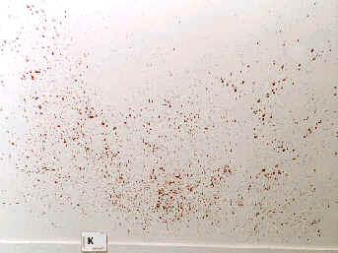
Bloodspatter Patterns
Projected Blood

Slide 45
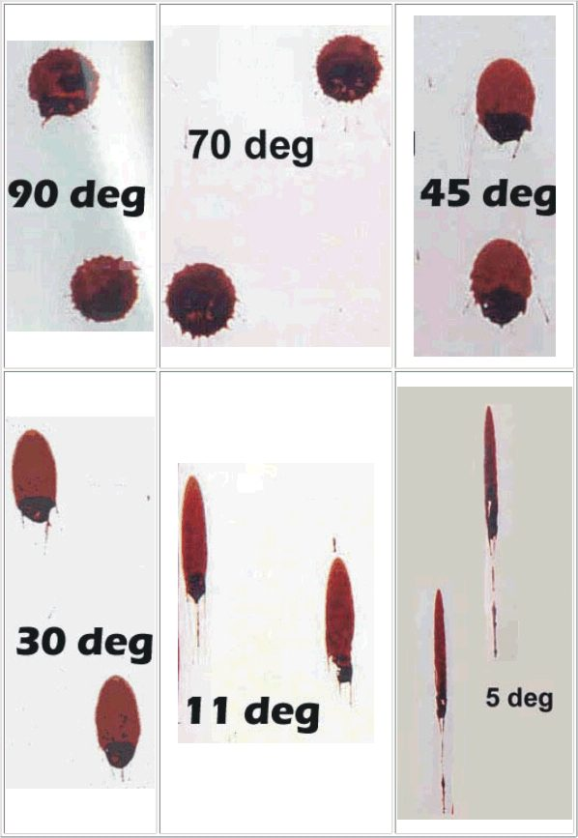
Bloodspatter Patterns Blood droplets from different angles

Slide 46
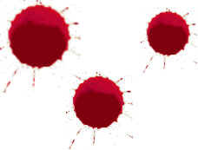
Passive Blood Droplets

Slide 47
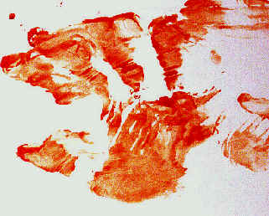
Transfer Blood Pattern

Slide 48
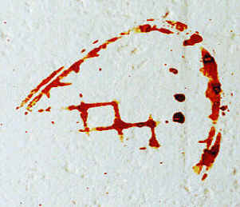
Transfer Bloodstains

Slide 49
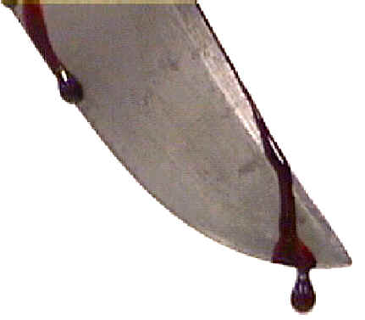

Passive Bloodstain from a Weapon

Slide 50
Dripped Blood

Slide 51
Spilled Blood

Slide 52
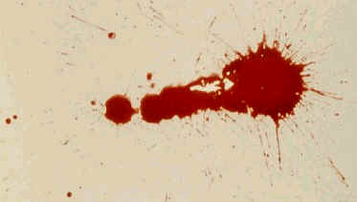
Projected Blood through a Syringe

Slide 53
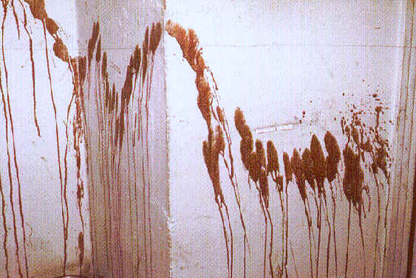
Arterial Spurt/Gush

Slide 54
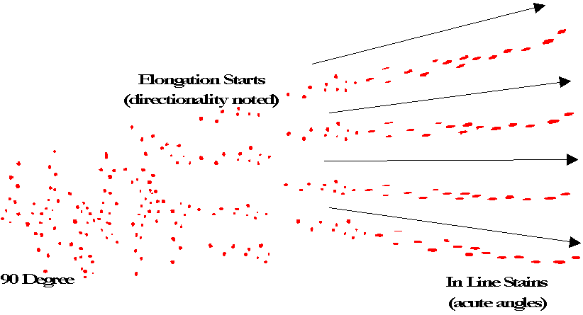
Cast-Off Stains

Slide 55
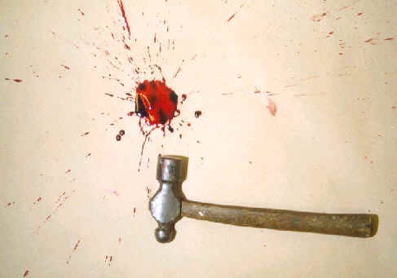
Impact Spatter – Low Velocity

Slide 56
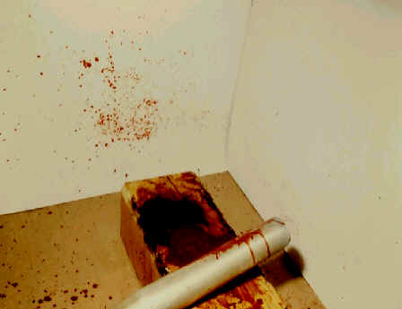
Medium Velocity

Slide 57
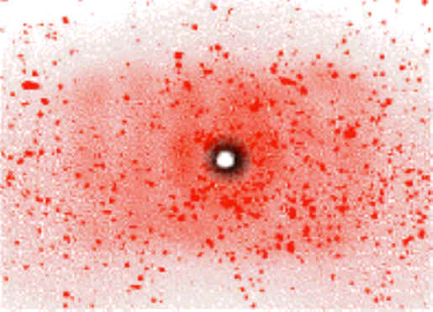
High Velocity

Slide 58
Blood Evidence Problems:
Communication between CSI and FS
Unfamiliarity with the types of bloodstain analysis
Lack of knowledge about which stains will yield the most useful information.
Poor reference samples.
Indiscriminately using Luminol at CS.

Slide 59
Nature of Blood Evidence
The identity and typing of bloodstains can
  Assist in establishing elements of the crime
  Can identify or eliminate a suspect
  Can be used to corroborate or dispute the statements of principals when the bloodstains play a part in a reconstruction of the crime.
  The proper collection is essential to the quantity and the quality of information from the stains

Slide 60
Nature of Blood Evidence
Bloodstain evidence has two primary categories of examination importance to the crime scene investigator:
  A. Bloodstain pattern interpretation
  B. Genetic Marker Typing

Slide 61
Blood Pattern Interpretation
Often overlooked by both the investigator and the laboratory personnel.
In many cases the blood pattern interpretation is more significant than the typing of the stains.

Slide 63
Blood Pattern Interpretation
May establish whether or not a crime occurred (murder vs. suicide or accident)
May dispute or corroborate witnesses’ statements.
Can determined from whom the bloodstain pattern emanated. (genetic marker typing)

Slide 64
Blood Pattern Interpretation
Proper documentation of the location and patterns of the bloodstains should always be a primary consideration of the crime scene investigator at a crime scene.
Collection should NOT be attempted until the patterns have been recorded.

Slide 65
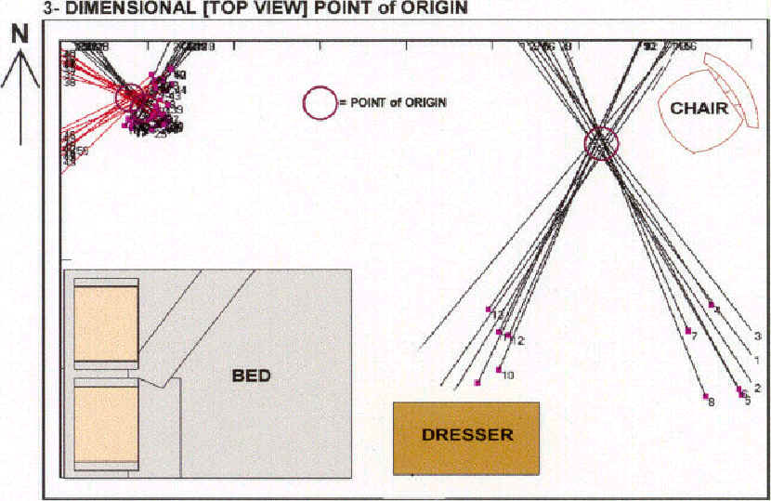

Slide 66
Blood Pattern Interpretation
All bloodstains should be recorded:
  In the Investigators Notes
  There should be crime scene sketches
  There should be photographs
  This will prevent a later attempt to interpret the pattern without proper documentation.

Slide 67
Blood Pattern Interpretation
The location, size, and appearance of the patterns must be carefully measured, sketched, and photographed with measuring scales in the photographs.

Slide 68
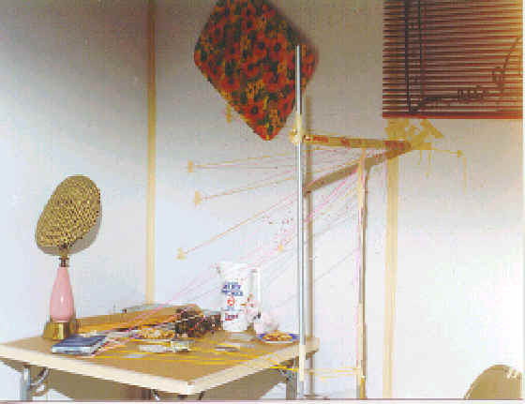

Slide 69
Blood Pattern Interpretation
Videotaping blood evidence can show the overall blood spatter patterns and how these spatters are inter related.
Videotaping can show the relationship of the spatters to the various structures at the crime scene.

Slide 70
Blood Pattern Interpretation
Videotaping can be used to document any blood trails leading away from the scene.
Indoors videotaping can show how the various areas are laid out in relation to each other and how they can be accessed.
  Valuable when recording peripheral bloodstains

Slide 71
Blood Pattern Interpretation
It is absolutely essential that still photos be taken.
When available use, color prints/slides and black & white film.
Infrared film can also be used for documenting bloodstains on dark surfaces.

Slide 72
Blood Pattern Interpretation
A good technique for recording large areas of blood spatter on a wall:
  Measure and record the heights of some of the individual blood spatters.
  Photograph the overall blood spatter with slide film using a yard stick as a measuring device.
  Can be projected onto a blank wall or the original wall later after cleanup.

Slide 73
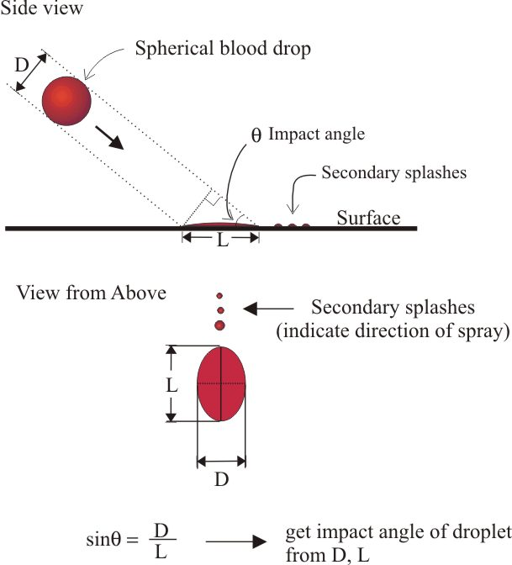
Impact Angle of Blood Droplet

Slide 74
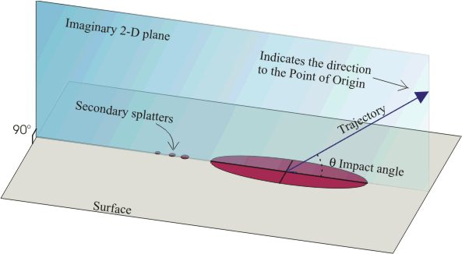
Impact Angle of Blood Droplet 2-dimensional plane

Slide 75
Blood Pattern Interpretation
Always draw a CS sketch.
  Photos are 2-dimensional
  The CS is 3-dimensional
  Photos can distort spatial relationships
  Computer programs are now available for sketching.

Slide 76
Blood Pattern Interpretation
Chain-of-Custody form.
  It is a written record of all evidence transfers from the CS to possession of the court or the clerk of court.
  The Chain-of-Custody thoroughly documents the movement of evidence, the security of evidence, who had possession of the evidence, and when the evidence was in a person’s possession.

Slide 77
Luminol Testing
Luminol is a visualization enhancing chemical.
  When applied to bloodstains, even very diluted bloodstains, will cause the bloodstains to glow in the dark.
  Drawbacks – should be a last resort for the CSI

Slide 78
Luminol Testing
The Problems with Luminol:
  One of the empirical tests for determining if a stain is blood is its appearance.
  If it is a bloodstain, it should look like blood.
  Blood should be present in sufficient quantity to perform confirmatory testing and genetic markers.

Slide 79
Luminol Testing
Luminol is, at best, a presumptive test for blood.
If the stain is so dilute that it can only be visualized with luminol, then no further analysis can be performed to confirm the presence of blood.

Slide 80
Luminol Testing
Luminol will give false reactions.
  Can react with copper ions, copper compounds, iron compounds, and cobalt ions.
  It will react with potassium permangante (found in some dyes) and hydrated sodium hypochlorite (bleach).
  Ferricyanide and plant peroxidases could also give false reactions.

Slide 81
Luminol Testing
Studies have shown that luminol will cause the loss of several genetic markers.
  Because luminol is water based, it could cause, latent, possibly bloody impression to smear.
  Luminol could also further dilute an already diluted stain. This may push the stain beyond the gentic marker analysis detection limits.

Slide 82
Luminol Testing
Unfortunately some crime scenes use Luminol as their first choice for detecting blood.
  This could cause loss of valuable information from a bloodstain.
  First choice should be high intensity light.

Slide 83
Luminol Testing
Bloodstains are not easy to eradicate.
Diluted blood will often leave a brownish stain when cleanup is attempted.
Has a tendency to flow into floorboards cracks, carpet padding, behind baseboards, etc.
These can usually be found using a high intensity light.

Slide 84
Luminol Testing
Because Luminol is so sensitive to bloodstains, it is occasionally used to enhance bloody impressions (shoeprint, fingerprint, etc).
Not the best method however, because it is water-based.

Slide 85
Collection and Preservation of Blood Evidence
Most items of blood evidence will be collected in clean, unused paper containers such as packets, envelopes, and bags.
  Can use plastic containers for up to 2-hours.
    I do not recommend any plastic containers.

Slide 86
Collection and Preservation of Blood Evidence
Key note:
  Do not allow any evidence, especially blood evidence to become contaminated with other evidence at the crime scene or during transportation to the crime lab.
  Remove blood evidence from the CS immediately and if wet allow to air dry at room temperature.

Slide 87
Collection and Preservation of Blood Evidence
UNDER NO CIRCUMSTANCES SHOULD EVIDENCE CONTAINING MOISTURE BE SEALED IN PLASTIC OR PAPER CONTAINERS FOR MORE THAN TWO HOURS.
  Moisture allows the growth of microorganism that can destroy or alter evidence.

Slide 88
Collection and Preservation of Blood Evidence
Any evidence that can cross contaminate each other must be packaged separately.
Containers should be closed and secured to prevent the mixture of evidence during transportation.

Slide 89
Collection and Preservation of Blood Evidence
Each container should have the collecting person’s initials, the date and time it was collected, a complete description of the evidence and where it was found, and the investigating agency’s name and file number/case number.

Slide 90
Collection and Preservation of Blood Evidence
Before transporting, examine the items to determine if there is any loose trace evidence (hairs, fibers, paint chips, etc) that may be lost in transportation.
Collect this evidence in a paper packet and place in an envelope.
  Give description that matches the original evidence where collected.

Slide 91
Collection and Preservation of Blood Evidence
Blood evidence must never be exposed to heat or humidity.
If possible, always refrigerate until it can be transported.
Take blood evidence to the lab as soon as possible.

Slide 92
Collecting Dried Bloodstains
If small and transportable, package it.
  Advantage
    Minimal interaction with stain by investigator.
    Allows serologist to make the decisions involved in collecting the samples
    Dilution and contamination potential minimized by eliminating water as the collection medium.
  Disadvantage:
    Bulky items require more storage space.

Slide 93
Collecting Dried Bloodstains
Large Items with stains:
  Cut out a portion of the item with the stain.
  Cut out sample portion away from stain.
  Advantage: Dilution and contamination minimized.
  Disadvantage: Must decide which stains and controls to collect.

Slide 94
Collecting Dried Bloodstains
Tape Lifting Bloodstain:
  Advantage
    Dilution and contamination potential minimized.
    Negative control is readily collected.
    Requires little storage space
    Easy to perform
  Disadvantage
    Must decide which stains to collect.

Slide 95
Collecting Dried Bloodstains
Scraping bloodstains into a paper packet:
  Advantage
    Dilution and contamination potential minimized.
  Disadvantage
    Must decide which stains to collect
    Stains tend to break into small, hard to handle flakes
    Flakes tend to get lost easily.
    Some surfaces are not easily scraped.

Slide 96
Collecting Dried Bloodstains
Absorbing stains onto moist ½” long threads
  Advantage
    Stains are concentrated onto a small areas.
    Requires little storage space
  Disadvantage
    Dilution and contamination problem increases.
    Must decide which stain to collect.
    70% ethanol is best to use as a dilution.

Slide 97
Collecting Dried Bloodstains
Absorbing onto moist ½ X ½ Cotton Square
  Advantage
    Stain on small area.
    Easier to handle than treads
    Requires little storage space
  Disadvantage
    Dilution and contamination potential increased.

Slide 98
Wet Bloodstains
If the item is small:
  Package in paper bag.
  Bring to a secured location
  Take it out of bag and allow to air dry.
  Repackage in original bag.
  May then place in additional dry bag.

Slide 99
Wet Bloodstains
  Advantage:
    Requires minimal amount of interaction with stain.
  Disadvantage
  More work for serologist
  Bulky items take more storage room.

Slide 100
Wet Bloodstains
Large Items:
  Advantage
    Requires little storage.
    Fairly easy technique to perform
    Stain concentrated onto small surface area.
  Disadvantage
    Must decide which stains and controls to collect
    Must have direct interaction with bloodstain

Slide 101
Bloodstains
Wet blood has more value than dried blood because more tests can be run.
  Blood begins to dry after 3 – 5 minutes of exposure to air.
  As it dries, it changes color towards Brown or black.
  Blood at a crime scene can be in the form of pools, drops, smears, or crusts.

Slide 102
Bloodstains
  Pools of blood have more evidentiary value.
  Drops of blood tell the height and angle from which the blood fell.
  Blood that falls perpendicular to the floor from a distance of 0 – 2 feet would make a circular drop with slightly frayed edges.
  Drops from a higher distance would have more pronounced tendrils fraying off the edges (sunburst pattern).

Slide 104
Bloodstains
  A blood smear on the wall or floor tells the direction of force of the blow.
  The direction of force is always in the direction towards the tail, or small end, of the smear, or splatter.
  In other words, the largest area of the smear is the point of origin. (wave cast-off pattern).
  Blood crusts need to be tested with crystalline methods to make sure it’s blood.

Slide 106
Bloodstains
Refrigerated red blood cells have a shelf life of about 42 days.
The serum containing white blood cells can be refrigerated much longer, almost up to a year.

Slide 107
Bloodstains
DNA can be extracted from blood (if white blood cells which always contain a nucleus are present) and also from sperm, bone marrow, tooth pulp, and hair roots.

Slide 108
Blood Pattern Analysis
Importance in the reconstruction of many crime Scenes:
  Indicates how the blood was projected from the body via several factors.
    Type of injuries
    The order in which the wounds were received
    Whose blood is present
    The type of weapon that caused the injuries
    Whether the victim was moved after the injury.
    How far the blood drops fell before hitting an object.

Slide 109
Blood Pattern Analysis
Blood may be dripped out, sprayed from an artery, oozed out through a large wound, or flung off a weapon raised to strike another blow.
In the 1930’s, Scottish pathologist John Glaister classified blood splashes into six distinct types.

Slide 110
Blood Pattern Analysis
Drops on a horizontal surface
Splashes, from blood flying through the air and hitting a surface at an angle.
Pools around the body, which can show if it’s been dragged.
Spurts from a major artery or vein
Smears left by movement of a bleeding person

Slide 111
Blood Pattern Analysis
“Bloodstain pattern will help the investigators understand the positions and means by which the victim and suspect moved, interacted, and struggled through the crime scene.
Helps to prevent an overabundance of redundant blood samples for DNA.

Slide 112
Blood Pattern Analysis
  The shape of the blood drop can reveal significant information.
  General rule of thumb for smooth, non-porous surface might be:
  Blood falls short distance – 12” at 90-deg. Angle, the marks tend to be circular.
  Fall several feet straight down, edges may become crenellated – more distance more crenellation.

Slide 113
Blood Pattern Analysis
    Falls 6’ or more can produce small spurts that radiate out from the main drop.
    Many drops less than an eighth of an inch across, with no larger drop, then it may be concluded that the blood spatter probably resulted from an impact.
    If the source was in motion when the blood leaked or spurted, or if the drops flew through the air and hit an angled surface, the drops generally look like stretched-out exclamation marks. The end of the stain with smallest blob indicates the direction in which the source was moving.

Slide 114
Blood Pattern Analysis
Leading Authority on blood stain Interpretation gives the following tips:
  It is possible to determine the impact angle of blood on a flat surface by measuring the degree of circular distortion of the stain. In other words, the shape of the stain tends to change depending upon the angle of impact which caused the stain. For example, the more the angle decreases, the more the stain is less circular and more long.

Slide 115
Blood Pattern Analysis
  Surface texture is one of the key components in determining spatter type. The harder the surface is, the more spatter will result. It is therefore extremely important to duplicate the surface in a controlled test.
  When a droplet of blood hits a surface which is hard as well as smooth, the blood usually breaks apart upon impact. This in turn causes smaller droplets. The smaller droplets will continue to move in the same direction as the original droplet.

Slide 116

American Crime School
For More Information – Contact
Lum Farr – President
American Crime School
817-598-6312 – Office
817-307-4732 – Cell
farr@wc.edu

