Slide 1
Direct observation of adaptive tracking on ecological timescales in Drosophila
Authors: Seth Rudman*, Sharon Greenblum *, Subhash Rajpurohit*, Nicolas Betancourt, Jinjoo Hanna, Susanne Tilk, Tuya Yokoyama, Dmitri Petrov, Paul Schmidt
One sentence summary:
Parallel phenotypic and genomic adaptation from standing balanced polymorphisms occurs in response to fluctuating selection due to monthly changes in natural environmental conditions.

Slide 2
Abstract
Direct observation of evolution in response to natural environmental change can resolve fundamental questions about adaptation including the pace, temporal dynamics, and underlying phenotypic and genomic architecture. We tracked evolution of fitness-associated phenotypes and allele frequencies genome-wide in ten replicate field populations of Drosophila melanogaster over ten generations from summer to late fall. Adaptation was evident over each sampling interval (1-4 generations) with exceptionally rapid phenotypic adaptation and large allele frequency shifts at many independent loci. The direction and basis of the adaptive response shifted repeatedly over time consistent with the action of strong and rapidly fluctuating selection. Overall, we find clear phenotypic and genomic evidence of adaptive tracking in response to environmental change over very short timescales, demonstrating the temporally dynamic nature of adaptation.

Slide 3
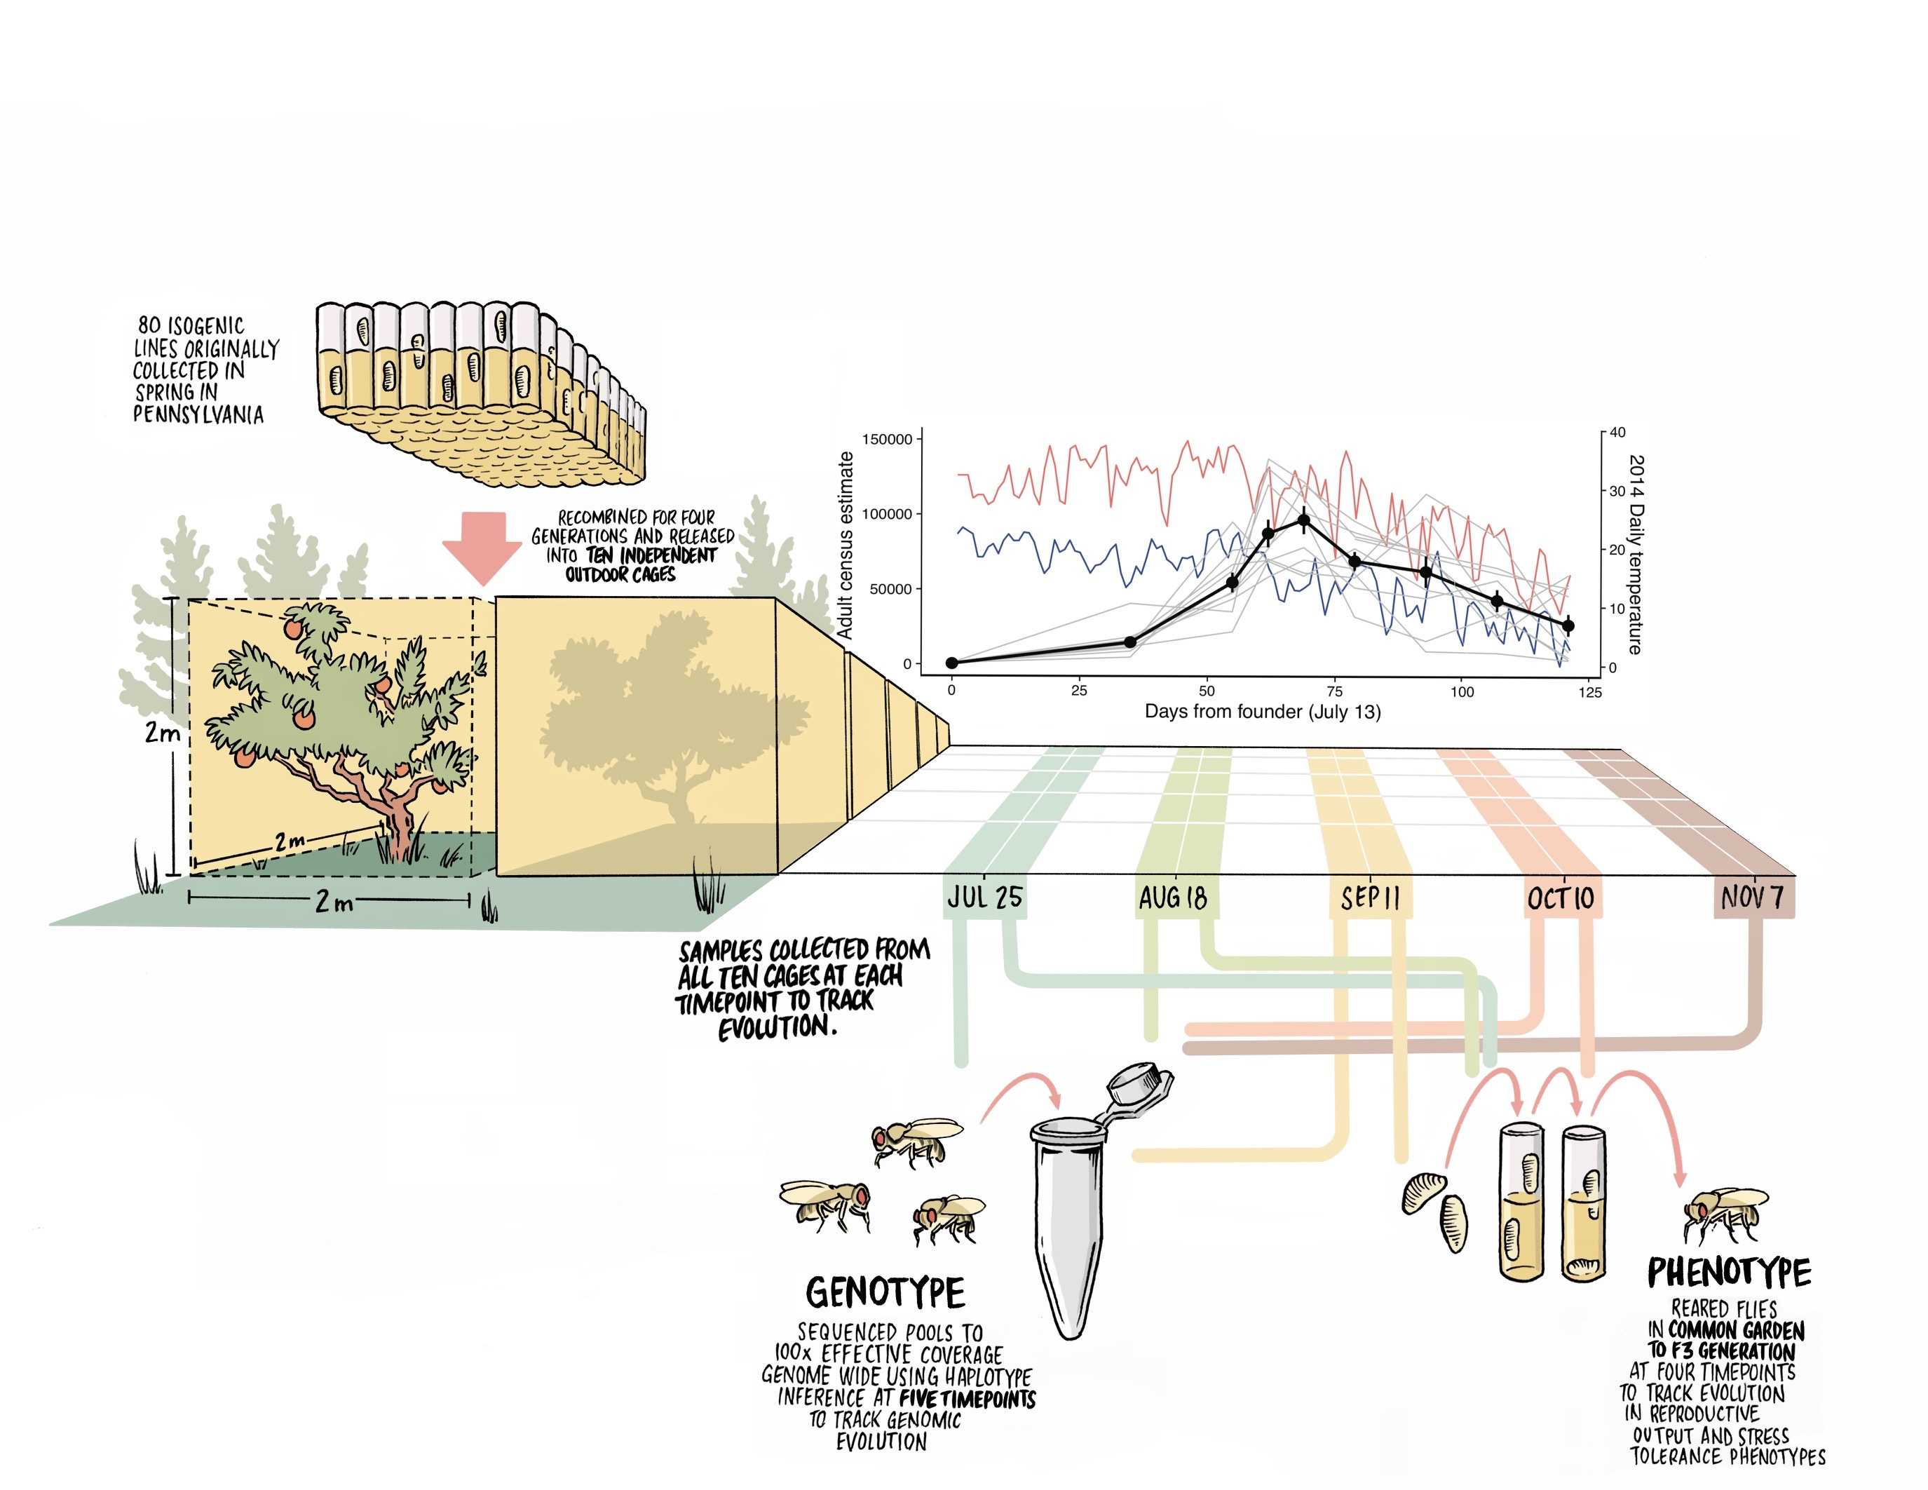
Figure 1: The experiment was designed to incorporate many aspects of ecological and evolutionary realism while testing for adaptation using replicate populations. 80 inbred lines originally collected in spring from an orchard in Pennsylvania were recombined and expanded for four generations into a genetically diverse outbred population in the laboratory. 500 males and 500 females from this outbred population were used to found 10 independent outdoor experimental arenas (2m x 2m x 2m). We measured daily minimum and maximum temperatures (blue and red, respectively) and estimated adult population size of each replicate over four months of seasonal change. To study adaptation we tracked phenotypic evolution by collecting eggs from each replicate, rearing under common garden laboratory conditions for three generations, and then measuring six fitness-associated phenotypes. We conducted this procedure at five time points to measure phenotypic evolution over time. To study adaptation at the genomic level we sequenced pools of 100 females from each cage to >100x effective coverage at five time points using haplotype inference (HAF-Pipe (Tilk et al. 2019)) based on the 80 founder lines and assessed changes in allele frequencies.

Slide 4
Figure 2: Parallel evolution of stress tolerance traits, reproductive output traits, and comparison of the rate of adaptation. Trajectories of phenotypic evolution for reproductive output (A, B, C) and stress resistance traits (D, E, F) as measured after three generations of common garden rearing. Panel A: mean fecundity as number of eggs/female/day, Panel B: mean egg size, Panel C: development rate as the fraction of development to pupation completed in one day (1/(total hours/24)). Panel D: starvation tolerance as time to starvation, Panel E: recovery time following chill coma, Panel F: desiccation tolerance as the time to death from desiccation. Blue points are the phenotypes of the founding population and red points are the mean of all cage means. Phenotypic trajectories for each individual replicate population are shown using light grey lines. Panel G: a comparison of the rates adaptation from this experiment over individual intervals (red) to rates of phenotypic change from a prior meta-analysis (blue) (Hendry et al. 2008).

Slide 5
Figure 3. Leave-one out 10-fold cross-validation of significant sites. A) In each round, significantly parallel sites (FDR <0.05, effect size>2%) at each time-segment were identified using 9 of the 10 cages, then the shift at those sites in the 10th left-out cage was measured at the same time segment (top row), as well as other time segments (bottom row). In each case, the set of shifts at parallel sites was compared to shifts at control sites matched for chromosome and initial frequency to determine whether shifts in the left-out cage at parallel sites were also significantly parallel (orange) or significantly anti-parallel (green). B) Median shift for each set of parallel sites (circles) and control sites (x marks) are plotted for each left-out cage, using the approach described in A.

Slide 6
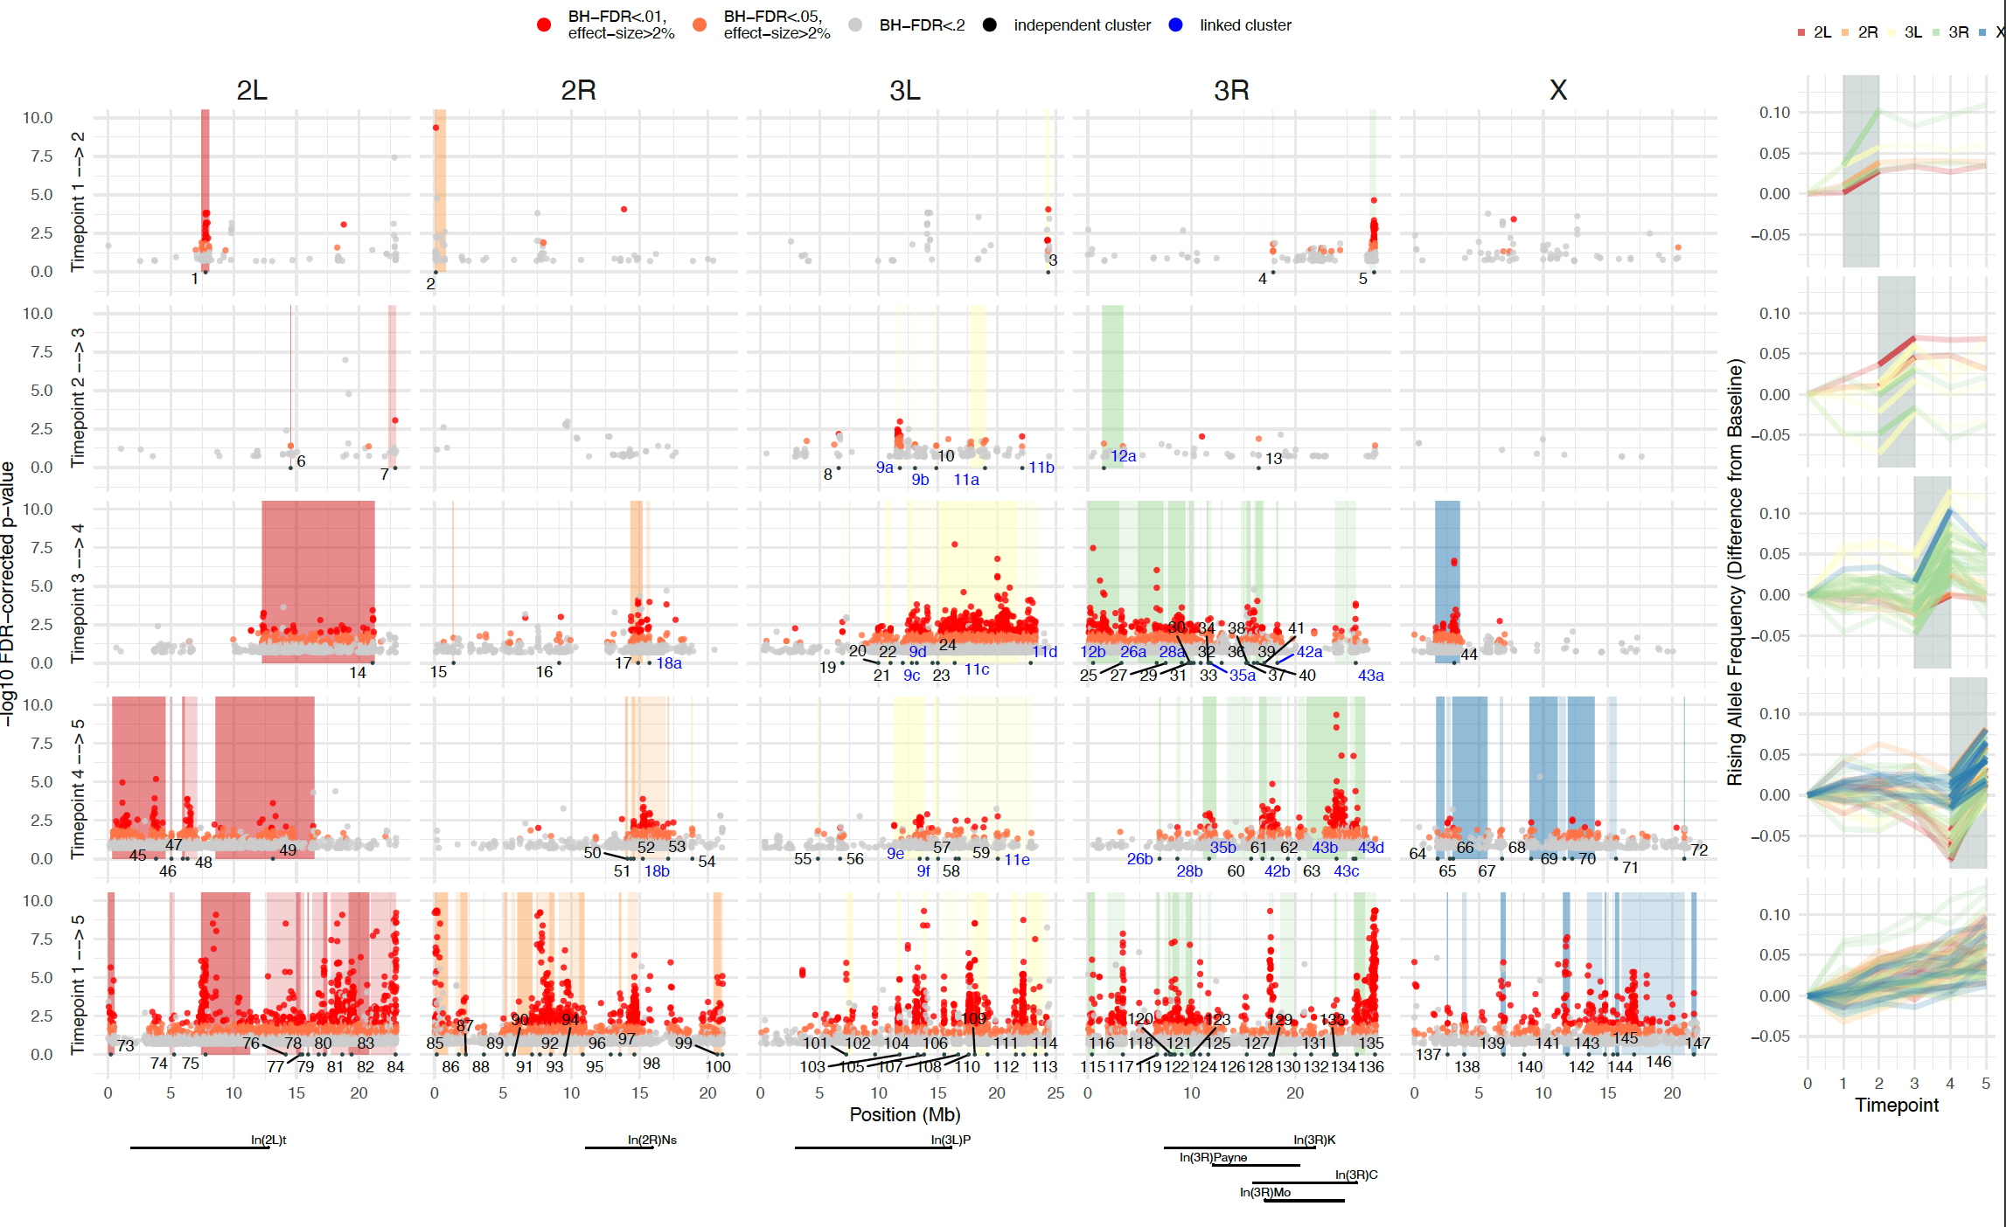

Slide 7
Fig 4: A) Manhattan plot of significant parallel allele frequency shifts over time in 10 replicate cages. Each dot shows the -log10 of the FDR-corrected p-value (y-axis) for the significance of the allele frequency shift at a given SNP position (x-axis) over a given time segment of the experiment (rows). Only SNPs with an FDR <0.2 are shown, and dots are colored according to 3 significance bins (legend). Shaded areas indicate regions of the genome that are likely driven by the same causal site, as defined by a clustering algorithm accounting for SNP linkage. Each clustered genome block is identified by a number marking the position of the top parallel SNP. Clusters from different time segments (‘superclusters’) that are significantly linked are given the same number, labeled in blue. The position of seven common chromosomal inversions are indicated below. B) Allele frequency trajectories are shown for the top marker SNP from each cluster. Each trajectory is translated to show allele frequency change relative to initial frequency in the baseline population, and phased to show the frequency of the rising allele at the time segment in which the cluster was identified.

Slide 8
Fig. S1. Haplotype-derived allele frequencies (HAFs; y-axis) obtained via low-coverage (~5x) sequencing of timepoint-5 samples followed by inference from founder haplotypes were compared to raw allele frequencies (x-axis) from deep re-sequencing of the same samples. Sites were binned by read depth in the deeply sequenced samples (separate panels). In all panels, concordance between HAFs and raw AFs increases as read depth of raw AFs increase, suggesting HAFs are effectively as accurate as raw AFs at >100x. A) Heatmaps of HAFs vs raw AFs for the same sample and site. B) Line of best fit (blue) for correlation between HAFs and raw AFs compared to line of perfect correlation (gray). C) Heatmaps of the shift between baseline and timepoint-5 calculated via HAFs vs raw AFs for the same sample and site D) Line of best fit (blue) for correlation between shifts from baseline calculated from HAFs vs raw AFs compared to line of perfect correlation (gray). E) Boxplots of HAF shifts binned by raw AF shift, at sites with raw read depth >=115x. All boxplots represent distributions with significantly different means (t-test p-values<.05).

Slide 9
Fig. S2. Distributions of pairwise Fst values between technical replicates (gray; same flies, different reads), biological replicates (pink; different flies, same timepoint), and experimental samples from different timepoints (blue). A) Genome-wide mean Fst distributions. Note that negligible Fst values between pairs of technical replicates are consistent with extreme precision of HAFs, suggesting that the variance in allele frequency estimates for biological replicates is primarily driven by sampling (~100 individuals or ~200 chromosomes per sample). Asterisks represent the significance of divergence over time compared to biological replicates from the same timepoint (t-test). B) Distributions of chromosome-wide mean Fst for experimental samples from each sampling timepoint vs. baseline samples.

Slide 10
Figure S3. Per-chromosome leave-one out 10-fold cross-validation of significant sites. In each round, significantly parallel sites at each time-segment were identified using 9 of the 10 cages, then the shift at those sites in the 10th left-out cage was measured at the same time segment. In each case, the set of shifts at parallel sites was compared to shifts at control sites matched for chromosome and initial frequency to determine whether shifts in the left-out cage at parallel sites were also significantly parallel (orange) or significantly anti-parallel (green). Median shift for each set of parallel sites (circles) and control sites (x marks) on each chromosome (rows) at each time segment (columns) are plotted for each left-out cage.

Slide 11
Fig S4. QQ plots for per-SNP GLM p-values giving the significance of a parallel shift across 10 replicate cages for true data (y-axis) and null model (x-axis) where timepoint labels for each site were shuffled across samples before fitting the GLM. Color of each point indicates whether the p-value for the true quantile passes various FDR thresholds.

Slide 12
Window size = 500 SNPs
Window size = 1000 SNPs
Window size = 1500 SNPs
Window size = 2000 SNPs
Window Score (true quantiles)
Window Score (null quantiles)
Figure S5. QQ plots of the distribution of significant sites in various equi-SNP sized sliding windows. Each SNP was scored (0,1,2, or 3) according to significance of parallelism at each time segment (see Methods). SNP-scores were averaged across consecutive SNPs to generate a window score. True window score quantiles (y-axis) were compared to quantiles from a null distribution generated by randomly shuffling SNP labels.

Slide 13
Figure S6. Smoothed average of linkage values as a function of distance between SNPs, measured between A) all pairs of significant (FDR<.05) SNPs on the same chromosome identified at the same time segment, B) pairs of SNPs on the same chromosome identified at the same time segment that were assigned to different clusters, and C) pairs of SNPs on the same chromosome identified at the same time segment that were assigned to the same cluster.

Slide 14
Figure S7. A) Distribution of the allele frequencies of inversion markers in the founder lines, baseline population, and across cages at each timepoint. B) Linkage between clusters (x-axis) and inversions (y-axis). Dots are colored by time segment of cluster identification and shading indicates whether clusters are unlinked, weakly linked (average R² between significant parallel SNPs and inversion markers is > 0.03) or strongly linked (average R² > 0.1).

Slide 15
Figure S8. Proportion of SNPs in the intersection of linked clusters from different time segments (aka superclusters) that continue shifting in the same direction across months (gray) or flip direction (orange). Two superclusters involve linked clusters from three different time segments (t2→3, t3→4, and t4→5); for these superclusters, color indicates the consistency of direction between t2→3 and t3→4, followed by the consistency of direction between t3→4 and t3→5 (ie. flips,same).

Slide 16
Figure S9. Distribution of the initial minor allele frequencies of marker SNPs for clusters identified at each time segment.

Slide 19
Table S3. Inversion marker counts. Segregating markers could be detected as bi-allelic SNPs in the baseline population, while filtered markers showed high correlation (Rsq>0.5) with each other across all sampled cages during the course of the experiment.

