Slide 1
Thermal Model for the HELIX Magnet System
Noah Green
University of Michigan

Slide 2
Outline
Goals
Thermal Model
Radiation
Convection
Conduction
Thermal Code Resurrection
Overview
Model vs Data
Goals again
Summary and future work

Slide 3
Goals
Accurately predict hold times for current system, even with varying initial conditions.
Provide capability to optimize currently modeled components, account for existing but still unmodeled components (e.g. the stack and current leads), and add new components (e.g. secondary dewar)
Optimize flow ratio between radiation shield cooling tube and stack.

Slide 4
Thermal Model
Based on Patrick Koehn’s senior thesis
Uses basic heat transfer equations to determine heat flow in/out of magnet system
Component-wise modeling
Radiation shield, square bore, cooling tube, cryostat support structure, superinsulation, and LHe bath
Does not consider for geometry of each component
Can model % of boiloff through cooling tube
Does not model heat flow through stack, so it’s unable to optimize cooling tube/stack boiloff ratio
Does not model heat added through current leads
Except for warmup, does not factor changing LHe level in to heat flow calculations

Slide 5
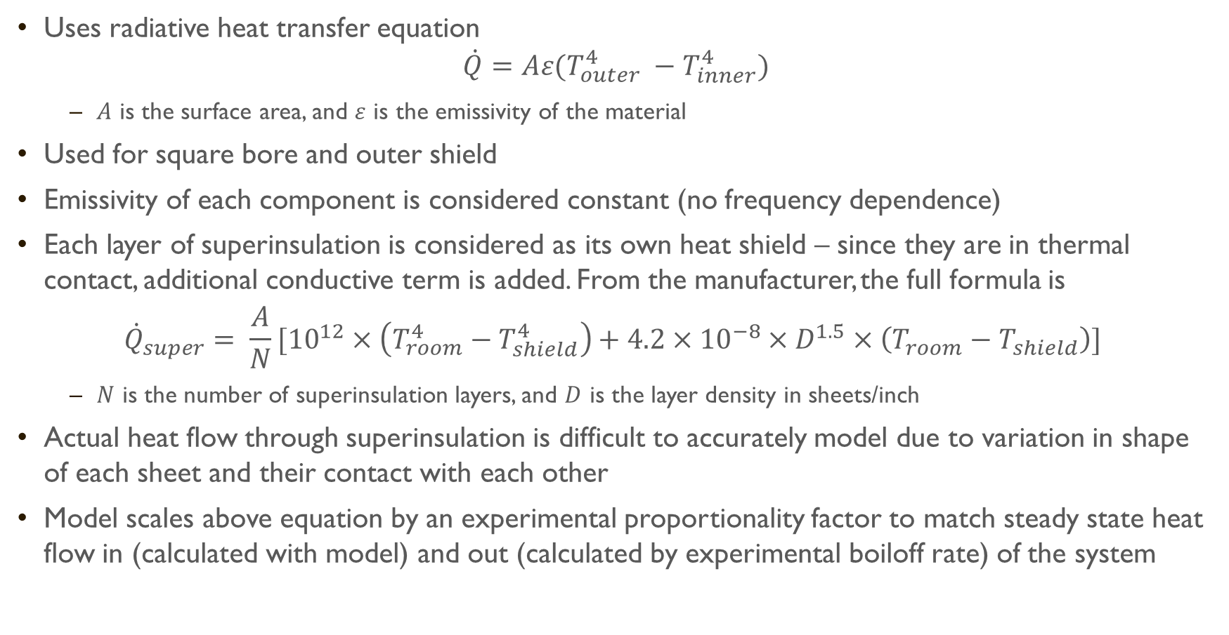
Thermal Model: Radiation
Uses radiative heat transfer equation
$$\dot{Q}=Aε(T_{outer}^{4} −T_{inner}^{4})$$
$A$ is the surface area, and $ε$ is the emissivity of the material
Used for square bore and outer shield
Emissivity of each component is considered constant (no frequency dependence)
Each layer of superinsulation is considered as its own heat shield – since they are in thermal contact, additional conductive term is added. From the manufacturer, the full formula is
$${\dot{Q}}_{super}= \frac{A}{N}[{10}^{12}×\left(T_{room}^{4}−T_{shield}^{4}\right)+4.2×{10}^{−8}×D^{1.5}×\left(T_{room}−T_{shield}\right)]$$
$N$ is the number of superinsulation layers, and $D$ is the layer density in sheets/inch
Actual heat flow through superinsulation is difficult to accurately model due to variation in shape of each sheet and their contact with each other
Model scales above equation by an experimental proportionality factor to match steady state heat flow in (calculated with model) and out (calculated by experimental boiloff rate) of the system

Slide 6
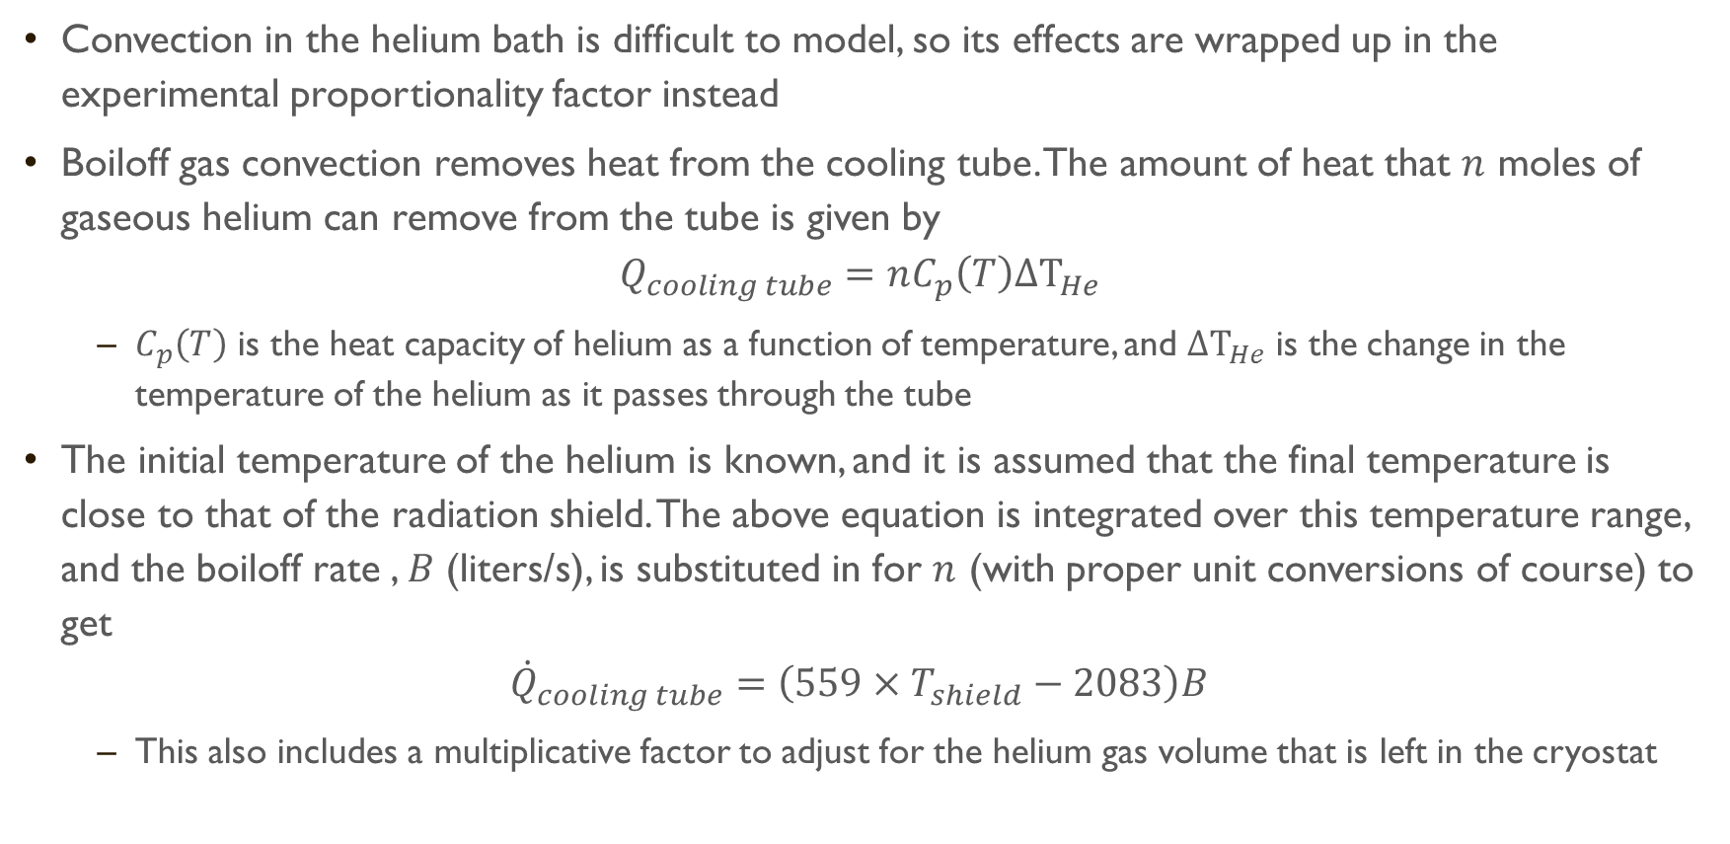
Thermal Model: Convection
Convection in the helium bath is difficult to model, so its effects are wrapped up in the experimental proportionality factor instead
Boiloff gas convection removes heat from the cooling tube. The amount of heat that $n$ moles of gaseous helium can remove from the tube is given by
$$Q_{cooling tube}=nC_{p}\left(T\right)ΔT_{He}$$
$C_{p}\left(T\right)$ is the heat capacity of helium as a function of temperature, and $ΔT_{He}$ is the change in the temperature of the helium as it passes through the tube
The initial temperature of the helium is known, and it is assumed that the final temperature is close to that of the radiation shield. The above equation is integrated over this temperature range, and the boiloff rate , $B$ (liters/s), is substituted in for $n$ (with proper unit conversions of course) to get
$${\dot{Q}}_{cooling tube}=\left(559×T_{shield}−2083\right)B$$
This also includes a multiplicative factor to adjust for the helium gas volume that is left in the cryostat

Slide 7

Thermal Model: Conduction
Conduction between layers of superinsulation already handled
Conduction from cryostat to LHe is not modeled yet (except for warmup)
Conduction through helium gas to LHe is considered negligible
Conduction through cryostat support structure is taken into account
Support structure treated as a series of concentric cylinders. Solid line: 5032 Al. Dotted line: G-10 material.
The heat transfer rate is given by Fourier’s Law,
${\dot{Q}}_{support}=U(T_{ambient}−T_{LHe})$,
where $U=(\sum_{i=1}^{n}{\frac{L_{i}}{k_{i}A_{i}})}$.
$L_{i}$ is the length, $A_{i}$ is the cross sectional area, and
$k_{i}$ is the thermal conductivity of each cylinder

Slide 8
Thermal Code Resurrection
Python code based off of Qbasic snippets from Patrick Koehn's thesis
Models the warmup of LHe to its boiling point
Distributes LHe into bins (currently uses a uniform distribution) . Each bin carries the temperature of a certain percentage of the LHe. This is supposed to represent
a gradual layering of temperatures with the warmest on top.
The fraction of the total heat input that passes through the portion
the cryostat in contact with the LHe is divided between all bins
Final bin (i.e. the top layer) gets the remaining heat input
If a bin reaches its boiling point, then its warmup is skipped
Warmup also models thermal expansion of LHe
Heat that does not contribute to warmup is applied to LHe at b.p. to calculate boiloff rate
Advances in units of seconds until LHe is below user defined critical level to get an estimated hold time for the magnet system

Slide 9
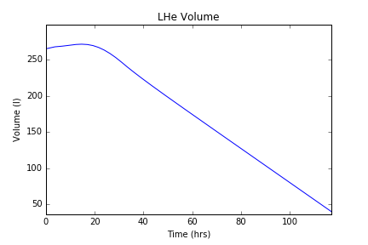
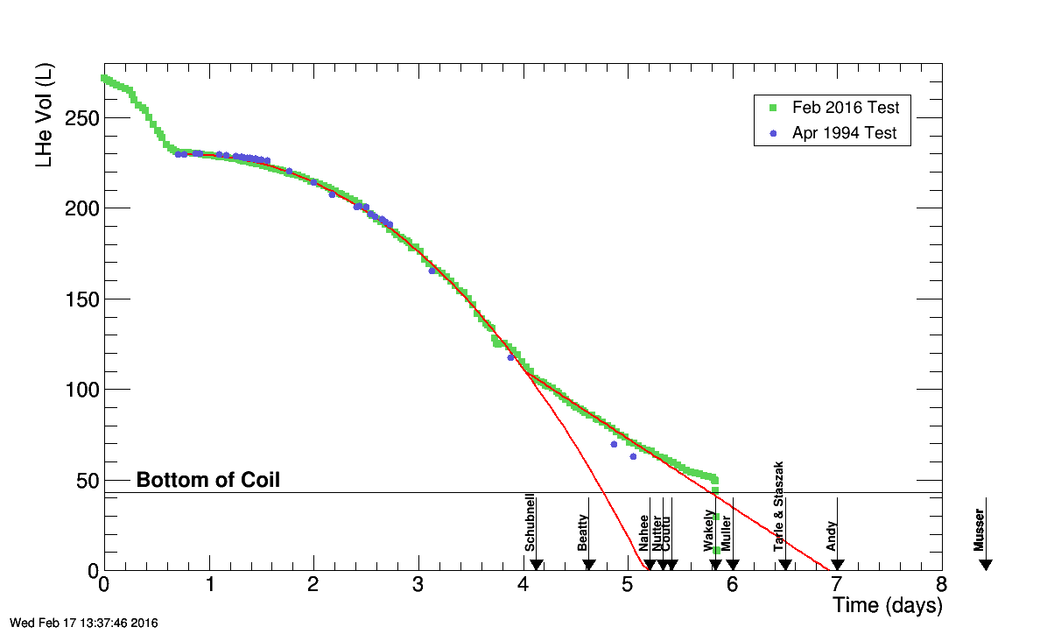
Thermal Code: Model vs Data
Same initial conditions (vs Feb 2016). Cooling tube flow set to 50%.
Final temperature: 106 K (Model), 105 K (Apr 1994)
Steady state boiloff rates: ~2.4 liters/hr (Model), ~2.3 liters/hr (Apr 1994, Feb 2016)
Difficult to judge a “steady state” boiloff rate when the rate is rarely constant. 2.3 liters/hr is roughly the slope of the data plot after a warmup period of ~1.5 days
Model: 4.88 days
Data: 5.83days

Slide 10
Thermal Code: Model vs Data
Elbows probably due to different heat transfer rates in upper and lower parts of cryostat
Note that if the day 4 elbow wasn’t there, then
the hold times would closely match
Curvature between 0.5 and 4 days probably due to
cylindrical nature of cryostat

Slide 11
Goals again
Accurately predict hold times for current system, even with varying initial conditions. Done?
Heavily relies on data from previous runs to tune the hold time.
Does not account for the effect of cryostat geometry on boiloff rate.
Provide capability to optimize currently modeled components, account for existing but still unmodeled components (e.g. the stack and current leads), and add new components (e.g. secondary dewar). Not done.
Program needs to be rewritten with proper object orientation
Move to a finite element analysis to help model temperature gradients and more complicated components
Optimize flow ratio between radiation shield cooling tube and stack. Not done.
Stack is not currently modeled, so impossible to optimize flow.
Solved by better component modeling solution that was already mentioned.

Slide 12
Summary/Future work
Resurrected old thermal model code from Patrick Koehn’s thesis and updated for Python
Thermal model can give a decent approximation of shield temperature, boiloff rate, and hold time, but needs input from previous testing to be accurate.
Limits ability to model new components
Future work:
Object orient code so it is easier to see the heat flow contributions of each component, and simpler to add new components to the model
Would like to add pony keg dewar that is yet to be designed
Include stack in thermal model for flow optimization.
If accurate enough, this flow optimization could even provide real-time input to flow control valves for the boiloff.
Model the effect of cryostat geometry and temperature gradients on the boiloff rate to reproduce elbows and curvature in volume vs time plot
Possibly upgrade to a finite element analysis to accomplish all of this

Slide 13
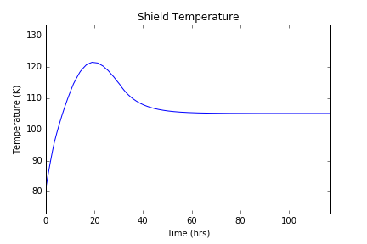
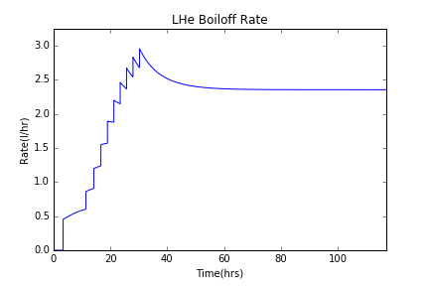
Backup: Additional Model Plots

