Slide 1
Coding for Linguists
LIN6209
Week 1
(Please logon while we are waiting)

Slide 2
Getting Started
Pre-requisites
Why Python?
Installing Python
Interactive Python programming
Values, Variables, Functions
Organising and saving your work

Slide 3
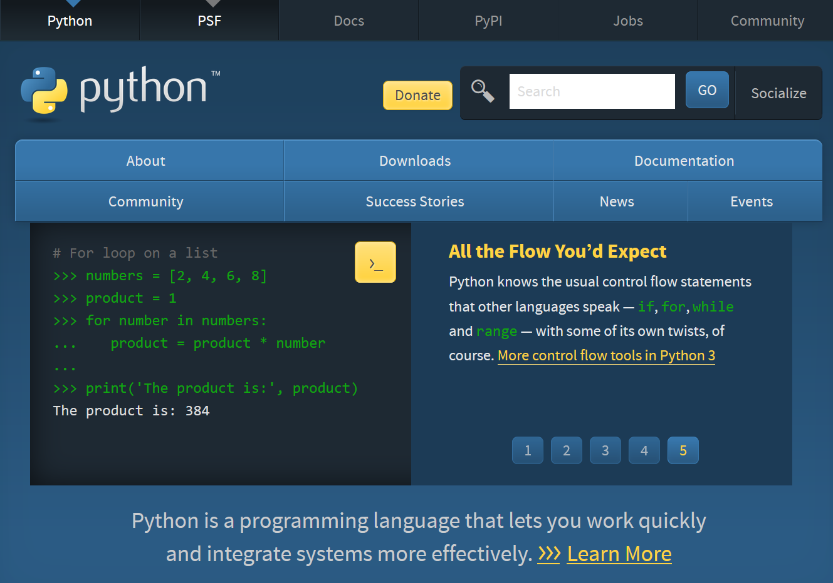
Notes:
https://wiki.python.org/moin/BeginnersGuide/NonProgrammers
https://wiki.python.org/moin/BeginnersGuide/Programmers

Slide 4

Pre-requisites:
A PC or laptop
You know how to switch it on and use it
You do need a PC for this course
There are ‘cloud based’ Python environments that you can use solely via your browser:
www.replit.com
www.pythonanywhere.com
docs.aws.amazon.com/cloud9/
But that’s another layer of learning you would need to work through
“Monty Python’s Flying Circus”

Slide 5
This week you will :
Install Python on own laptop/PC
Start and use Python IDLE
Write and execute Python interactively
Save your Python programs
Execute your saved programs
Understand what a value is
Understand what a type is
Understand what a variable is
Understand what a function is
Create and use integer, float, string (text), and bool values
Create a variable and assign it a value
Understand and use the operators:
+, -, *, /, **, %, //
<, <=, ==, !=, >=, >
and, or, not, in
Understand and use the built-in functions int(), float(), str(), bool(), print() and input()
Begin to explore the Python Standard Library

Slide 6
Python Learning Resources
The python website
https://docs.python.org/3/
The python tutorial
https://docs.python.org/3/tutorial/index.html
The python index
https://docs.python.org/3/genindex.html
Online Tutorials
https://realpython.com/
https://www.freecodecamp.org/
https://www.w3schools.com/
and YouTube is awash with them
Practice exercises and mini projects
https://snakify.org/en/
…
…
…

Slide 7
Python Learning Resources
Books – There is no required textbook for this course. There are LOTS of suitable books. A few of my choices are:
Practical Programming: An introduction to computer Science using Python 3 by Gries, Campbell, Montojo
Python Basics: A practical introduction to Python 3 by the realpython.com tutorial team
Automate the boring stuff with Python by Al Sweigart
Learn Python in One Day and Learn It Well by Jamie Chan
Stack Overflow
https://stackoverflow.com
Use this with caution

Slide 8
Why Python?
Free
www.python.org
Easy to get started
>>> a = 2 + 2
>>> b = ‘sp’ + ‘am’
>>> c = (b + ‘ ’) * a + ‘& ’ + b
Easy to get help
www.stackoverflow.com
www.w3schools.com
www.realpython.com
and much, much more
Interpreted not compiled
So ‘instant’ execution
Used extensively by professional software developers
High quality ‘community editions’ of the same development tools used by professionals
High quality function libraries:
Text processing
Web scraping and content management
Natural Language Analysis
Machine Learning & Artificial Intelligence
Statistics and data analysis
And just about anything else

Slide 9
Installing Python on your PC
Installing Python
Testing your Python installation
Go to www.python.org
Download the installer
Find it on your PC (!)
Execute the installer
Accept all the defaults
Start ‘Python IDLE’
At the prompt ‘>>>’
Enter 2 + 2
Press ‘Enter’ or ‘Return’ key
The result should be 4
This is part of your assignment this week

Slide 10
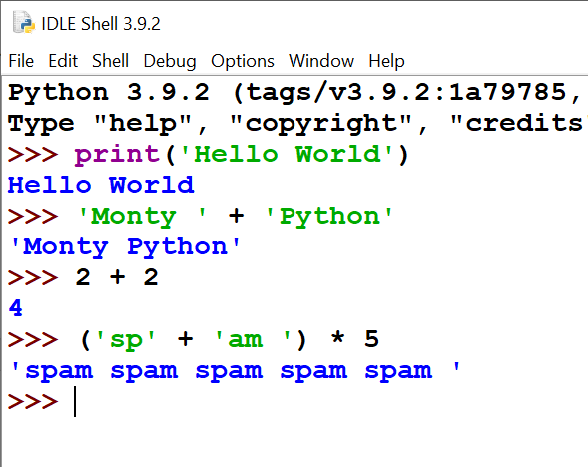
The Interactive Python Shell

Slide 11
Logon to classroom PC
Start Python IDLE
Make sure you are in the interactive shell
At the ‘>>>’ prompt type this
>>> print(‘Hello World!’)
And press the ‘Enter’ key
If you get a ‘Traceback’ message try again.
Congratulations. You have written your first Python program

Slide 12
Practice Worksheet
Try the examples and questions yourself
Section 1 – Getting Started
15 minutes

Slide 13
Python
Computer Scientists count from 0 (zero)
Everything in Python is an object
Types of Python objects
Integer: int()
Floating point: float()
Boolean: bool()
String (text): str()
. . .
Python Operators
+, -, *, /, //, %
<, <=, ==, !=, >=, >
and, or, not
[ ] in
Combine objects and operators
>>> 2+2
>>> 3-1
>>> 5*6
>>> 11/3
>>> 11//3
>>> 11%3
>>> 2>11
>>> ‘3’+‘4’

Slide 14
Python
Computer Scientists count from 0 (zero)
More examples
>>> not True
>>> True and False
>>> False or 5>4
>>> ‘Ni ’ * 5
>>> ‘abcd’[1] * 7
>>> ‘c’ in ‘abracadabra’
Convert one type to another
>>> str(5)
>>> int(‘5’)
>>> bool(4)
>>> bool(‘4’)
Determine the type of an object
>>> type(3)
>>> type(‘abcd’)
>>> type(5>4)
>>> type(5/3)

Slide 15
Interactive Programming is good – but …
It’s a lot of repetitive typing
Programs have to be typed out every time
It’s easy to make mistakes
How to solve this?
Variables
Modules
Functions
Classes and Objects

Slide 16
Variables

Slide 17
Variables
The name of an address in the computer’s memory that contains a value
A variable name MUST start with a letter and have no spaces
A variable name SHOULD start with a lower-case letter
Assign a value to a variable with the ‘=‘ sign
Variable names SHOULD be meaningful
>>> a = 3 
>>> b = 5 
>>> c = 7 
>>> d = a == b 
>>> e = a * b + c 
>>> f = a * (b + c) 
>>> a, b, c, d, e, f 

Slide 18
Practice Worksheet
Try the examples and questions yourself
Section 2 - variables
15 minutes

Slide 19
Saving & reusing your work

Slide 20
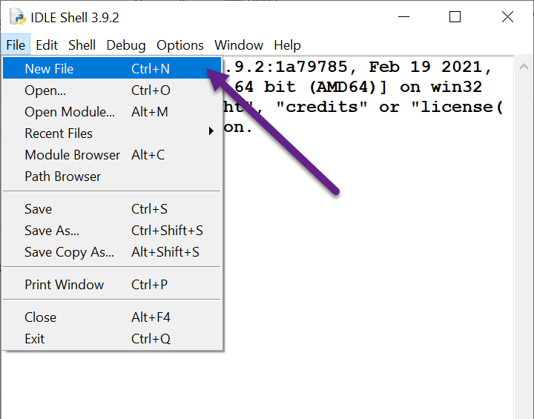
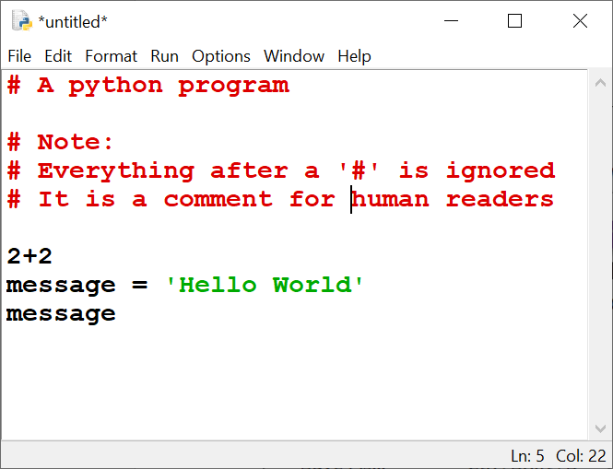
Create and write python module

Slide 21
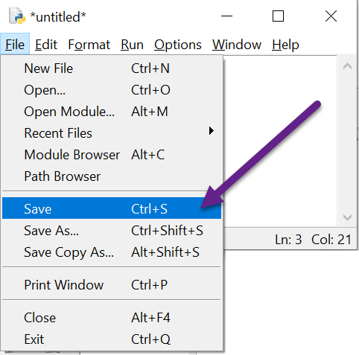
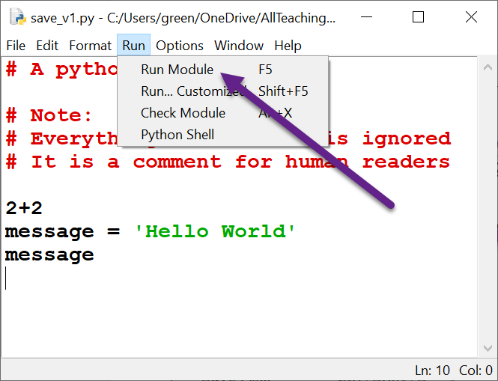
Save it and then run it

Slide 22
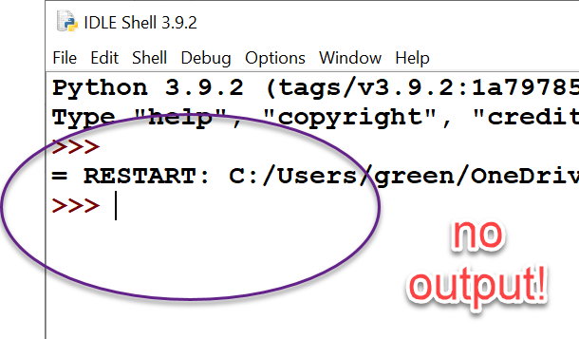
Need to explicitly tell Python to output results.
The print() function does this.

Slide 23
The print() and input() functions

Slide 24
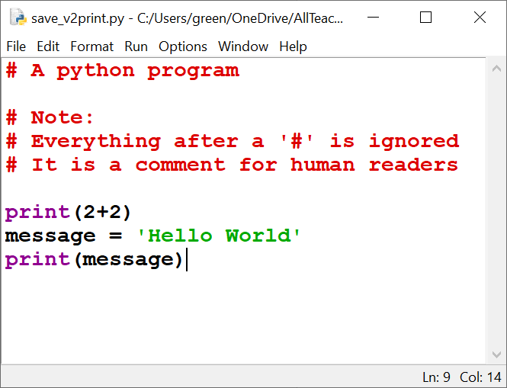
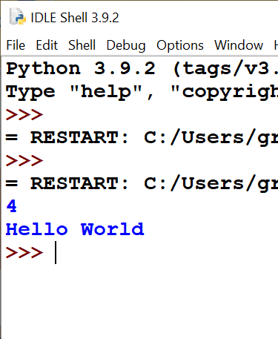
The print() function
Now it works ☺

Slide 25
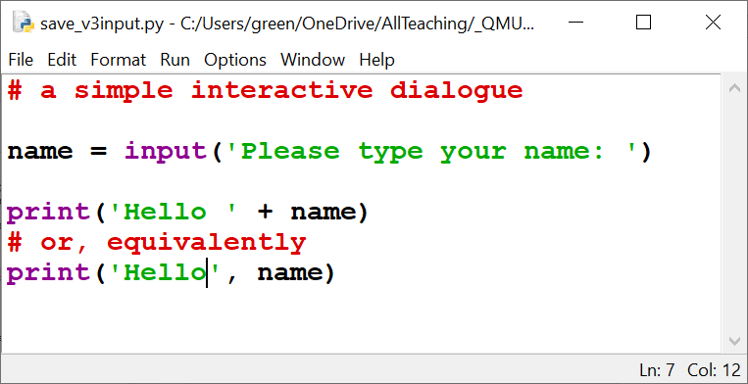
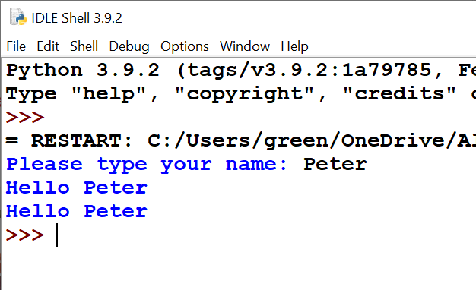
The input() function

Slide 26
Practice Worksheet
Try the examples and questions yourself
The print() and input() functions
Notes:
Printing and pretty printing.
Simple dialogues using input()

Slide 27
This week’s Assignment
Notes:
Explain this now so that it’s not scrunched in at the end

Slide 28
Built-in Functions https://docs.python.org/3/library/functions.html
int()
bool()
float()
str()
input()
print()
len()
chr()
ascii()
slice()
sorted()
abs()
min()
max()

Slide 29
Creating a string object
Computer Scientists count from 0 (zero)
Class str()
Single quote marks
Double quote marks
Triple quotes
str(anyobject)
'a string'
"a string"
'''a string''' or """astring"""

Slide 30
Strings are indexable
Computer Scientists count from 0 (zero)
>>> a = ‘a_string’
>>> len(a)
8
>>> a[0]
'a'
>>> a[2]
's'
>>> a[-2]
'n'
>>> a[3:6]
'tri'
>>> a[:1]
'a'
>>> a[-4:]
'ring'
>>> a[:1]+’ '+ a[4:]
'a ring'
>>> a[0:-1:2],a[-1::-2]
('asrn', 'git_')

Slide 31
The str Library https://docs.python.org/3/library/stdtypes.html#text-sequence-type-str
There are many string methods
Examples
Prototype of usage:
'the string'.method_name()
casefold()
isdecimal()
isalpha()
join()
lower()
upper()
removeprefix()
…
…

Slide 32
Practice Worksheet
Try the remaining examples and questions yourself.
More practice at:
https://docs.python.org/3/tutorial/introduction.html#strings
https://realpython.com/python-strings/

