Slide 1
LIN6209 Coding for Linguists
Jupyter Notebooks
https://jupyter.readthedocs.io

Slide 2
Last week – analysing text
Letters
Words
Sentences
Paragraphs
And other document structures, etc
Occurrence
Counting
Relative frequency
Simple pattern recognition

Slide 3
design
build
test
evaluate
analyse
requirements

Slide 4
This week – Jupyter Notebooks
What a Jupyter notebook is and why it is useful
How to create a Jupyter notebook
How to use a Jupyter notebook
Jupyter notebook set-up
Client
Server
Jupyter use cases:
Software design
Data analysis
Presentation of results
Static presentation
Dynamic presentation
Collaborative working
‘Anywhere & Anytime’

Slide 5

Jupyter Notebooks
Introduction

Slide 6
A Jupyter Notebook is . . .
A 100% web application
A 100% browser based user interface
Notebook user interface presented in browser is connected to a web-server based software application development environment
Create, read, update and delete notebooks from browser
Executes code in notebook code on server
Results of execution presented in browser

Slide 7



Jupyter Architecture
WWW
Jupyter Server
Jupyter
Notebook
Jupyter
Notebook
Jupyter
Notebook
Jupyter
Notebook
Jupyter
Notebook
Jupyter
Notebook
Jupyter
Notebook
Jupyter
Notebook
Jupyter
Notebook

Slide 8
Jupyter Notebooks
Your coding notebook

Slide 9
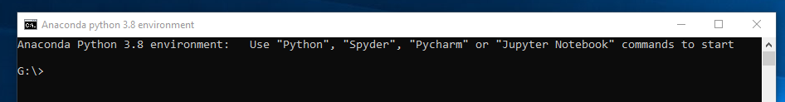
in QB212
Start Python 3.8
G:\>Jupyter Notebook

Slide 10
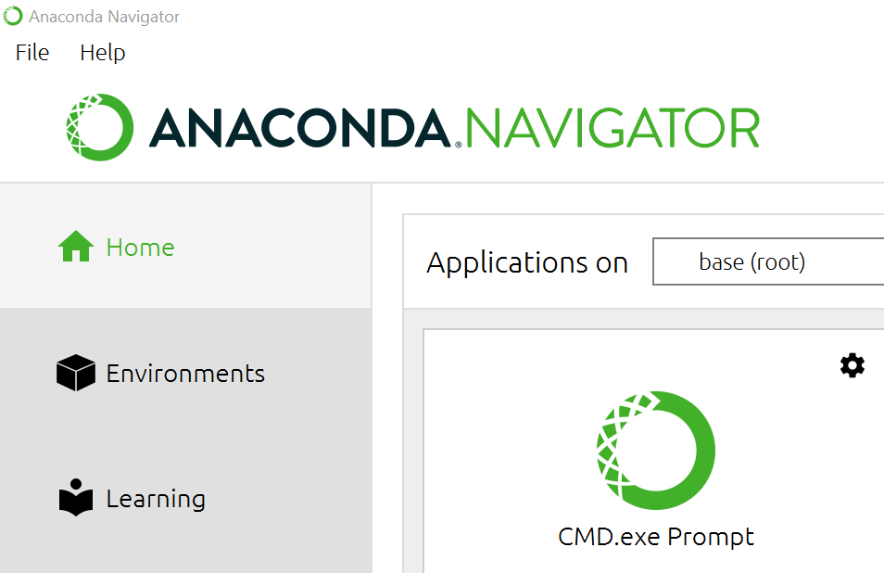
On your own PC Download and instal Anaconda (www.anaconda.com)

Slide 11
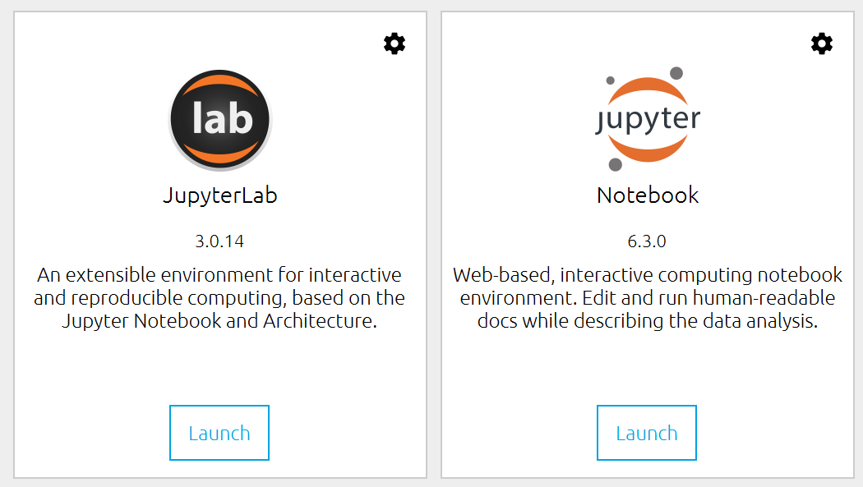
Launch Jupyter Notebook

Slide 12
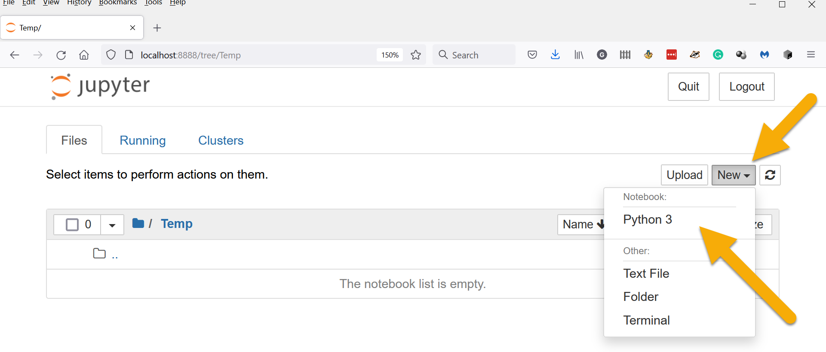
Create a new Python 3 Jupyter Notebook

Slide 13
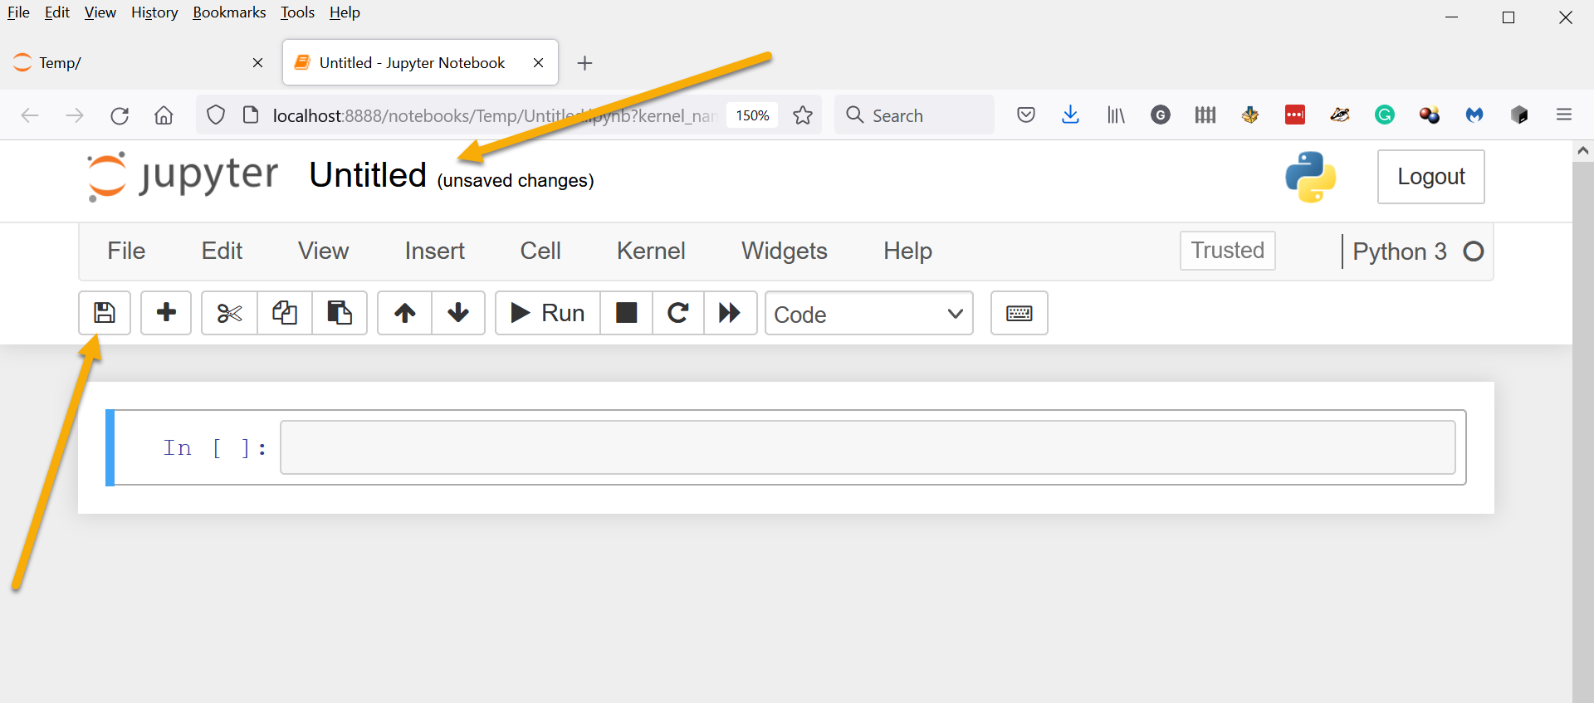
Give the notebook a name and save it

Slide 14
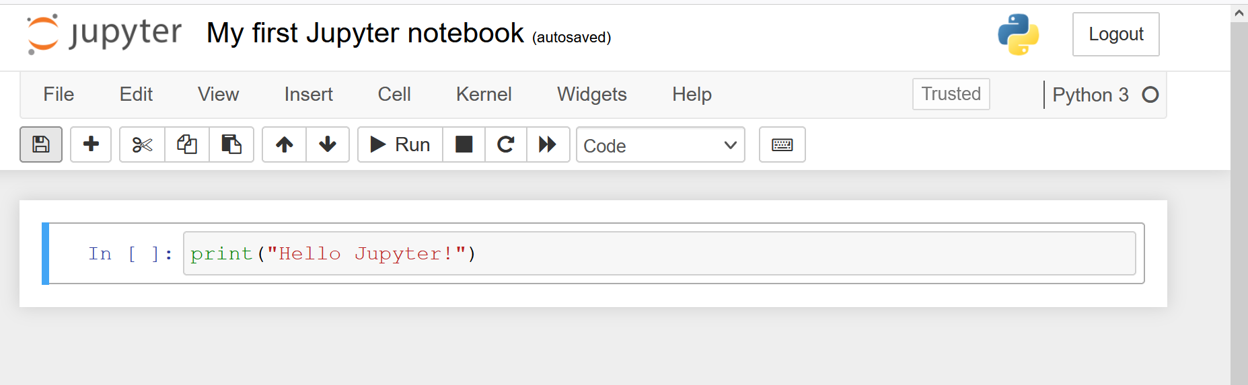
Write your first code in Jupyter

Slide 15
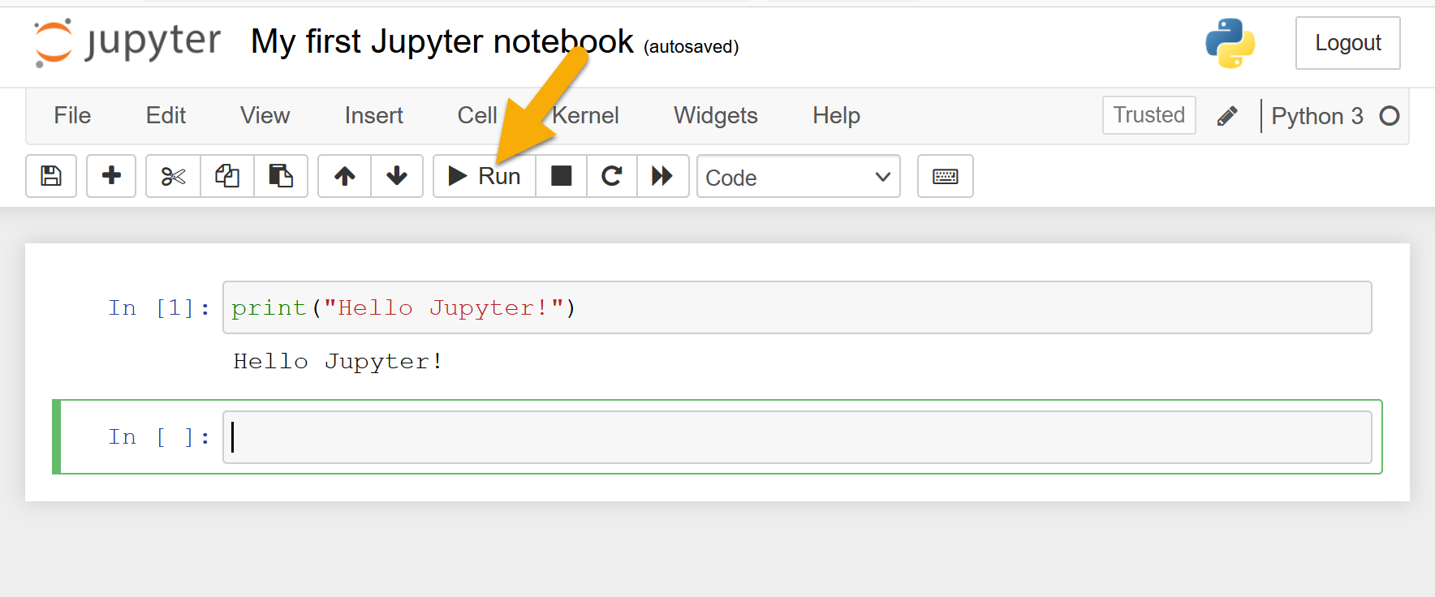
And then run it

Slide 16
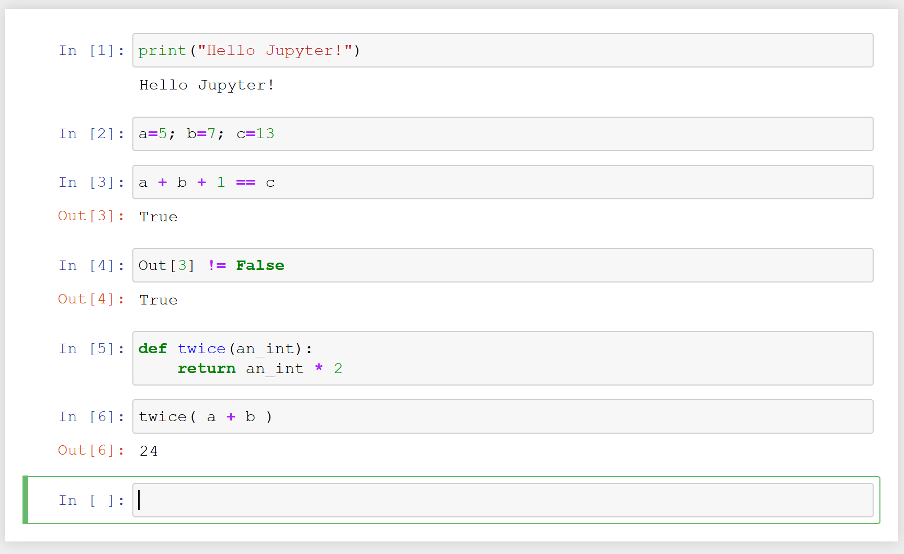
Run any Python code in a cell, use variables in and between cells, functions, …

Slide 17
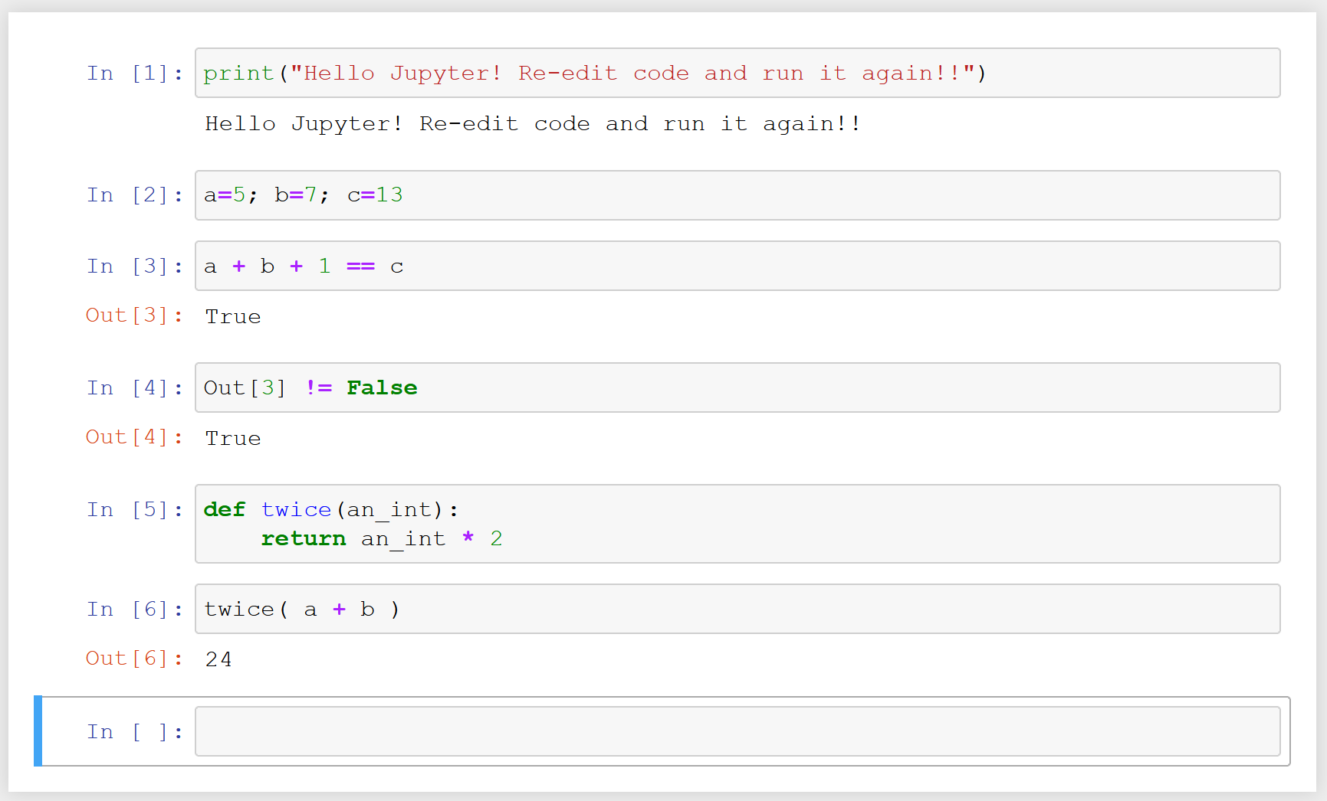
Edit any code in any cell and run that cell and any other cells again

Slide 18
Start Jupyter
Create a notebook
Copy the code for the function thermostat() into a cell
Run the cell
Test the function thermostat() works correctly in the following cells
Create another notebook and do the same for score_2()
‘’ ‘’ ‘’ ‘’ ‘’ ‘’ score_6()
‘’ ‘’ ‘’ ‘’ ‘’ and other functions

Slide 19
Jupyter Notebooks
Your coding notebook – markdown

Slide 20
MarkDown
Increasingly popular with software developers
Simple syntax
Plain text so no special editor required
Translated to HTML
Which means HTML can be included in MarkDown
Headings, lists, tables, code blocks, bold, italic, hyperlinks, …
Integrated into Jupyter notebook

Slide 21
Examples of Notebooks with Markdown

Slide 22
Assignments
How you did on the last one
The next two

Slide 23
W6 Assignment Summary Feedback

Slide 24
Final 2 Assignments
Is a single assignment in two parts

Slide 25
The final two assignments are a software development project
Part 1
A software project development proposal describing the ideas and objectives you intend to explore and an outline of the software you will build
Part 2
A development diary describing your work on the product; the analysis, the designs, the false starts, the stuff that didn’t work, the stuff that did work, the testing, the changes of direction, and hopefully, the bits that did work
The software system you built (regardless of whether it fully works or not!). The code, the data files, the test evidence, and so on
Deadlines: Part 1 in 2 weeks. Part 2 by 7 January.

Slide 26
Final Assignment part one = Definition Assignment:
Briefly describe the project objectives; the question(s) you intend to explore, your scope, and the intended deliverables
If you need data, where will you source it from?
A outline description of the software components you will build and how they will work together to deliver the project objectives
A simple project plan
Submit your proposal to me for marking and advice
About 500 words or a couple of sides of A4 including lists & sketches

Slide 27
Final Assignment part one = Definition Marking and feedback
Your assignment will be judged and marked as a software development project
It will not be judged on the linguistic concepts you propose to investigate
My feedback will be in one of three categories
Too ambitious, reduce your scope
About right
Too modest, increase your scope

Slide 28
Final Assignment part two Report – section A
The project objective
The question(s) you intended to explore, and the intended deliverables
Data
Where you got your data
How you decided it was useful/representative
An analysis of the problem into its component parts
The design of the software components to be built and how they will work together to deliver the project objectives
How the software was tested (or was intended to be tested!)
About 2000 words of prose / tables / lists / documentation

Slide 29
Final Assignment part two Report – Section B
Your project diary
The approximate equivalent of a laboratory scientists ‘lab notebook’
Doing ‘experiment 27’ is the equivalent of ‘build function 27’
Describe each experiment/function before it is done and how your code achieves that aim
Do it. Making notes of any ‘fixes’ or ‘corrections’ applied, or problems spotted along the way
Record end result and testing. Did it work? How well ?
Review: Good enough? Thoughts on how to do it better?
Move on to next experiment / software component

Slide 30
Final Assignment part two Report – Section C
Your code
With sufficient instructions from you to me that I can fathom how to use it

Slide 31
Example Project #1
Arthur Conan Doyle’s ‘Sherlock Holmes’ vocabulary
The total vocabulary with word frequencies
The vocabulary of each written work
The vocabulary of novels compared to short stories
Changes in vocabulary over time
Words ‘near’ the character Holmes
Words ‘near’ the character Watson
Words ‘near’ the character Moriarty

Slide 32
MarkDown
Examples & Guide

Slide 33
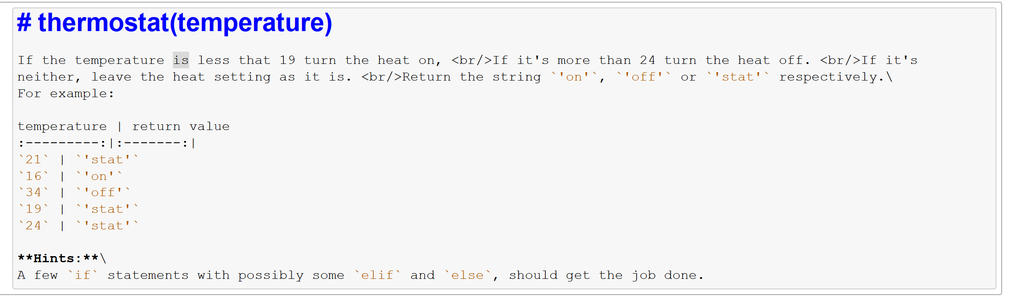
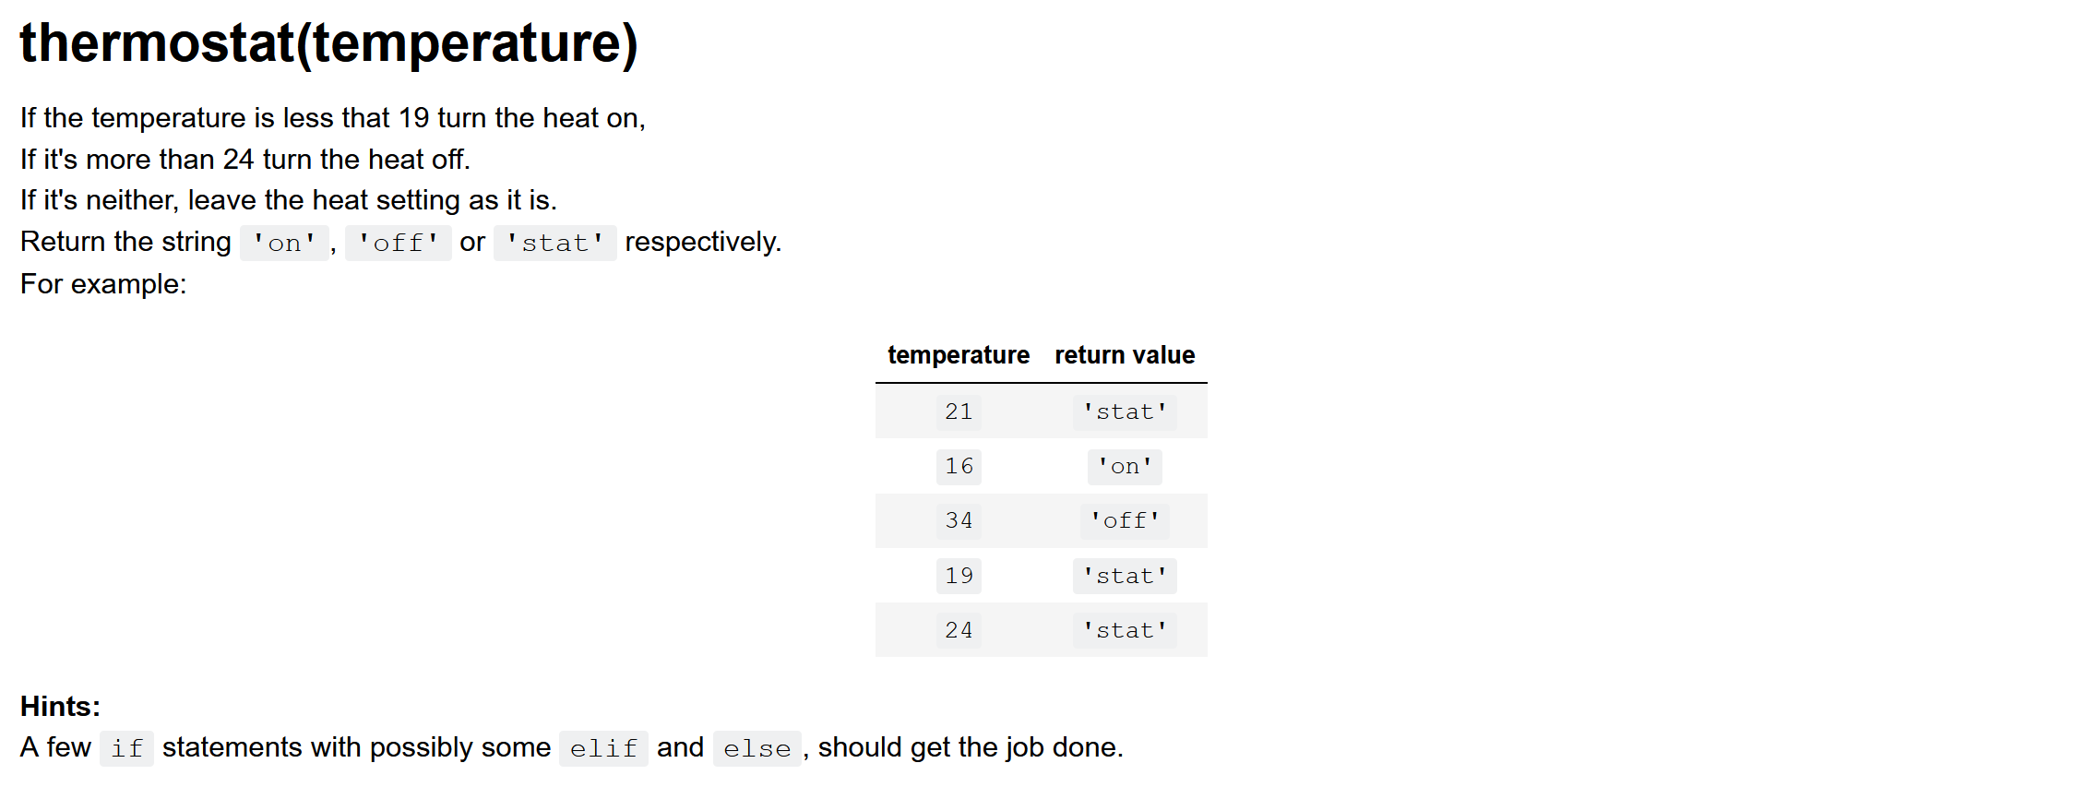

Slide 34
Markdown Syntax
# Headers
* Bullet list
1. Numbered list
Column 1 | Column 2
--------------|-------------
Col 1 cell 1 | col 2 cell 1
Col 1 cell 2 | col 2 cell 2
*italic* or _italic_
**bold** or __bold__
- [ ] to-do item
- [x] to-do item done
’’’ code block ’’’
Blockquote
![image](URL)
[link](URL)

Slide 35
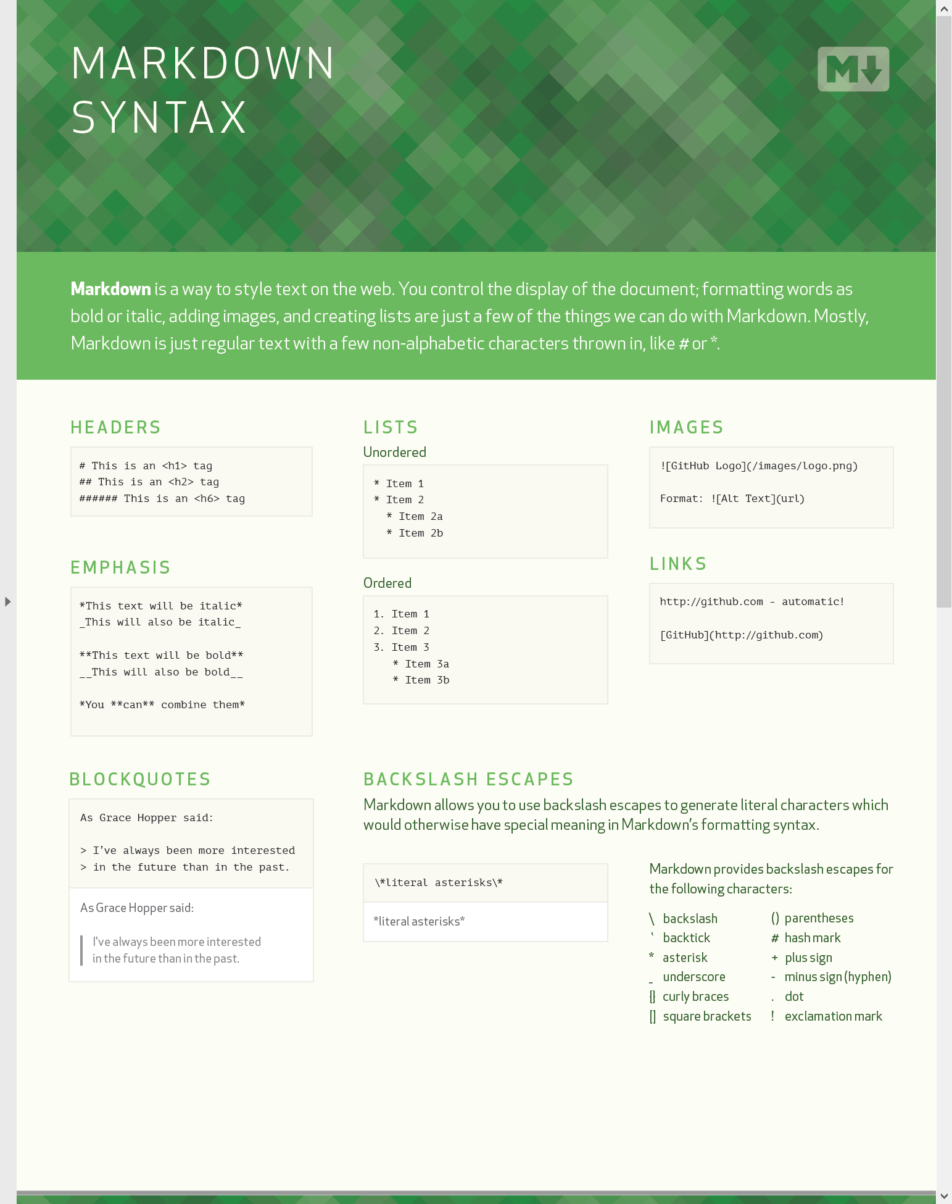
Markdown Syntax
Handy guide in this lessons resources folder

Slide 36
Jupyter & Markdown Practice -
Copy one of your assignment functions into a Jupyter notebook
Execute it and test it
Add brief documentation to your function using MarkDown
Test your function with ‘assert’ statements
Start writing your project specification in a Jupyter notebook with MarkDown

