Slide 1
LIN6209 Coding for Linguists
Jupyter Notebooks

Slide 2
Last week – analysing text
Letters
Words
Sentences
Paragraphs
And other document structures, etc
Occurrence
Counting
Relative frequency
Simple pattern recognition

Slide 3
design
build
test
evaluate
analyse
requirements

Slide 4
This week – Jupyter Notebooks
What a Jupyter notebook is and why it is useful
How to create a Jupyter notebook
How to use a Jupyter notebook
Jupyter notebook set-up
Client
Server
Jupyter use cases:
Software design
Data analysis
Presentation of results
Static presentation
Dynamic presentation
Collaborative working
‘Anywhere & Anytime’

Slide 5

Jupyter Notebooks
Introduction

Slide 6
A Jupyter Notebook is . . .
A 100% web application
A 100% browser based user interface
Notebook user interface presented in browser is connected to a web-server based software application development environment
Create, read, update and delete notebooks from browser
Executes code in notebook code on server
Results of execution presented in browser

Slide 7



Jupyter Architecture
WWW
Jupyter Server
Jupyter
Notebook
Jupyter
Notebook
Jupyter
Notebook
Jupyter
Notebook
Jupyter
Notebook
Jupyter
Notebook
Jupyter
Notebook
Jupyter
Notebook
Jupyter
Notebook

Slide 8
Jupyter Notebooks
Your coding notebook – running code!

Slide 9
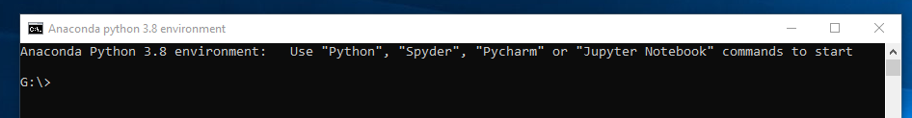
in QB212
Start Python 3.8
G:\>Jupyter Notebook

Slide 10
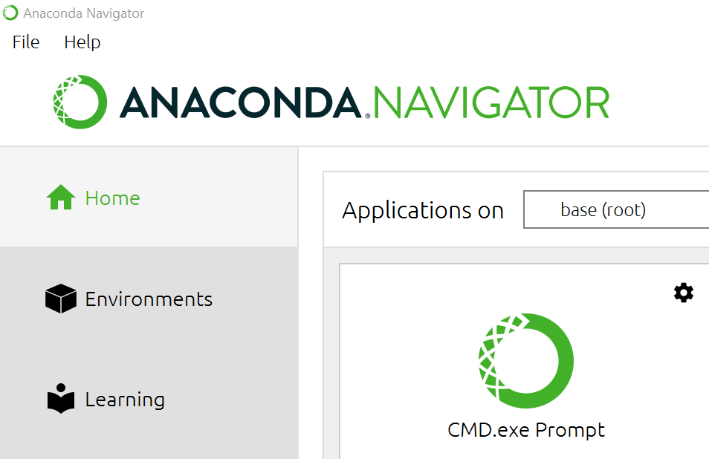
On your own PC Download and instal Anaconda (www.anaconda.com)

Slide 11
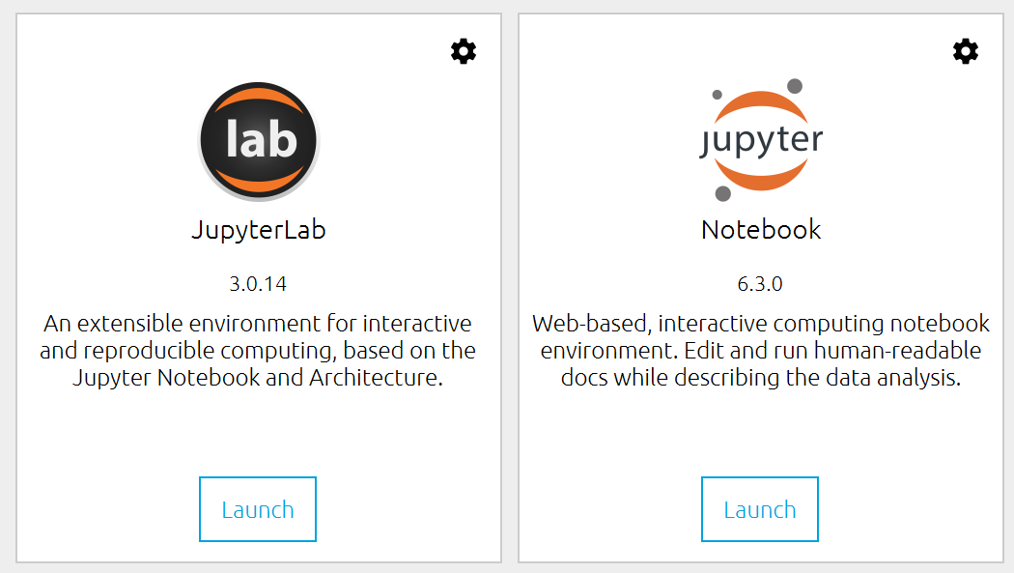
Launch Jupyter Notebook

Slide 12
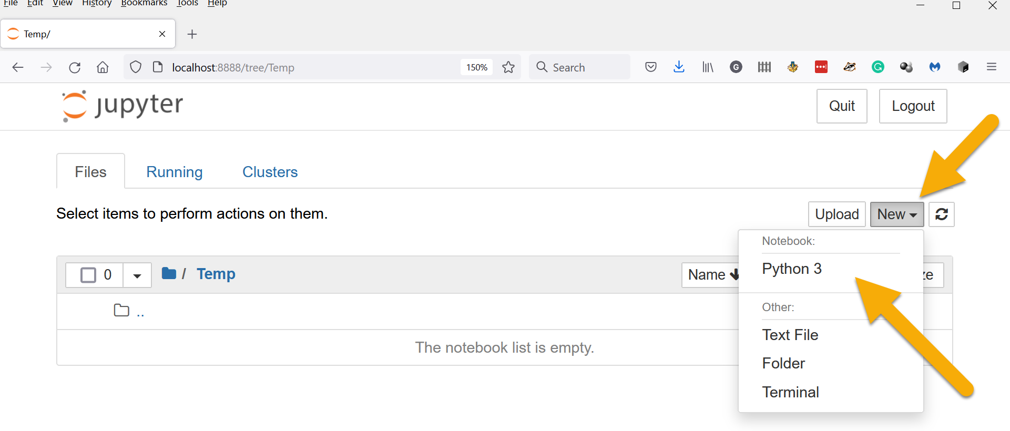
Create a new Python 3 Jupyter Notebook

Slide 13
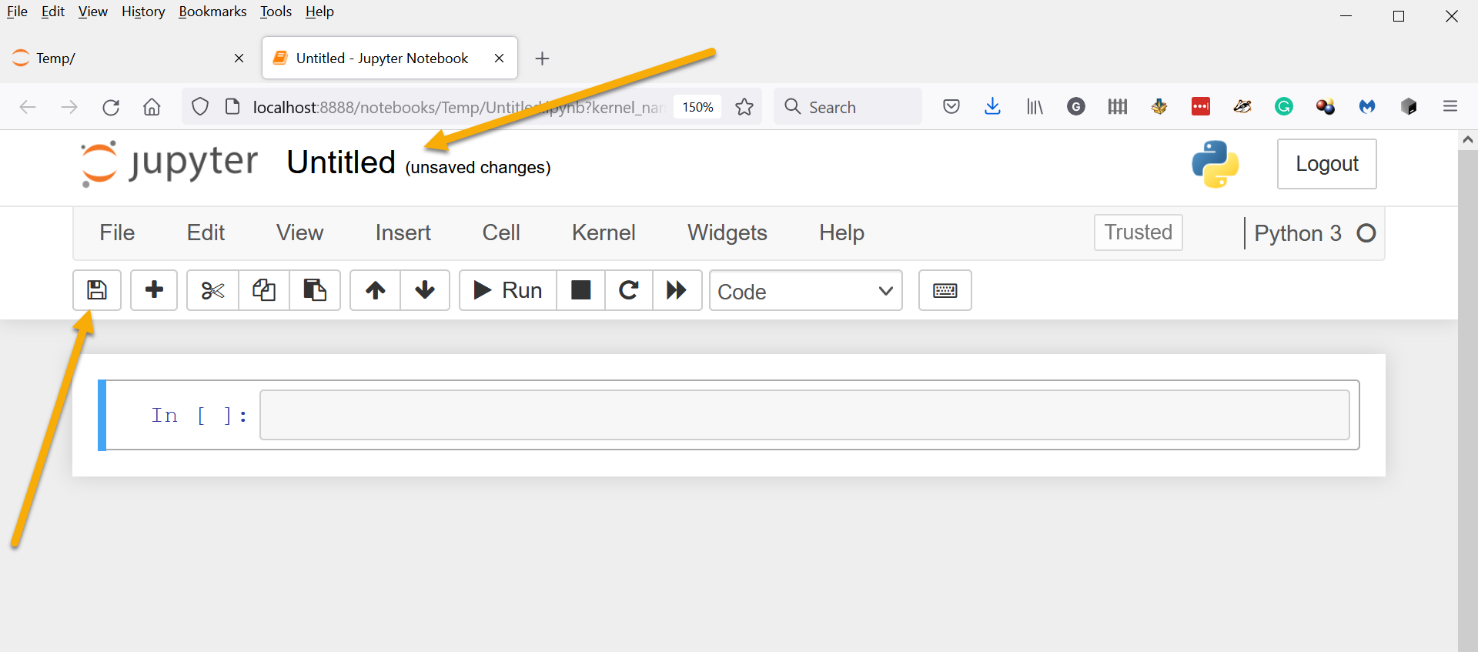
Give the notebook a name and save it

Slide 14
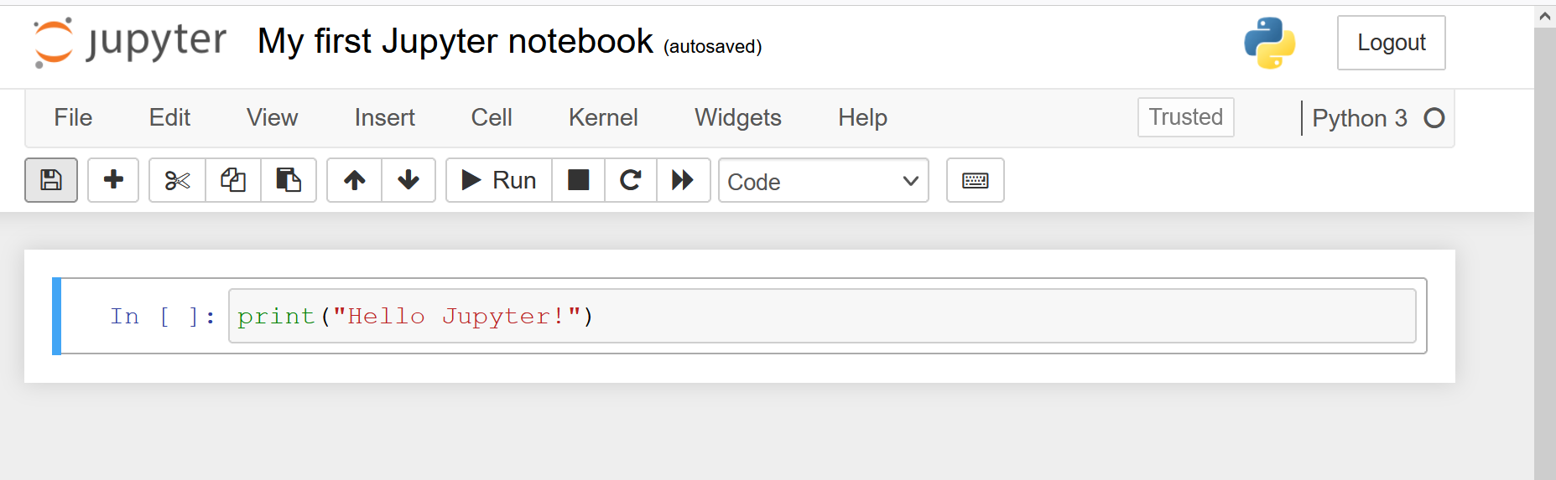
Write your first code in Jupyter

Slide 15
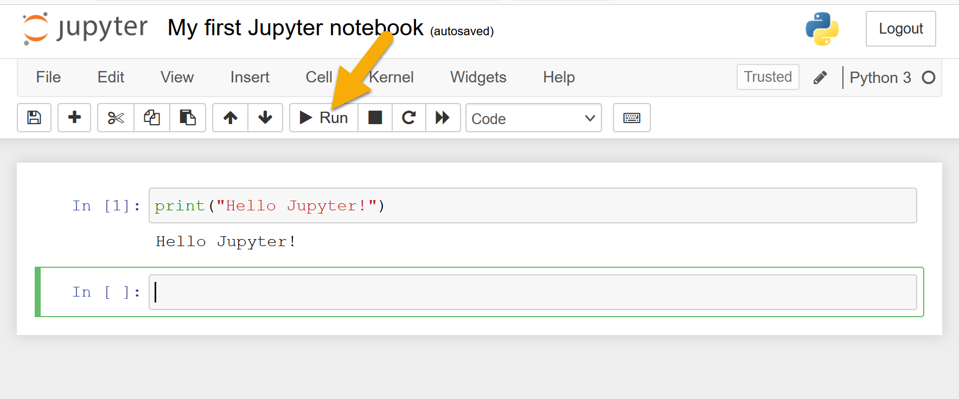
And then run it

Slide 16
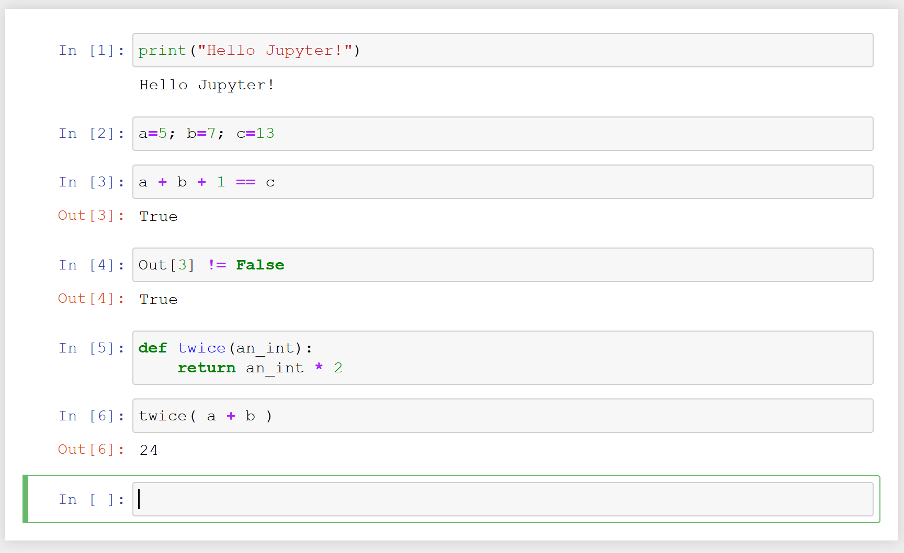
Run any Python code in a cell, use variables in and between cells, functions, …

Slide 17
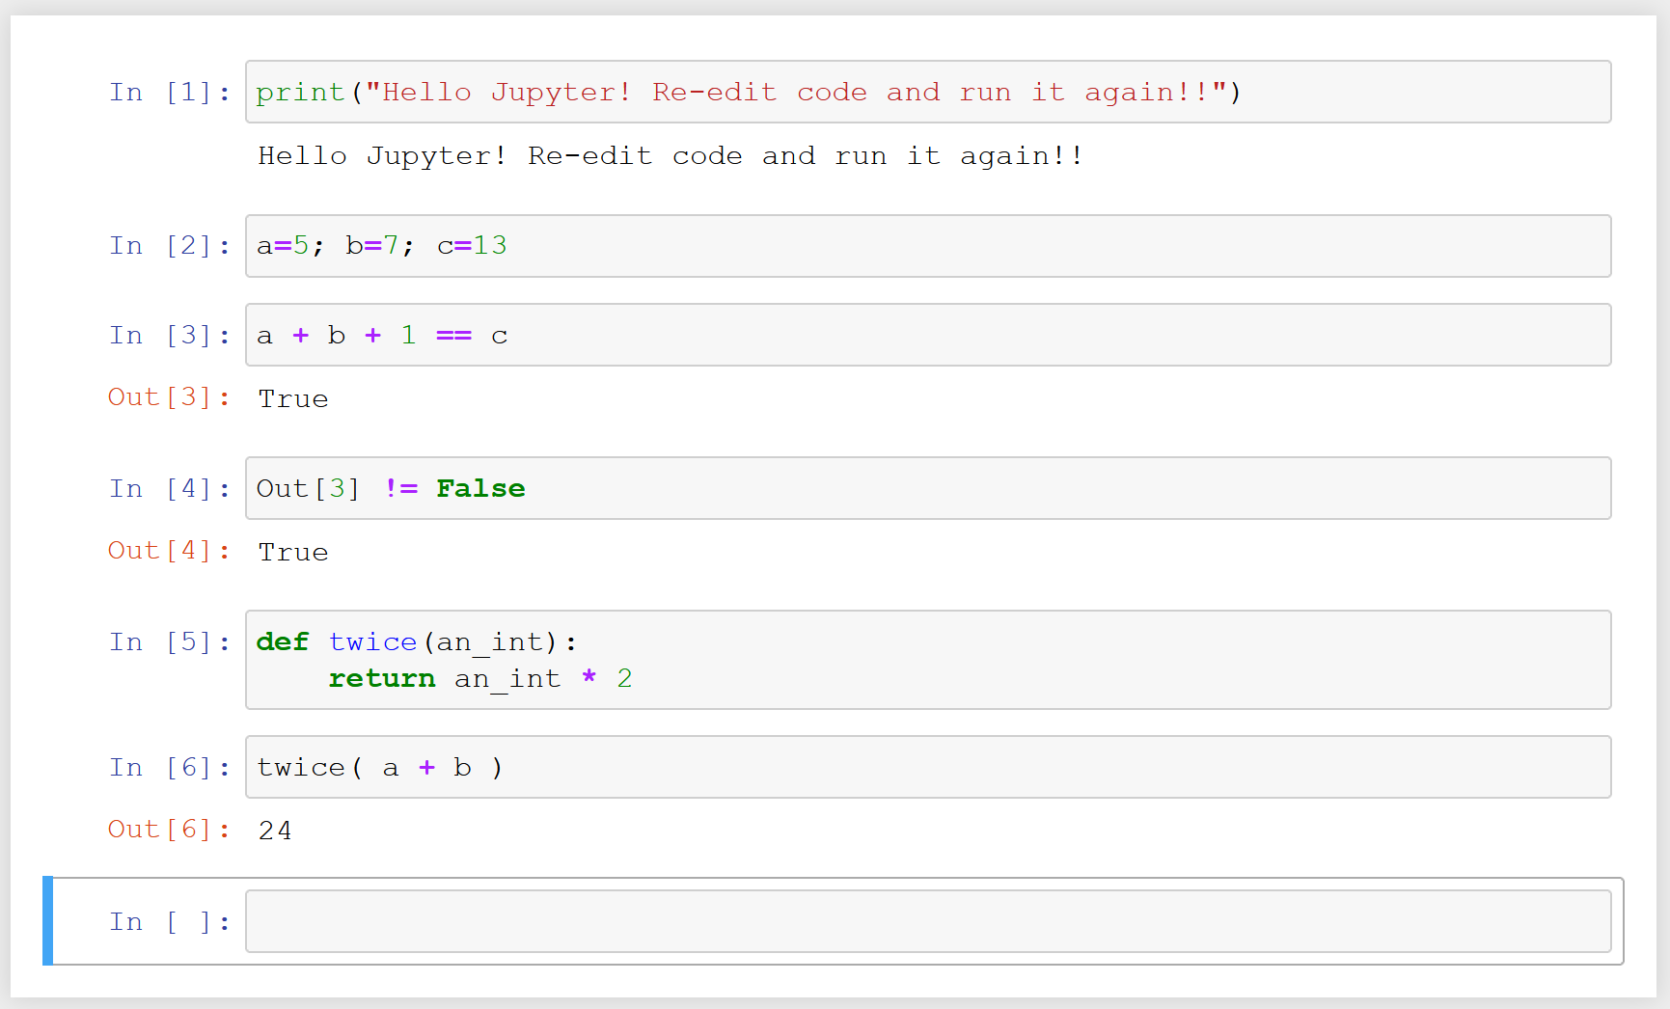
Edit any code in any cell and run that cell and any other cells again

Slide 18
Start Jupyter
Create a notebook
Copy the code for the function thermostat() into a cell
Run the cell
Test the function thermostat() works correctly in the following cells
Create another notebook and do the same for score_2()
‘’ ‘’ ‘’ ‘’ ‘’ ‘’ score_6()
‘’ ‘’ ‘’ ‘’ ‘’ and other functions

Slide 19
Jupyter Notebooks
Your coding notebook – markdown

