Slide 1
LIN6209 Coding for Linguists
Regular Expressions

Slide 2
Last week – analysing text
Randomness
Probability
Dependant & Independent events
Bayes Theorem
Statistical measures
Average: mean, mode, median
Distributions
Measures of variance
Regression Analysis
Cluster analysis

Slide 3
design
build
test
evaluate
analyse
requirements

Slide 4
This week – regular expressions
What is a regular expression?
Search
Searching for text that matches a given pattern
Search & Replace
Searching for text that matches a given pattern
Replacing that text with another pattern
Lexical analysis
Syntax analysis
Abstract syntax trees
BNF notations
Language translation
Compilers and interpreters
The syntax of Python

Slide 5
Search & Replace
A gentle introduction to regular expressions with MS Word

Slide 6
MS Word documents ‘search & replace’
Search to find sequences of text
Many options to modify search, including use of ‘wildcards’
Optionally substitute found text with replacement text

Slide 7
The MS Word ‘Search’ feature
Search
Specify the whole document, or from your cursor upwards or downwards
Match case
Find words that only match specific capitalization
Find Whole words only:
Avoid partial matches, for example searching for "One" doesn't find "Someone"
Use wildcards
Get partial matches. For example, "the*" finds "theatre", "thespian", and "theremin"
Sounds like (English)
Match words that sound like others, for example "they're", "there", and "their."
Find all word forms (English)
Find all verb tenses. For example, type "find", and Word will return "finds", "finding", and "found"
Match prefix
Works with other settings to find words with common prefixes or beginnings
Match suffix
Works with other settings to find words with common suffixes or endings
Ignore punctuation characters
Ignore differences in hyphenation
Ignore white-space characters
Ignore spacing between characters

Slide 8
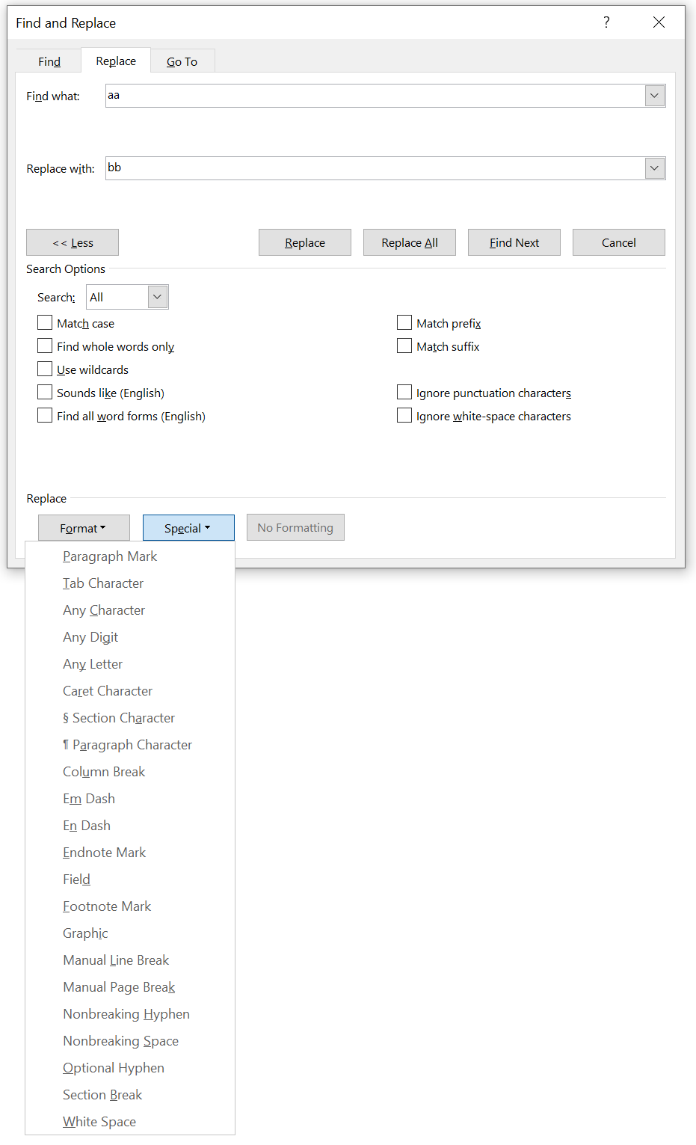
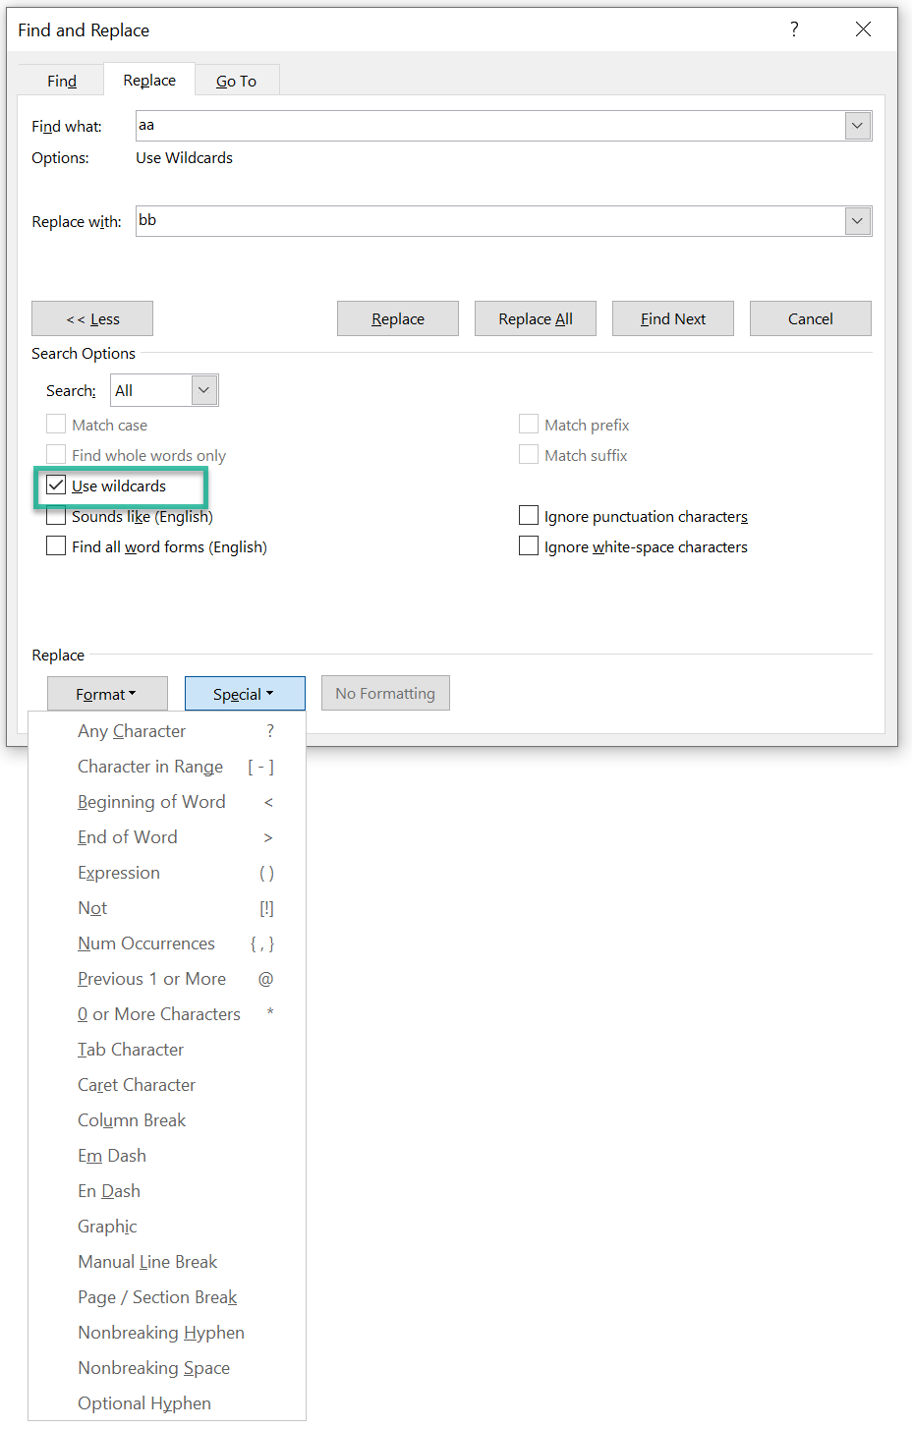

Slide 9
MS Word ‘wildcards’
Wildcard characters & their meaning |  |  | Example search strings
? | Any single character |  | s?t | ‘sit’, ‘sat’, ‘inset’, ‘s t’ but not ‘stir’
* | Any number of characters |  | s*t | ‘sit’, ‘start’, (note it’s NOT ‘start’)
@ | One or more of previous char |  | s?*t | ‘sit’, ‘inset’, ‘start’
< > | Start and end of word markers |  | <ful@> | ‘ful’, ‘full’
[ a-c ] | Sets or ranges of char |  | [w-y][tp] | ‘text’, ‘expand’, ‘expert’, ‘eXtend’, ‘ypres’
\ | Escapes special meaning of above |  | [\?] | ‘m?rk’
[ ! ] | Negation of set or range of chars |  | [!a-za-z] | Matches anything not in a-z and A-Z
{ n } | Exactly ‘n’ occurrences of previous char |  | a{2} | ‘aa’, ‘aaa’, ‘aaa’, ‘aaaaa’
{n,m} | Between n and m occurrences |  | a{2, 3} | ‘aa’, ‘aaa’, ‘aaaa’ but not ‘caraway’
( ) | Identify sub-parts of search patterns |  | (<>)[ ](<>) | Two strings separated by a space
^ | ^t = tab, ^g = graphic, ^^=^ |  |  | This feature is incomplete and buggy

Slide 10
Regex in MS Word – Find the occurrences of
Text ‘and’
Text ‘s_s’ where _ is a vowel
Every number
Words that begin with ‘s’ and end with ‘t’
Words that contain two adjacent vowels
Find every word that ends with a question mark
Words that begin with a letter, three digits ‘-’ two digits e.g. A123-45
Find ‘fruit’ and transpose it with the immediately following word
https://wordmvp.com/FAQs/General/UsingWildcards.htm

Slide 11
Python Challenge
Write functions to search for each of the patterns on previous slide
This starts easy for the simple examples
But steadily becomes more and more difficult
Emulating the search patterns that use wildcards can be difficult
Search for ‘123’ = easy
Search for any three-digit number embedded in a word = not so easy!

Slide 12
Regular expressions in Python
The re library

Slide 13
The Python re library
https://docs.python.org/3/library/re.html
Comprehensive documentation on the many features of the re library
Not the best way to get started
https://docs.python.org/3/howto/regex.html
A simpler introduction with lots of examples – start here
https://pythex.org/
Interactive regex checker that models Python re library
https://www.w3schools.com/python/python_regex.asp
As always, a good starting point

Slide 14
Python re metacharacters
Metacharacter and its meaning (abbreviated list)
. | any single character except newline
* | zero or more repetitions
+ | one or more repetitions
? | zero or one repetition
{} | specified number of repetitions
[] | specifies a character class
| | designates alternation
^ | complements a character class
\ | escape metacharacter

Slide 15
Searching text with re
import re
s = 'foo123bar'
re.search('123', s)
# <re.Match object; span=(3, 6), match='123’>
s[3:6]
# ‘123’
# using metacharacters
re.search('[0-9][0-9][0-9]', s)
# or, even better
re.search('[0-9]{3}', s)
# ints must be consecutive
t= 'a12ccccc34a'

Slide 16
Try these – in a string search for . . .
A vowel
A lower case letter followed by an upper case letter
A capital letter followed by at least 2 lower case letters
A binary number (consecutive zero’s and one’s)
A hexadecimal number (any of 0123456789abcdefABCDEF)
The letter sequence ‘a’, followed by any letter, followed by ‘a’
The letter sequence any vowel, any letter, vowel
A valid Python variable name
An email address

Slide 17
Python re anchors
Metacharacter anchor and its meaning (abbreviated list)
\A | Beginning of string
\b | At word boundary
\B | Not At word boundary
\d | Contains digits
\D | Does not Contains digits
\s | Contains white space
\S | Not whitespace
\w | Word characters a-zA-Z0-9_
\W | No word characters
\Z | End of string

Slide 18
Greedy and lazy quantifiers
By default, regular expressions are greedy
This means that for as long as the rule is satisfied they will continue to consume characters until the end of the string
<.*>
# will consume everything from the first ‘<‘ to the last ‘>’
<.*?>
# will consume everything from the first ‘<‘ to the first following ‘>’

Slide 19
There are many options in the re library
Far too many to list here . . . . .

Slide 20
Compiling regular expressions
If you are only going to use a regular expression once then use re.search()
If you are going to us the same regular expression many times, e.g. you are building a function that uses a regex to find email addresses, compile the regex with re.compile()
Compiled regular expression objects (patterns) have many methods, including pattern.search(), pattern.findall(), and pattern.split()

Slide 21
Try this in IDLE, and your own examples
import re
P = re.compile('abc’)
p.search('zzzabcqqq')
<re.Match object; span=(3, 6), match='abc’>

Slide 22
Project Planning
Delivering projects on-time and on-budget

Slide 23
A minimal project plan contains
Project Goals
You have already done this
Deliverables
Project report
Minimal acceptable product
Resources
You
Your PC / PC lab / …
QMUL library
Nexis
whatever
Work Breakdown Structure
Component work packages
Ideally with a hierarchy of sub-tasks, sub-sub-tasks, etc
Dependencies
Dates
Deadline = Jan 9th = 34 days
Intermediate milestone dates
Dates for iteration1, 2, 3, …
Sketch it out and stick to it

Slide 24
A Project GANTT
Tasks | December 2021 | January 2022
 | 1 | 2 | 3 | 4 | 5 | 6 | 7 | 8 | 9 | 10 | 11 | 12 | 13 | 14 | 15 | 16 | 17 | 18 | 19 | 20 | 21 | 22 | 23 | 24 | 25 | 26 | 27 | 28 | 29 | 30 | 31 | 1 | 2 | 3 | 4 | 5 | 6 | 7 | 8 | 9 | 10
Definition
Data
Find & extract
Clean
20% for testing
Functions
F1
F2
F3
Charts
Design
Create
Report
Outline draft
Draft 2
Proof read
Package
Deliver
15/1
Data
Functions
design – build - test
design – build - test
design – build – test – fix – fix – fix!
Infomatics
Infomatics
Report write-up
Package for delivery
9 Jan
9 Jan

Slide 25
Project Management
Maintain countdown to delivery in plain sight = 34 days
At least every week inspect Plan & GANTT and update progress
Identify achievements = products delivered
Identify issues = work that is late, unanticipated problems
Decide on corrective action
Reduce scope – Increase work-rate – Simplify features – DO SOMETHING
Update the plan to reflect reality

Slide 26
The import statement
You do NOT have to write all of your project in one Python script

Slide 27
Modularise your code Each Python script has a distinct ‘theme’
Data extraction and clean-up code in ‘get_data.py’ and ‘data_clean.py’
Functions in one of more scripts ‘freq_analysis.py’, ‘regression_analysis.py’, ‘cluster_analysis.py’
Charting code in ‘my_charts.py’
A master control script to pull it all together
All in the same folder
import get_data
import data_clean
...
import my_charts
# code to pull everything together and conduct operations goes here

Slide 28
Module Evaluation
Do that now

Slide 29
Rule based transformation of text
Using the Python re library

Slide 30
Transforming text with re.sub()
re.sub(<regex>, <replacement>, <string>)
Scans a string for <regex> matches, replaces the matching portions of the string with the <replacement> string, and returns the result
re.subn (<regex>, <replacement>, <string>)
Behaves like re.sub() but also returns information regarding number of substitutions made

Slide 31
# try this, and your own examples
s = 'foo.123.bar.789.baz'
re.sub(r'\d+', '#', s)
re.sub('[a-z]+', '(*)', s)

Slide 32
Backreferences
# re keeps track of matches and numbers them
# these can be referenced in the replacement str
re.sub(r'(\w+),bar,baz,(\w+)’,
r'\2,bar,baz,\1',
'foo,bar,baz,qux’)
>>>'qux,bar,baz,foo'

Slide 33
Named backreferences, try your own
# number references are OK, but names are better
re.sub(r'foo,(?P<w1>\w+),(?P<w2>\w+),qux',
r'foo,\g<w2>,\g<w1>,qux',
'foo,bar,baz,qux’)
>>> 'foo,baz,bar,qux'

Slide 34
Rule based transformation of text
Translating the text of source code into binary machine code

Slide 35
Compiling computer languages
Source Code
Machine code
The text the programmer writes
A sequence of characters
The instructions the computer executes
A sequence of binary digits
Unicode characters

Slide 36
Important aside about digital computers
It’s called a digital computer because it operates exclusively on the binary digits zero ‘0’ and one ‘1’
That means that everything inside the computer, in its RAM, ROM, hard disks, solid state disks, USB flash drives, in the cloud, on your phone, … is just a long sequence on zeros and ones
Every picture, every audio recording, every text document, this PowerPoint deck; everything is a sequence of 0’s and 1’s
Computers follow complex rules defined as sequences of 0’s and 1’s to transform a sequence of 0’s and 1’ into another, and do it FAST

Slide 37
The stages of computer language compilation
Lexical analysis
Breaking source code into words and checking they are properly formed
Tokenisation
Symbol table construction
All objects and names and scopes
Syntax analysis
Checking that source code obeys rules of language grammar
Almost always construct an abstract syntax tree (AST) in parallel
Semantic analysis
Type mismatches, undeclared variables, reserved identifier/name misuses, multiple declarations of variable, accessing out of scope variables, actual and formal parameter mismatches, …
Code generation
Most often by AST rewriting
Code optimisation

Slide 38
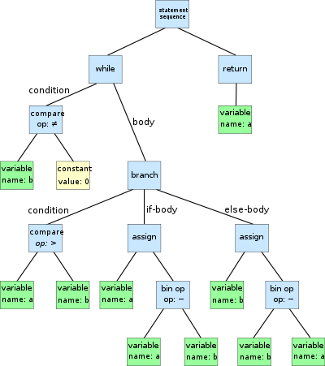
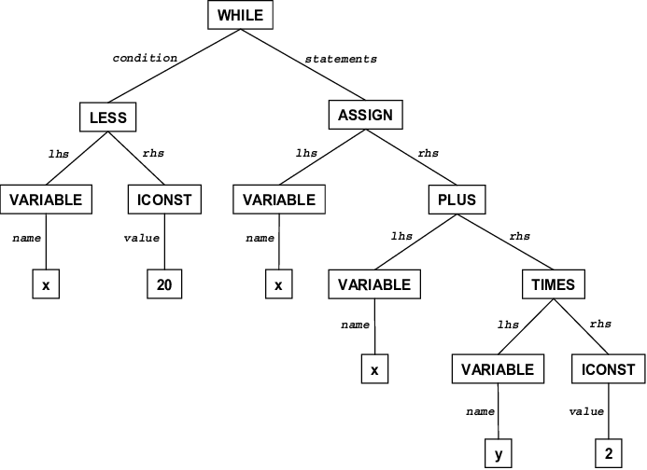
Example ASTs
while b ≠ 0:
if a > b:
a := a - b
else:
b := b - a
return a
while x < 20
x = x + y * 2

Slide 39
The definition of Python
Uses a modified BNF grammar for both lexical and syntax production rules, for example:
name ::= lc_letter (lc_letter | "_")*
lc_letter ::= "a"..."z“
Note
a lexical definition operates on the individual characters of the input source
a syntax definition operates on the stream of tokens generated by the lexical analysis

Slide 40
Python definitions – a few more examples
The arithmetic operations
m_expr ::= u_expr | m_expr "*" u_expr | m_expr "@" m_expr |
m_expr "//" u_expr | m_expr "/" u_expr |
m_expr "%" u_expr
a_expr ::= m_expr | a_expr "+" m_expr | a_expr "-" m_expr
The comparison operations
comparison ::= or_expr (comp_operator or_expr)*
comp_operator ::= "<" | ">" | "==" | ">=" | "<=" | "!="
| "is" ["not"] | ["not"] "in"

Slide 41
Designing & Building a computer language
Computer languages do not have to be big and complex
A computer language could be specific to just a single application
Often as part of the user interface

Slide 42
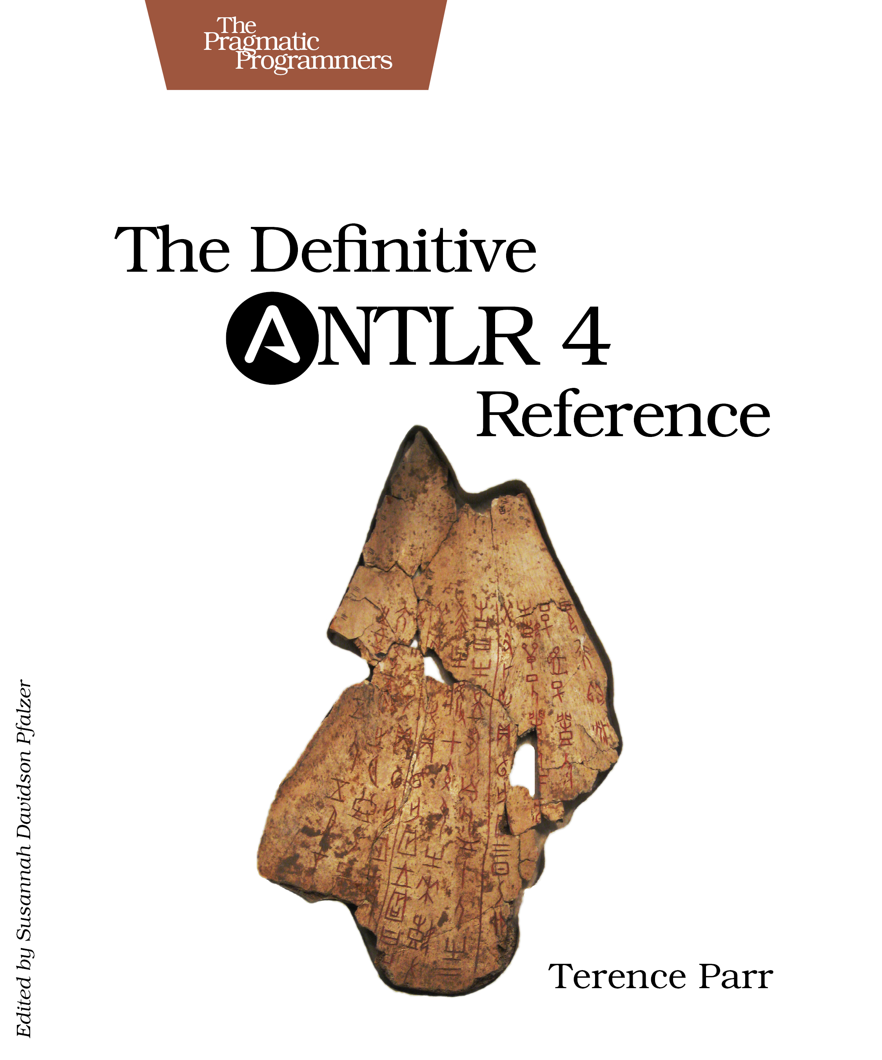
Building a computer language
Many applications use a ‘mini-language’
A very approachable tool for building a computer language is ‘ANTLR’
The book is very practical with just enough references to theory
You will need to learn Java (your second computer language ?)
https://www.antlr.org

Slide 43
Next Week – The Python Ecosystem
A quick tour of the parts of Python didn’t cover
A broader look at the uses of Python
A quick overview of the IT industry

Slide 44
Last Slide
That’s it for today

