Slide 1
LIN6209 Coding for Linguists
Regular Expressions

Slide 2
design
build
test
evaluate
analyse
requirements

Slide 3
This week – regular expressions
What is a regular expression?
Search
Using a regex to search for text that matches a given pattern
Search & Replace
Using a regex to search for text that matches a given pattern and replace it with text that matches another pattern

Slide 4
A regular expression is a sequence of characters that specifies a search pattern in text

Slide 5
Search & Replace
A gentle introduction to regular expressions with MS Word

Slide 6
MS Word documents ‘search & replace’
Search documents to find specific sequences of text
Many options to modify search, including the use of ‘wildcards’
Optionally substitute found text with replacement text

Slide 7
The MS Word ‘Search’ feature
Search context
Specify the whole document, or from your cursor upwards or downwards
Match case
Find text that only matches specified capitalization
Find Whole words only:
Avoid partial matches, for example searching for "One" doesn't find "Someone"
Wildcards
Get partial matches. For example, "the*" finds "theatre", "thespian", and "theremin"
Sounds like (English)
Match words that sound like others, for example "they're", "there", and "their."
Find all word forms (English)
Find all verb tenses. For example, type "find", and Word will return "finds", "finding", and "found"
Match prefix / postfix
Works with other settings to find words with common beginnings and/or endings
Ignore punctuation characters
Ignore non-alphabetic characters
Ignore white-space characters
Ignore spacing between characters

Slide 8
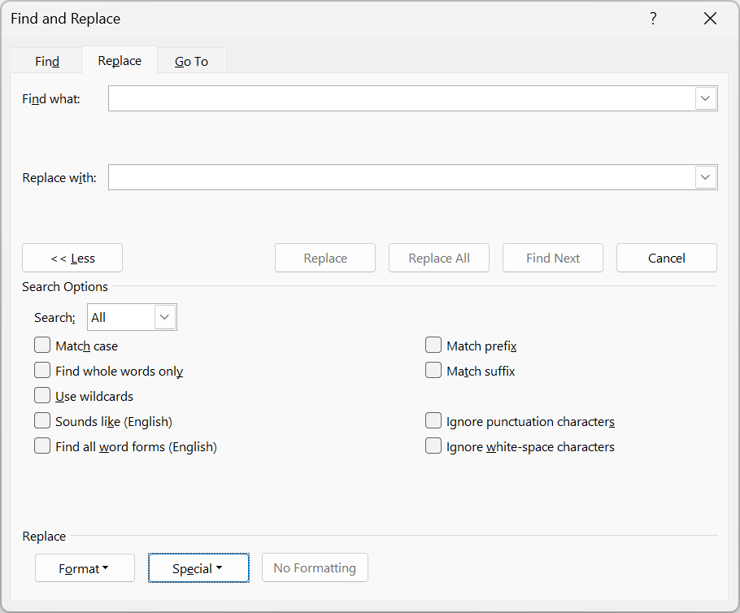
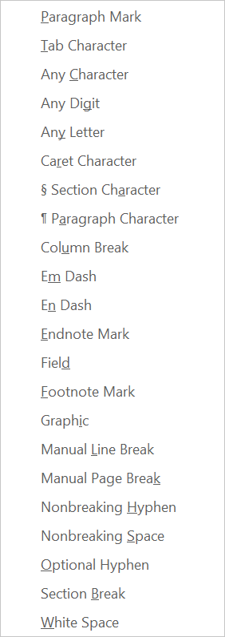
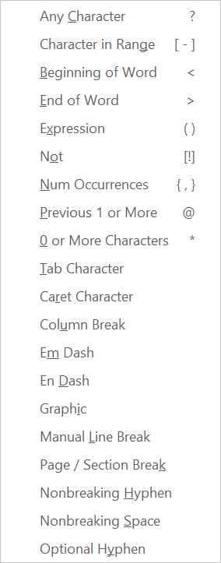

Slide 9
MS Word ‘wildcards’
Wildcard characters & their meaning |  |  | Example search strings
? | Any single character |  | s?t | ‘sit’, ‘sat’, ‘inset’, ‘s t’ but not ‘stir’
* | Any number of characters |  | s*t | ‘sit’, ‘start’, (note it’s NOT ‘start’)
@ | One or more of previous char |  | s?*t | ‘sit’, ‘inset’, ‘start’
< > | Start and end of word markers |  | <ful@> | ‘ful’, ‘full’
[ a-c ] | Sets or ranges of characters |  | [w-y][tp] | ‘text’, ‘expand’, ‘expert’, ‘eXtend’, ‘ypres’
\ | Escapes special meaning of above |  | [\?] | ‘m?rk’
[ ! ] | Negation of set or range of chars |  | [!a-zA-Z] | Matches anything not in a-z and A-Z
{ n } | Exactly ‘n’ occurrences of previous char |  | a{2} | ‘aa’, ‘aaa’, ‘aaa’, ‘aaaaa’
{n,m} | Between n and m occurrences |  | a{2, 3} | ‘aa’, ‘aaa’, ‘aaaa’ but not ‘caraway’
( ) | Identify sub-parts of search patterns |  | (<*>)[ ](<*>) | Two words separated by a space
^ | ^t = tab, ^g = graphic, ^^=^

Slide 10
Regex in MS Word – Find the occurrences of
The occurrences of the text ‘and’
The text ‘s_s’ where _ is a vowel
Every number that is followed by a letter
Words that begin with ‘s’ and end with ‘t’
Words that contain two adjacent vowels
Find every word that ends with a question mark
Words that begin with a letter, three digits ‘-’ two digits e.g. A123-45
Find ‘fruit’ and transpose it with the immediately following word
https://wordmvp.com/FAQs/General/UsingWildcards.htm

Slide 11
Now you do it . . .

Slide 12
Regular expressions in Python
The re library

Slide 13
The Python re library
docs.python.org/3/library/re.html
Comprehensive documentation but not the best way to get started
docs.python.org/3/howto/regex.html
A simpler introduction with lots of examples – start here

Slide 14
Python re metacharacters
Metacharacter and its meaning (abbreviated list)
. | any single character except newline
* | zero or more repetitions
+ | one or more repetitions
? | zero or one repetition
{} | specified number of repetitions
[] | specifies a character class
| | designates alternation
^ | complements a character class
\ | escape metacharacter
( ) | identify sub-parts of search patterns

Slide 15
Searching text with re
import re
a_str = 'foo123bar'
re.search('123', a_str)
# <re.match object; span=(3, 6), match='123’>
a_str[3:6]
# ‘123’
# using metacharacters
re.search('[0-9][0-9][0-9]', a_str)
# or, even better
re.search('[0-9]{3}', a_str)
# ints must be consecutive
t= 'a12ccccc34a'

Slide 16
Python re anchors
Metacharacter anchor and its meaning (abbreviated list)
\A | Beginning of string
\b | At word boundary
\B | Not At word boundary
\d | Contains digits
\D | Does not Contains digits
\s | Contains white space
\S | Not whitespace
\w | Word characters a-zA-Z0-9_
\W | No word characters
\Z | End of string

Slide 17
Greedy and lazy quantifiers
By default, regular expressions are greedy
This means that for as long as the rule is satisfied they will continue to consume characters until the end of the string
<.*>
# will consume everything from the first ‘<‘ to the last ‘>’
<.*?>
# will consume everything from the first ‘<‘ to the first following ‘>’

Slide 18
There are many options in the re library
Far too many to list here . . . . .
Let’s practice some python regular expressions at pythex.org
Many other flavours of regular expression at regex101.com
Solve the same problems with the same piece of text as you just did in MS Word

Slide 19
Try these – in a string search for . . .
A vowel
A lower case letter followed by an upper case letter
A capital letter followed by at least 2 lower case letters
The letter sequence any vowel, any letter, any vowel
A valid Python variable name
A binary number (consecutive zero’s and one’s)
A hexadecimal number (digits are 0123456789abcdefABCDEF)
The letter sequence ‘a’, followed by any letter, followed by ‘a’
An email address

Slide 20
Compiling regular expressions
If you are only going to use a regular expression once then use re.search()
If you are going to us the same regular expression many times, e.g. you are building a function that uses a regex to find email addresses, compile the regex with re.compile()
Compiled regular expression objects (patterns) have many methods, including pattern.search(), pattern.findall(), and pattern.split()

Slide 21
Try this in IDLE, and your own examples
import re
p = re.compile('abc’)
p.search('zzzabcqqq’)
# re.Match object; span=(3, 6), match='abc’

Slide 22
Lots more practice and guidance here:
https://pythex.org/
Interactive regex checker based upon Python re library
realpython.com/regex-python-part-1/ and part-2/
w3schools.com/python/python_regex.asp
As always, both are good starting points

Slide 23
Now you do it . . .

Slide 24
Lets Take a Break!

Slide 25
Rule based transformation of text
Using the Python re library

Slide 26
Transforming text with re.sub()
re.sub(<regex>, <replacement>, <string>)
Scans a string for <regex> matches, replaces the matching portions of the string with the <replacement> string, and returns the result
re.subn (<regex>, <replacement>, <string>)
Behaves like re.sub() but also returns information regarding number of substitutions made

Slide 27
# try this, and your own examples
s = 'foo.123.bar.789.baz'
re.sub(r'\d+', '#', s)
re.sub('[a-z]+', '(*)', s)

Slide 28
Backreferences
# re keeps track of matches and numbers them
# these can be referenced in the replacement str
re.sub(r'(\w+),bar,baz,(\w+)’,
r'\2,bar,baz,\1',
'foo,bar,baz,qux’)
>>>'qux,bar,baz,foo'

Slide 29
Named backreferences, try your own
# number references are OK, but names are better
re.sub(r'foo,(?P<w1>\w+),(?P<w2>\w+),qux',
r'foo,\g<w2>,\g<w1>,qux',
'foo,bar,baz,qux’)
>>> 'foo,baz,bar,qux'

