Slide 1
LIN6209 Coding for Linguists
Randomness, Statistics, Regression & Machine Learning

Slide 2
design
build
test
evaluate
analyse
requirements

Slide 3
This week
Randomness
Probability
Dependant & Independent events
Bayes Theorem
Statistical measures
Average: mean, mode, median
Distributions
Measures of variance
Regression Analysis
Cluster analysis

Slide 4
Randomness, Probability and Sampling

Slide 5
Random events
Selecting one from a collection
Selecting many from a collection
Tossing a coin
Pick a marble from a bag of 3 blue and 9 red marbles
Pick a card, any card, …
Toss the same coin twice
Pick two marbles from a bag of 3 blue and 9 red marbles
Pick two cards

Slide 6
Dependant & Independent events

Slide 7

Choosing two marbles from a bag
Independent events
Choose a marble from the bag
Replace the marble in the bag
Choose a marble from the bag
Dependent events
Choose a marble from the bag
Do not replace marble in bag
Choose a marble from the bag

Slide 8
Python libraries
# standard library
# do these first
from random import *
randint(5)
choice() # read
choices # the Python
shuffle() # docs
sample() # for these
# numpy library
# do these second
from numpy import random x=random.randint(100, size=(5)) print(x)

Slide 9
Task 1
Task 2
from numpy import random as r x=r.randint(100, size=(25)) y=r.randint(100, size=(25))
# create scatter plot
# in a Jupyter notebook?
# create a separate chart with # floating point random values
# create a third scatterplot # containing both sets of data.
# label the chart and axis. # colour the data meaningfully.

Slide 10
Now you do it . . .

Slide 11
Bayes’ Theorem
The probability of event B given that event A has already happened

Slide 12
It’s the mid 18th century and you have poxy spots! Is it chickenpox (inconvenient) or smallpox (fatal)?
The patient
The doctor
A sudden rash of blistery spots
Looks like smallpox !
Smallpox is disfiguring and often fatal !!!
I’m a gonner!
What is your advice and prognosis?

Slide 13
Diagnosis depends on relative size and overlap
Total population
smallpox
poxy spots

Slide 14
Diagnosis depends on relative size and overlap
Total population
poxy spots
smallpox

Slide 15
Diagnosis depends on relative size and overlap
Total population
poxy spots
smallpox

Slide 16
Diagnosis depends on relative size and overlap
Total population
poxy spots
smallpox

Slide 17
Diagnosis depends on relative size and overlap
Total population
poxy spots
smallpox

Slide 18
The doctors local knowledge
Total population is twice this size
poxy spots
81 in 1,000 have poxy spots
1 in 1,000 of pop have smallpox
9 in 10 smallpox patients have spots
So chances you have smallpox is about 1%
smallpox

Slide 19
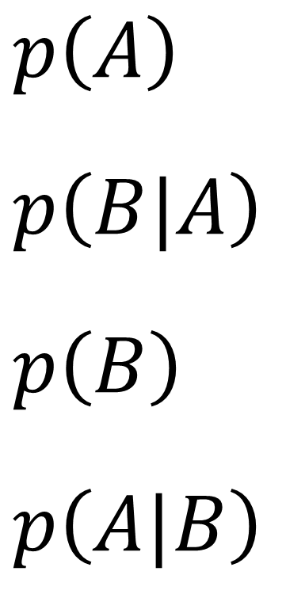
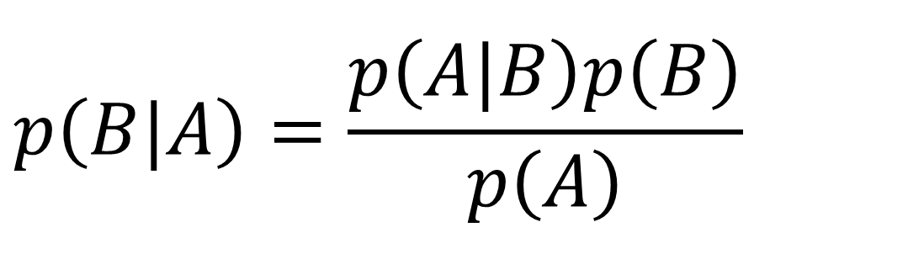
Bayes Theorem
$$p\left(B|A\right)=\frac{p\left(A|B\right)p\left(B\right)}{p\left(A\right)}$$
$p\left(A\right)$
$$p\left(B|A\right)$$
$$p\left(B\right)$$
$$p\left(A|B\right)$$
Probability of A
Probability of B given A is true
Probability of B
Probability of A given B is true

Slide 20
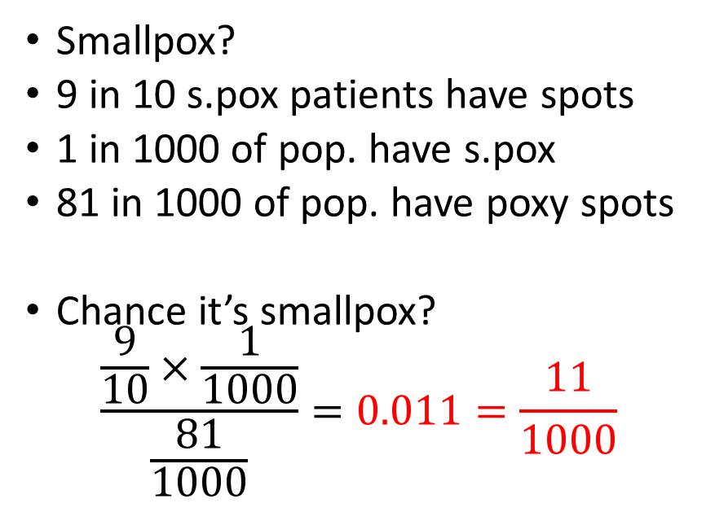
It’s the mid 18th century and you have poxy spots! Is it chickenpox (inconvenient) or smallpox (fatal)?
The patient
The doctor
A sudden rash of blistery spots
Looks like smallpox !
Smallpox is disfiguring and often fatal !!!
I’m a gonner!
Smallpox?
9 in 10 s.pox patients have spots
1 in 1000 of pop. have s.pox
81 in 1000 of pop. have poxy spots
Chance it’s smallpox?
$$\frac{\frac{9}{10}×\frac{1}{1000}}{\frac{81}{1000}}=0.011=\frac{11}{1000}$$

Slide 21
Bayes Theorem for Machine Learning
Conditional probability
Muffled sound A after sound(s) B then most probably A is sound ‘X’
Unknown word after word(s) B is most probably the word ‘Y’
Classification analysis
Most likely it’s an ‘X’ rather than a ‘Y’
Example – analysis of Titanic survival probabilities*
Woman with 1st class ticket – group most likely to write memoirs
Anyone in 3rd class or stowage – put your last message in that bottle now
* Titanic step-by-step analysis on Kaggle: https://www.kaggle.com/alexisbcook/titanic-tutorial

Slide 22
Statistical Measures
Bringing it all down to one number

Slide 23
Statistical Measures
Mean
Arithmetic, Harmonic
Mode
Most frequent data item
Median
Equal data both sides
Variance
Standard deviation
Skew
Distribution
Binomial
Normal
Log normal
…

Slide 24
Python statistics Library
https://docs.python.org/3/library/statistics.html
https://www.w3schools.com/python/module_statistics.asp
Use statistics judiciously, most people are easily confused
Case by case – decide which statistical measures give meaningful insights into the structure of your data

Slide 25
Regression Analysis
‘Best fit’ approximations

Slide 26

Two Dimension Linear Regression Prediction with a straight edge ruler
good fit
poor fit
→
y
$$y=mx+c$$
x→

Slide 27
Two Dimensional Linear Regression
Good Fit – least total error
good fit
Datapoints have two dimensions (x, y)
Minimise the distance between datapoints and predictions

Slide 28
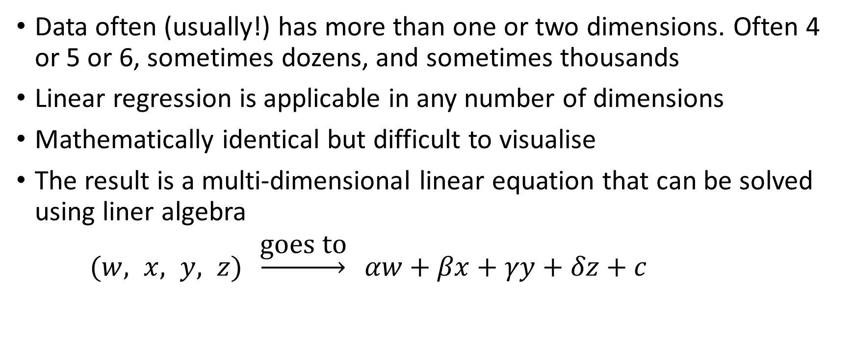
Multi-dimensional Linear Regression
Data often (usually!) has more than one or two dimensions. Often 4 or 5 or 6, sometimes dozens, and sometimes thousands
Linear regression is applicable in any number of dimensions
Mathematically identical but difficult to visualise
The result is a multi-dimensional linear equation that can be solved using liner algebra
$(w, x, y, z) \underset{→}{\text{goes} \text{to}} αw+βx+γy+δz+c$

Slide 29
Polynomial Regression – the data

Slide 30
Polynomial Regression – good enough?

Slide 31
Polynomial Regression – is middle bump real?

Slide 32
Polynomial Regression – overfitted

Slide 33
Regression using Anaconda

Slide 34
Anaconda Regression Analysis
# import libraries
import numpy as np
import matplotlib.pyplot as plt
from sklearn.linear_model import LinearRegression

Slide 35
Anaconda (3.8) – prepare the data
# get the data
xdata = np.array([5, 15, 25, 35, 45, 55])
ydata = np.array([5, 20, 14, 32, 22, 38])
# transform arrays for regression
x = xdata.reshape((-1, 1))
y = ydata
# print these to check they are OK and see the shape

Slide 36
Anaconda (3.8) – create model and fit to data
# create model object
model = LinearRegression()
model.fit(x, y)
# examine its properties
r_sq = model.score(x, y)
print('coefficient of determination:', r_sq)
print('intercept:', model.intercept_)
print('slope:', model.coef_)

Slide 37
Anaconda (3.8) – plot the data and regression
plt.plot(xdata, ydata, ls='', marker = 'o’)
yline = np.array([model.intercept_, 55*model.coef_[0] + model.intercept_])
xline = np.array([0, 55])
plt.plot(xline, yline)
plt.show()

Slide 38
Anaconda (3.8) another example
xdata2 = np.array([0.1, 1.09, 2.11, 2.91, 3.8, 4.9, 5.9])
ydata2 = np.array([1.9, 4.9, 8.2, 11.4, 13.7, 16.7, 20.2])
plt.plot(xdata2, ydata2, ls='', marker = 'o’)
x2 = xdata2.reshape((-1, 1))
y2 = ydata2
model2 = LinearRegression().fit(x2, y2)
yline2 = np.array([model2.intercept_, 6*model2.coef_[0] + model2.intercept_])
xline2 = np.array([0, 6])
plt.plot(xline2, yline2)
plt.show()

Slide 39
Now you do it . . .

Slide 40
Python 3.10
New feature in Python 3.10

Slide 41
Python – regression analysis
# python version 3.10 includes # linear_regression() in statistics library
xdata = [0.1, 1.09, 2.11, 2.91, 3.8. 4.9, 5.9]
ydata = [1.9. 4.9, 8.2,11.4, 13.7, 16.7, 20.2]
# plot data and best fit linear model # on same chart

Slide 42
Python – installed on your PC
Upgrade to version 3.10
Error messages much improved!
IDLE has minor but worthwhile improvements

Slide 43
Category Analysis

Slide 44

Friend or Foe?

Slide 45
Pattern Analysis
There are a multitude of patterns that do not yield to regression

Slide 46


Other techniques required

Slide 47
Next week The IT ecosystem

