Slide 1
Compilers: Translating program source code into binary machine code
The rule based transformation of text, much like Regular Expressions

Slide 2
Important aside about digital computers
It’s called a digital computer because it operates exclusively on the binary digits zero ‘0’ and one ‘1’
Everything inside the computer, instructions and data, … is just a long sequence of zeros and ones
Digital Computers follow complex rules, many built into the silicon hardware, to transform sequences of 0’s and 1’s into other sequences of 0’s and 1’s , and do it FAST

Slide 3
Compiling computer languages
Source Code
Machine code
The text the programmer writes
A sequence of characters
The instructions the computer executes
A sequence of binary digits
Transformation rules

Slide 4
Remember ‘Regula Expressions’?
# enables complex find & replace rules
re.sub(r'foo,(?P<w1>\w+),(?P<w2>\w+),qux',
r'foo,\g<w2>,\g<w1>,qux',
'foo,bar,baz,qux’)
>>> 'foo,baz,bar,qux'

Slide 5
The stages of computer language compilation
Lexical analysis
Breaking source code into words and checking they are properly formed
Tokenisation
Symbol table construction
All names, objects and scopes
Syntax analysis
Check that source code obeys the rules of the language grammar
Almost always construct an abstract syntax tree (AST) in parallel
Semantic analysis
Detect type mismatches, undeclared variables, reserved identifier/name misuses, multiple declarations of variable, accessing out of scope variables, actual and formal parameter mismatches, …
Code generation
Most often by AST rewriting
Code optimisation
Leave it to the compiler

Slide 6
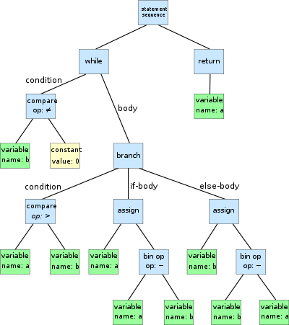
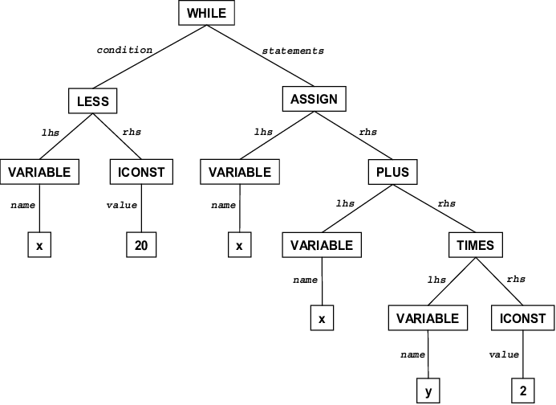
Example ASTs
while b ≠ 0:
if a > b:
a := a - b
else:
b := b - a
return a
while x < 20
x = x + y * 2

Slide 7
The definition of Python
Uses a modified BNF grammar for both lexical and syntax production rules, for example:
name ::= lc_letter (lc_letter | "_")*
lc_letter ::= "a"..."z“
Note
a lexical definition operates on the individual characters of the input source
a syntax definition operates on the stream of tokens generated by the lexical analysis

Slide 8
Python definitions – a few more examples
The arithmetic operations
m_expr ::= u_expr | m_expr "*" u_expr | m_expr "@" m_expr |
m_expr "//" u_expr | m_expr "/" u_expr |
m_expr "%" u_expr
a_expr ::= m_expr | a_expr "+" m_expr | a_expr "-" m_expr
The comparison operations
comparison ::= or_expr (comp_operator or_expr)*
comp_operator ::= "<" | ">" | "==" | ">=" | "<=" | "!="
| "is" ["not"] | ["not"] "in"

Slide 9
Designing & Building a computer language
Computer languages do not have to be big and complex
A computer language can be specific to just a single application
Often as part of the user interface

Slide 10
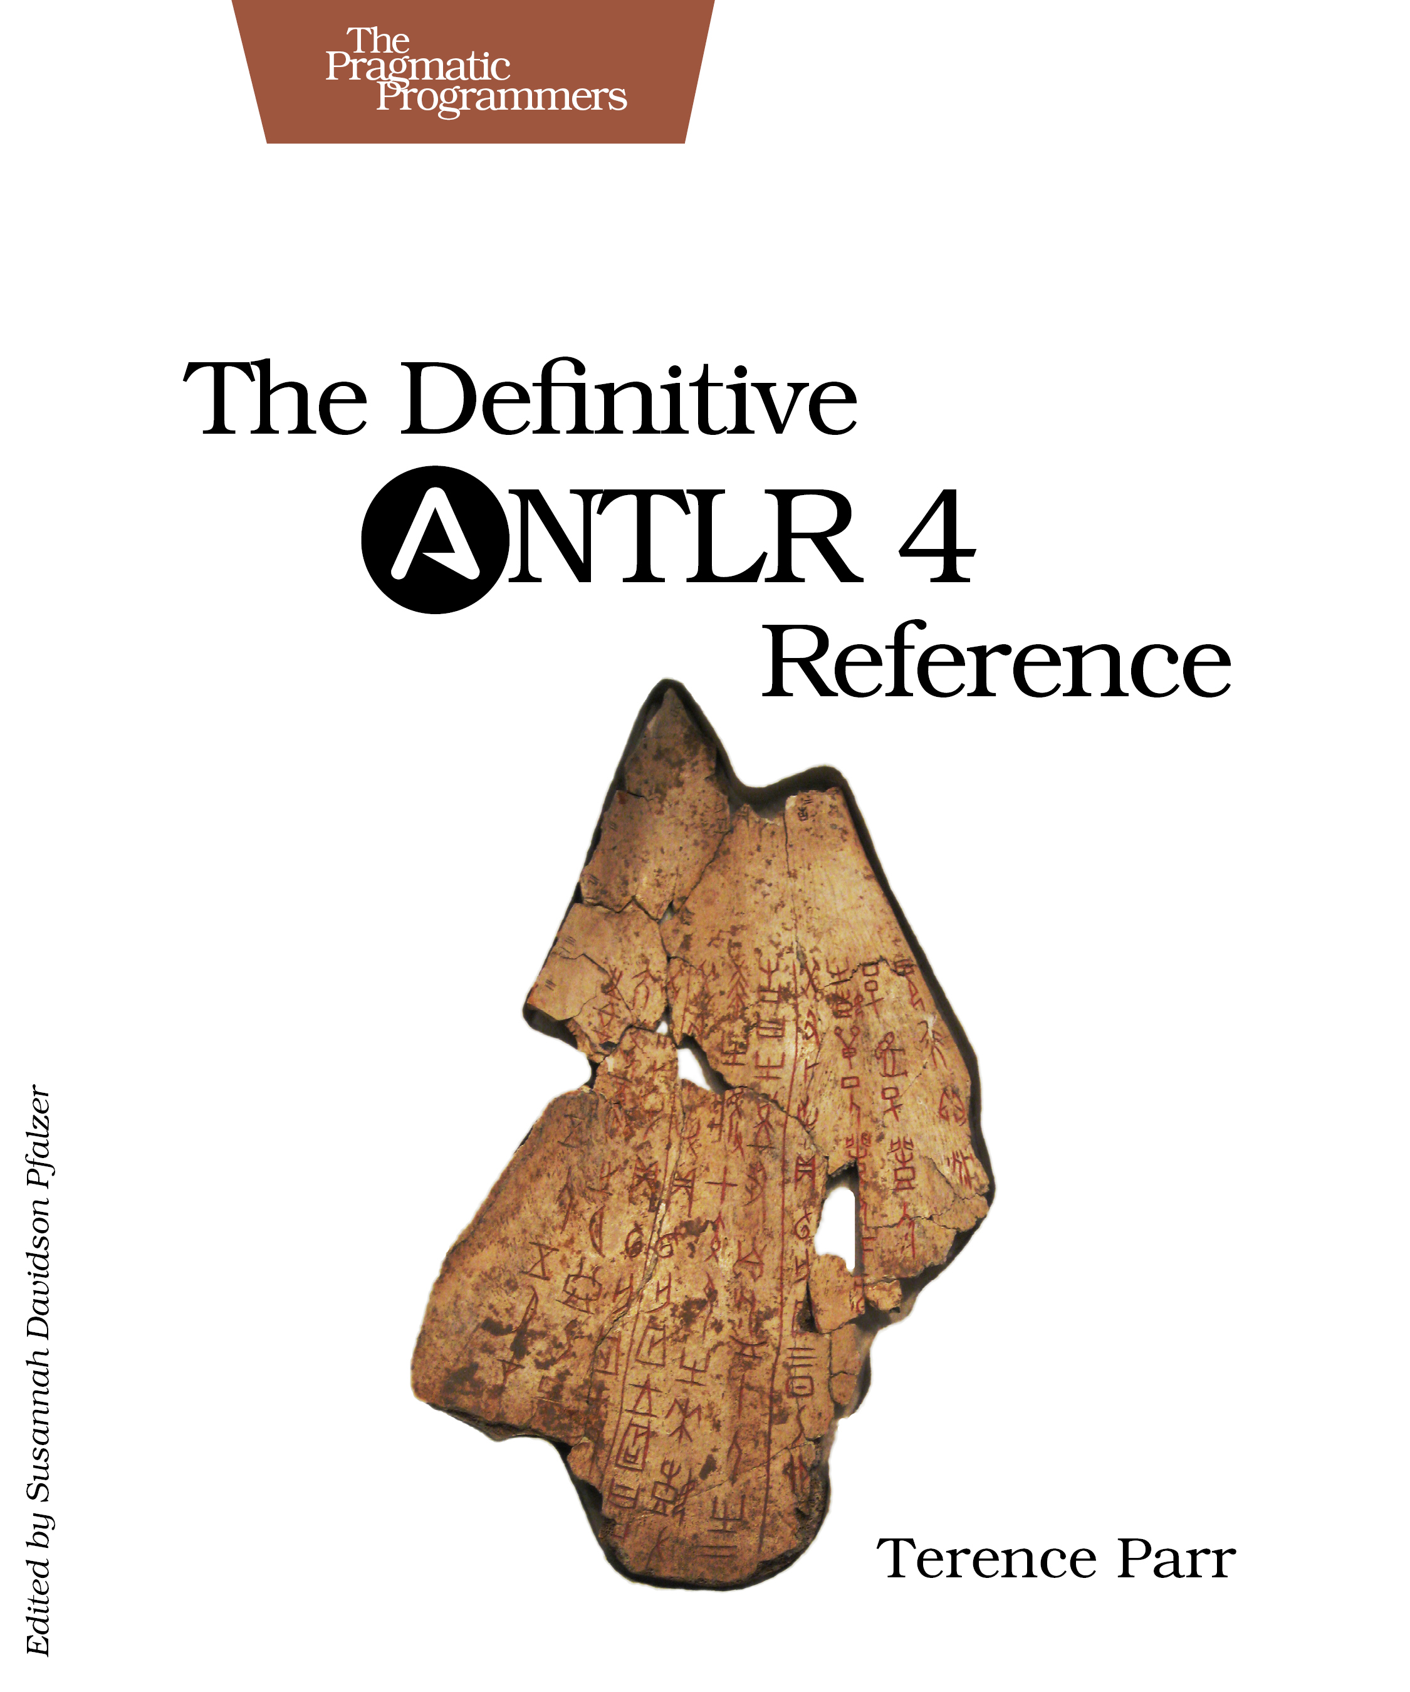
Building a computer language
Many applications use a ‘mini-language’
A very approachable tool for building a computer language is ‘ANTLR’
The book is very practical with just enough references to theory
You will need to learn Java (your second computer language ?)
https://www.antlr.org

