Slide 1
Coding for Linguists week 1. Getting Started

Slide 2
What is a Digital Computer
A digital computer is a machine that inputs data and instructions encoded in binary and outputs a result encoded in binary
Binary is a sequence of 0’s and 1’s
‘000101010111011100101001001001111101101011010101010…’
Writing programs in binary is very tedious

Slide 3
What is ‘Programming’ ?
Start with a problem
Analyse the problem and possibly decompose it into simpler problems
Design an algorithm to solve it – question: what is an algorithm?
Translate the algorithm into statements in a programming language
Translate the programming language statements into binary machine code
Execute the machine code on a digital computer

Slide 4

Getting Started

Slide 5
Pre-requisites:
A PC or laptop
Windows
Apple
Unix
You know how to switch it on
Find applications and start them
Create and edit files/documents
Not a tablet or smartphone
There are ‘cloud based’ Python environments that you can use solely via your browser:
www.replit.com
www.pythonanywhere.com
docs.aws.amazon.com/cloud9/
anaconda.cloud
But that’s another layer of learning you would need to work through

Slide 6
This week you will :
Install Python and Anaconda on you own laptop / PC
Write and execute Python interactively
Use Python IDLE to write and save your Python programs
Execute your saved programs
Understand what a value, type, variable, function, and object is
Create and use integer, float, string (text), and boolean values
Create a variable and assign it a value
Understand and use the operators:
+, -, *, /, **, %, //
<, <=, ==, !=, >=, >
and, or, not, in
Understand and use the built-in functions int(), float(), str(), bool(), print() and input()
Begin to explore the Python Standard Library

Slide 7
Why Python?
Free
www.python.org
www.anaconda.com
Easy to get started
a = 2 + 2
b = ‘sp’ + ‘am’
c = (b + ‘ ’) * a + ‘& ’ + b
Easy to get help
www.stackoverflow.com
www.w3schools.com
www.realpython.com
and much, much more
Interpreted not compiled
So ‘instant’ execution
Used extensively by professional software developers & linguists
High quality ‘community editions’ of the same development tools used by developers and researchers freely available
High quality function libraries:
Text processing; web scraping; natural language analysis; data analysis; graphing & charting; regression;
And just about anything else

Slide 8
Let’s run some code

Slide 9
Logon to classroom PC
Start Python by typing ‘python’
At the ‘>>>’ prompt type this:
2 + 2
Press the ‘Enter’ key
If you get a ‘Traceback’ message try again.
If you get the response 4 then you are programming in Python

Slide 10
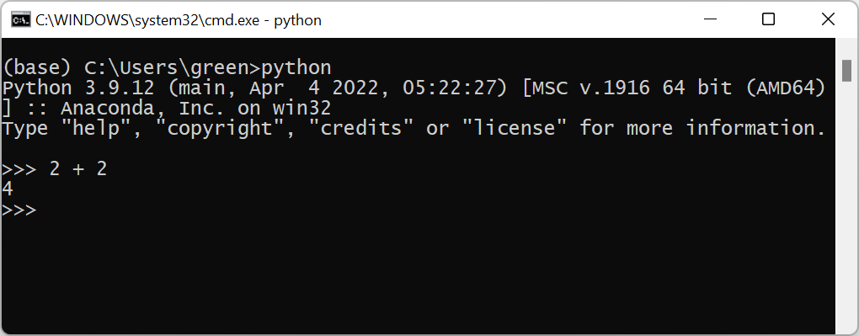
Interactive Python

Slide 11
Doing Python
Computer Scientists count from 0 (zero)
>>> 2 + 2
>>> 3 - 1
>>> 5 * 6
>>> 11 / 3
>>> 11 // 3
>>> 11 % 3
>>> 2 - 3 + 4
>>> (2 - 3) + 4
>>> 2 - (3 + 4)
>>> 11 // 2 * 2 + 11 % 2
>>> 11 // (2 * 2) + 11 % 2
>>> (11 // 2 * 2 + 11) % 2
>>> (2 ** 41 + 2 ** 43) // 1000 % 10

Slide 12
Doing Python
Computer Scientists count from 0 (zero)
5 > 4
5 < 4
4 < 5
5 == 5
4 == 6
4 != 6
5 < 4 == 4 > 5
5 < 4 != 4 > 5
Try your own arithmetic

Slide 13
Practice Worksheet
Try the examples and questions yourself
Sections: Getting Started, Numbers and Arithmetic, The Operators, BODMAS / BIDMAAS / BEDMAS / PEDMAS etc, The Relational Operators
15 minutes

Slide 14
Introducing Strings
AKA text

Slide 15
Introducing Strings - 1
' this is a string ’
“ this is a string ”
‘ ‘ ‘ this is a string ‘ ‘ ‘
“ “ “ this is a string “ “ “
‘ This string has a newline \n in it ‘
‘ This \\ is just a single backslash ‘
f“ this is an 'f' or 'format' string "
r“ this is a\n 'r' or 'raw’ s\string "

Slide 16
Introducing Strings - 2
' Monty ' + ' ' + ' Python '
# returns 'Monty Python’
'Spam' + ' and eggs' * 5
# returns 'Spam and eggs and eggs and eggs and eggs and eggs'
' a ' < ' b ‘
' a ‘ <= ' b ‘
' a ‘ !< ' b ‘
' a ‘ == ' b ‘
' a ' < ' b ‘
'A’ < 'a'
'Z’ < 'a'
'A' != 'a'

Slide 17
Practice Worksheet
Try the examples and questions yourself
Sections: Strings (text)
15 minutes

Slide 18
Boolean (truth) Values
True
False
4 == 4
4 == 5

Slide 19
Python
Computer Scientists count from 0 (zero)
More examples to try
>>> not True
>>> True and False
>>> False or 5>4
>>> ‘Ni ’ * 5
>>> ‘abcd’[1] * 7
>>> ‘c’ in ‘abracadabra’
Convert one type to another
>>> str(5)
>>> int(‘5’)
>>> bool(4)
>>> bool(‘4’)
Determine the type of an object
>>> type(3)
>>> type(‘abcd’)
>>> type(5>4)
>>> type(5/3)

Slide 20
Practice Worksheet
Try the examples and questions yourself
Sections: Strings & Boolean values
15 minutes

Slide 21
Variables
A variable is the name of a location (address) in memory where a value is stored

Slide 22
Variables
Assign a value to a name with the equality ( = ) sign
A variable is the name of an address in the computer’s memory that contains a value
Creating variables
a = 3 
b = 5 
c = 7 
d = a == b 
e = a * b + c 
f = a * (b + c) 
a, b, c, d, e, f 

Slide 23
Variable names
A variable name MUST start with a letter
A variable name MUST NOT contain spaces
A variable name MUST ONLY contain letters, digits and underscores
A variable name SHOULD start with a lower-case letter and SHOULD be meaningful
Creating variables
a = 3 
b = 5 
c = 7 
d = a == b 
e = a * b + c 
f = a * (b + c) 
a, b, c, d, e, f 

Slide 24
Practice Worksheet
Try the examples and questions yourself
Section: - variables
15 minutes

Slide 25
More about Strings
Exploring strings and the string library

Slide 26
Creating a string object
Computer Scientists count from 0 (zero)
Class str()
Single quote marks
Double quote marks
Triple quote marks
str(any_object)
'a string'
"a string"
'''a string''' or """a string"""

Slide 27
Strings are indexable & sliceable
>>> a = ‘a_string’
>>> len(a)
8
>>> a[0]
'a'
>>> a[2]
's'
>>> a[-2]
'n'
>>> a[3:6]
'tri'
>>> a[:1]
'a'
>>> a[-4:]
'ring'
>>> a[:1]+’ '+ a[4:]
'a ring'
>>> a[0:-1:2]
'asrn'
>>> a[-1::-2]
'git_'

Slide 28
The str Library https://docs.python.org/3/library/stdtypes.html#text-sequence-type-str
There are many string methods
Examples
Prototype of usage:
'the string'.method_name()
casefold()
isdecimal()
isalpha()
join()
lower()
upper()
removeprefix()
…
…

Slide 29
Practice Worksheet
Try the examples and questions yourself
Section: - more about strings
15 minutes

Slide 30
Pythons built-in functions

Slide 31
Built-in Functions https://docs.python.org/3/library/functions.html
int()
bool()
float()
str()
input()
print()
len()
chr()
ascii()
slice()
sorted()
abs(), min(), max(), …
No need to study these in detail. Just try a simple example or two for each one. That should be enough to ensure that in future you will 'know' that Python has that particular nugget of functionality 'built in'.

Slide 32
Practice Worksheet
Try the examples and questions yourself
Section: - built in functions
15 minutes

Slide 33
Saving & reusing your work

Slide 34
Interactive Programming is good – but …
It’s a lot of repetitive typing
Programs have to be typed out every time
It’s easy to make mistakes
How to solve this? ⇨ Save your programs in files

Slide 35
Every python program file MUST
Be plain text.
Do NOT use a word processor to write your programs.
Use a text editor.
Have the file extension .py
Have a file name that follows the same naming convention as variable names

Slide 36
Tools for writing python programs
Windows notepad (and lots of other 3rd party options)
MacOS textedit (and lots of other 3rd party options)
IDLE – an IDE bundled with Python – use this for now
Spyder – an open source IDE
PyCharm – a commercial IDE by JetBrains with a free ‘community’ version
Visual Code Studio – Microsoft’s commercial IDE with a free ‘community’ version

Slide 37
Find and run IDLE on your PC
In PC lab
Type IDLE at the OS prompt
On a Windows PC
From the start menu show ‘All apps’
Find the python folder and open it
Start the IDLE application
On an Apple Mac
Open Finder (or launchpad)
Find the python folder and expand it
Start the IDLE application

Slide 38
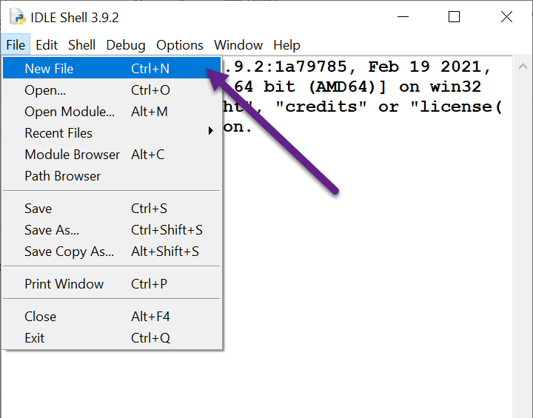
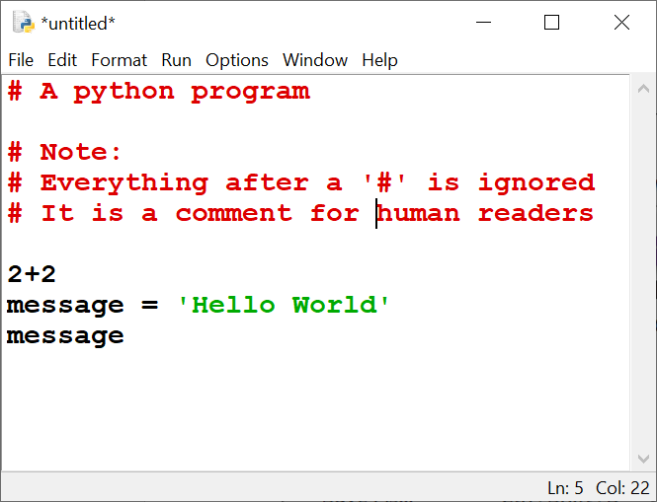
Create and write python module

Slide 39
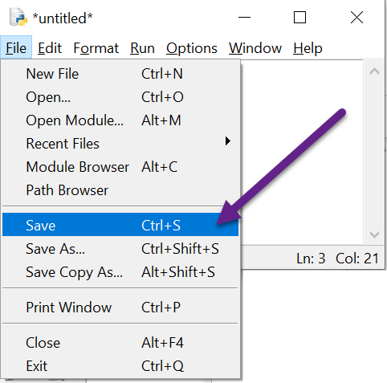
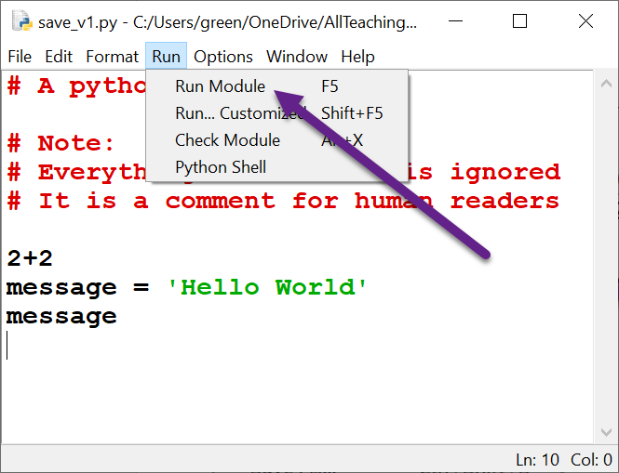
Save it and then run it

Slide 40
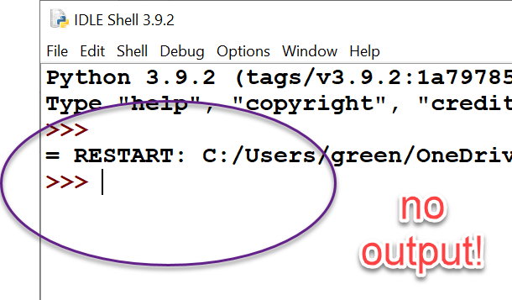
Need to explicitly tell Python to output results.
The print() function does this.

Slide 41
The print() and input() functions

Slide 42
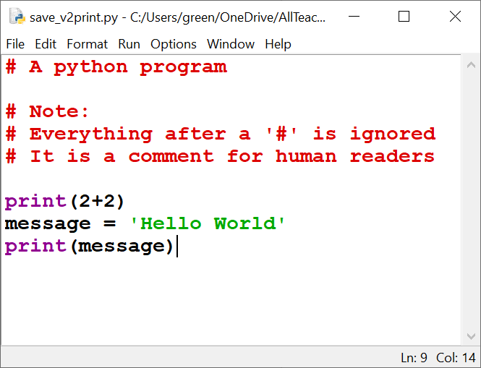
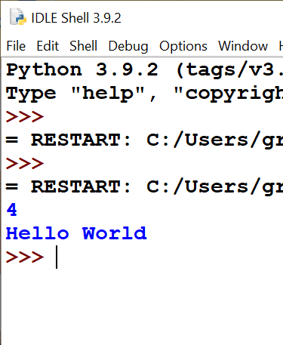
The print() function
Now it works ☺

Slide 43
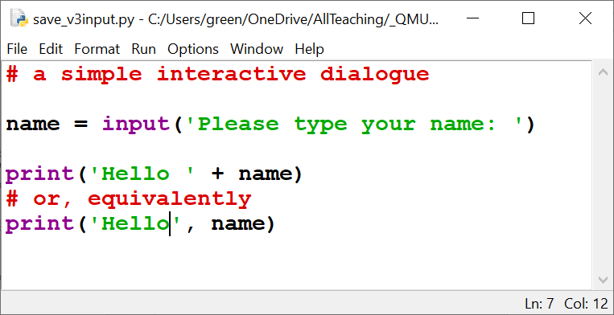
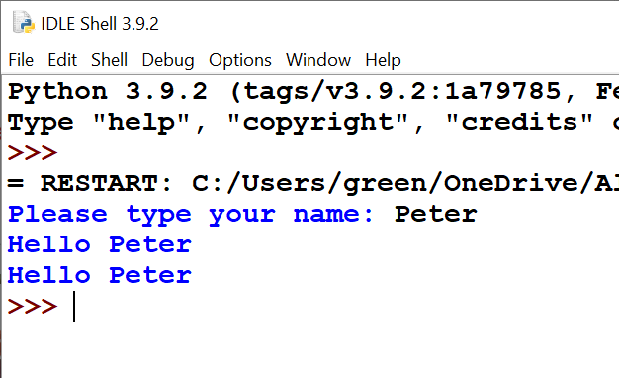
The input() function

Slide 44
Practice Worksheet
Try the examples and questions yourself
Section: - Writing and Saving Programs
15 minutes

Slide 45
Practice Worksheet
Try the remaining examples and questions yourself.
More practice and guidance at:
https://docs.python.org/3/tutorial/introduction.html#strings
https://realpython.com/python-strings/
https://www.w3schools.com/python/default.asp

Slide 46
This week’s Assignment (not assessed)
Notes:
Explain this now so that it’s not scrunched in at the end

Slide 47
Install Python and Anaconda on your PC
Go to www.python.org
Download and install the version of Python for your PC
Go to www.anaconda.com
Download and install the version of Anaconda for your PC

Slide 48
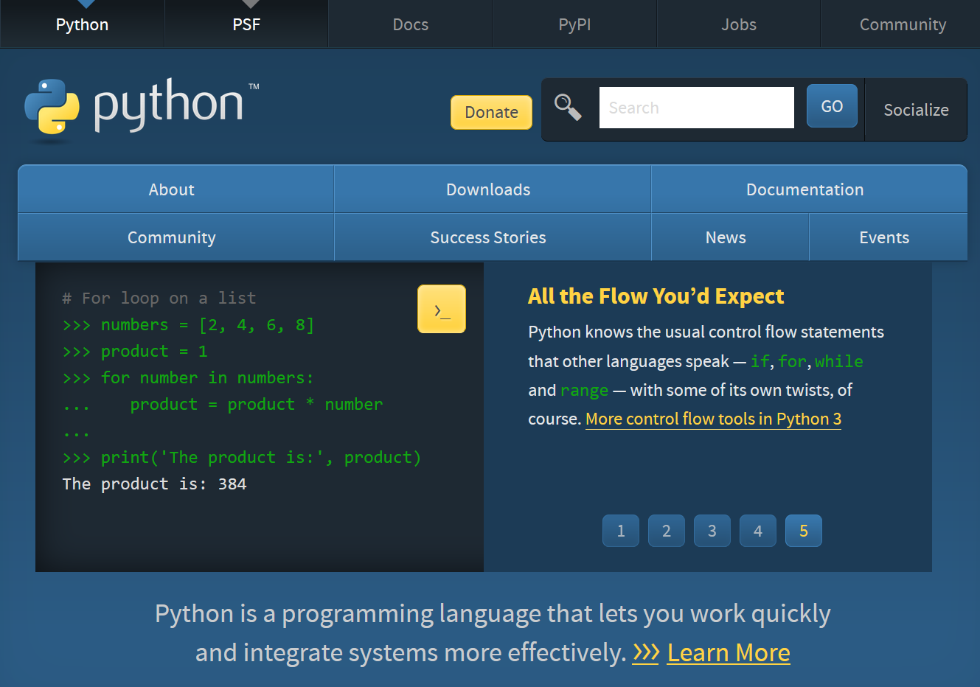
Notes:
https://wiki.python.org/moin/BeginnersGuide/NonProgrammers
https://wiki.python.org/moin/BeginnersGuide/Programmers

Slide 49
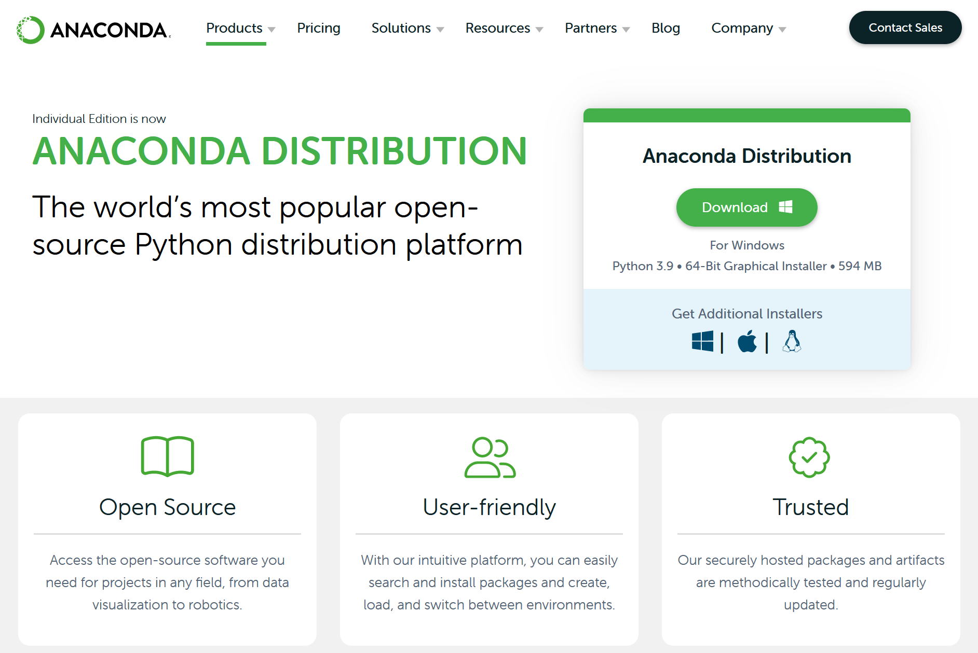

Slide 50
Python Learning Resources
The python website
https://docs.python.org/3/
The python index
https://docs.python.org/3/genindex.html
The python tutorial
https://docs.python.org/3/tutorial/index.html
Assumes you have already done some coding in another language!
Online Python Tutorials
https://realpython.com/
https://www.freecodecamp.org/
https://www.w3schools.com/
and YouTube is awash with them
Practice exercises and mini projects
https://snakify.org/en/
…
Google ‘beginners programming problems’
…

Slide 51
Python Learning Resources
Books – There are no required textbook for this course. There are LOTS of suitable books. A few of my choices are:
Practical Programming: An introduction to computer Science using Python 3 by Gries, Campbell, Montojo
Python Basics: A practical introduction to Python 3 by the realpython.com tutorial team
Automate the boring stuff with Python by Al Sweigart
Learn Python in One Day and Learn It Well by Jamie Chan
Stack Overflow
https://stackoverflow.com
A great resource but use with caution

