Slide 1
Coding for Linguists week 6. Data Visualisation
Pandas, Numpy, MatPlotLib, Seaborn, Bokeh & Jupyter

Slide 2
Last week – Files & File Processing
What a file is
Data and metadata
Binary files and text files
Unicode utf-8
Read a text file
Write a text file
Append a text file

Slide 3
The string prefixes ‘f’, ‘r’ and ‘u’
As if there wasn’t already more than enough to remember about strings
‘f’ is the format prefix
f “the value of the variable x = {x} is placed between the curly brackets”
‘r’ is the raw prefix
r “treat escape sequences such as \n and \t as plain text”
‘u’ is the Unicode prefix
u “this is a Unicode string – the u prefix is not required in Python v3”

Slide 4
Files, filenames and string prefixes
Use the same naming convention for file and folder names as for variables:
First character is a letter
Contains no spaces
Relative file names:
Single leading dot ( . ) means ‘in this folder’
Double leading dot ( .. ) means ‘in the folder above this one’
Use the ‘r’ prefix for any filename that has a ‘\’ in it. Be safer still and use the ‘r’ prefix for every filename

Slide 5
design
build
test
evaluate
analyse
requirements

Slide 6
This Week – Data Visualization
Line graphs
Bar charts
Histograms
Scatter plots
Pie charts
Contour maps
Pseudo-colour images
Some background on:
Pandas
Numpy
Matplotlib
Seaborn
Bokeh
These packages have a large number of methods, often with an equally large number of options
So . . Keep . . Things . . SIMPLE

Slide 7
Getting started
But first some preparatory knowledge

Slide 8
Python Libraries
Pandas
Panel Data (like a spreadsheet)
Getting your data into Python, cleaning it up and making it ready for processing
Numpy
Numerical python
Optimised for fast and efficient calculations on large amounts of data
Matplotlib
Is not primarily about maths!
Plotting data on charts
Seaborn
Even more plotting
Built upon matplotlib
Bokeh
Interactive visualizations

Slide 9
The import statement - imports code from other python files into your program
file1.py
file2.py
def f1():
return ‘ this is f1() in file1’
def f1():
return ‘ this is f1() in file2’
def f2():
return ‘ this is f2() in file2’

Slide 10
Example import statements
file3.py
file4.py
import file1
import file2 as prog2
print( file1.f1() )
print( prog2.f1() )
print( prog2.f2() )
from file1 import f1 as g1
from file2 import *
print( g1.f1() )
print( f1() )
print( f2() )

Slide 11
Enough of that Lets do some charts!

Slide 12
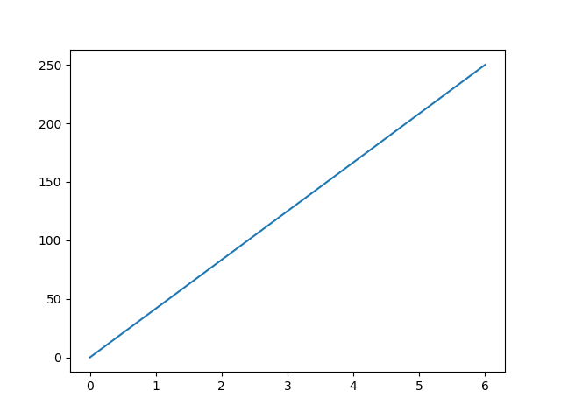
Drawing a chart – example 1
import matplotlib.pyplot as plt import numpy as np xpoints = np.array([0, 6])
ypoints = np.array([0, 250]) plt.plot(xpoints, ypoints) plt.show()

Slide 13
FYI - Numpy arrays and Python lists
For these simple examples it is not necessary to create numpy arrays.
Python lists work equally well. Try it and see.
The reason numpy is used in these examples is that when you search for notebooks online they will more often than not be using numpy to analyse the data. It’s therefore it's important you can recognise numpy when you see it.

Slide 14
Drawing a chart – example 1 with Python lists
import matplotlib.pyplot as plt # import numpy as np xpoints = [0, 6]
ypoints = [0, 250] plt.plot(xpoints, ypoints) plt.show()

Slide 15
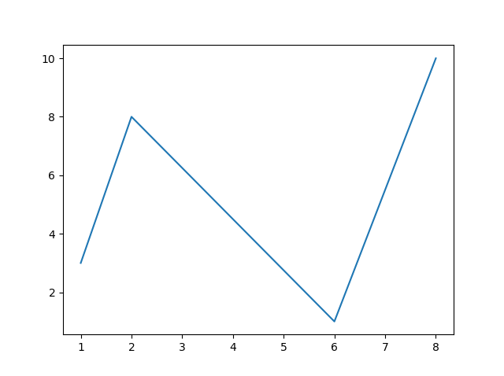
Drawing a chart – example 2
import matplotlib.pyplot as plt import numpy as np xpoints = np.array([1, 2, 6, 8])
ypoints = np.array([3, 8, 1, 10]) plt.plot(xpoints, ypoints) plt.show()

Slide 16
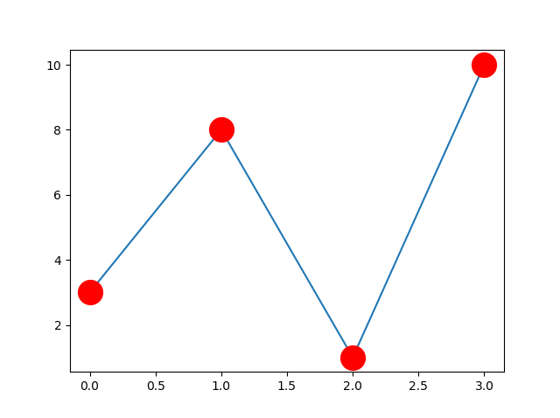
Drawing a chart – example 3
import matplotlib.pyplot as plt import numpy as np ypoints = np.array([3, 8, 1, 10]) plt.plot(ypoints, marker = 'o', ms = 20, mec = 'r', mfc = 'r’)
plt.show()

Slide 17
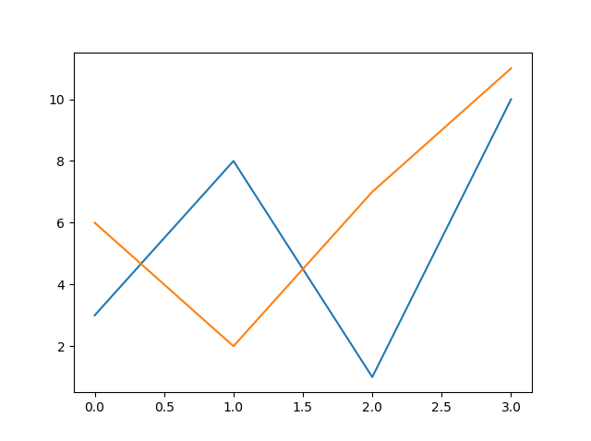
Drawing a chart – example 4
import matplotlib.pyplot as plt import numpy as np y1 = np.array([3, 8, 1, 10]) y2 = np.array([6, 2, 7, 11]) plt.plot(y1) plt.plot(y2) plt.show()

Slide 18
Drawing a chart – example 5
import matplotlib.pyplot as plt import numpy as np x1 = np.array([0, 1, 2, 3]) y1 = np.array([3, 8, 1, 10])
x2 = np.array([0, 1, 2, 3]) y2 = np.array([6, 2, 7, 11]) plt.plot(x1, y1, x2, y2) plt.show()

Slide 19
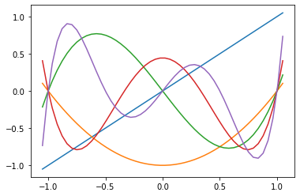
Drawing a chart – example 6

Slide 20
Now you do it – w3schools.com
Execute the examples yourself at W3Schools.com
Modify the code to increase your understanding.

Slide 21
Assignments - Review

Slide 22
General feedback & advice
Take more time to
Analyse the problem
Design the algorithm
Write the algorithm on paper using pseudocode BEFORE coding
Keep expressions simple and use brackets
Execute statements in the IDLE shell to confirm your logic
Test your code.
Ideally, write the test statements BEFORE the code(TDD*)
*Test Driven Development

Slide 23
Analyse and Design before build
Understand the fundamental problem, discard extraneous detail
Think - How would I solve this problem with paper & pencil?
Describe the algorithm (the process or recipe) for solving this problem to another person, ideally one five years old
Outline the procedure with pseudocode
Desk-check your pseudocode
Write the code
Look at the big picture, avoid getting trapped in the details

Slide 24
And Now for Something Completely Different
Film, released in 1971

Slide 25
Use Anaconda: It is _so_ much easier
Make sure you have Anaconda installed and working on your PC
Anaconda has Pandas, Numpy, Matplotlib, Seaborn, Bokeh, Jupyter, and many more packages pre-installed
Start Python IDLE
Write and run the practice examples in the normal way

Slide 26

Jupyter Notebooks
Designed for interactive coding and data exploration

Slide 27
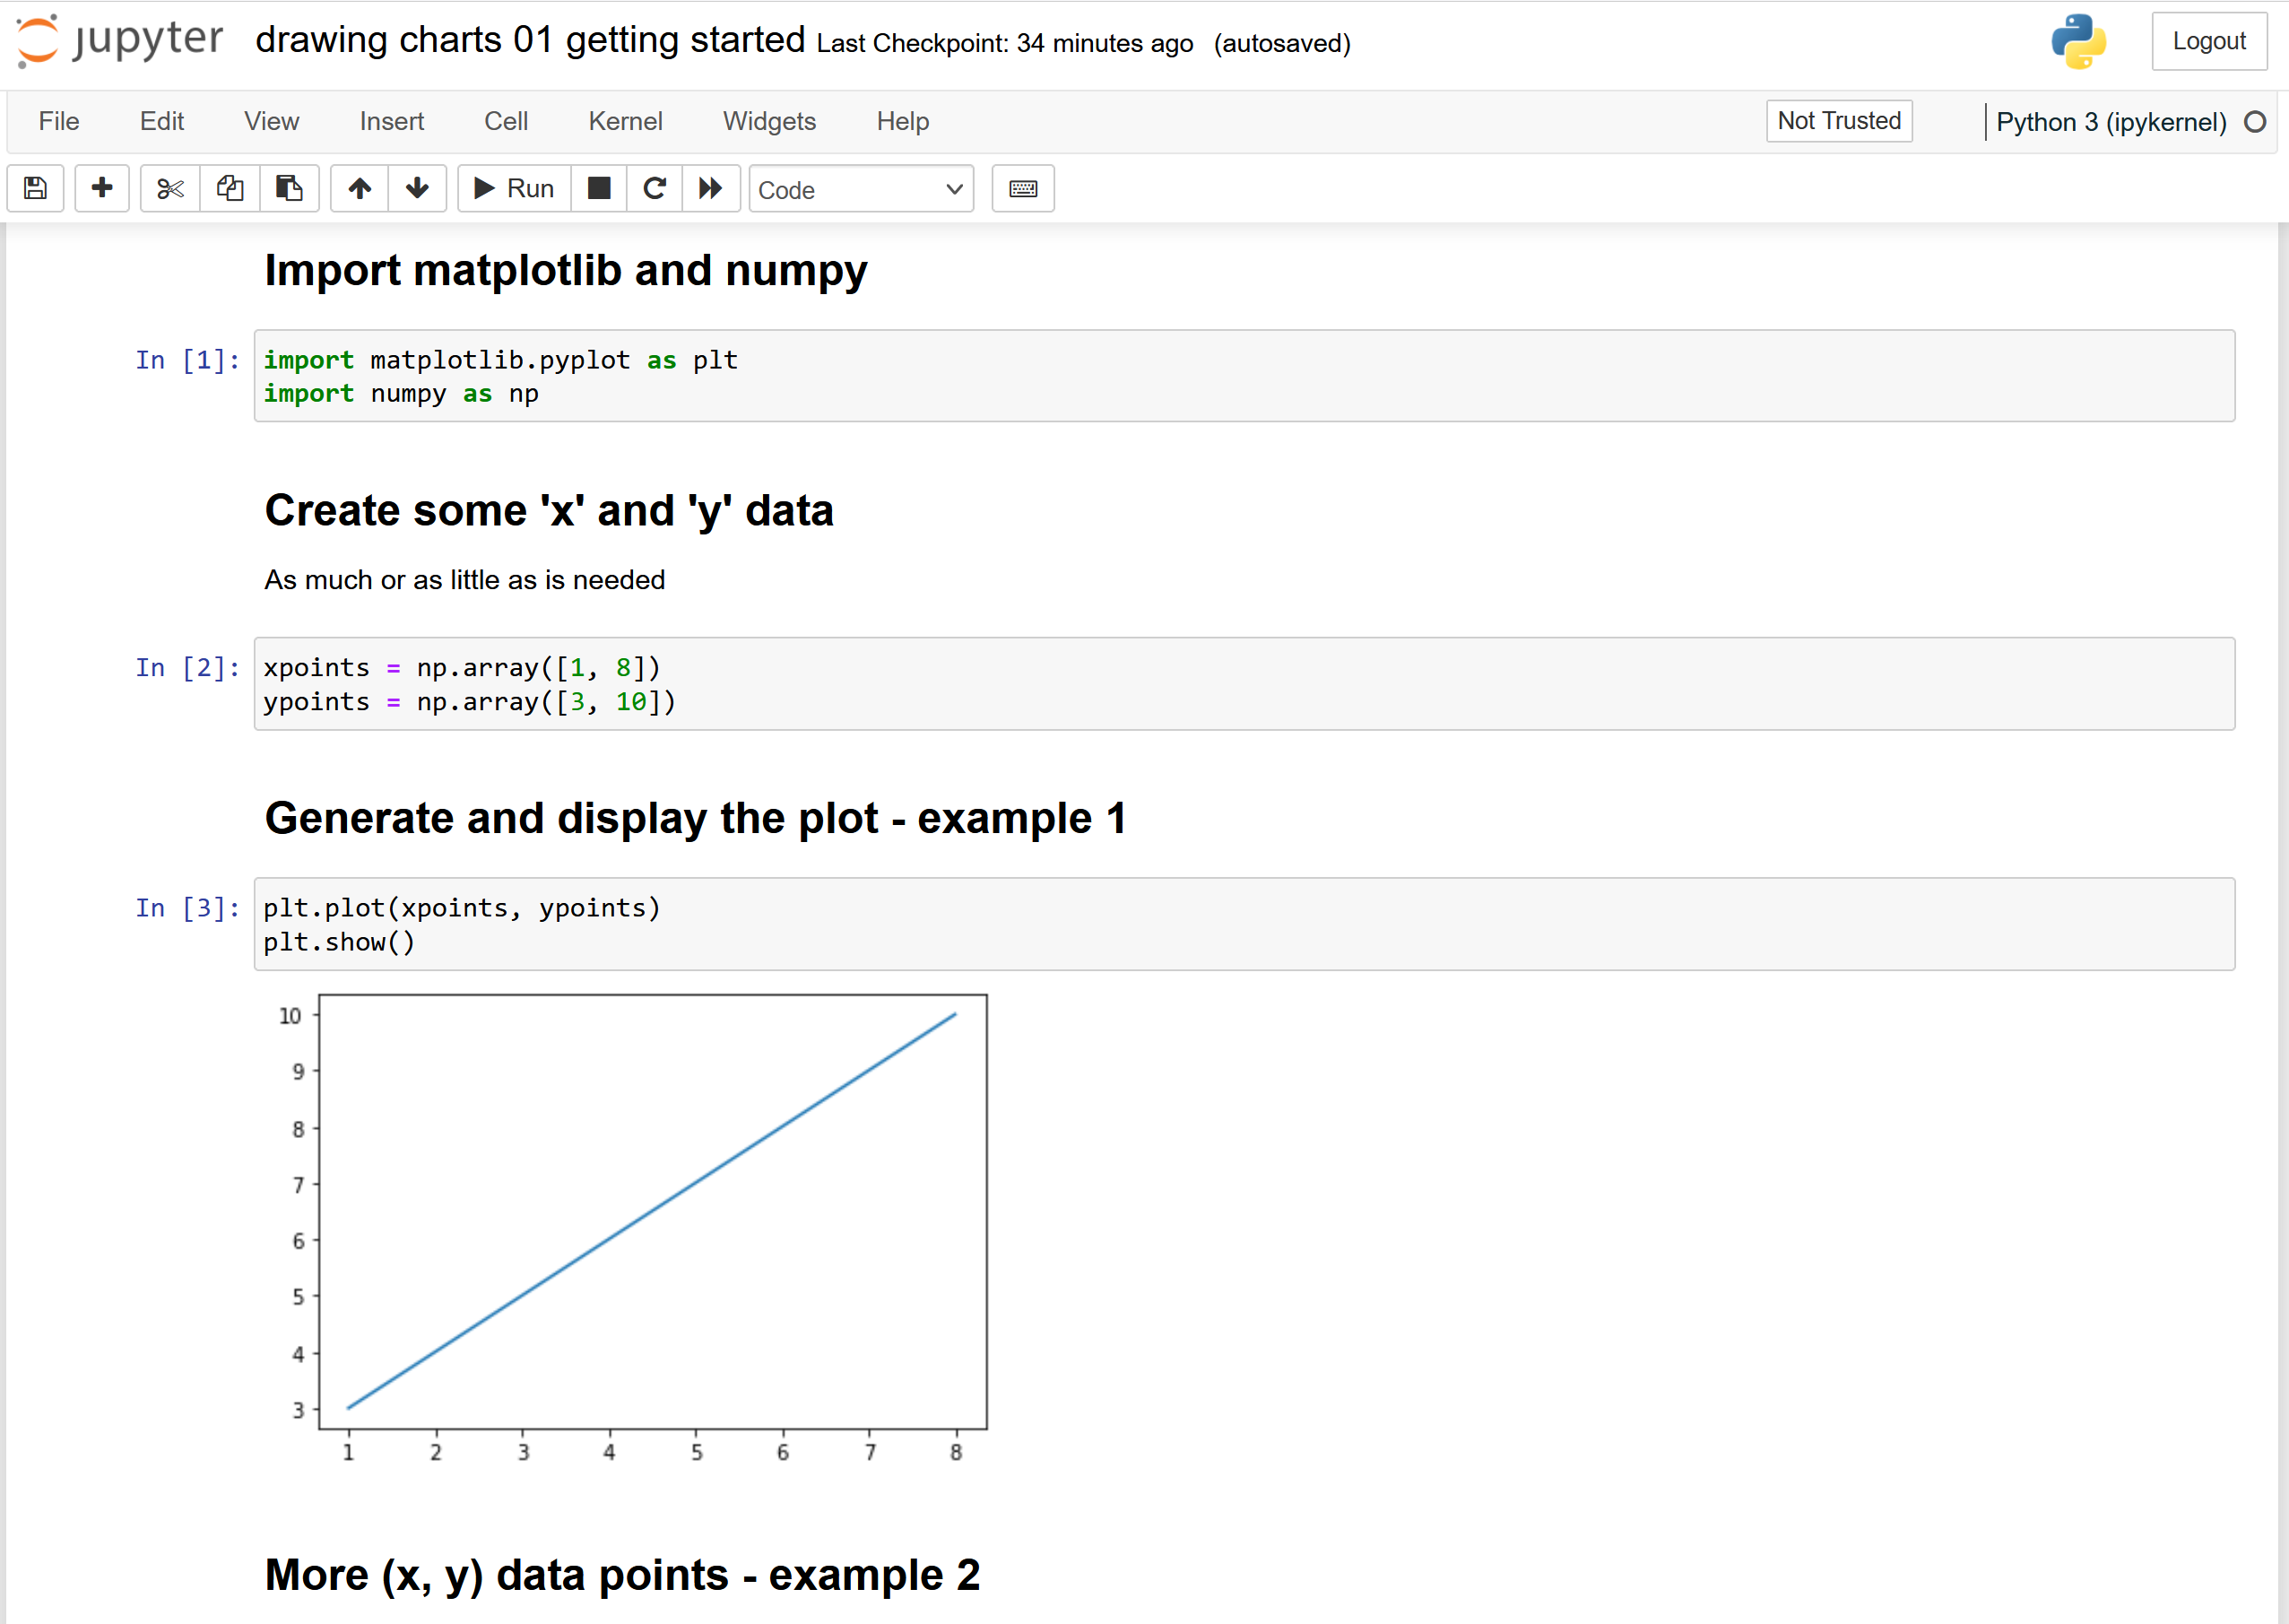

Slide 28
Jupyter Notebooks – Pros & Cons
Positives
Negatives
It’s visual – so much more intuitive
Great for trying things out and exploring ideas
Great for presenting your work attractively and persuasively
Re-use other people’s work as a starting point. Run cell by cell to understand what the code does
Notebooks can easily become a mess of half formed ideas and jottings
Code is scattered across many cells which can hide interdependencies and makes code re-use tricky
Version control

Slide 29
More Charts and More Options
Some examples:

Slide 30
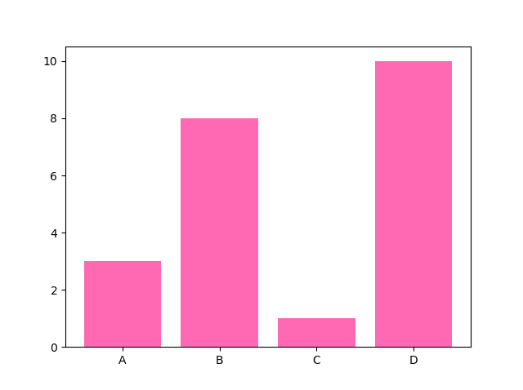
Bar Chart
import matplotlib.pyplot as plt import numpy as np x = np.array(["A", "B", "C", "D"]) y = np.array([3, 8, 1, 10]) plt.bar(x, y, color = "hotpink") plt.show()

Slide 31
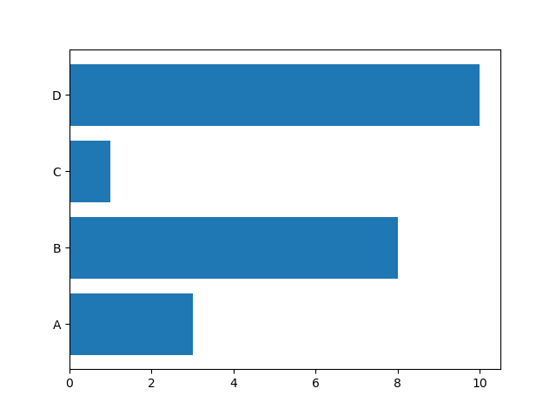
Horizontal Bar Chart
import matplotlib.pyplot as plt import numpy as np x = np.array(["A", "B", "C", "D"]) y = np.array([3, 8, 1, 10]) plt.barh(x, y) plt.show()

Slide 32
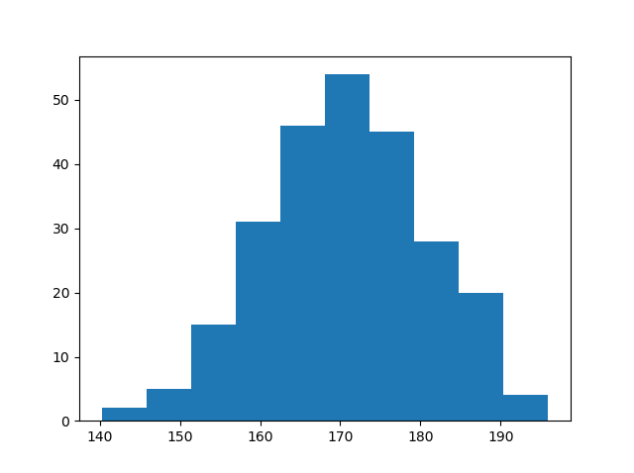
Histograms
import matplotlib.pyplot as plt import numpy as np
# generate 250 random data points
# normally distributed around 170
# with a SD of 10
x = np.random.normal(170, 10, 250) plt.hist(x) plt.show()

Slide 33
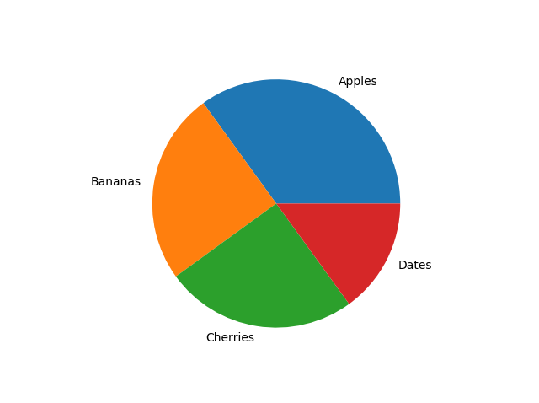
Pie Chart
import matplotlib.pyplot as plt import numpy as np y = np.array([35, 25, 25, 15]) mylabels = ["Apples", "Bananas", "Cherries", "Dates"] plt.pie(y, labels = mylabels) plt.show()

Slide 34
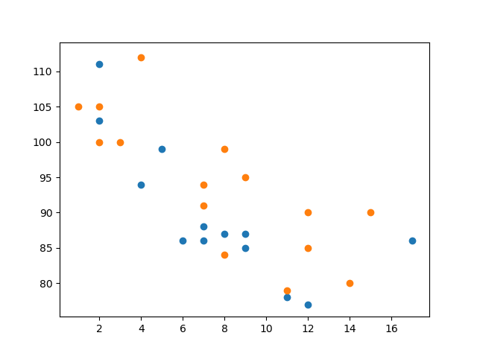
Scatter Plot
import matplotlib.pyplot as plt import numpy as np #day one, the age and speed of 13 cars: x = np.array( [5,7,8,7,2,17,2,9,4,11,12,9,6]) y = np.array( [99,86,87,88,111,86,103,87,94,78,77,85,86]) plt.scatter(x, y) #day two, the age and speed of 15 cars: x = np.array( [2,2,8,1,15,8,12,9,7,3,11,4,7,14,12]) y = np.array( [100,105,84,105,90,99,90,95,94,100,79,112,91,80,85]) plt.scatter(x, y) plt.show()

Slide 35
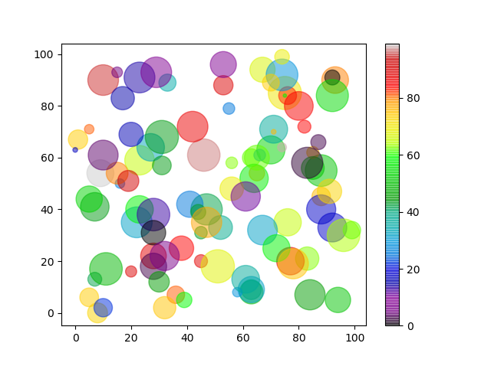
Colourful Scatter Plot
import matplotlib.pyplot as plt import numpy as np x = np.random.randint(100, size=(100)) y = np.random.randint(100, size=(100)) colors = np.random.randint(100, size=(100)) sizes = 10 * np.random.randint(100, size=(100)) plt.scatter(x, y, c=colors, s=sizes, alpha=0.5, cmap='nipy_spectral') plt.colorbar() plt.show()

Slide 36
Now you try
Create, execute, and save your own notebooks

Slide 37
Labelling and Grouping Charts

Slide 38
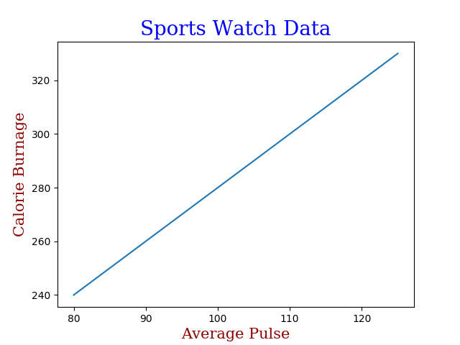
Labelling a chart
import numpy as np import matplotlib.pyplot as plt x = np.array([80, 85, 90, 95, 100, 105, 110, 115, 120, 125]) y = np.array([240, 250, 260, 270, 280, 290, 300, 310, 320, 330]) font1 = {'family':'serif','color':'blue','size':20} font2 = {'family':'serif','color':'darkred','size':15} plt.title("Sports Watch Data", fontdict = font1) plt.xlabel("Average Pulse", fontdict = font2) plt.ylabel("Calorie Burnage", fontdict = font2) plt.plot(x, y) plt.show()

Slide 39
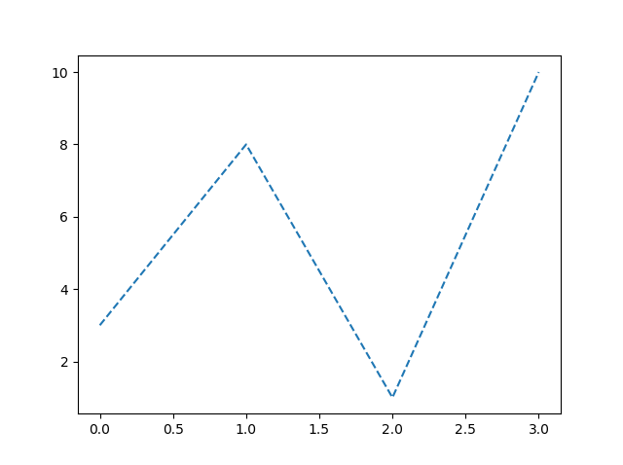
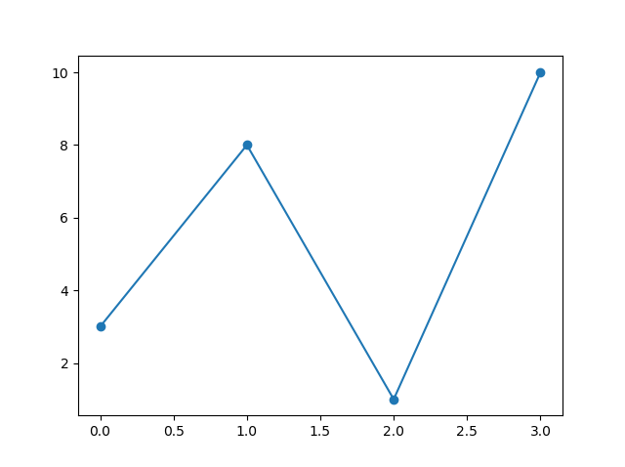
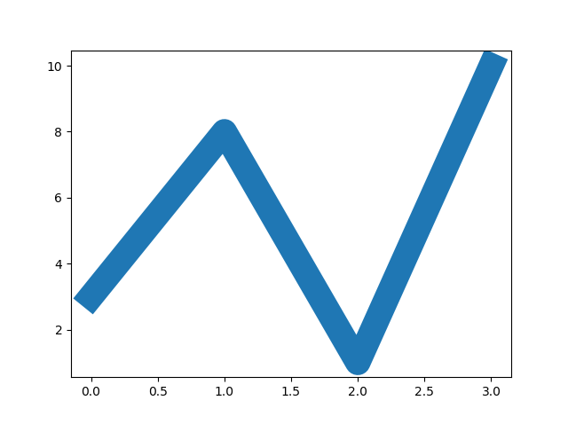
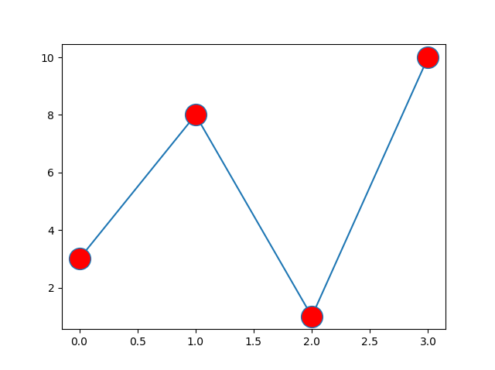
Lines
Points

Slide 40
Ten Simple Rules for charting
Know Your Audience
Identify Your Message
Adapt the Figure
Captions Are Not Optional
Do Not Trust the Defaults
Use Colour Effectively
Do Not Mislead the Reader
Avoid “Chartjunk”
Message Trumps Beauty
Get the Right Tool
Design first – code second

Slide 41
Example Applications

Slide 42
1 - Character Frequency Analysis
Find a suitable source of text
Read the text into Python
Clean the data. Maybe it has headers, footers, page numbers, ISBN information, publication dates, etc,. Remove them.
Decide what counts as a character.
Count the number of occurrences of every character
Transform that information into lists or numpy arrays
Display using Matplotlib
A Study in Scarlet by ACD
Easy
It does have all of those. Could have written code to clean it but decided it was quicker to do it manually in notepad++
Only count [a-z][A-Z] as characters
Create a dictionary with [a-z] as keys and respective count as value
Easy peasy .
Histogram is a good choice

Slide 43
Character Frequency Analysis Charts go here
You to do

Slide 44
2 - Word Frequency Analysis
Find a suitable source of text
Read the text into Python
Clean the data. Maybe it has headers, footers, page numbers, ISBN information, publication dates, etc,. Remove them.
Decide what counts as a word.
Count the number of occurrences of every word
Transform that information into a numpy array
Display using Matplotlib
A Study in Scarlet by ACD
Cleaned manually in notepad++
Only count [a-z][A-Z] as word characters. Everything else is a word separator. Possessives and hyphens?
Dictionary with lowercase words as keys and respective count as value
There are lots of words.
Histogram may not be a good choice? Some data analysis required to decide on presentation. Sort words from high to low frequency and plot that slope? Or word length vs frequency?

Slide 45
Word Frequency Analysis Charts go here
You to do

Slide 46
Websites and resources
python.org
w3schools.com
realpython.com
Project Gutenberg
pandas.pydata.org
numpy.org
matplotlib.org
seaborn.pydata.org
bokeh.org

Slide 47
The Plan after Reading Week

Slide 48
Week by week outlines
W8
Data, databases, SQL
Data science, regression analysis, machine learning, AI
W8
Your project ‘lift speech’
Tools and processes for application development
NLTK, SpaCy, etc.,
W10
Project interviews
W11
Regular Expressions (may change)
W12
The python ecosystem
In demand skills
Project clinic

Slide 49
Reading Week
Assignment catch-ups
Write your project descriptions
DO start work on your project

