Slide 1
Coding for Linguists week 8. Project Management

Slide 2
design
build
test
evaluate
analysis
requirements

Slide 3
Important facts for business and IT managers
Software development is difficult
Software development is expensive
Most software development projects:
Cost more than promised
Take longer than promised
Deliver less than promised
Sometimes fail completely and deliver nothing
Renowned for OVER promising and UNDER delivering
Liable to rapid obsolescence

Slide 4
Examples
Post Office – A human disaster for many post office managers (736)
NHS – 2013 – about £10 billion, mostly written off
Apple Copeland – 1995+, £? unknown but close to existential
Mars Climate Orbiter – 1999, £327m, metric-imperial confusion
Ariane 5 Launcher – 1996, £350m, 64-bit→16-bit register overflow
Google Nest – Issued software update that ‘bricked’ devices
Lt Col Stanislav Petrov – 1983 ballistic missile alert
Brokerage Knight Capital – 2012, $450m trading loss in 45 minutes

Slide 5
Some Common Causes
Top-down with minimal bottom-up engagement
Poor organisational buy-in by business or IT
Poor accountability
Poor budget control
The sunk costs illusion
Multiple suppliers and poor contract management
More – Haste – Less – Speed
https://faethcoaching.com/it-project-failure-rates-facts-and-reasons/

Slide 6
Good Practice Principles
Start with realistic cost & time estimates – and regularly update them
Strict accountability. A business champion & an IT champion
Strict change control
Strict budget control
Have early and frequent delivery milestones
Test, test, test
No one plans to fail, but you should definitely plan for it

Slide 7
What is a Project?

Slide 8
The Defining Features of a Project
It has a beginning
It has an end
It builds and/or delivers something

Slide 9
Projects take time, cost money, use resources
Time
Sometimes fixed: A legal deadline. An incoming Chicxulub asteroid. Y2k.
Cost
£ budget, opportunity costs, market share, productivity
Resources
People
Premises
Hardware and software
Partners & Suppliers

Slide 10
At best you can decide 2
Resource
Time
Cost

Slide 11
Have a Project Plan
Have one!
Dates
Resource allocations
Deliverables
Dependencies
The critical path

Slide 12
Requirements Negotiation
Strive for clear understandings and regular communication
Who is in charge?
Who makes the decisions?
What is to be delivered?
When it is to be delivered?
What is the budget?
All written down and signed off by all parties!

Slide 13
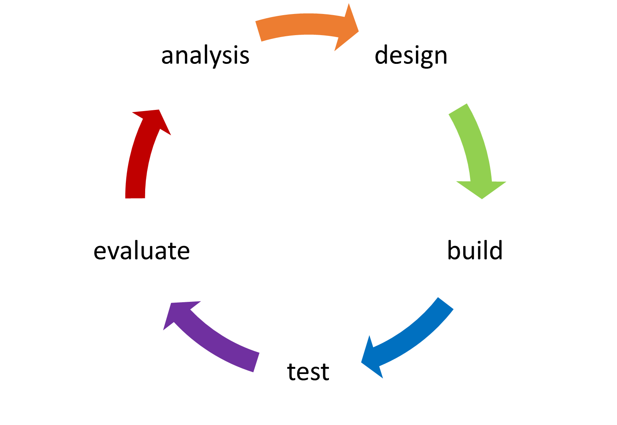
Agile Development not Waterfall
There are exceptions
But assume there are not, until proven otherwise
Analysis
Design
Build
Test
Done!

Slide 14
Change Control
The project starts with costs, resources and dates all agreed
ANY change will change those costs, resources and dates
Even just the evaluation of a proposed change will change them
Every successful project has a successful change management process
Remember: Project creep kills projects

Slide 15
Software re-use or (Not) Reinventing the Wheel

Slide 16
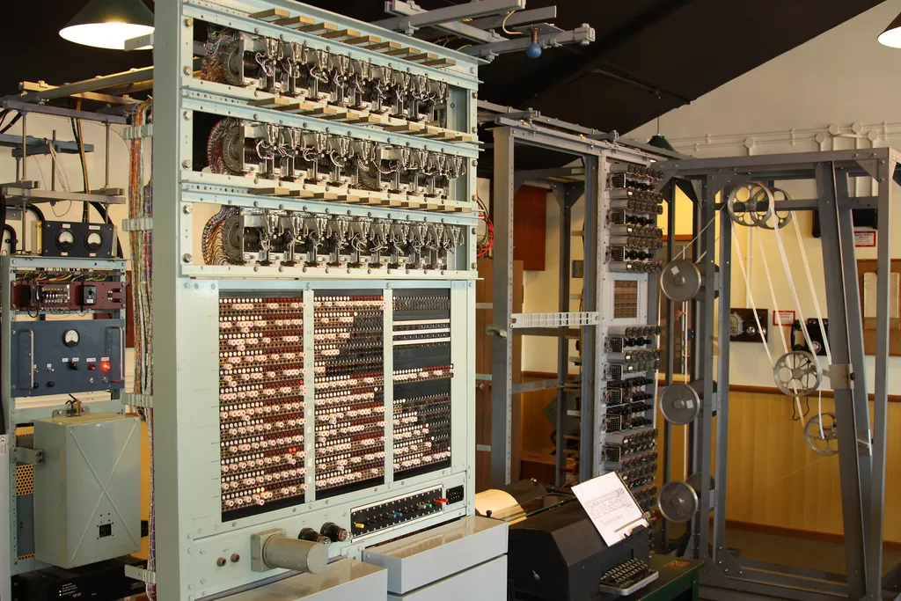
Reusing software
The earliest computers were programmed with wires ad switches
Changing the program meant rewiring and resetting switches
The first stored-program computers were programmed in binary
All modern software is built using pre-existing software

Slide 17
Re-using your functions and software
So far you have written each assignment in a single .py script
For larger assignments, such as your project, this rapidly becomes untenable
The import statement solves this problem
Groups of related functions can be placed in a single file and imported into another
import assign04 as a4
print(a4.score_2(1,6))
print(a4.score_4(2,3,4,5))

Slide 18
Reusing Code from the Standard Library
You need a random number
Reading a comma separated variables file
Reading JSON data
Regular expressions
When you need multiple nested ‘for’ loops
import random
import csv
import json
import re
import itertools

Slide 19
Reusing code NOT in the standard library
Use a package manager to incorporate the module into your python environment
Use PIP for Python
Use Conda for Anaconda (and Python)
Most of you will NOT need to do this

Slide 20
Project Documentation
Just have some! Too many projects have next to none.

Slide 21
Project Documentation
User guides – obviously
Technical manuals – equally obviously for IT Operations, helpdesk support, and future developers
Code style guides – yes really!
For your project your documentation is:
Your report
Comments and docstrings in your code

Slide 22
Tools for Developers

Slide 23
IDEs – Integrated Development Environments
Used by programmers writing code
Intelligent coding assistance with syntax checking and prompting
Code formatting (code prettification)
Code structure navigation and thread visualization
Advanced debugging and testing
Object inspection, variable watchlists and alerts
Performance profiling
Integrated version control
Code search and refactoring tools . . . . . . . . . .

Slide 24
Code Version Control – part I
During development code and documentation are frequently changing
When adding a feature to code that already works it is easy to break it
When that happens developers ‘undo’ back to the version that works
Then they add the feature in another way, and maybe that doesn’t work
So undo, try design 3, undo, redo v4, then decide design 2 was best
But undo-redo cannot unwind back to that point – argh!
Now imagine multiple developers working on the same project – arghhh!
That’s why version control systems were invented

Slide 25

Code Version Control – part II
Start with a single ‘master version’
Create a branch for your new feature
Build v1 of new feature and ‘commit’ changes to new branch
Restore master version
Create a new branch for v2, build, commit. Repeat for v3, v4, . . . .
Each branch exists and can be restored and worked on independently
When the preferred version is decided it is merged into master
Branches can be deleted when no longer required

Slide 26
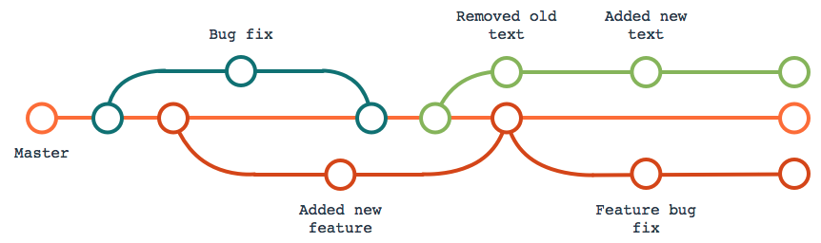

Slide 27
Virtual Environments – part I
A software developer will often work on more than one product
Different products may need incompatible s/w environments
To avoid having to set up separate machines to work on different projects, create multiple ‘virtual environments’ on same machine
Each virtual environment is completely isolated from all other virtual environments
To work on a particular project the developer closes their current virtual environment and switches to the other virtual environment

Slide 28
Virtual Environments – part II
a Python virtual environment is a folder structure that gives you everything you need to run a lightweight yet isolated Python environment
Venv
Included in Python standard library
https://docs.python.org/3/library/venv.html
Anaconda
Environments are Anacondas equivalent
https://docs.anaconda.com/navigator/overview/?highlight=environments#environments-page

Slide 29
Importing python modules

Slide 30
Testing is not an afterthought
Test everything from the beginning and then test, test and test again

Slide 31
Testing
Unit Testing
Individual software functions and objects are tested stand-alone
Integration Testing
Interacting units of functionality are tested
System testing
The complete system is tested end-to-end
Regression testing
Testing that a change (an ‘improvement’) has not broken something
Backout testing
Testing that a change implemented into the ‘live’ system can be undone and the original system restored

Slide 32
Test Driven Development
During analysis and design functions and software components are identified and specified in terms of the tests they must pass
Even for simple functions this list of tests can be long e.g. isa_triangle(num1, num2, num3)
Writing the list of tests is a good QA of the function specification
The developer builds functions that pass all the tests

Slide 33
Test Automation
Testing is time-consuming, tedious, and effort prone
So automate it
Python libraries for testing
doctest
unittest
Pytest
Popular open source library
Commercial products
# example pytest code
def test_score_2():
assert score_2(1, 5) == 6
assert score_2(5, 1) == 6
assert score_2(3, 4) == 14
assert score_2(5, 2) == 14
assert score_2(2, 2) == 6
assert score_2(6, 6) == 24

Slide 34
UX design and testing
UX = User eXperience
More important that commonly appreciated
Scenario: Technically everything works perfectly but users get lost in menus
Oceans of functionality that is never used

Slide 35
A/B Feature Testing
Frequently used for web applications with a large user base
Two versions of UX are developed
Some users are presented with version A, others with version B
User behaviour is measured and evaluated
The best option is implemented for all users
Example: Where to present advertisement on screen for best effect

