Slide 1
Data, Databases & SQL
Data, data everywhere
But not a byte worth using
Data, files, CSV, JSON, Database, SQL

Slide 2
design
build
test
evaluate
analysis
requirements

Slide 3
Storing Data in Files

Slide 4
Common Data File Formats
Text
CSV = Comma Separated Variables
Each line is a record
Each record contains variables separated by commas
JSON = JavaScript Object Notation
Attribute : value pairs
XML = Extensible Markup Language
Standard way of exchanging information
YAML = Yet Another Markup Language

Slide 5
Reading and writing text files
You have already done this ☺

Slide 6
Practice: reading and writing text data files
You have already done this ☺
Open a file for read or write
Read it all into a single string
Read successive lines into individual strings
Same for writing a text file
# read the whole file
with open(‘file.txt’, ‘r’) as f:
data = f.read()
# read the file a line at a time
with open(‘file.txt’, ‘r’) as f:
line1 = f.readline()
line2 = f.readline()
line3 = f.readline()
line4 = f.readline()

Slide 7
Reading and writing CSV files
Use the CSV module from standard library

Slide 8
fields
Header
record
first_name | second_name | module_name
Adam | Charm | Coding
Billie | Gluon | Colang
Clara | Atomic | Colang
David | Electron | Coding
Edwina | Boson | Coding
Ferdinand | Tau | Coleng
Gary | Graviton | Coding
Clara | Atomic | Colang
David | Electron | Coding
Edwina | Boson | Colang
Adam | Charn | Coding
Ferdinand | Tau | Colang
records

Slide 9
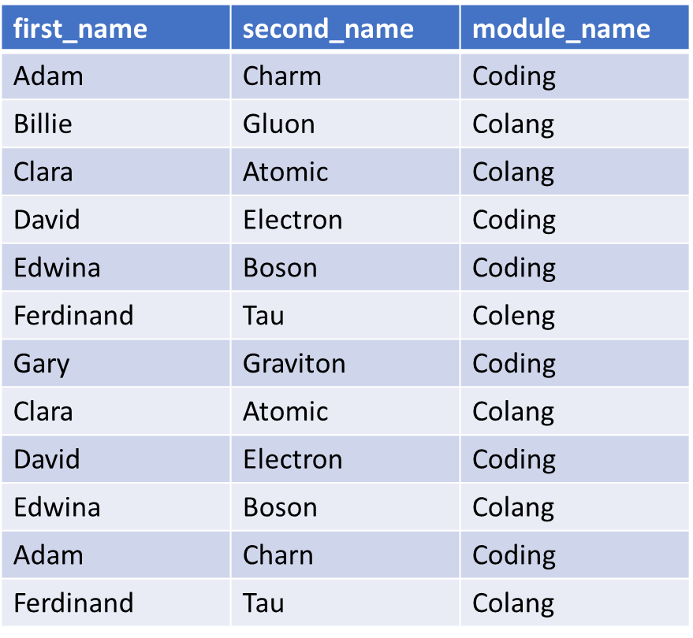
CSV = Comma Separated Variables
The file may or may not have a header record
The header record contains the names of the ‘fields’
Each line of the file is a ‘record’
The ‘fields’ in each ‘record’ are separated by commas
The CSV module is part of the python standard library

Slide 10
Writing CSV Files
From a list of strings
From a list of dictionaries
import csv
with open(‘data_out1.csv) as csvfile:
csv_writer = csv.writer(csvfile)
rec_1 = [‘name’, ‘age’]
rec_2 = [‘Jane’, ‘27’]
rec_3 = [‘Joe’, ‘27’]
csv_writer.writerow(rec_1)
csv_writer.writerow(rec_2)
csv_writer.writerow(rec_3)
import csv
with open(‘data_out2.csv) as csvfile:
writer = csv.DictWriter(csvfile, fieldnames=fieldnames)
fieldnames = ['name', ‘age']
writer.writeheader()
writer.writerow({name’:’Jane’,’age’:’27’})
writer.writerow({’age’:’27’, name’:’Joe’})

Slide 11
Reading a CSV File
Into lists of strings
Into a list of dictionaries
import csv
with open(‘data_in.csv’) as csvfile:
csv_reader = csv.reader(csvfile)
for record in csv_reader:
print(record)
import csv
with open(‘data_in.csv) as csvfile:
csv_reader = csv.dictreader(csvfile)
for record in csv_reader:
print(record)

Slide 12
CSV files practice
https://realpython.com/python-csv/

Slide 13
Reading and writing JSON files
Use the JSON module from standard library

Slide 14
JSON = JavaScript Object Notation
JSON files are text files
Readable by computers and HUMANS
Composed of attribute:value pairs, and lots of brackets
The look something like python dictionaries

Slide 15
Some data and some JSON
py_data = {
"president": {
"name": "Zaphod Beeblebrox",
"species": "Betelgeusian"
}
}
json_str = """
{
"researcher": {
"name": "Ford Prefect",
"species": "Betelgeusian",
"relatives": [
{
"name": "Zaphod Beeblebrox",
"species": "Betelgeusian"
}
]
}
}
"""

Slide 16
Writing and Reading JSON strings
json.dumps(python_object)
json.loads(json_string)
import json
# dump python object to a string
j_str = json.dumps(py_data)
print(j_str)
import json
# read python object from a string
py_obj= json.loads(j_str)
print(py_obj)

Slide 17
Writing and Reading JSON files
json.dump(python_object)
json.load(json_file)
import json
# dump python object to a json file
with open(“j_write.json",
"w”) as f:
json.dump(py_data, f, indent =4)
import json
# read json file to a python object with open(“j_write.json", “r”) as f:
py_obj =json.load(j_write.json,f)
print(py_obj)

Slide 18
Writing More JSON
py_jane = {
"firstname": "jane",
"lastname": "doe",
"hobbies": ["running", "sky diving", "singing"],
"age": 35,
"children": [
{
"firstname": "alice",
"age": 6
},
{
"firstname": "bob",
"age": 8
}
]
}
import json
with open(“jane_data.json",
"w“
indent =4) as f:
json.dump(py_jane, f)

Slide 19
JSON practice
https://realpython.com/python-json/#look-its-json

Slide 20
Problems with Data

Slide 21
Data proliferation
There is lots of data
Storing data costs £, fast storage costs even more
And more and more data every day
Costs ££
Lots of data is duplicated
Even more £££
The duplicates tend not to be identical
Which of the duplicates is correct?
One version is the truth

Slide 22
Data Lifetime Management
New data
Data creation events by both users and processes
Current data
Used in active business processes
Needs high speed access
Historical data
Used for reporting
Not used for business processes
Lower speed storage acceptable
Archive data
Must be preserved
Often for legal & regulatory reasons
Rarely used, if ever
Retirement and destruction
Defined end-of-life criteria
Deletion events

Slide 23
Data Management Problems
Security
Classification: Public, Confidential, Personal, Secret, Top Secret, etc
Users: which users are allowed to create/read/update/delete which data items
Concurrent access
Multiple users need to read and write the same data items at the same time
Audit
All writes: user, date, time, place
All reads: user, date, time, place
Business Rules
The ‘order delivery date’ cannot be before the ‘order received date’ for any given order
Students must study at least three, but no more than six, modules in a semester
Data Integrity & Consistency
Every exam result must have a student
Every order must have a customer
A customer cannot be deleted if they have orders in the system

Slide 24
Data Transactions
A transaction is a change to stored data that must be done as a complete indivisible unit
A single transaction can involve multiple changes to many different files
Either ALL of the individual data changes in a transaction are successful, or the transaction does not happen at all
Bank Transfer
Remove £5 from my bank account
Add £5 to your bank account
Ship order item
Check there is enough stock
Remove item from stock
Print label & put in post
Mark item as ‘shipped’

Slide 25
ACID Transactions
A – atomic
Either all of the statements in a transaction execute successfully or none of them are executed
C – consistent
The effect of the same transaction is always the same
I – isolated
Concurrent transactions don’t interfere with or affect one another
D – durable
Changes made by successfully executed transactions are always saved, even in the event of system failure

Slide 26
Databases are the answer to many problems with data
Don’t re-invent the wheel

Slide 27
Relational Databases
The dominant database type
SQL and all that stuff

Slide 28
Relational Databases
There are many different types of databases but when just the word ’database’ is used that almost invariably means ‘Relational Database’
Relational databases were first introduced by Codd & Date at IBM in the 1970’s and steadily became dominant
Ideal for most business processes
A relational database consists of tables, relations and rules
SQL (Structured Query Language) is the language used to create, manage, and query relational databases

Slide 29
Relational Database Management System (RDBMS)
Storing the data and relations in tables
Manage user security and access control
Enforce the constraints

Slide 30
Tables and Relations

Slide 31
Tables
A table is (a little) like a spreadsheet
Each row of the table is a record
Each column is a field
Every table has a primary key
The primary key is one or more fields
The values of the primary key UNIQUELY identify the row
Not two rows have the same primary key value

Slide 32
columns / fields
field
names
student_id | first_name | second_name
s_001 | Adam | Charm
s_002 | Billie | Gluon
s_003 | Clara | Atomic
s_004 | David | Electron
s_005 | Edwina | Boson
s_006 | Ferdinand | Tau
s_007 | Gary | Graviton
s_008 | Clara | Atomic
s_009 | David | Electron
s_010 | Edwina | Boson
s_011 | Adam | Charn
Table Name
Students
Primary key
student_id
rows /
records

Slide 33
Relationships
Table Name
Enrolments
student_id | module_id | date
s_001 | m_027 | 01/09/2022
s_001 | m_024 | 01/09/2022
s_001 | m_011 | 01/09/2022
s_002 | m_024 | 01/09/2022
s_002 | m_011 | 01/09/2022
s_006 | m_027 | 01/09/2022
s_007 | m_027 | 01/09/2022
s_006 | m_024 | 01/09/2022
s_007 | m_024 | 01/09/2022
s_007 | m_011 | 01/09/2022
s_003 | m_042 | 01/10/2022
The primary key can be used to refer to that entity (record) in another table
When used in another table it is then called a foreign key

Slide 34
Entity Relationship Diagrams
Student
Module
1
1
0:n
0:n
Enrolment

Slide 35
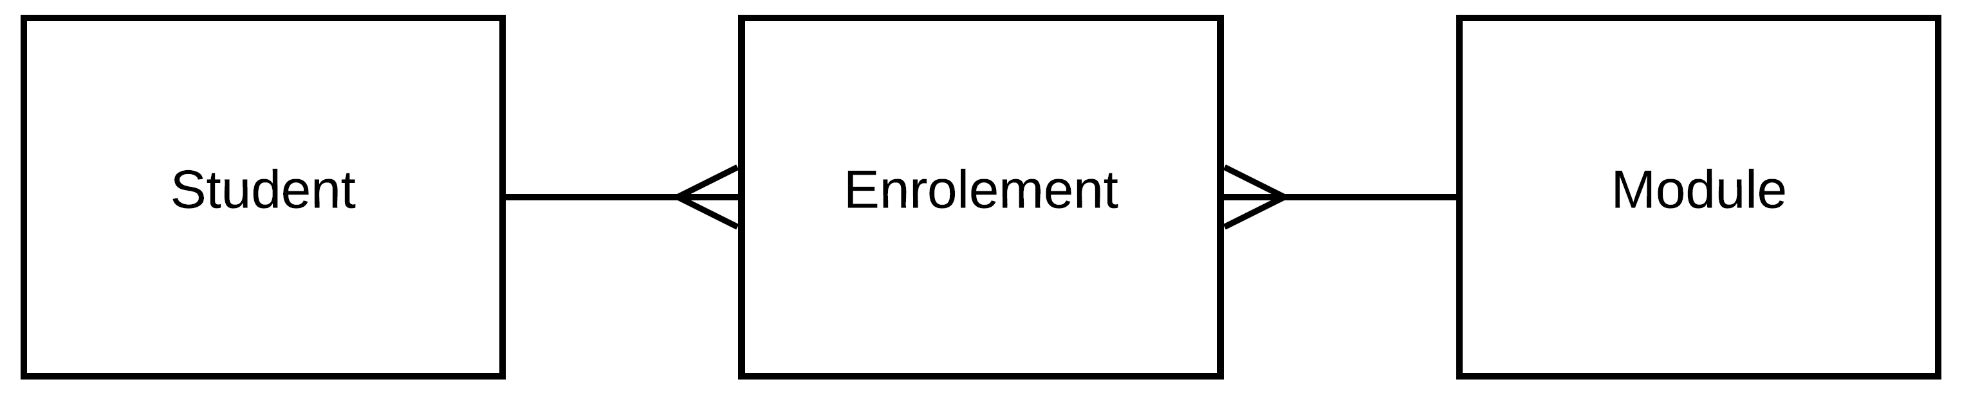

Slide 36
SQL – Structured Query Language
SQL is a declarative language (Python is a procedural language)
You declare the data you want, and the DBMS works out how to get it

Slide 37
An SQL query
SELECT module_id
FROM Enrolments
WHERE student_id = ‘s_007’
-- lists the module identifiers of the modules
-- student ‘s_007’ is enrolled in

Slide 38
Another SQL query
SELECT module_name
FROM Modules
WHERE module_id IN (SELECT module_id
FROM Enrolments
WHERE student_id = ‘s_007’)

Slide 39
Databases in Python
All database management systems have a python library
The sqlite3 module supports SQLite
SQLite is an excellent piece of software. Great for ‘getting started’, delivering small to medium sized projects, and initial design
Most other relational databases need a separate database server setting up and have complex prerequisites. They are essential for large databases with complex requirements

Slide 40
SQL Practice
Nobody is proposing to use a database in their project
That said, it’s definitely good to have some familiarity with SQL
Learning SQL
SQL zoo : https://sqlzoo.net/wiki/SQL_Tutorial
W3schools: https://www.w3schools.com/sql/default.asp

Slide 41
None Relational Databases

Slide 42
Nonrelational & no-SQL databases
These are slightly misnamed in that of course they do store and preserve the relationships between items of data
The data is often stored in graphs
Neo4j is a widely used graph database
https://neo4j.com/
https://graphacademy.neo4j.com/categories/

Slide 43
The End
Next Week
individual project reviews
15 minutes each

