Slide 1
Project 4: Cannon Game
By: Stephen Green

Slide 2
Language Used
After experiencing great success using HTML and JavaScript for my first two projects I decided to once again use those languages

Slide 3
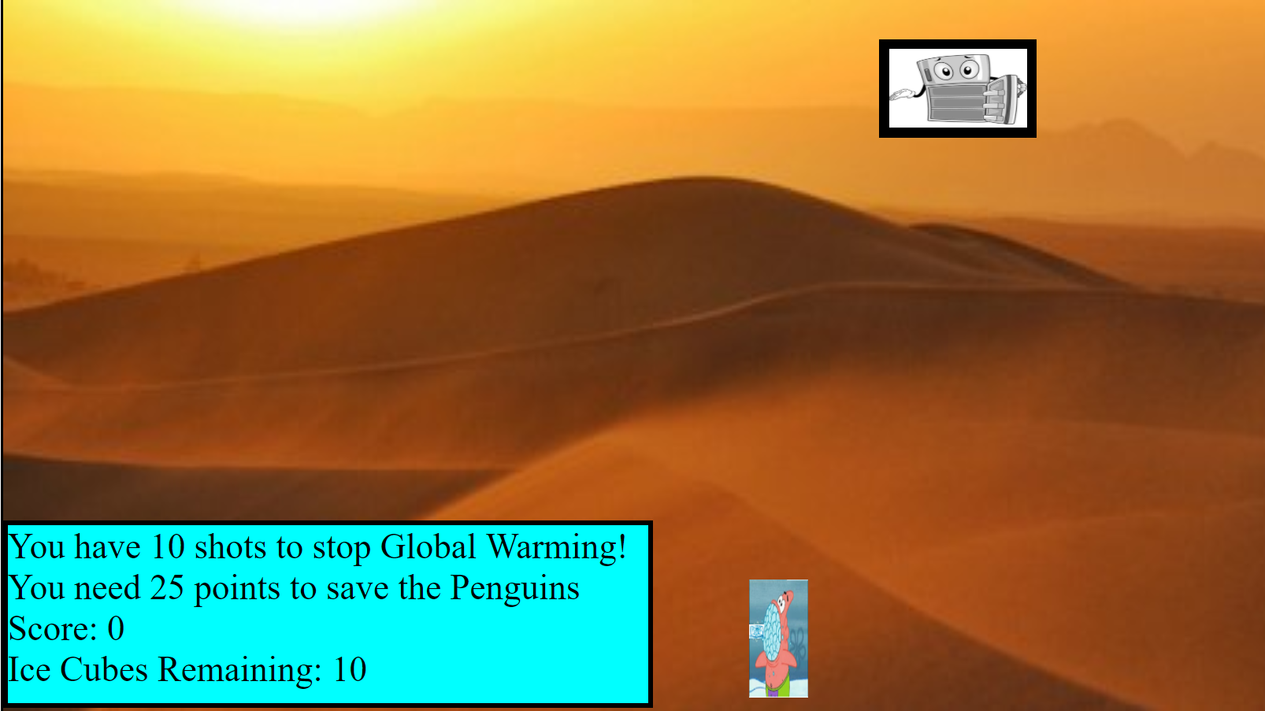

Slide 4
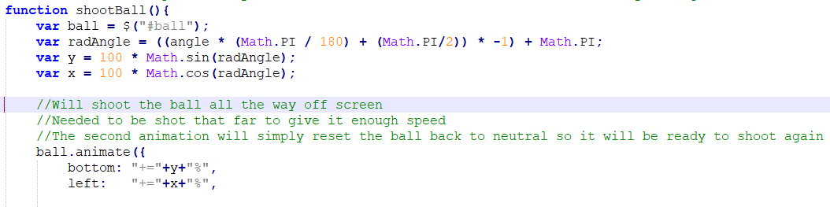
Implementation
The game engine is ran on an interval I created in JavaScript. It was created to continuously make the target move and to check when the ball overlaps the target
The target is set to move at constant speed back and forth across the screen
Whenever space bar is pressed the ball shoots at the angle the cannon is facing and will fly off the screen in that direction. It will then be reset back to its original position to be shot again

Slide 5
Known Problems
When the ball is shot off the right bound it will drag the screen with it for a second or two. Doesn’t affect the gameplay but visually is not appealing
The “GAME OVER” message is displayed as soon as you run out of shots so even if you reach the score on your last shot it will display that and the background will change

Slide 6
Creative Features
Instead of calculating one point per hit of the target. I calculate the score based on how long the ball passes through the target. More accurate shots result in more points. The range is anywhere from 1 to I believe 6
Target will light up upon hit and will also play a sound effect
With the players able to score up to 6 points a shot I decided that 25 points was a fair benchmark to keep the game somewhat challenging and once they reach that score the background changes.
I also decided to go with a fun global warming meme where the user is able to shoot ice into a freezer to save the penguins. The initial background is a hot desert but once they reach enough score it will change to a snowy background

