Slide 1
Awareness

Slide 2
Awareness is the state or quality of being aware of something.
Aware is having knowledge or perception of a situation or fact.

Slide 3
Why be aware?
Prevents yourself from being targeted
Protect property and valuables
Prepared to take action

Slide 4
Prevents yourself from being targeted
From thieves
Location
Time of day
Valuable items

Slide 5
Protect property and valuables
Increase Security
Security system
Camera system
Locks
Relocate valuable items

Slide 6
Prepared to take action
Increasing security
Calling for assistance: 911
Aware of surroundings

Slide 7
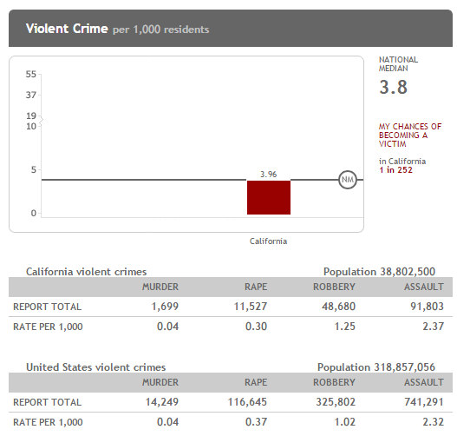
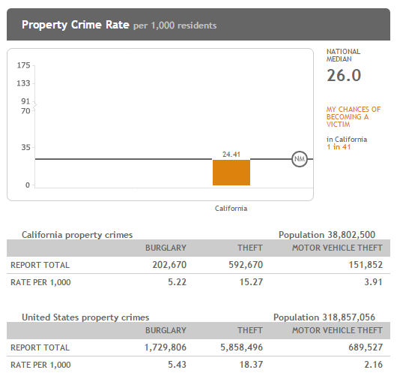
http://www.neighborhoodscout.com/ca/crime/

Slide 8
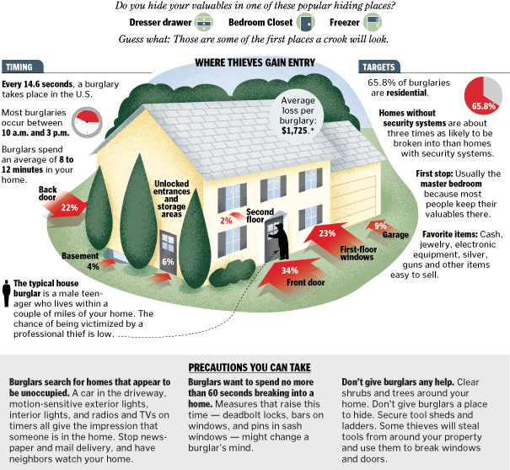
http://www.washingtonpost.com/wp-srv/artsandliving/homeandgarden/features/2007/burglary-070507/graphic.html

Slide 9
Summary
Being aware will make you feel safer
Be aware of yourself and your surroundings
Protect yourself
Take preventive actions

Slide 10
Be Safe

