Slide 1
Random Walks with Erasure
Diversifying Personalized Ranking
Paper: Bibek Paudel (Stanford) · Abraham Bernstein (UZH) — WWW 2021
Implementation, diagrams & deck: Sai Sanath Erram · Amrita Vishwa Vidyapeetham
A slide-by-slide walkthrough mapped to this implementation.
Deck recreated from the talk; diagrams + code-mapping by the project.
Notes:
Implementation of Paudel & Bernstein, WWW 2021. This deck recreates the talk and maps every part to the rwe/ codebase.

Slide 2
The problem: filter bubbles
• Recommenders show "more of what you already like" → filter bubbles.
• 2010–13: social media praised as an enabler of democracy and protest.
• Then criticised for increasing polarization and harming society.
• High polarization → suspicion, hostility, and lower political participation.
→ In the code: motivation captured in GUIDE.md §1
Notes:
Ten years ago social media was praised as a democracy enabler; soon after, blamed for polarization. We focus on the diversity of information in personalized recommendations.

Slide 3
How to bridge the divide?
• Cross-cutting awareness = exposure to viewpoints from the other side.
• It is linked to greater political understanding and participation.
• Goal: recommend content that is relevant AND bridges viewpoints.
→ In the code: RWEB (bridging) + extensions satisfaction.py / agent_sim.py
Notes:
Cross-cutting awareness and discussions increase political understanding and participation.

Slide 4
Challenge of political content
• Naive fix: mix outlets by their known slant (e.g. AllSides). Not enough.
• Two articles from the SAME outlet were shared by opposite Brexit camps.
• Ideological positions are issue/event-specific → must be learned, not labelled.
→ In the code: IdeologyModel.fit(R, S) learns issue-specific positions from behaviour
Notes:
Pre-existing labels / known slants are unreliable; positions change with the issue and event, so we learn them.

Slide 5
Our approach — three steps
• 1. Identify ideological positions of elites AND content from event discussions.
• 2. Choose a diversification strategy (naive "mix both sides" may fail).
• 3. Random Walk with Erasure (RWE): recommend diverse content via weak ties.
→ In the code: ideology.py · RWED / RWEB · RWE
Notes:
Three parts: learn positions, pick a strategy, run RWE.

Slide 6
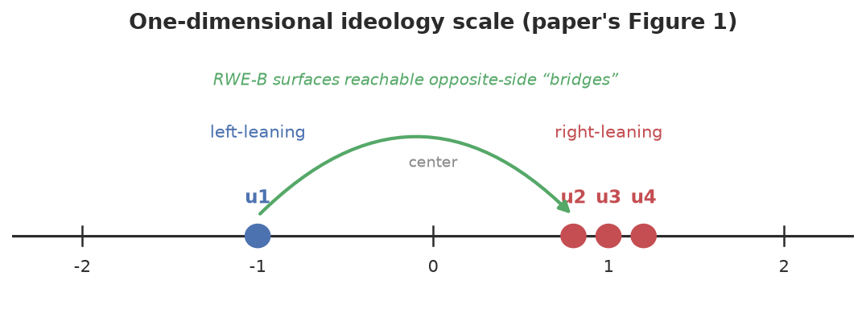
Ideology of users, elites & content
• Each retweet yields three roles: User (retweeter), Elite (author), Content (URL).
• Two graphs: elite-endorsement R and content-share S.
• Place users, elites and content on one shared left–right scale.
→ In the code: IdeologyModel.fit(R, S) → positions θ (users), φ (elites), ψ (content)
Notes:
A retweet gives a user→elite endorsement (R) and a user→content endorsement (S); both place everyone on one 1-D scale.

Slide 7
Ideal-point model + joint learning
• Elite: p(R=1) = σ( −‖θ_u − φ_e‖² + α_u + β_e )
• Content: p(S=1) = σ( −‖θ_u − ψ_c‖² + α_u + γ_c )
– Closer ideology ⇒ more likely to endorse.
• Joint objective: maximise μ·Σ_R[·] + Σ_S[·] − (λ/2)(‖θ‖²+‖φ‖²+‖ψ‖²)
• ⟹ sim(u, c): similarity of political stance.
→ In the code: ideology.py: Pi_R / Pi_S (eqs 6/9), _objective (eq 11); sim = RWEB.similarity
Notes:
Endorsement probability decreases with squared ideological distance; elite and content models are learned jointly.

Slide 8
Estimated positions (results)
• Recovers left/right correctly across UK, US and Germany.
• Captures issue-specific cases (e.g. Conservatives who backed Remain → left).
• Joint learning (elite + content) beats elite-endorsement alone.
→ In the code: validated on synthetic data (real Twitter data not shareable) — demo_synthetic.py
Notes:
Issue-specific positioning is exactly what learning-from-behaviour captures, unlike fixed party labels.

Slide 9
Normative goals for diversification
• Personalized: high accuracy.
• Long-tail: expose users to more low-degree items.
• Bridging: show the other side — but not too polarizing — via weak-tie "bridges".
→ In the code: accuracy metrics · RWED · RWEB (max_distance = "not too far")
Notes:
Diversity is calibrated: accurate, strategy-specific, and reachable via weak ties rather than jarring opposite extremes.

Slide 10
Diversification strategies — the erase matrix Q
• Q on the user-item graph prefers certain random walks over others.
– Example I — Bridging: items on the opposite side of the user.
– Example II — Long-tail: low-degree items.
– Example III — Contrarian: items opposite to the user.
• Generalized framework: any property defined on items or user-item pairs.
→ In the code: RWE(item_erasure=…): RWEB · RWED · or any callable (contrarian = one-liner)
Notes:
Q is the single knob; different Q gives different strategies. The framework is open-ended.

Slide 11
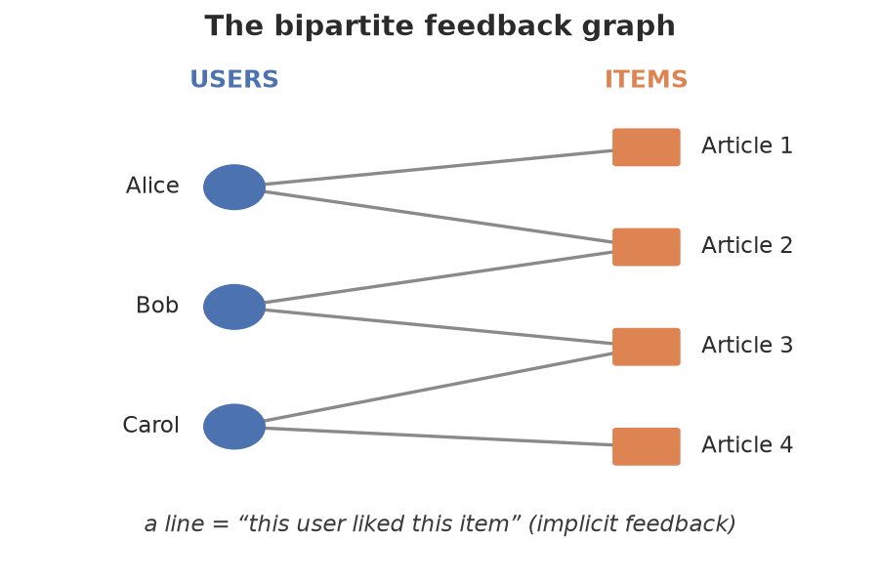
Random Walk with Erasure — the algorithm
• Bipartite graph: m users, n items; k-step transitions Pᵏ.
• Erase matrix Q ∈ [0,1)^{(m+n)×(m+n)}.
• Sample multiple rounds; erased mass becomes the next round's start.
→ In the code: FeedbackGraph (A^G, P=D⁻¹A^G); item_distribution(users, k)
Notes:
Normal k-step walk via the transition matrix, plus an erase matrix Q; at each round the initial-state probabilities are modified by Q.

Slide 12
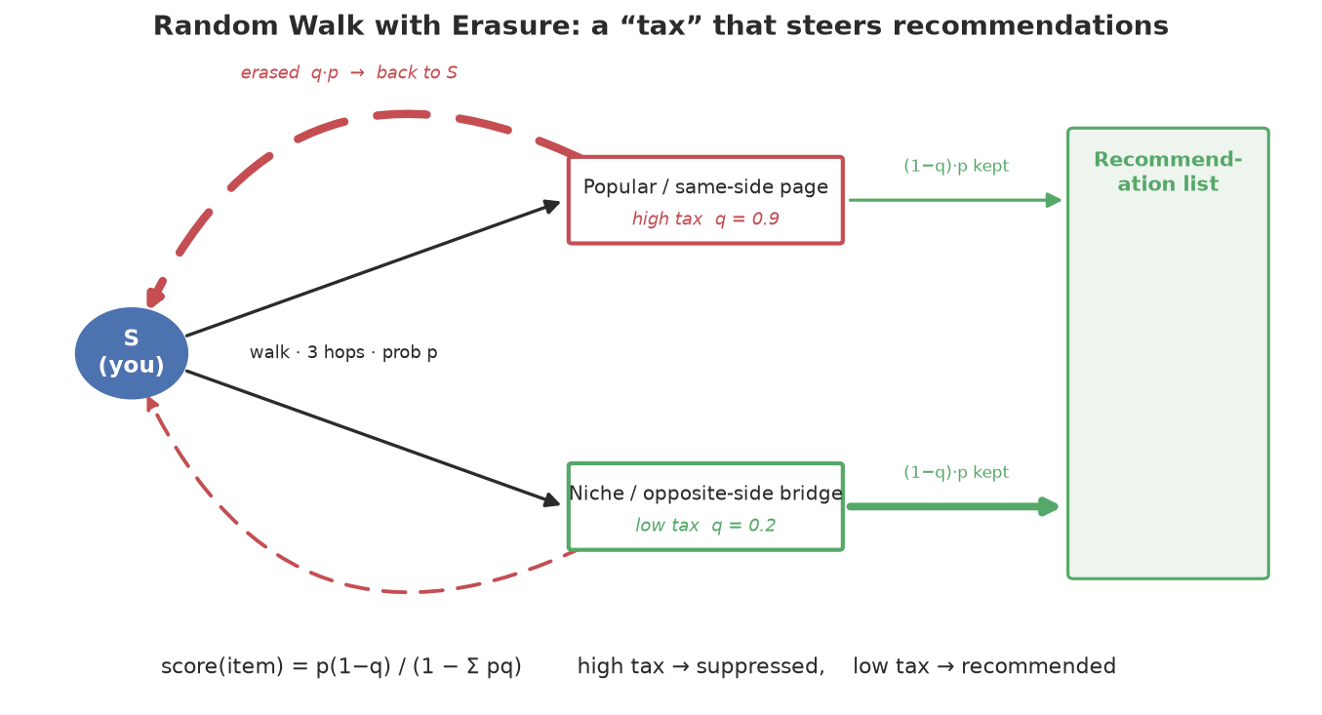
How erasure steers recommendations
• Score(item) = p·(1−q) / (1 − Σ p·q) — the mass that survives the "tax".
• High tax q ⇒ suppressed; low tax q ⇒ recommended.
• Final score: w_s = Σᵢ v_{s,i} Pᵏ ∘ (1 − Q).
→ In the code: RWE.score_iterative (rounds) == derived closed form; tested to match
Notes:
The repeat-forever erasure loop telescopes into a closed form; the denominator is constant per user so it doesn't change the ranking.

Slide 13
Long-tail worked example (reproduced)
• Pᵏ_{u₄,i*} = [0.16, 0.16, 0.66]; Q = 1 − [1/3, 1/2, 1/2] = [0.66, 0.5, 0.5].
• Erased = Pᵏ ∘ Q; start mass falls 1 → 0.51 → 0.26 across rounds.
• Suppresses the high-degree item, lifts the low-degree ones.
• Our code reproduces these numbers to the decimal.
→ In the code: RWED (β=1) via score_iterative — verified against the slide
Notes:
A plain walk scores i1 and i2 equally; degree-based erasure lowers the high-degree node and raises low-degree ones.

Slide 14
Experimental evaluation — three questions
• Q1. Does joint learning identify ideological positions accurately?
• Q2. Can RWE generate accurate AND diverse long-tail recommendations?
• Q3. Can RWE generate accurate AND ideologically diverse recommendations?
→ In the code: IdeologyModel · RWED · RWEB + metrics.py
Notes:
Three evaluation axes: ideology accuracy, long-tail diversity, ideological diversity.

Slide 15
Datasets & baselines
• 6 Twitter graphs: UK / US / DE × {retweets (RT), URL shares}.
• Plus benchmarks ML-1M and Yelp for long-tail diversity.
• Baselines (RecSys'19 study): Collaborative Filtering, Matrix Factorization,
– graph-based P³, and long-tail-diversifying RP³_β.
→ In the code: ItemKNN · BPRMF · P3 · RP3Beta; data.py (synthetic stand-ins for private data)
Notes:
State-of-the-art recommenders from a recent evaluation study.

Slide 16
Result I — ideological range of top-10
• Average spread of ideological positions in the top-10 list.
• RWE-B has the widest range on all but the smallest dataset.
– → more viewpoint-spread per recommendation list.
→ In the code: metrics.rec_range_at_k (reported as rec_range@10)
Notes:
RWE-B's recommendations span a wider ideological range than the most competitive baselines.

Slide 17
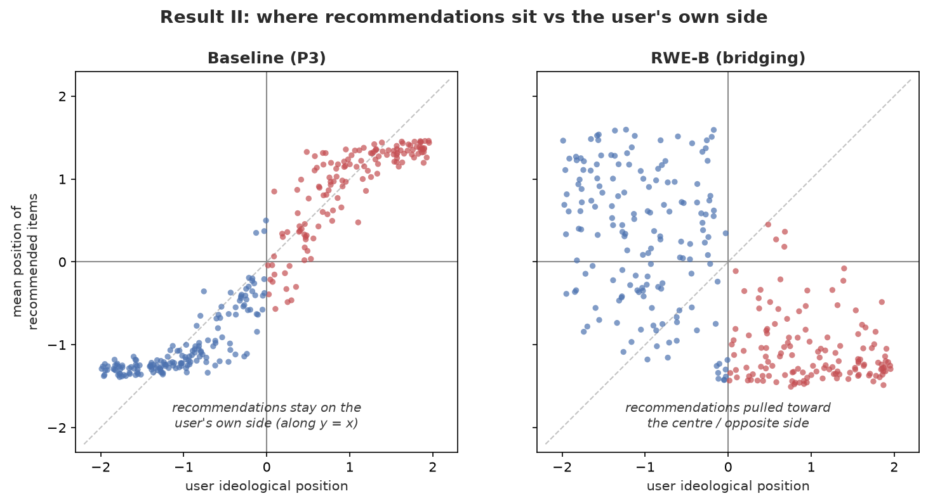
Result II — ideological diversity
• x = user position, y = mean recommended position (each dot a user).
• Baselines keep users on their OWN side (dots on the diagonal).
• RWE moves recommendations to the OPPOSITE quadrant / centre.
→ In the code: docs/make_diagrams.py quadrant_scatter — metrics.mean_recommended_position
Notes:
Baselines recommend from the same quadrant; RWE recommends from the opposite quadrants and the centre.

Slide 18
Result III — ideological shift
• User-Shift = Pos(Recs) − Pos(u); Train-Shift = Pos(Recs) − Pos(Train).
• Left users shift right, right users shift left.
• RWE shows the strongest, cleanest shift toward the opposite side.
→ In the code: metrics.ideological_shift (exact definition) → directed_shift
Notes:
Shift = difference between recommended position and the user's own / training position.

Slide 19
Result IV — weighted ideological diversity
• Two properties: lean toward centre (per user); wider range for extremes.
• Measures UW / TW (weighted by user / training position): Recs, Shift, Range.
• RWE-B is best on all three — while keeping accuracy (AUC, HR@10) on par.
→ In the code: weighted_position (UW/TW-Recs) · weighted_shift · weighted_range — uw_* in evaluate()
Notes:
Lower is better except for UW-Range, AUC and HR@10. RWE-B at erasure exponent v ∈ {5, 2, 0.5}.

Slide 20
Contributions & main results
• A probabilistic model to estimate ideological positions (users, elites, content).
• Personalized ranking based on RWE.
• Two diversification strategies: long-tail and political bridging.
• A general framework to diversify personalized ranking.
→ In the code: ideology.py · RWE · RWED/RWEB · RWE(item_erasure=…)
Notes:
The four contributions, each realised in the rwe/ package.

Slide 21
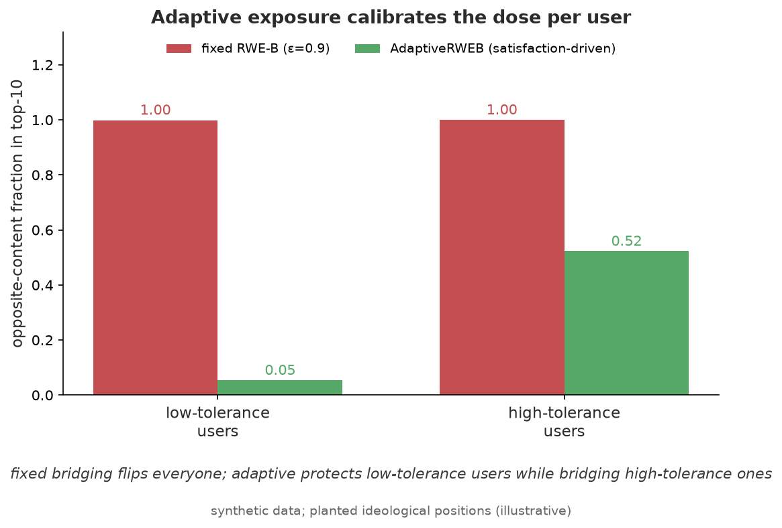
Beyond the paper — adaptive exposure
• Our extension: tailor how much opposing content each user sees.
• Satisfaction score = pages read in the first opposing community before exiting.
• Higher tolerance → more opposing content surfaced (AdaptiveRWEB).
→ In the code: rwe/satisfaction.py: WebGraph · SatisfactionModel · AdaptiveRWEB
Notes:
A fixed aggressive strategy flips every user; the adaptive version protects low-tolerance users while still bridging high-tolerance ones.

Slide 22
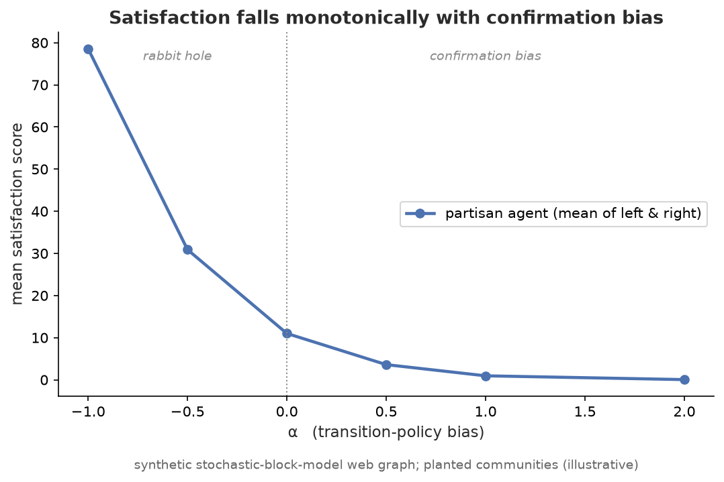
Beyond the paper — agent browsing simulation
• Agent-based model on a networkx web graph (Louvain/Leiden communities).
• State machine: own side → first opposite page → track → exit.
• Tunable α: confirmation bias (α>0) vs "rabbit hole" (α<0); Monte-Carlo scores.
→ In the code: rwe/agent_sim.py: NewsfeedSimulator · monte_carlo · alpha_sweep
Notes:
α-sweep validation: mean satisfaction falls monotonically as confirmation bias rises.

Slide 23
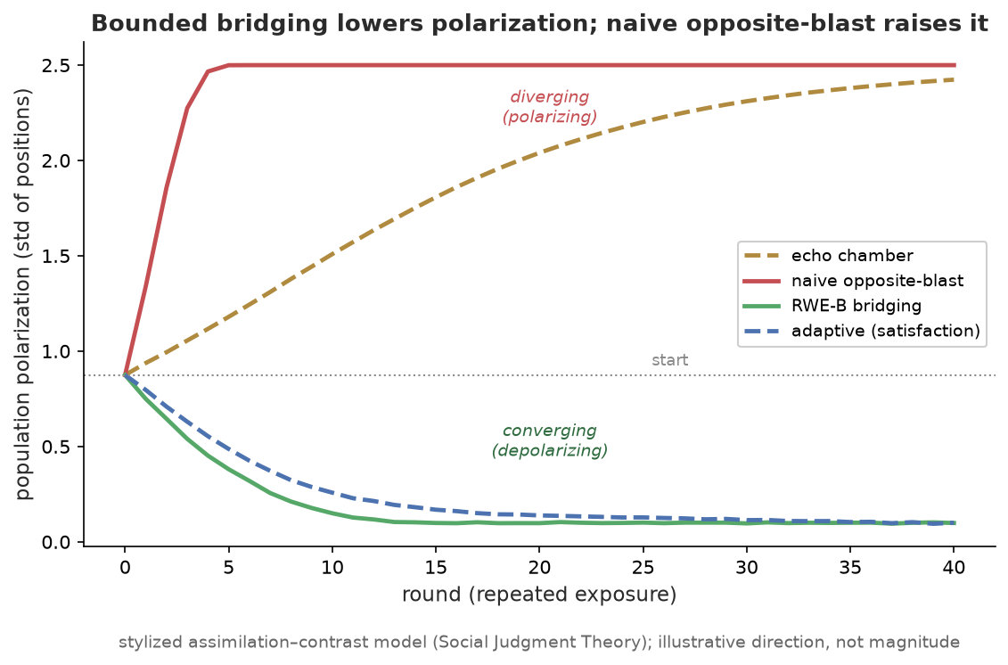
Beyond the paper — does bridging backfire?
• Risk: naive opposite-view exposure can INCREASE polarization (Bail et al. 2018).
• Simulation: users assimilate nearby views but reject (backfire on) far ones.
• Bounded bridging → opinions converge (depolarize); opposite-blast → diverge.
→ In the code: rwe/opinion_dynamics.py: assimilation–contrast model · compare_policies
Notes:
Same goal (expose to opposite views), opposite outcome depending on HOW: bounded 'not too far' bridging lowers polarization; naive opposite-blast raises it.

Slide 24
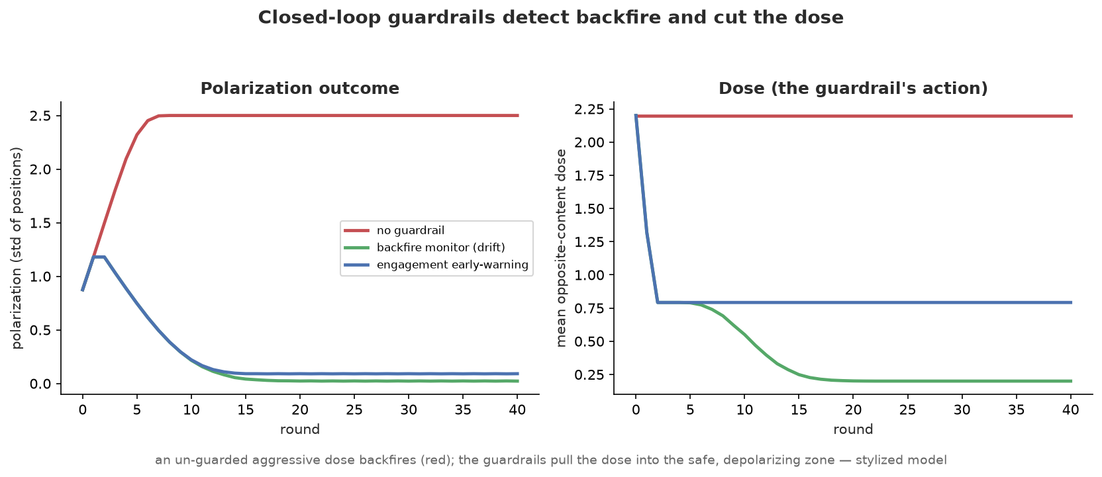
Beyond the paper — guardrails that catch backfire
• Don't just bound the dose — MONITOR each user and cut it if backfire starts.
• Backfire monitor (ideology drift) + engagement early-warning (satisfaction).
• Un-guarded aggressive dose polarizes; guardrails detect it and depolarize.
→ In the code: rwe/guardrails.py: BackfireMonitor · EngagementGuardrail · compare_guardrails
Notes:
Closed-loop controllers watch a signal (ideology drift / satisfaction) and cut the per-user dose when it trends toward backfire — the 'measure it' safeguard turned into code.

Slide 25
This implementation
• Full paper in rwe/ (graph, RWE, ideology, baselines, metrics) + 4 extensions.
• 79 tests — including the worked erasure example reproduced to the decimal.
• 8 diagrams, a beginner guide (GUIDE.md) and a verification report (TALK.md).
• Run: pip install -e . · pytest -q · python examples/demo_synthetic.py
→ In the code: github: greenwichg/random_walks_with_erasure
Notes:
What this repository adds on top of the paper.

Slide 26
Thanks
• Paper: Paudel & Bernstein, "Random Walks with Erasure", WWW 2021.
• Original talk: Bibek Paudel — @biasedcoin · bibekp@stanford.edu.
• Implementation & deck: Sai Sanath Erram, Amrita Vishwa Vidyapeetham
– erram.sanath@gmail.com
Notes:
Acknowledging the Hasler Foundation's support of the original work.

