Slide 1
Open Refine: Intermediate Skills for Metadata Manipulation
Continuing Resources & Metadata Community of Interest
Boston Library Consortium
May 2, 2024
Greer Martin
gmartin5@luc.edu
Metadata Technologies Libarian, Loyola University Chicago

Slide 2
Agenda
What is Open Refine?
Create our project
Faceting and filtering
GREL
Regular Expressions
Break
Clustering and API querying
Reconciliation
Wrap up

Slide 3
What is Open Refine? how is it different from excel?

Slide 4
Open Refine
Open-source desktop application that runs in your browser
Connects to the web, can bring in data from external sources
Can export data in various formats (XML, JSON)
Documentation: https://openrefine.org/docs

Slide 5
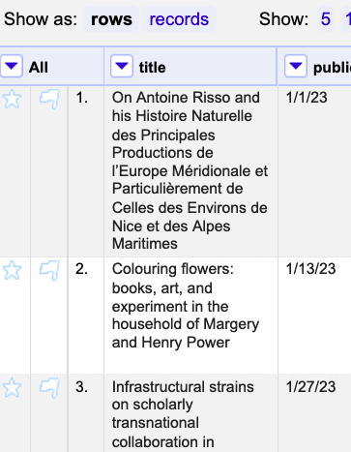
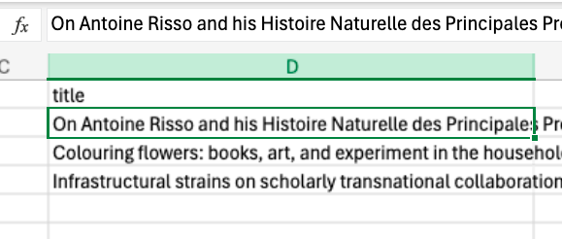
Excel And Open Refine
Excel: Cell-based tasks
Open Refine: Column-based tasks

Slide 6
Excel and Open Refine: Comparative Strengths
Excel
Open Refine
Data entry
Data organization
Cell value edits
Computation with functions
Data storage
Data review
Data normalization
Data transformation
Enhancement with external data
Exporting in a different data format

Slide 7
Let's Get Started!

Slide 8
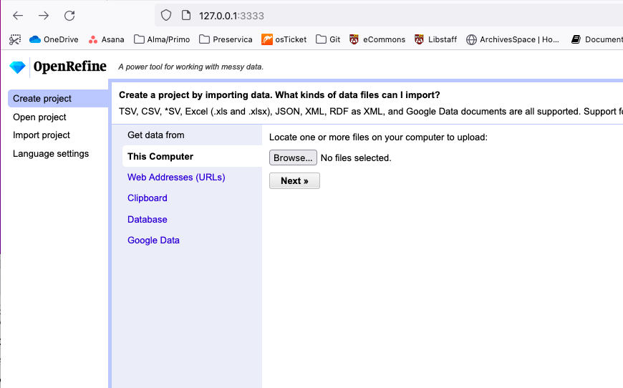

Start Open Refine
Start Open Refine by double clicking on the icon
If it does not open automatically in your browser, go to:
http://127.0.0.1:3333/
Notes:
Show this after you demo these steps

Slide 9
https://bit.ly/openrefine2024

Slide 10
Create Your Project
In Create Project tab, select "Web Addresses (URLs)"
Once the page loads, copy the URL from the dataset (raw) file in GitHub: https://raw.githubusercontent.com/greermartin/openrefine-workshop/main/repository-data.csv
Paste the URL into the Web Addresses (URLs) field
Click Next
Notes:
Show this after you demo these steps

Slide 11
TExt Faceting and Filtering

Slide 12
Filtering with Regular Expressions
Regular expressions (or "regex" with a hard g) match text patterns, not just literal characters
Text filter: "art" versus "\bart\b"
\b indicates a word boundary in regular expressions

Slide 13
Task #1: Remove XML Tags from Titles

Slide 14
Writing GREL Expressions
value.replace("<i>","")
value: contents of cell
replace: GREL function
"<i>": first argument – what to find
"": second argument – what to replace with

Slide 15
GREL with REGEX
value.replace(/<[^>]+>/,"")
value: contents of cell
replace: GREL function
/<[^>]+>/: first argument – what to find
"": second argument – what to replace with

Slide 16
GREL with REGEX
/<[^>]+>/: first argument – what to find
Regex in GREL must be enclosed in //
Matches a text pattern that begins with <, 1 or more of any characters except for >, and then >
Will match the entirety of the tags, not only the < and >
https://regexr.com is an excellent resource for learning regex

Slide 17
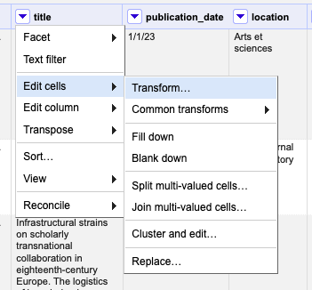
Using Grel Expressions
You can use GREL expressions in many places in Open Refine
First, we will use it in Edit Cells > Transform...
This will edit all the cells in the title column

Slide 18
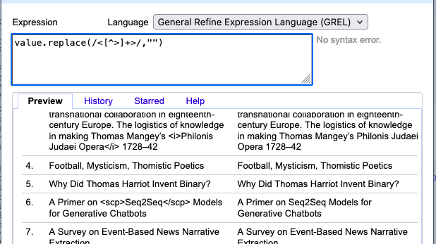
Edit Cells > Transform...

Slide 19
Task #2: Move DOIS to their own column and create URLs

Slide 20
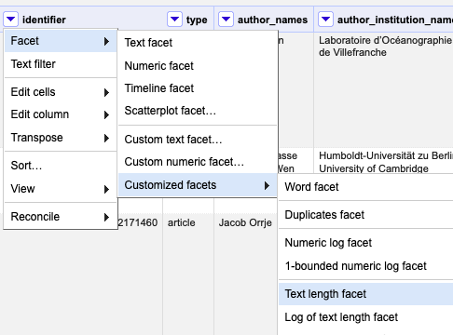
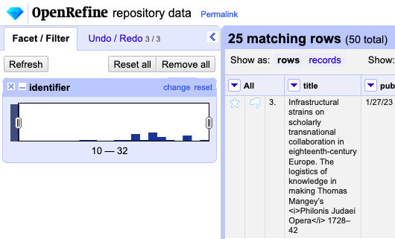
Text Length Facet

Slide 21
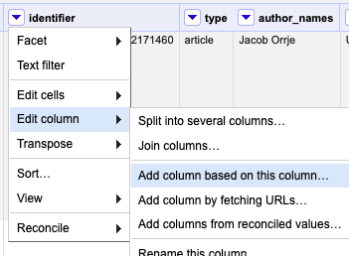
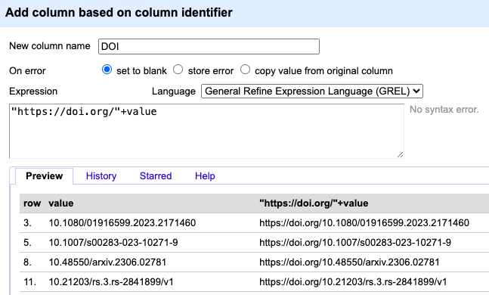
Copy DOIs to a new Column and Add HTTP

Slide 22
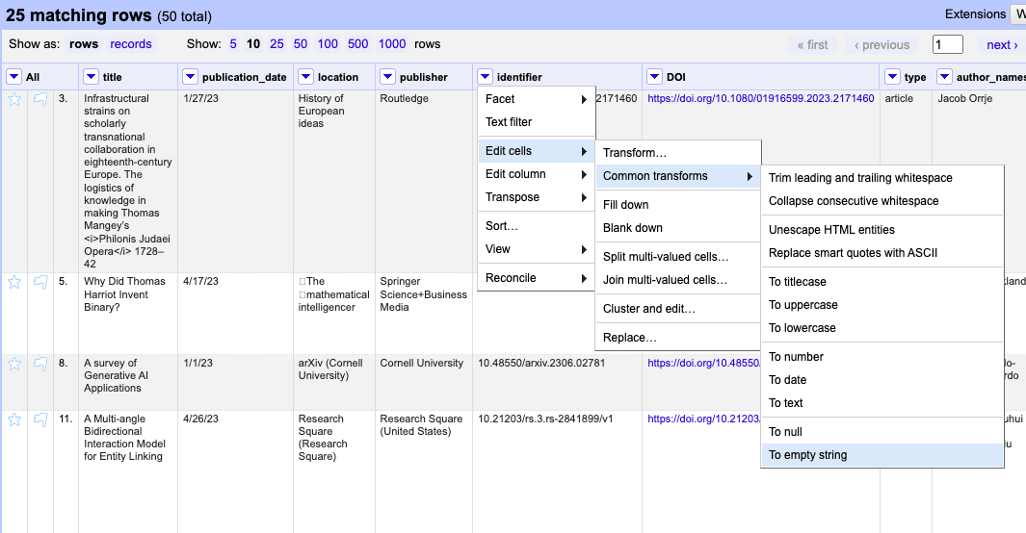
DElete DOIs from Identifier Column

Slide 23
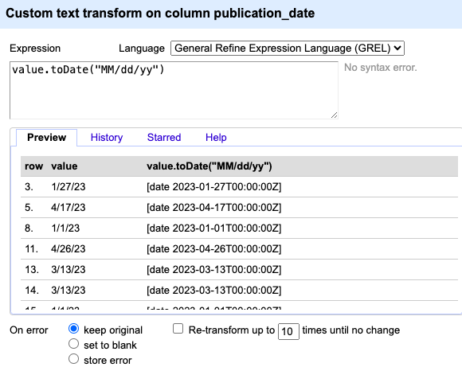
Change Date Format to ISO 8601
toDate() will take a value and return a date in ISO 8601 format
Include an argument that shows the month, day, and year pattern for the original data

Slide 24
break

Slide 25
APIs

Slide 26
What is an API?
An API is the code that governs access to data on a server.
Designed for applications to communicate with one another via HTTP requests (like javascript in a website)
Returns raw, machine-readable data
This same kind of data is accessible to humans via a user interface, which we use to make our queries
For example: OCLC's assignFAST website: https://experimental.worldcat.org/fast/assignfast/

Slide 27
Task #3: Normalize keywords and match with FAST vocabulary

Slide 28
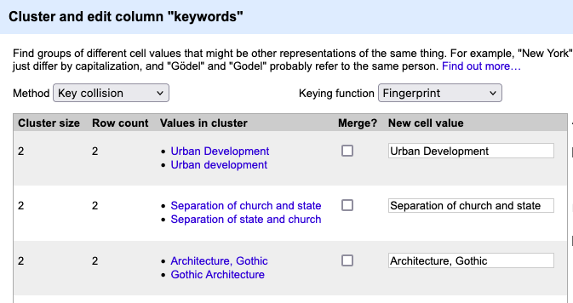

Slide 29
FAST API Query Construction
http://fast.oclc.org/searchfast/fastsuggest?&query=Humanities&queryIndex=suggestall&queryReturn=suggestall%2Cidroot%2Cauth%2Ctag%2Ctype&suggest=autoSubject&rows=1
Base URL | http://fast.oclc.org/searchfast/fastsuggest?
Query parameters | query=Humanities | Search for the term “Humanities”
 | queryIndex=suggestall | Search against all FAST headings
 | queryReturn=suggestall, auth, type, idroot, tag | Return these data fields
 | rows=1 | Return max 1 heading

Slide 30
Putting It Into Open Refine
Our HTTP API request:
http://fast.oclc.org/searchfast/fastsuggest?&query=Humanities&queryIndex=suggestall&queryReturn=suggestall%2Cidroot%2Cauth%2Ctag%2Ctype&suggest=autoSubject&rows=1
Becomes:
[Keyword column] Edit column > Add column by fetching URLs
Enter:
'http://fast.oclc.org/searchfast/fastsuggest?&query='+escape(value,"url")+'&queryIndex=suggestall&queryReturn=suggestall%2Cidroot%2Cauth%2Ctag%2Ctype&suggest=autoSubject&rows=1'

Slide 31
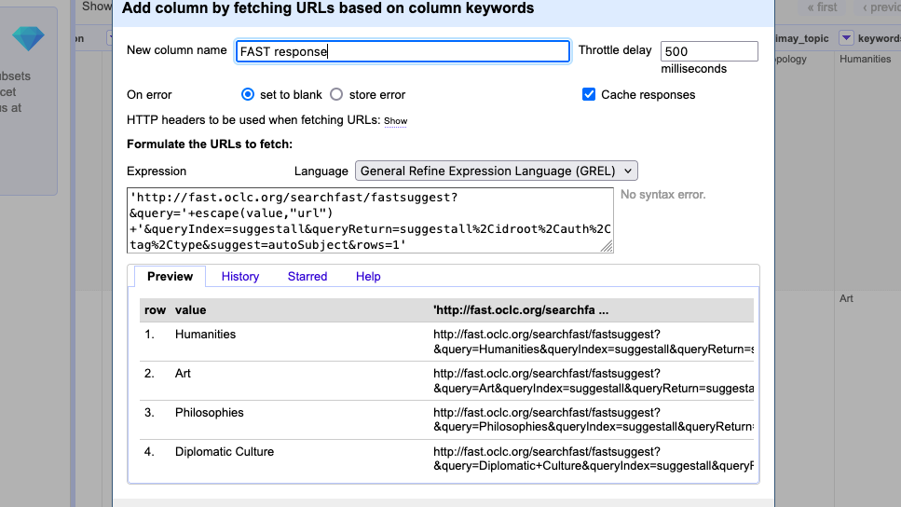

Slide 32
PARSING the JSON
Edit Column > Add column based on this column
Copy authorized heading into new column:
Enter:
value.parseJson()["response"]["docs"][0]["auth"]
Copy FAST ID into new column:
Enter:
value.parseJson()["response"]["docs"][0]["idroot"]

Slide 33
Reconciliation

Slide 34
Task #4: Reconcile institution names WIth LC Names (VIA VIAF)

Slide 35
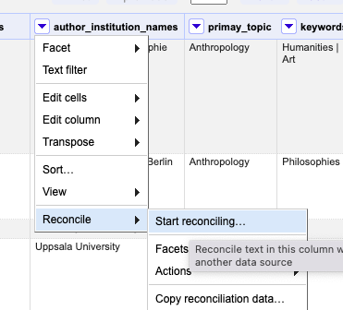
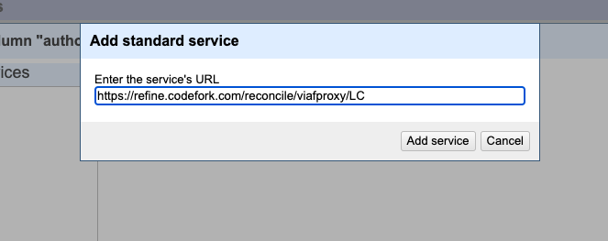
Add VIAF Reconciliation Service

Slide 36
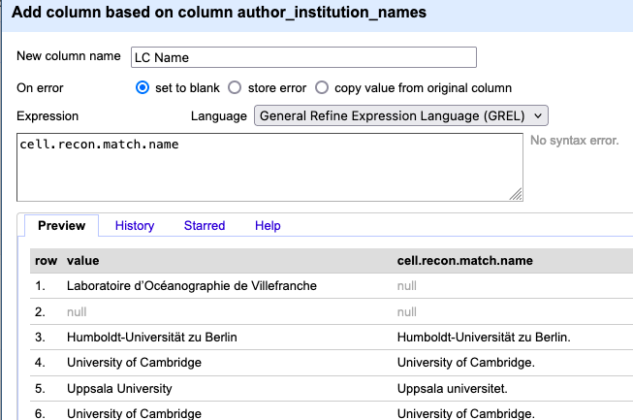
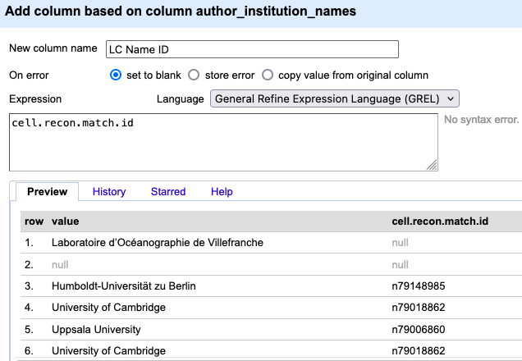
Copy Matched Values and IDs To New Columns

Slide 37
Tips for Reconciliation (And APIs)
Don't expect 100% matches
For best results, clean up your data beforehand using the text facet, cluster, and trim whitespaces tool
Use reconciliation facets and actions to group successful and unsuccessful matches, and perform actions in bulk
Look for reconciliation or API documentation for that service or data source. (Getty has a 69-page Getty Vocabularies OpenRefine Tutorial!)
If there isn't a reconciliation service for a data source, see if there is an open API

Slide 38
Resources
Workshop materials: https://bit.ly/openrefine2024
Open Refine documentation: https://openrefine.org/docs
Blog
Forum
Library Carpentry Open Refine Tutorial: https://librarycarpentry.org/lc-open-refine/
Reconcile-csv: https://www.alcts.ala.org/metadatablog/2017/06/metadata-librarians-little-helper-openrefine-reconciliation-services/
Cell Cross: https://ruthtillman.com/talk/cell-cross-webinar-2020-03/

Slide 39

Thank you!

