Slide 1
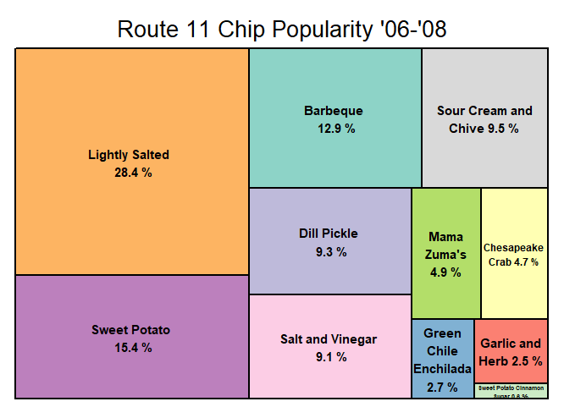
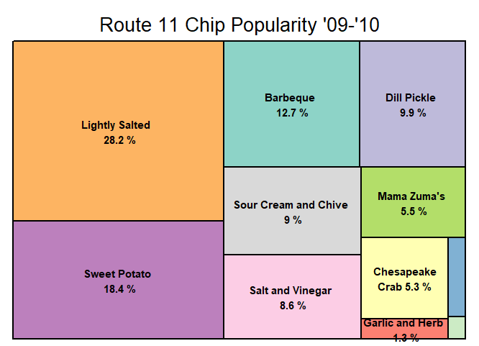
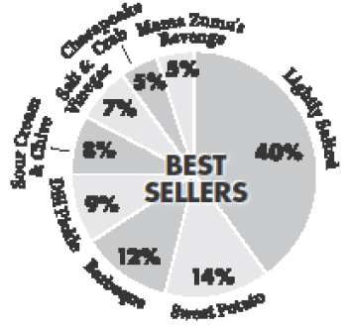
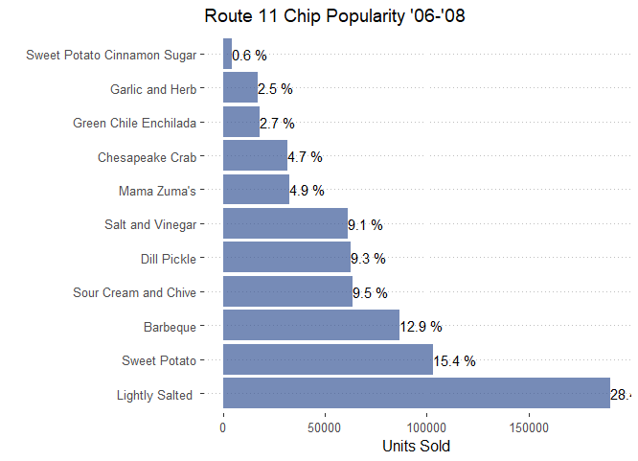
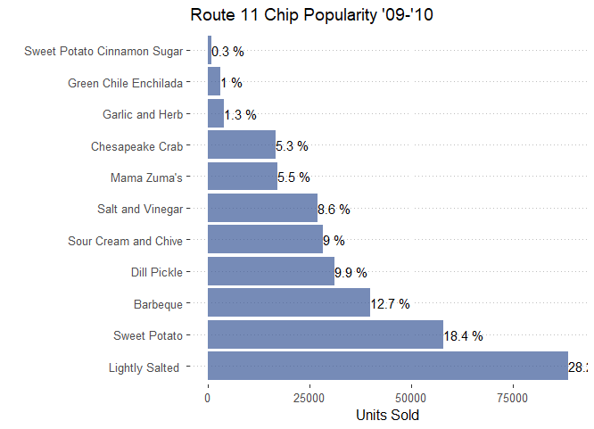
The pie chart in case Exhibit 2 provides guidance to wholesale buyers about the relative market share of different flavors. It was computed using the total ounces sold at Route 11’s on-site gift shop during calendar years 2006–2008. Using the data on actual wholesale purchases during this same time period, confirm (or refute) that these are accurate market share predictions for these flavors. By the 2009–2010 time frame, have these relative market shares shifted?
Wholesale purchases were not exactly
The same as the pie chart. Relative Market
Shares have not changed much.. Don’t drop
Salt and Vinegar (last question)

Slide 2
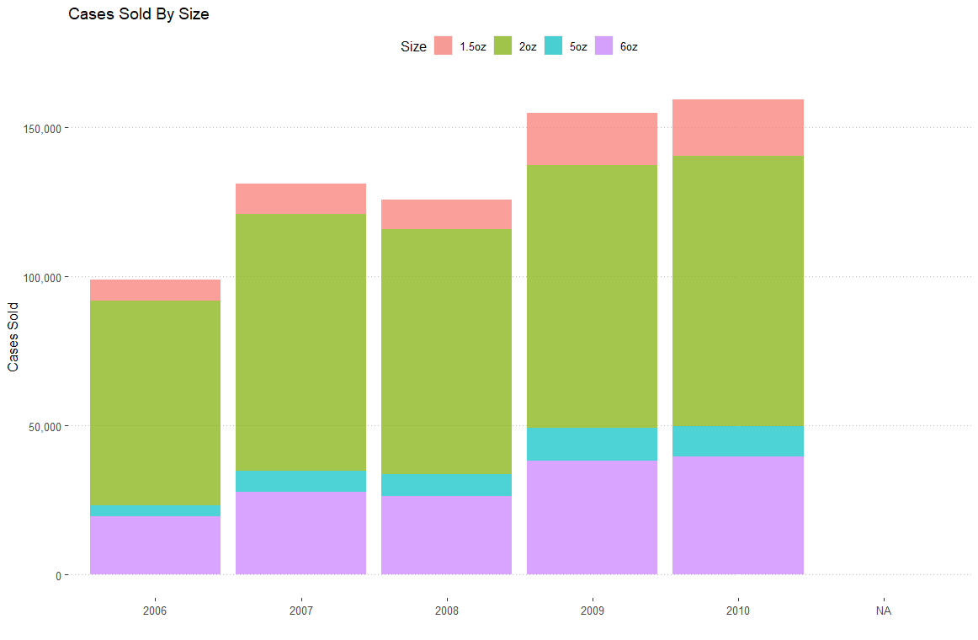
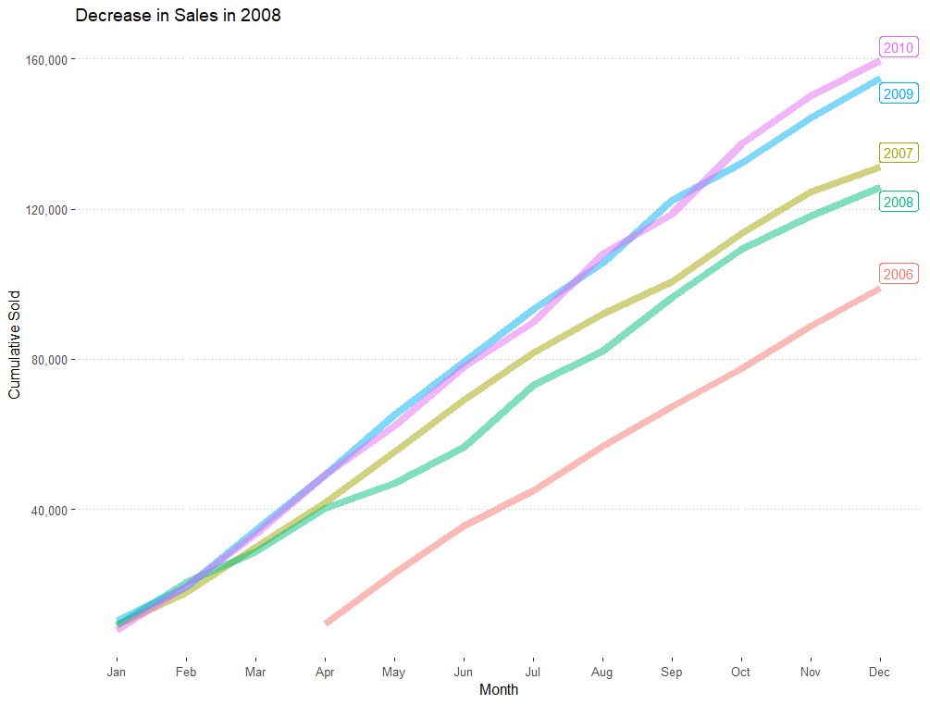
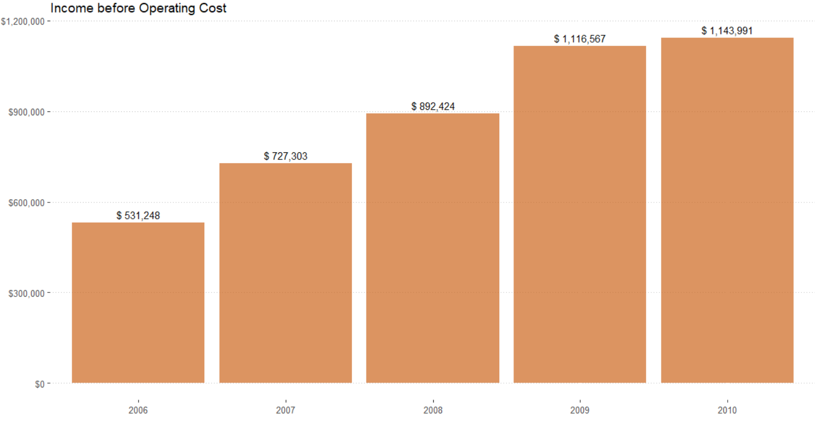
Price Hike in Jan 08’ decreased sales quantity from what was observed in 2007, but sales rebounded in 2009 Despite decrease in total sales, Rte11 saw in increase in income

Slide 3
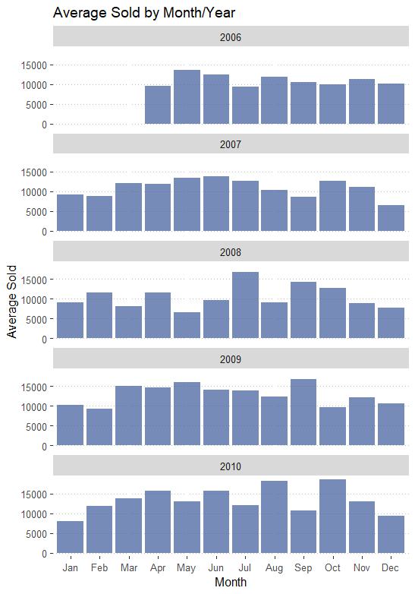
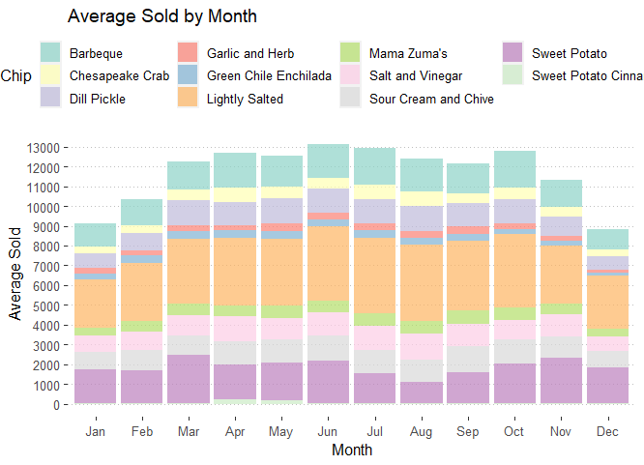
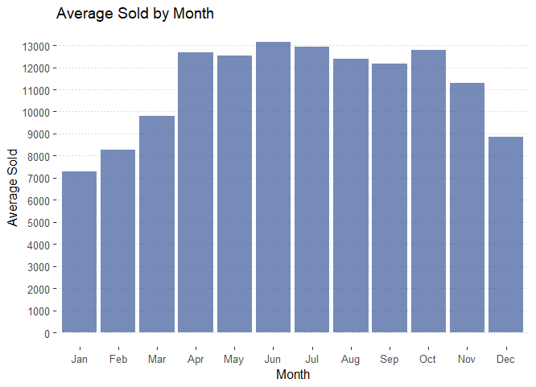
Is this a seasonal business? Yes- less purchases in winter months

Slide 4
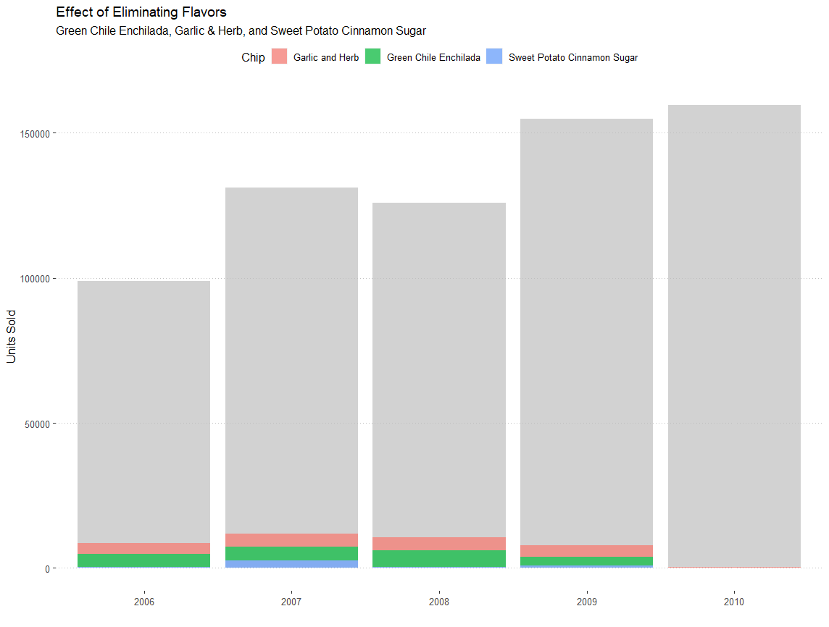
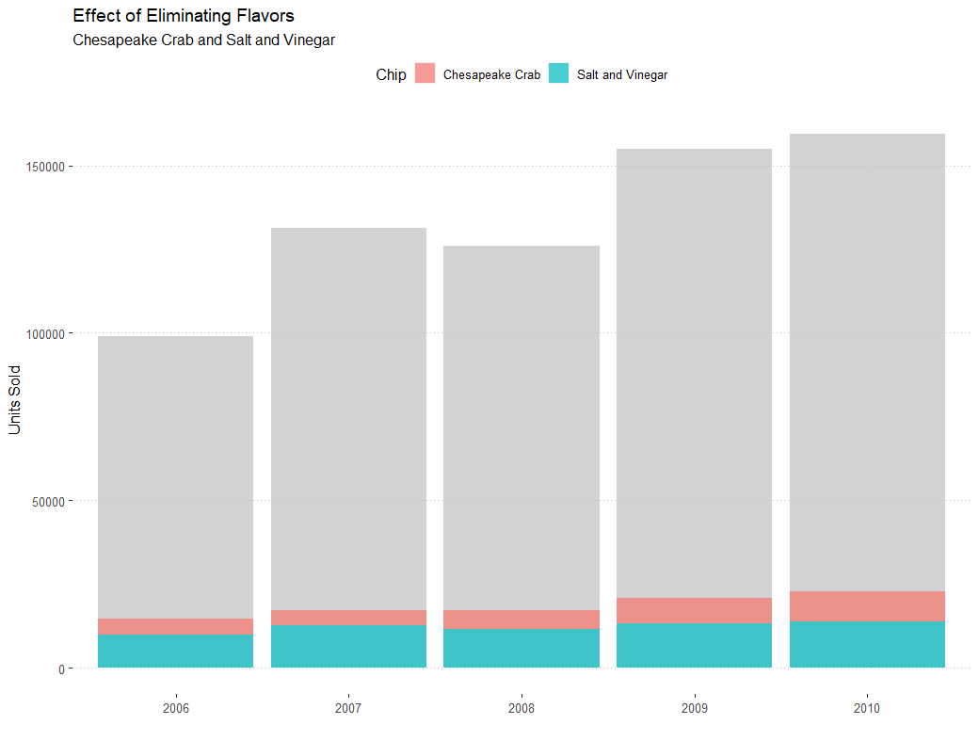
How did eliminating some of its flavors affect its sales?
In the previous two years, it had discontinued the flavors Green Chile Enchilada, Garlic & Herb, and Cinnamon &Sugar Sweet Potato.
Next on the potential chopping block was Salt and Vinegar, and Chesapeake Crab, a flavor unique to Route 11. Both were disappointing performers whose sales probably didnot justify their costs.
Eliminating the 3 low sellers had no affect. Recommend against eliminating S&V or Chesapeake Crab

Slide 5
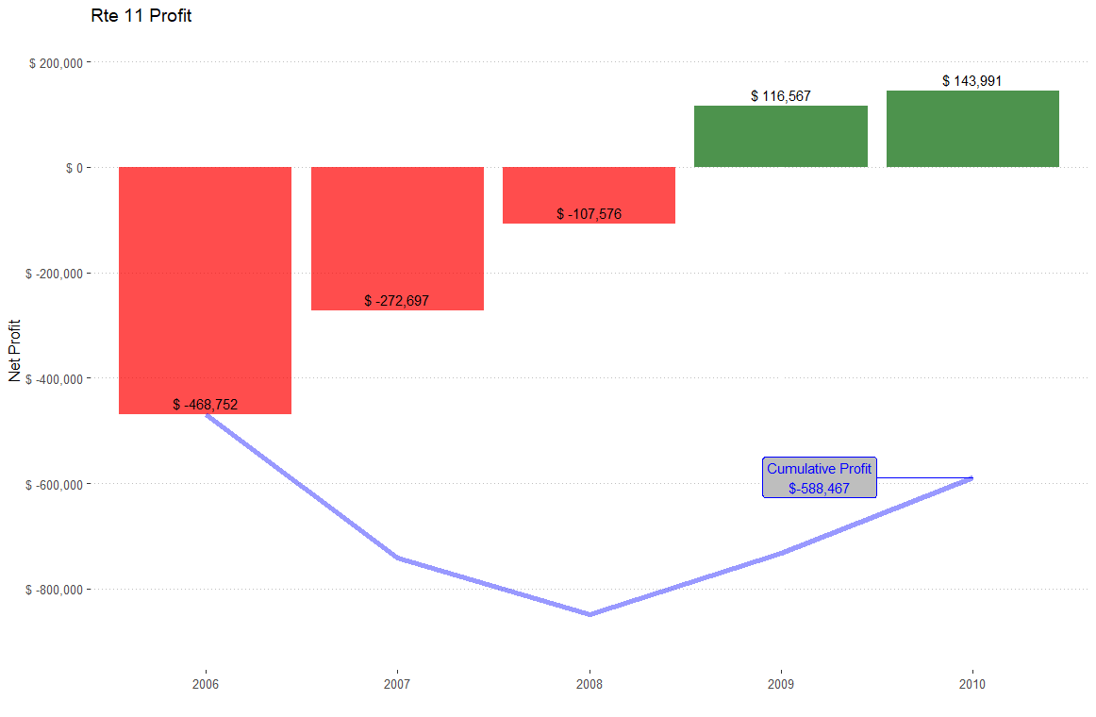
Accounting for a 25% discount on half cases sold, as well as 1mm/yr operating cost
How big is this business? Is this company growing?
What are the dollar sales in 2010? What is the growth in dollar sales from 2007–2010?
Is Route 11 making money?

Slide 6
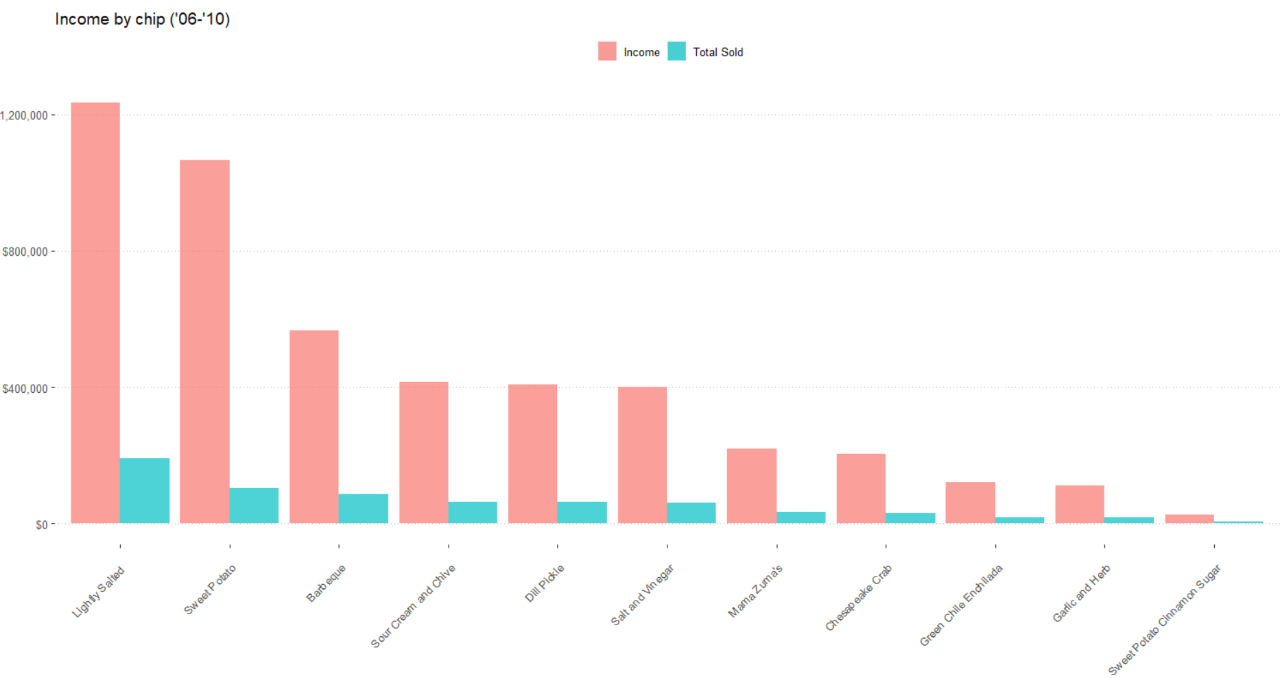

Slide 7
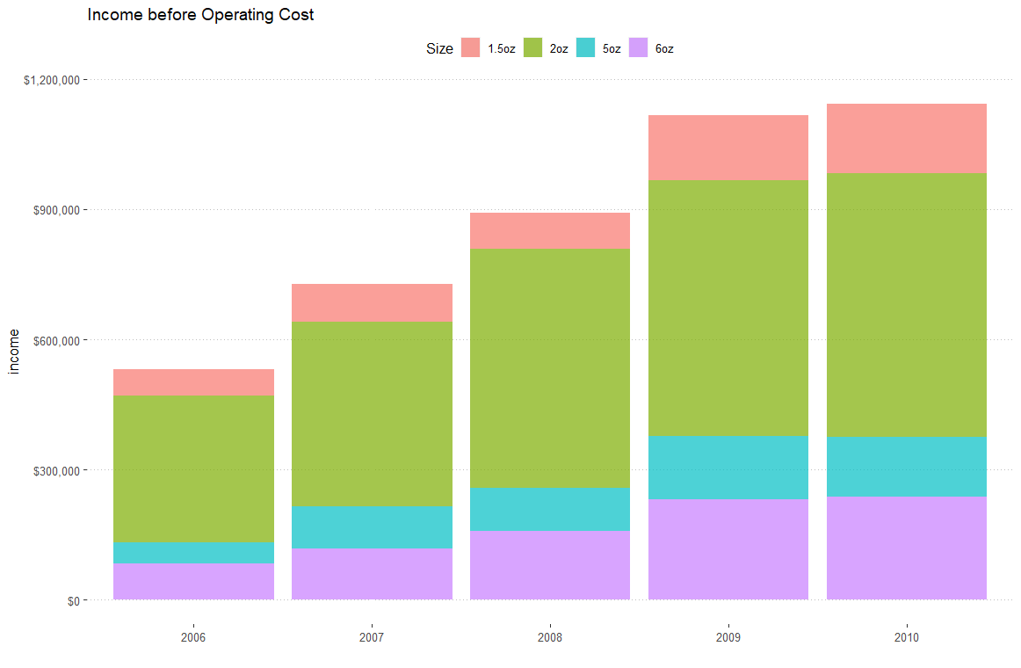
To calculate profit I multiplied
(cases sold * unitprice) –
(cases sold *caseCost)
I got caseCost from costperbag*#bags in a case
This is accounting for 25% dicount on ½ sales

Slide 8
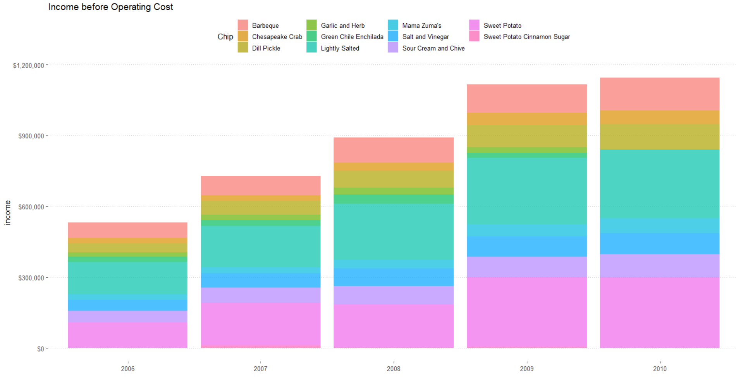

Slide 9
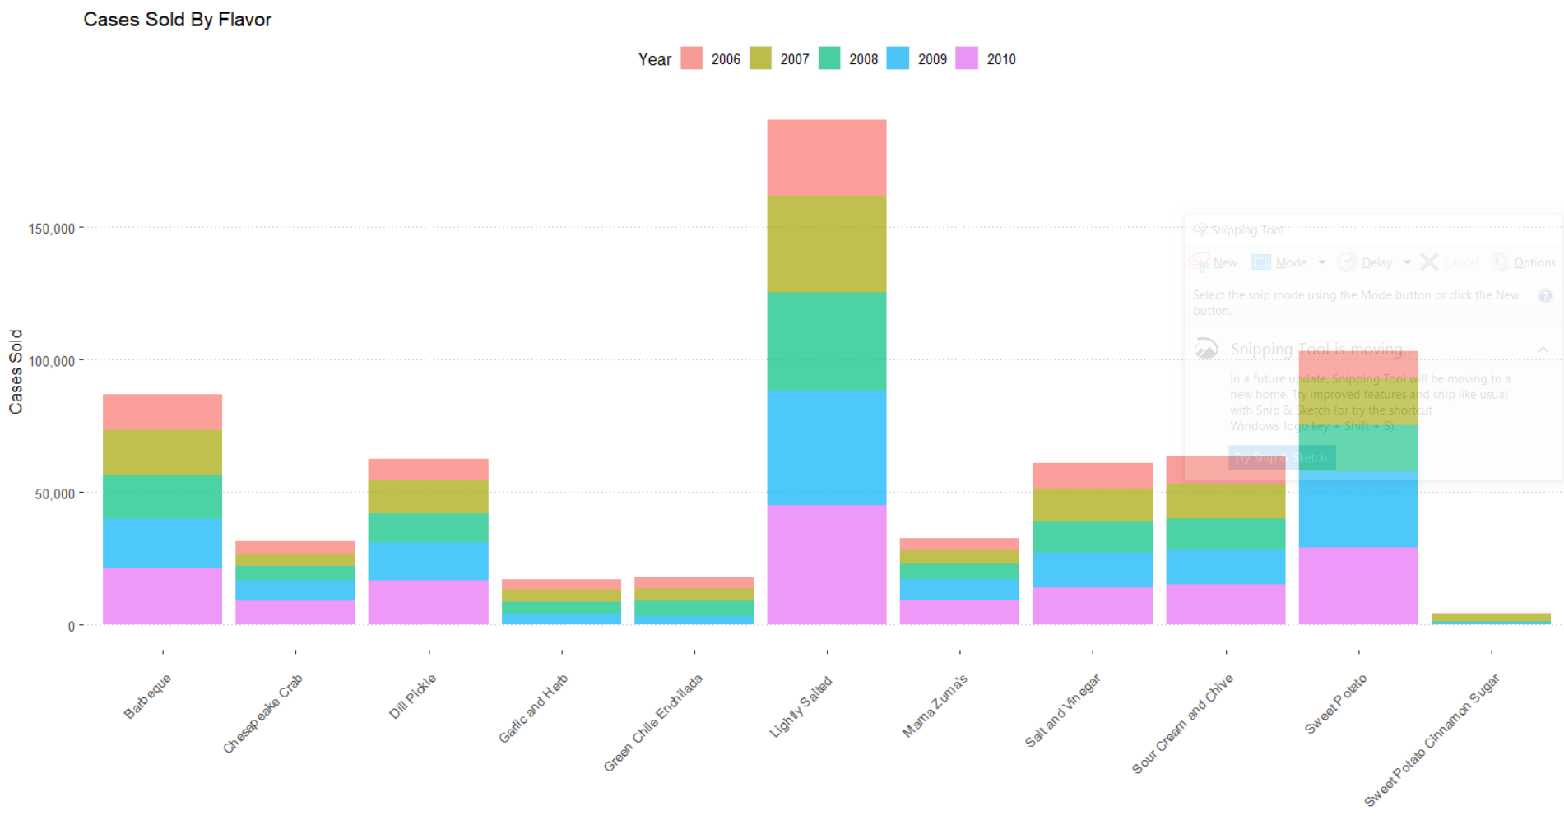

Slide 10
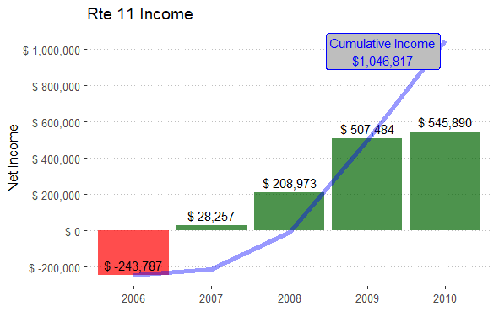
Without discount

Slide 11
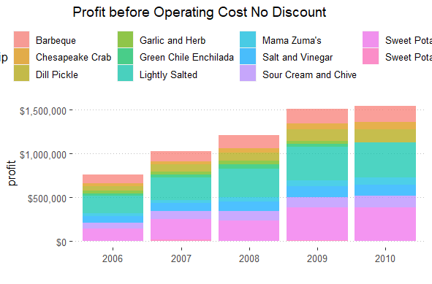
Without discount

