Slide 1
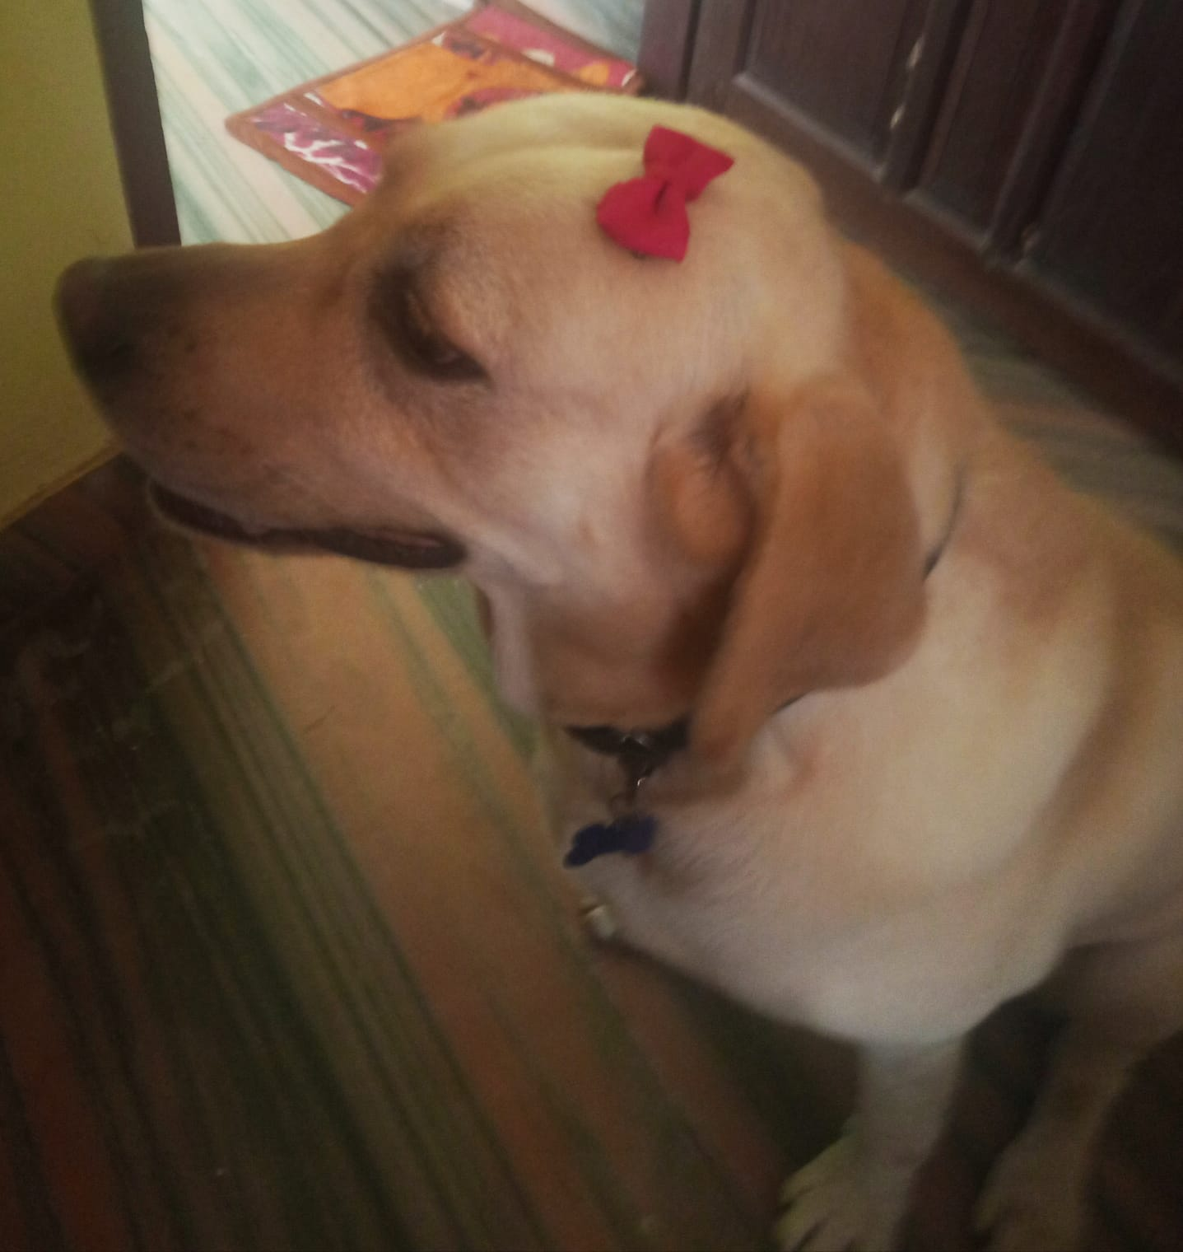
BIO DATA
NAME:
Tom Louis ll
AGE:
3
GENDER:
Male
HEIGHT:
57 cm
WEIGHT:
36 kg
RELATION STATUS:
Single
JOB:
Barking

