Slide 1

LIBRARY CATLOG
JAVA PROJECT

Slide 2

PROBLEM STATEMENT
Design and implement a modern library catalog system to efficiently manage the inventory, circulation, and user interactions within a library. The library catalog system should address the following key challenges and requirements:
1. Inventory Management:
2. User Interaction:
3. Circulation Management:
4. Reporting and Analytics:
5. Integration:
6. Scalability and Performance:
7. Accessibility and User Experience:
8. Security:

Slide 3
INTRODUCTION
A library catalog is a fundamental and indispensable tool within the world of libraries, serving as the gateway to a vast treasure trove of knowledge and information. It is the organized inventory of a library's holdings, providing users with a systematic and structured means to search, locate, and access the library's collection of books, periodicals, multimedia, digital resources, and more.
Key Elements of a Library Catalog:
1. *Bibliographic Records:* At its core, a library catalog comprises bibliographic records for each item in its collection. These records contain essential information about each item, including its title, author(s), publication date, subject, and unique identifiers like ISBNs or call numbers.
2. *Search Interface:* To enable users to explore the library's holdings effectively, a library catalog offers a user-friendly search interface. Users can input keywords, titles, authors, or subject terms to initiate searches.
3. *Classification and Call Numbers:* Library catalogs employ classification systems (e.g., Dewey Decimal, Library of Congress) and call numbers to organize physical items on shelves systematically. This allows users to locate items physically within the library.
4. *Availability Information:* Catalogs provide real-time information about the availability of items. Users can determine if a book is currently checked out, on hold, or available for borrowing.
5. *Additional Information:* Beyond basic bibliographic data, catalogs may include additional details such as book summaries, table of contents, reviews, and links to digital resources.

Slide 4
EXISTING SYSTEM LIBRARY
The existing system for a library catalog typically encompasses traditional and digital components, which may vary depending on the library's size, resources, and technological infrastructure. Here's an overview of the key elements of an existing library catalog system:
1. *Physical Catalogs:* In traditional libraries, physical card catalogs used to be the primary means of organizing and accessing information about the library's physical holdings. These card catalogs contained index cards with bibliographic information arranged alphabetically by title, author, and subject.
2. *Online Public Access Catalog (OPAC):* With the advent of computers and the internet, libraries transitioned to online catalog systems known as Online Public Access Catalogs (OPACs). OPACs provide users with web-based interfaces to search and locate library materials. Users can search by keywords, titles, authors, and subjects, and view the availability status of items.
3. *Bibliographic Databases:* Libraries maintain comprehensive bibliographic databases that store records for all items in the collection. These databases include detailed metadata such as titles, authors, ISBNs, subject headings, and publication dates.
4. *Classification Systems:* Libraries use classification systems like the Dewey Decimal Classification or Library of Congress Classification to categorize physical items and assign call numbers for easy shelving and retrieval.
5. *Barcode and RFID Technology:* To streamline circulation and tracking of physical items, libraries often employ barcode labels or Radio-Frequency Identification (RFID) tags on books and other materials. This technology assists in checking items in and out, managing inventory, and reducing theft.

Slide 5
PRoPOSED SYSTEM
1.computerized
2.Database Maintenance
3.Reports
4.Transaction Entry

Slide 6
SOFTWARE REQURMENTS
Windows 2016
Eclipse
MYSQL
Apache tomcat web server
Postman Api

Slide 7
HARDWARE REQURMENTS AND COMPONENTS
Laptop 4 GHz minimum, multi-core processor
Memory (RAM) 4GB, preferably higher, and commensurate with concurrent usage
Hard disk space 1TB or SDD having (256GB and above)
Postman
Google Chrome
Eclipse
MYSQL

Slide 8
MODULES INVOLVED IN PROJECT
JAVA MODULE:
entity module
Author.java Controller module:
Book.java 1.AuthorController.java
Card.java 2. BookController.java
Student.java 3. StudentController.java
Transaction.java 4.TransactionController.java

Slide 9
Repository Module:
AuthorRepository.java ServiceModule:
BookRepository.java 1.AuthorService.java
StudentRepository.java 2. BookService.java
TransactionRepository.java 3. StudentSerivce.java
CardRepository.java 4. CardSerivce.java
5. TransactionSerivce.java

Slide 10
ENTITIES
Entities
Actors/Entities are inspired by the real world entities that can use the applications
Student having attributes:
unique primary key student_id, country, emailId, name, age, card_id(foreign key)
Card having attributes:
unique primary key card_id, createdOn, updatedOn, status(ACTVATED/DEACTIVATED)
Book having attributes:
Unique primary key book_id, isAvailable(True/False), genre, author_id(foreign key)
Author having attributes:
unique primary key author_id, country, name, emailId

Slide 11
Relationships Between Entities and ER diagram
An additional SQL table created to map the N:M mapping between the Card and the Book called Transaction table. The Transaction table has the following entities:
unique primary key transaction_id which is not given back to the client
Randomly Generated UUID given back to the calling client after the request is processed for future queries regarding the transactions
Card_id Foreign key
Book_id Foreign key
isIssue Operations (true for issue operations and false for return operation)
Transaction status (SUCCESSFUL/PENDING/FAILED)
date
fine amount (Applicable only while return operations and fine calculated based on a pre-defined Business logic written clearly in the Transaction Service class)

Slide 12
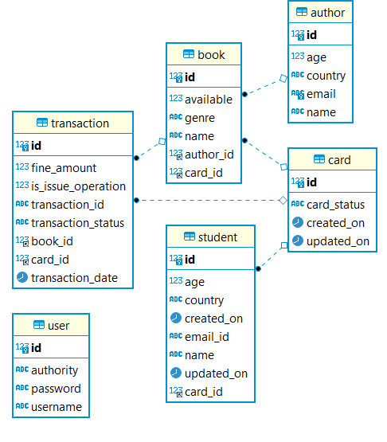
ER DIAGRAM

Slide 13
code
Refer to the jar file or the documentation.

Slide 14

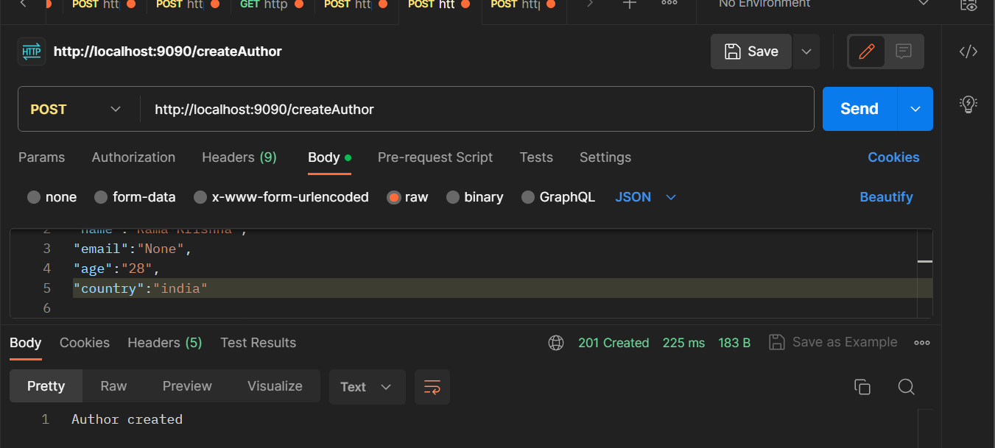
OUTPUT
Insert author to the author table.

Slide 15
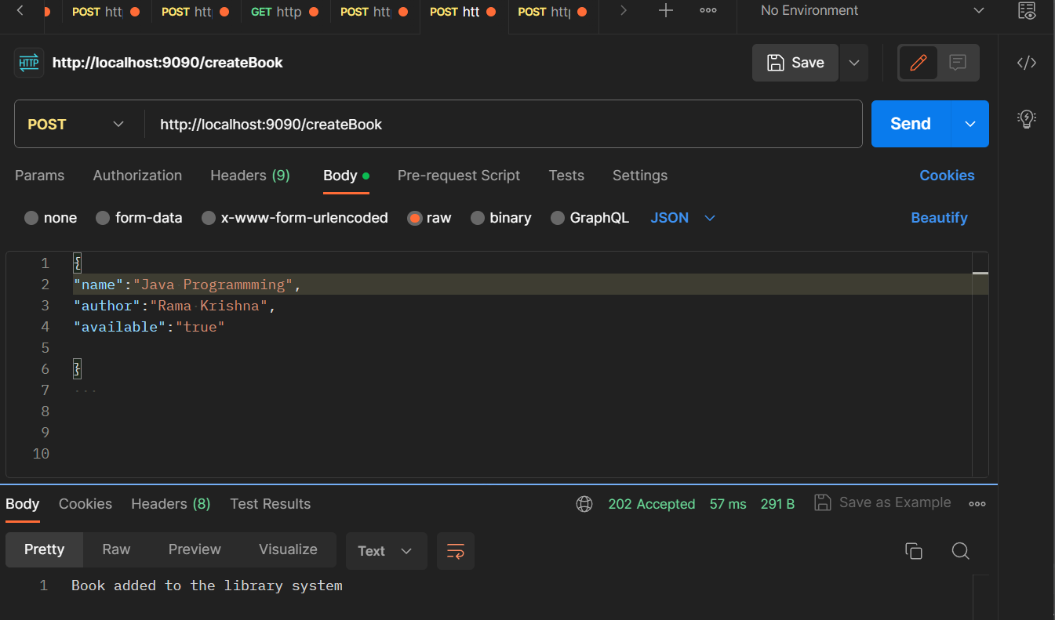
output
Adding book data to the book table

Slide 16
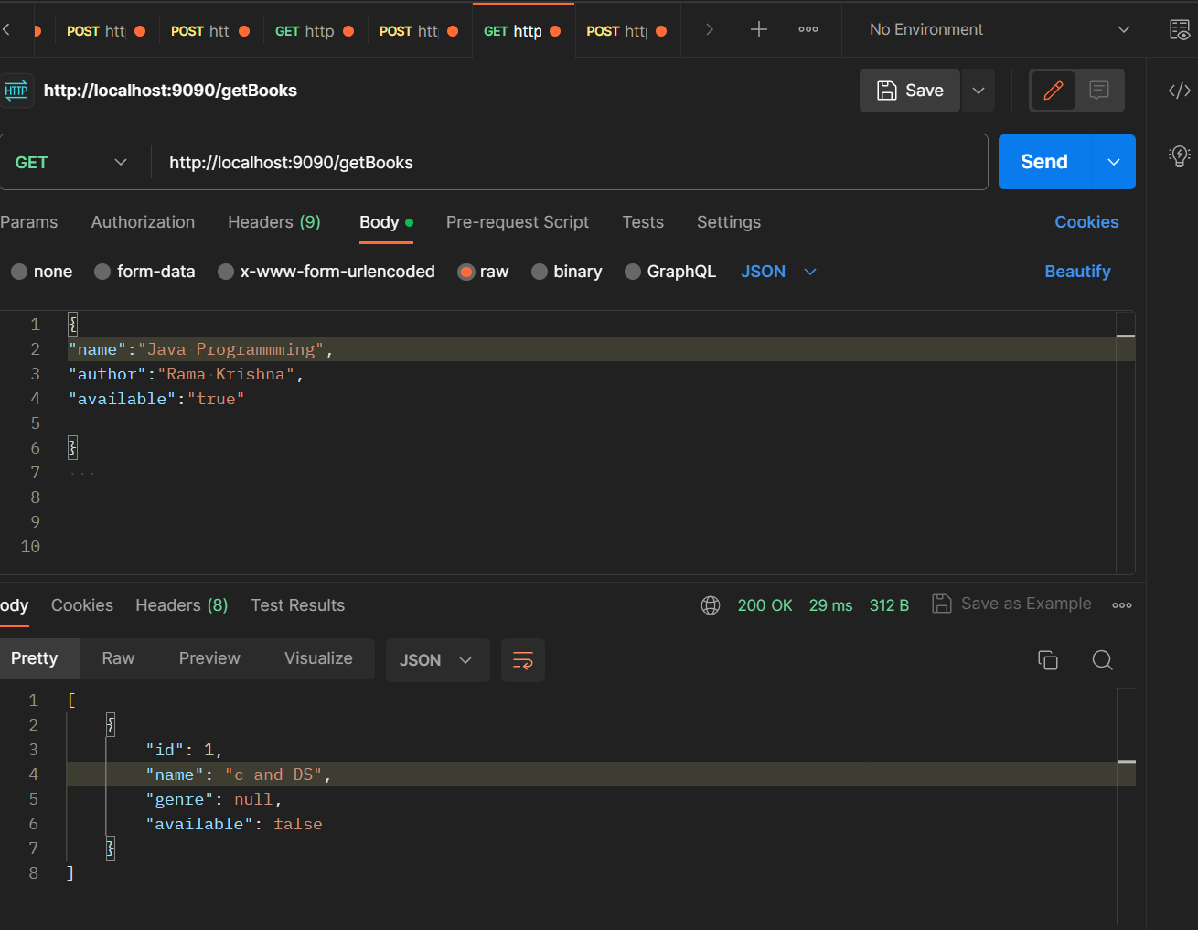
output
Display all the books

Slide 17
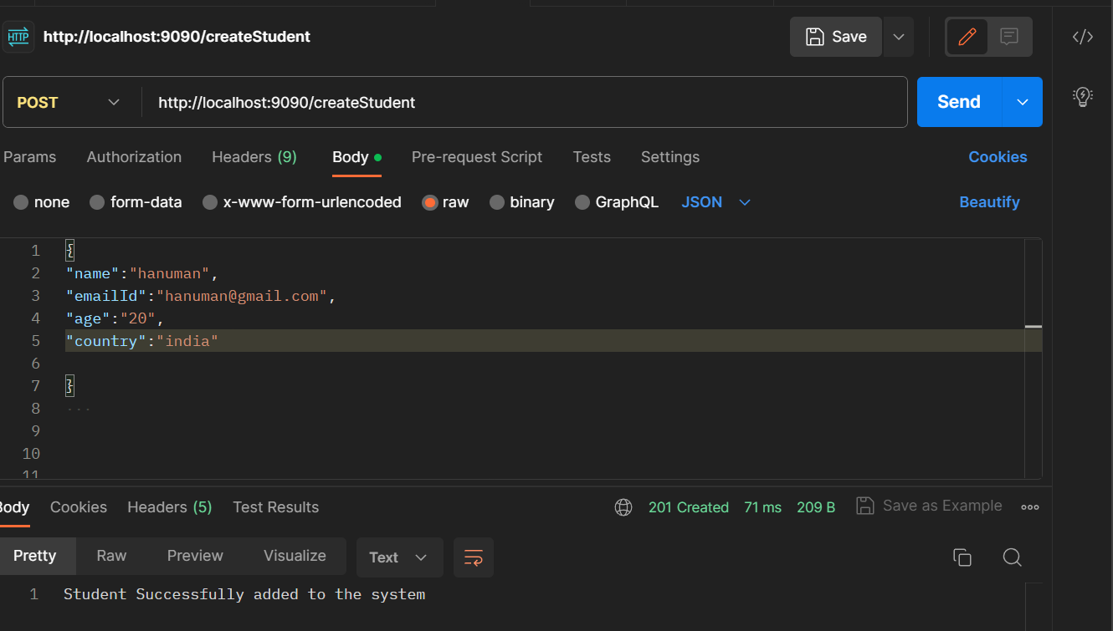
output
Adding student to the database.

Slide 18
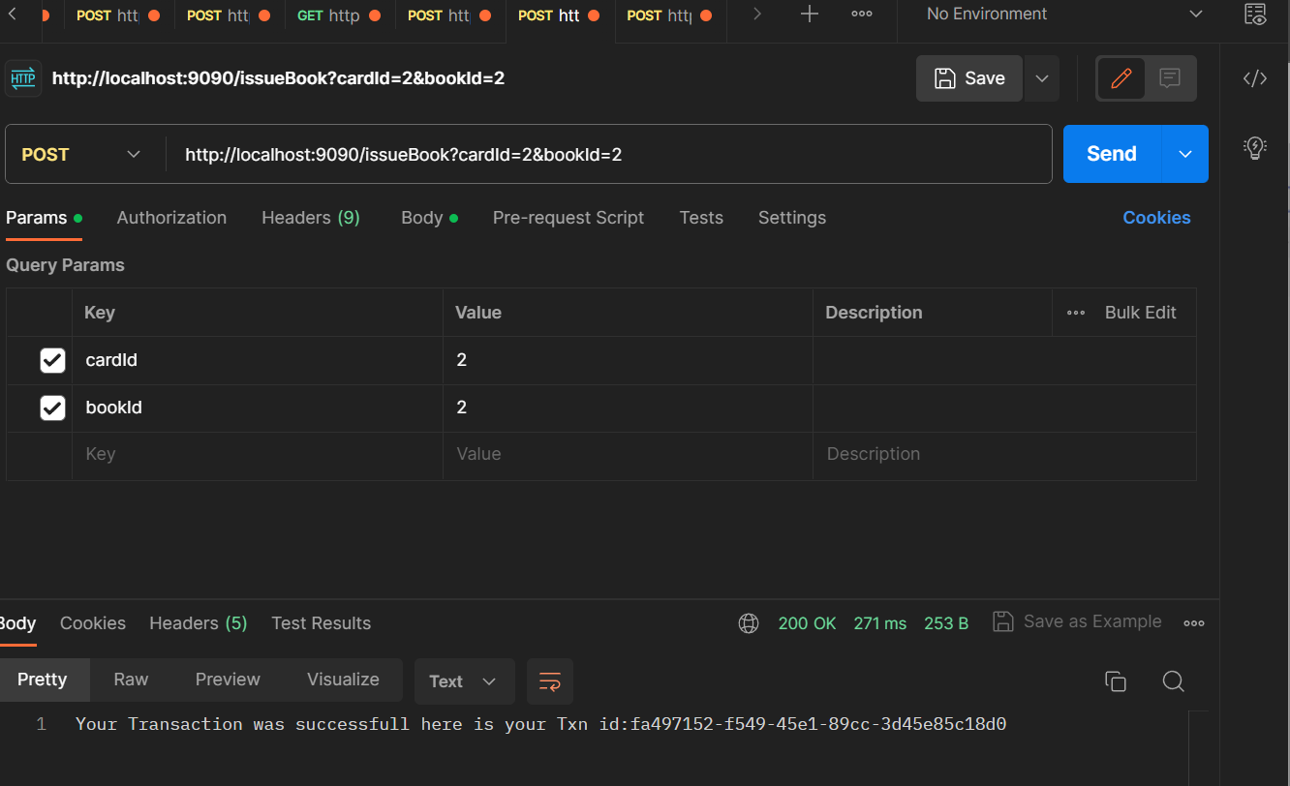
output
Transaction of a book by book id and card id.

Slide 19
CONCLUSION
In conclusion, our Library Management System represents a significant leap forward in streamlining library operations, enhancing user experiences, and promoting efficient resource utilization
With its user-friendly interface, robust database, and automation capabilities, our LMS empowers librarians and patrons alike
By embracing technology and innovation, we are not only preserving the tradition of libraries but also shaping their future. Thank you for your attention, and we look forward to implementing this system to revolutionize the way libraries serve their communities."

Slide 20


