Slide 1


CASE STUDY ANALYSIS – NREGA USING POWERBI
BY GREESHMA SAJU

Slide 2
Introduction
NREGA: A Data-Driven Look at Rural Employment in India .This project analyzes data on the National Rural Employment Guarantee Act (NREGA), a program offering wage employment to rural households. We explore a rich dataset encompassing job cards issued, workforce participation, budget allocation, and work completion across Indian states and districts.
Through data analytics, we aim to understand NREGA's effectiveness in generating employment, identify regional disparities, and assess budget utilization. Additionally, we'll investigate factors influencing work completion and potential roadblocks.The ultimate goal is to leverage data-driven insights to guide policymakers and administrators in optimizing NREGA's impact on rural employment and poverty alleviation.

Slide 3
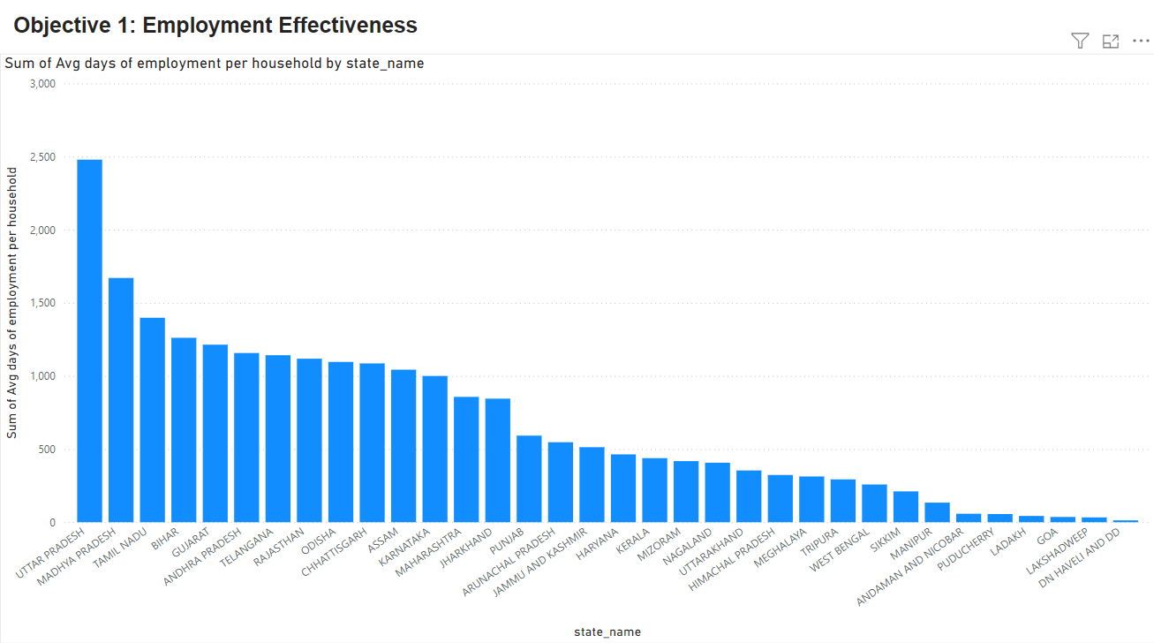
Here are some of the observations
The state with the highest average number of days of employment per household is Uttar Pradesh, followed by Madhya Pradesh.
The states with the lowest average number of days of employment per household are Arunachal Pradesh, Mizoram, Nagaland, Uttarakhand, Himachal Pradesh, Meghalaya, Tripura, Sikkim, Manipur, Andaman and Nicobar Islands, Puducherry, Ladakh, Lakshadweep, and Dadra and Nagar Haveli.
The x-axis of the graph lists the state names in India. The y-axis shows the “Sum of Avg days of employment per household”. The values on the y-axis range from 0 to 3,000 days.

Slide 4
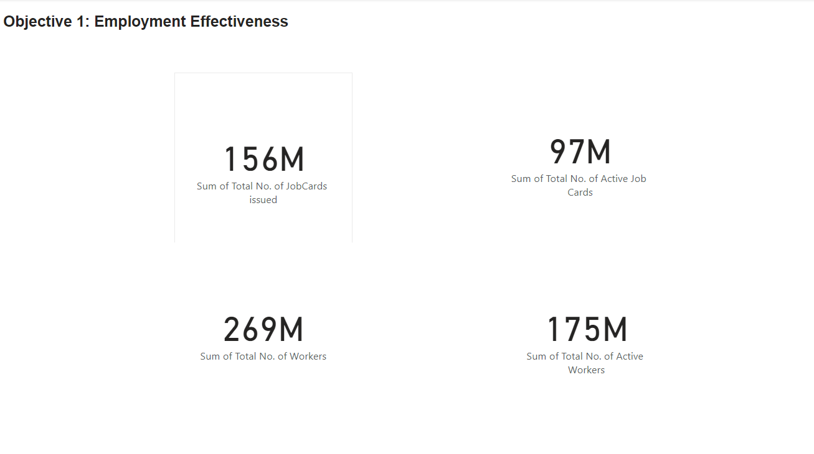
There are four metrics listed:
Sum of Total No. of JobCards issued
Sum of Total No. of Active Job Cards
Sum of Total No. of Workers
Sum of Total No. of Active Workers
The number of both total and active job cards has increased significantly from the earlier time period to the later time period. This suggests that the company is issuing more job cards, which could indicate that they are trying to fill more positions.It’s also possible that the company has redefined what constitutes a “job card” between the two time periods

Slide 5
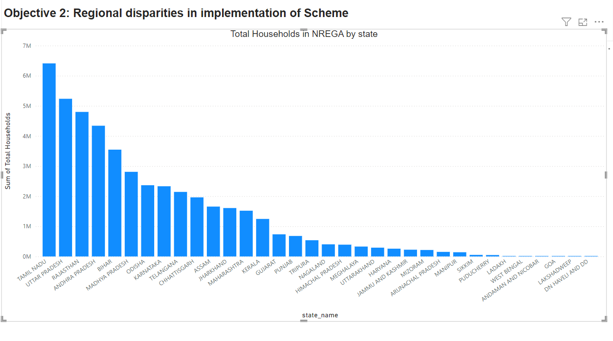
Here are some of the observations can make from the data:
The states with the highest percentage of households participating in NREGA are Andhra Pradesh, Telangana, Odisha, Jharkhand, and West Bengal.
The states with the lowest percentage of households participating in NREGA are Punjab, Haryana, Gujarat, Himachal Pradesh, and Jammu and Kashmir.

Slide 6
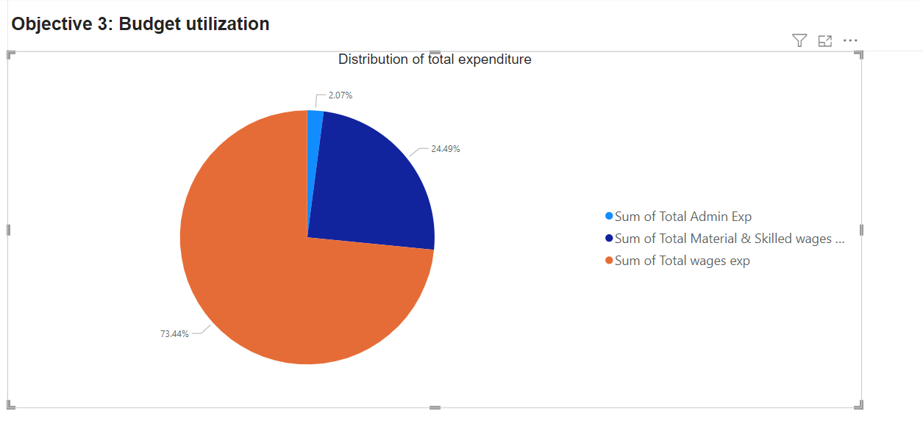
Overall, the pie chart shows that the majority of the expenditure (73.44%) is allocated to wages. Material and skilled wages account for a smaller portion (24.49%), while administrative expenses make up the smallest portion (2.07%) of the total expenditure.
The pie chart is divided into three slices colored blue, orange, and gray.
The largest slice is blue and labeled “Sum of Total Admin Exp” It represents 2.07% of the total expenditure.
The orange slice is labeled “Sum of Total Material & Skilled wages…” This slice makes up 24.49% of the total expenditure
.The smallest slice is gray and labeled “Sum of Total wages exp”. It accounts for 73.44% of the total expenditure.

Slide 7
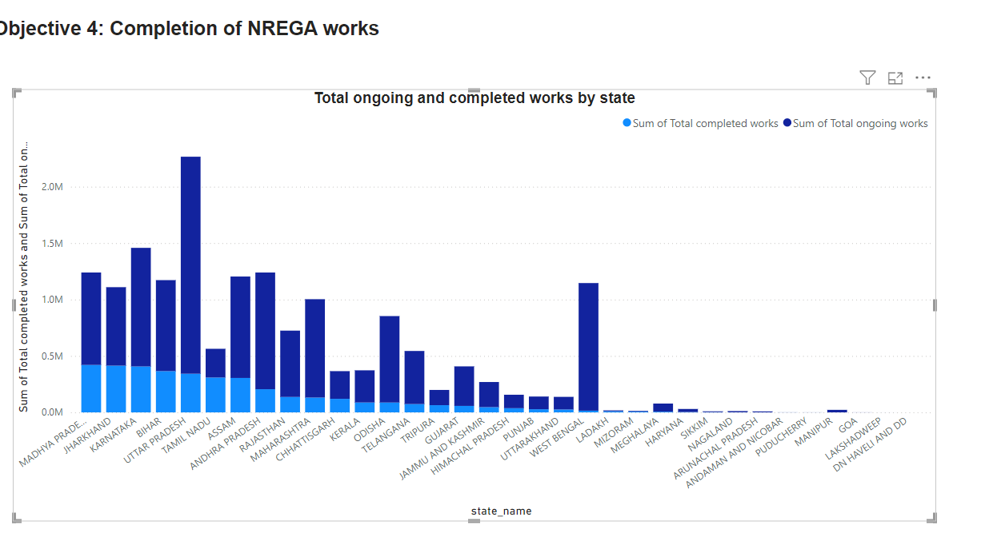
The state with the most completed NREGA works is Madhya Pradesh, followed by Andhra Pradesh and Tamil Nadu.
The states with the fewest completed NREGA works are Arunachal Pradesh, Mizoram, Nagaland, Puducherry, Lakshadweep, Andaman and Nicobar Islands, and Dadra and Nagar Haveli

Slide 8
Thank you

