Slide 1
COMP 6731Pattern Recognition Project
Retinal Vessel Segmentation using 2–D Gabor Wavelet and Supervised Classification
Group Number 1:
ABC – Student ID
DEF – Student ID
GHI – Student ID

Slide 2
CONTENTS
 | Overview | 1
 |  | -
 |  | -
 |  | -
 | PROJECT 2 - FREQUENT ITEM-SET MINING | -
 | Overview of algorithms considered | -
 | Challenges Faced | -
 | … | -
 | Results | -

Slide 3

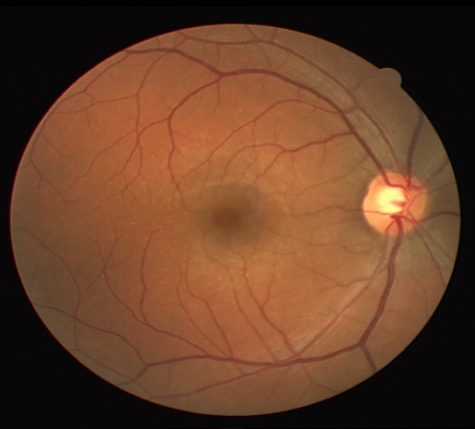
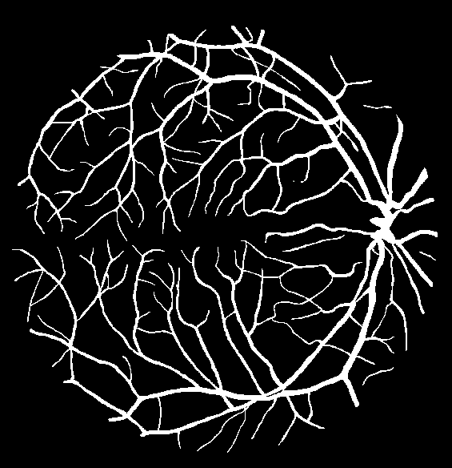
Overview
Input
Pattern recognition and machine learning has now become the answer to many real life problems, especially in medical applications. By use of supervised learning techniques we can create an optimal solution algorithm for medical diagnosis.
The purpose of our project is to provide a method for automated segmentation of the vessels of retinal images
Expected Result

Slide 4
Problem
Optic fundus assessment has been widely used by the medical community for diagnosing vascular and nonvascular pathology.
We present a method for automated segmentation of the vessels in retinal images. The method produces segmentations by classifying each image pixel as vessel or non-vessel, based on the pixel’s feature vector.

Slide 5
Methodology Overview
In our approach, each pixel is represented by a feature vector including measurements at different scales taken from the two-dimensional wavelet transformation.
The resulting feature space is used to classify each pixel as either a vessel or nonvessel pixel. This is done using a Bayesian classifier with class-conditional probability density functions (likelihoods) described as Gaussian mixtures.

Slide 6
Description of Architecture
Feature Extraction
The wavelet is useful for tuning to specific frequencies, thus helping with noise filtering and structural image enhancement.
Classifier
We use a Bayesian classifier with class-conditional probability density functions, over the extracted feature sets. producing a fast classification, while being able to model complex decision surfaces.
Database
Publicly available DRIVE (Staal et al., 2004) and STARE (Hoover et al., 2000) databases of manually labeled images ().

Slide 7
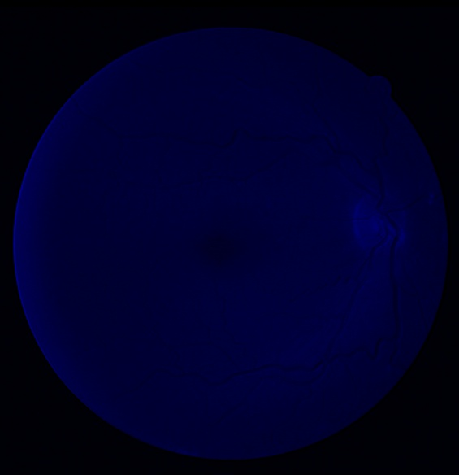
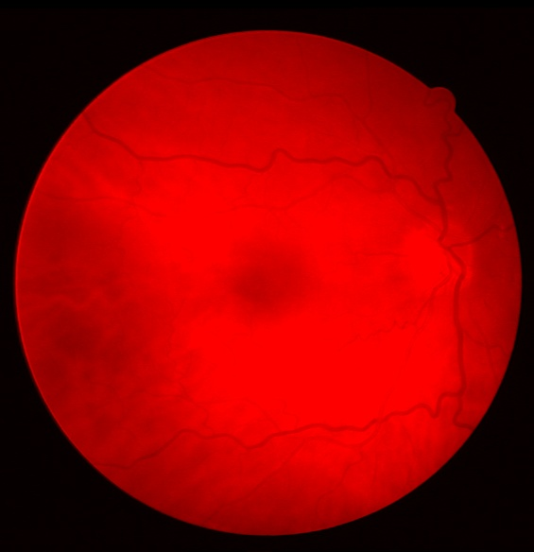
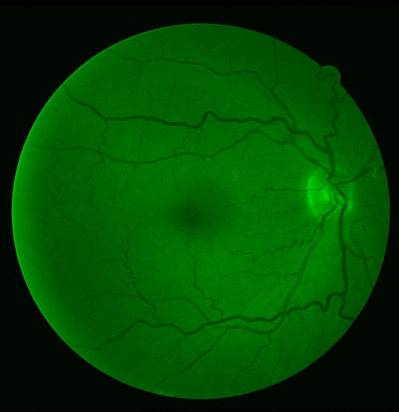
Feature Extraction
Feature 1:- Green channel extraction,
Why green channel ?
The green channel shows the best vessel/background contrast, whereas the red and blue channels show low contrast and are very noisy . Therefore, the green channel was selected to be processed by the wavelet, as well as to compose the feature vector itself, i.e., the green channel intensity of each pixel is taken as one of its features.
Too dark Too contrast Best vessel/background contrast

Slide 8
Feature Extraction
.
Feature 2 : - Apply wavelet transformation on Inverted green channel image
Why wavelet transformation ?
We use the Fourier Transform to transform a signal from its time-domain to its frequency domain.
The peaks in the frequency spectrum indicate the most occurring frequencies in the signal.
The location (frequency-value) and height (amplitude) of the peaks in the frequency spectrum then can be used as input for Classifiers.
This approach of using the Fourier Transform will work very well when the frequency spectrum is stationary.
The more non-stationary/dynamic a signal is, the worse the results will be. That’s too bad, since most of the signals we see in real life are non-stationary in nature.

Slide 9
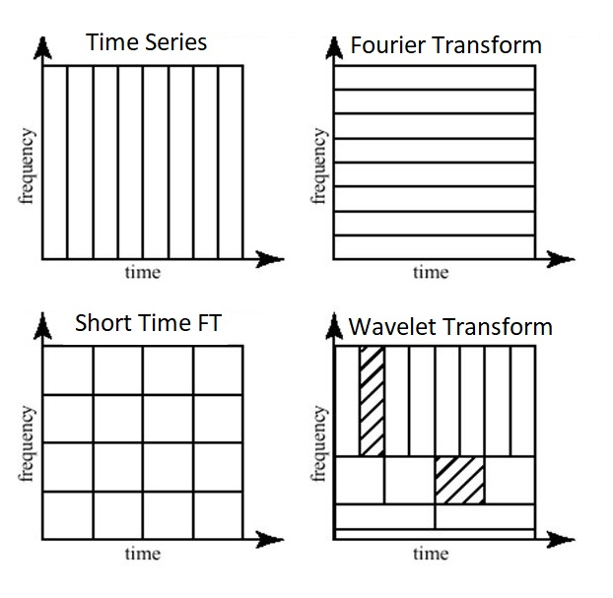
Feature Extraction
Feature 2 : - Apply wavelet transformation on Inverted green channel image
Why wavelet transformation ?
A much better approach is to use the Wavelet Transform instead of the Fourier Transform.
The Wavelet Transform has a high resolution in both the frequency- and the time-domain.
It does not only tell us which frequencies are present in a signal, but also at which time these frequencies have occurred by working with different scales.
This is accomplished First we look at the signal with a large scale/window and analyze ‘large’ features and then we look at the signal with smaller scales in order to analyze smaller features.

Slide 10


Feature Extraction(Gabor Wavelet):
The green channel is then inverted before applying the wavelet function
We use Gabor wavelet transform due to its directional selectiveness capability of detecting oriented features and fine tuning to specific frequencies
This important because it helps in filtering out the background noises of the fundus images.
The Gabor wavelet transform is given by,
We consider a set of orientations: Thus, the Gabor wavelet transform is computed for spanning from 0 up to 170 at steps of 10 and the maximum value is taken.
The maximum modulus of the wavelet transform over all angles for multiple scales are then taken as pixel features
This given by,

Slide 11
Gabor Wavelet Transform
The Gabor filters is applied on image to extract features from many scale or frequencies aligned at different angles.
The frequency and orientation of Gabor filter provide prominent information of shape or pattern of digital image. An orientation provide the information regarding the location of edges and shapes in the image. The Gabor features are evaluated using convolution operation of Gabor filter bank Ψ (x,y) with input image I (x, y) which is defined in equation

Slide 12
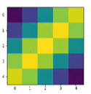
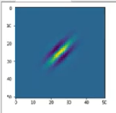
Changing Kernel Size
K-size= 5
K-size = 50

Slide 13
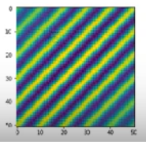
Changing sigma
Sigma = 3
Sigma =30

Slide 14
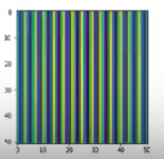
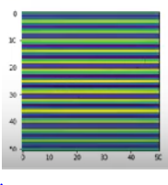
Changing theta
Theta = np.pi / 4 (45 degrees)
Theta = np.pi / 2 (90 degrees)
Theta = np.pi/1 (180 degrees)

Slide 15
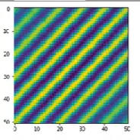
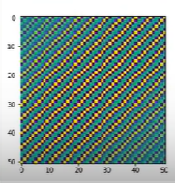
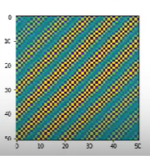
Changing frequency
Lambda = np.pi / 4
Lambda = np.pi /2
Lambda = np.pi /16

Slide 16
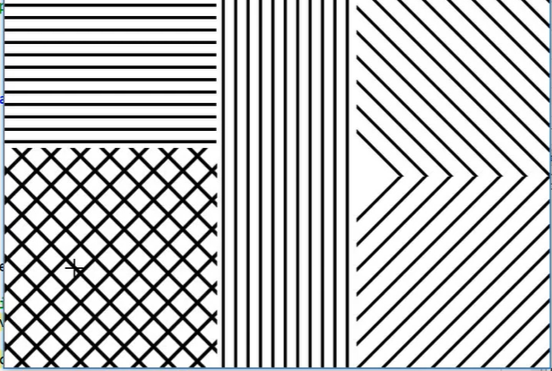

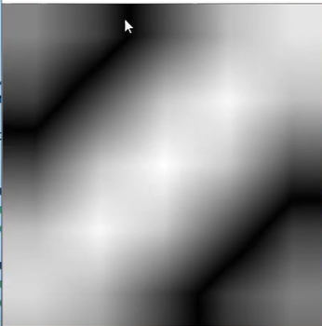


Slide 17

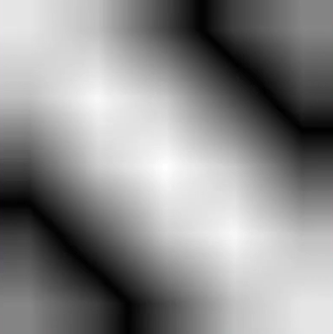


Slide 18

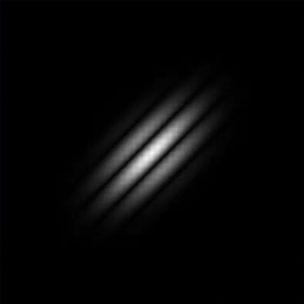


Slide 19
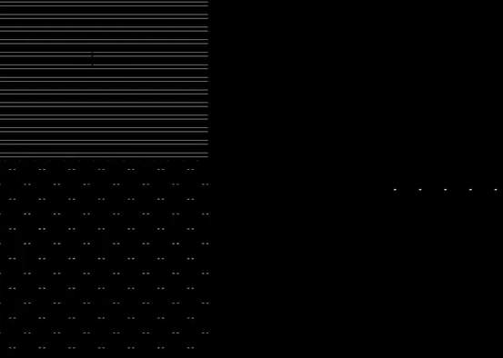
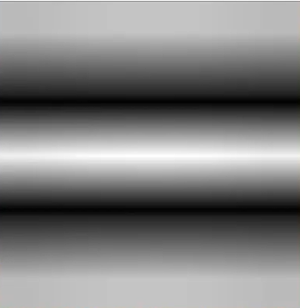


Slide 20
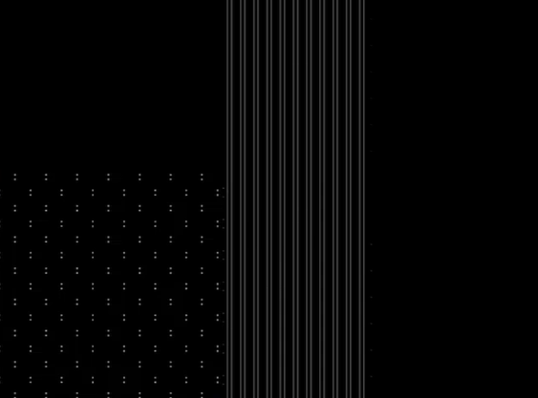
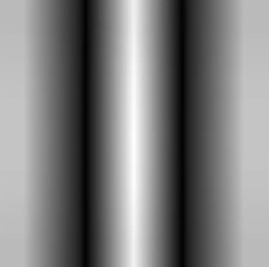

-

Slide 21

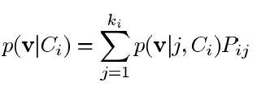
Classifier
The image pixels of a fundus image are viewed as objects represented by feature vectors, so that we may apply statistical classifiers in order to segment the image
The two classes for the pixels considered here are {vessel pixels} and {non-vessel pixels}.
Several fundus images have been manually segmented, allowing the creation of a labeled training set into classes and (see Subsection II-A).
Due to the computational cost of training the classifier and the large number of samples, we randomly select a subset of the available samples to actually use for training.
We have achieved very good results using a Bayesian classifier in which each class-conditional probability density function (likelihood) is described as a linear combination of Gaussian functions.
To obtain a decision rule based on estimates from our training set, we use Bayes decision rule, given by:
Where p(v/Ci) is the class-conditional probability density function, also known as likelihood, and p(Ci) is the prior probability of class .
We estimate the prior probabilities as , the ratio of class samples in the training set and class likelihoods are described as linear combinations of Gaussian functions given by

Slide 22
Evaluation of Results
The performances are measured using ROC curves.
ROC curves are plots of true positive fractions versus false positive fractions for varying thresholds on the posterior probabilities.
A pair formed by a true positive fraction and a false positive fraction is plotted on the graph for each threshold value

Slide 23
Significance
Assessing the optic fundus has been used in the medical community for diagnosing numerous vascular and non-vascular pathology.
Inspection of retinal vasculature may reveal hypertension, diabetes, arteriosclerosis, cardiovascular disease, and stroke.
Analysing the images of the optical fundus can be used for early recognition of blood vessel patterns that can prevent major vision loss is recognised as early as possible.
To provide the opportunity for initial assessment to be carried out by community health workers, computer-based analysis has been introduced.
This requires segmentation of vessels from the background for feature extraction and processing
Since segmentation algorithms requires to be fast and should not critically depend on configuring several parameters, we use supervised classification framework, which only depends on manually segmented images and can be implemented efficiently

