Slide 1
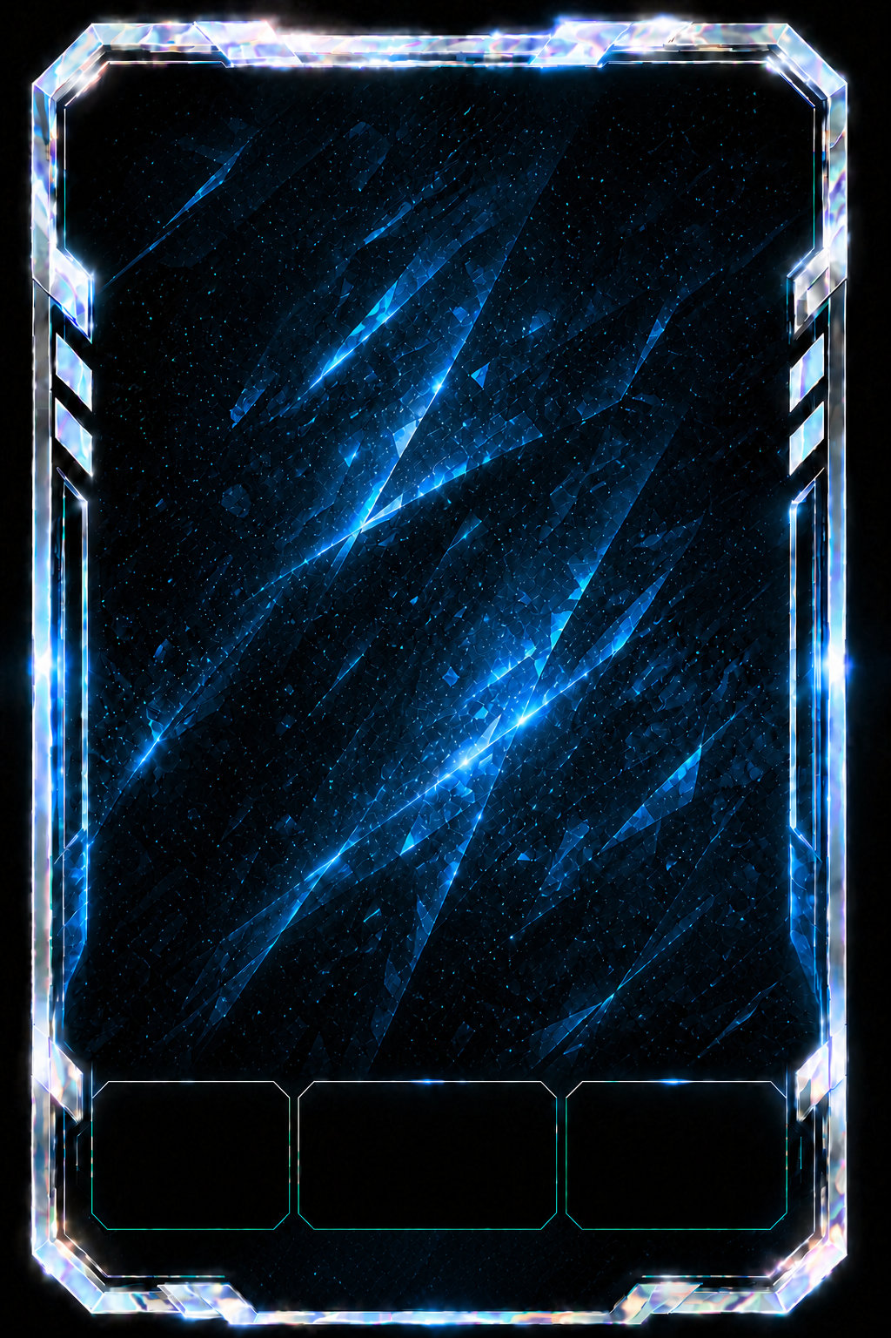
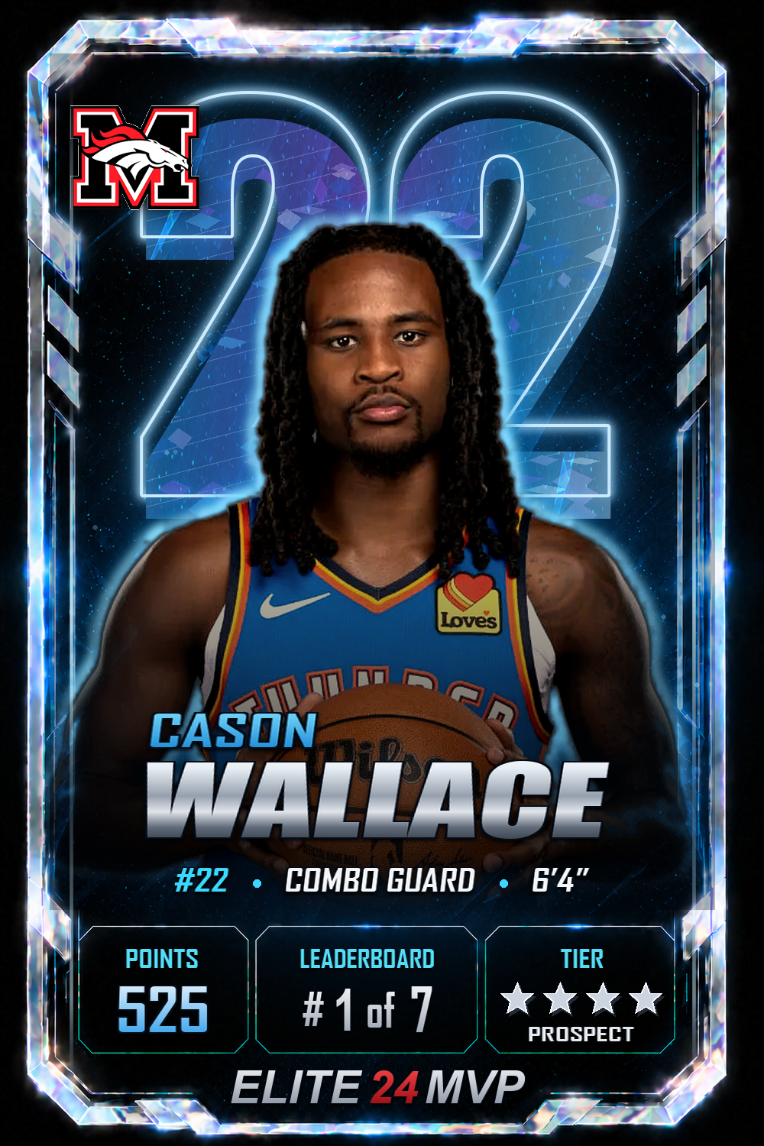


★★★★
PROSPECT
ELITE24MVP / PLAYER CARDS
PLATINUM FINISH
YOUR PHOTO.
YOUR CARD.
YOUR LEGACY.
Upload once. Step into a card that tracks the player, the team and every level earned.
→
→
01
UPLOAD
02
CUTOUT
01
Notes:
The same player image is preserved from upload through the finished card.
The card becomes a persistent identity layer around the athlete—not a one-off graphic.
[Sources]
- C:/Users/arrow/AppData/Local/Temp/codex-clipboard-8d94679c-de23-4e0b-9f5d-7bba88cb911b.png
- C:/Users/arrow/.codex/worktrees/1edd/elite24mvp/public/card/proofs/cason-wallace-local-cutout-v1.png
- C:/Users/arrow/.codex/worktrees/1edd/elite24mvp/public/card/proofs/cason-wallace-platinum-proof-v1.png
[/Sources]

Slide 2
ELITE24MVP / PLAYER CARDS
FULLY ASSEMBLED
BUILT IN LAYERS. EARNED IN LEVELS.
One locked card system combines the player, team and live performance data—then upgrades the finish as stars are earned.
CASON
WALLACE
22
+
=
+
+
525 • #1 OF 7
★★★★ PROSPECT
03 PLAYER CUTOUT
04 LIVE DATA
02 PLAYER NUMBER
01 ENVIRONMENT
PROSPECT LEVELS
1★
2★
3★
4★
5★
PROSPECT
PROSPECT
PROSPECT
PROSPECT
PROSPECT
BRONZE FINISH
SILVER FINISH
GOLD FINISH
PLATINUM FINISH
DIAMOND FINISH
02
Notes:
The production card is composed from reusable layers: environment, player number, normalized cutout, live data and finish treatment.
Every level remains a Prospect card. Bronze through Diamond describe the finish—not the tier name.
[Sources]
- C:/Users/arrow/.codex/worktrees/1edd/elite24mvp/public/card/platinum-environment-v2-no-plaque.png
- C:/Users/arrow/.codex/worktrees/1edd/elite24mvp/public/card/proofs/cason-wallace-local-cutout-v1.png
- C:/Users/arrow/.codex/worktrees/1edd/elite24mvp/public/card/proofs/cason-wallace-platinum-proof-v1.png
[/Sources]

