Slide 1

Recent Advances in Atomic Timekeeping: Optical Clocks
Candidacy Examination Presentation by:
Greg Smith
July 1, 2014

Slide 2
Why do we need good clocks?
Clock-based geodesy
Can test symmetry between matter and anti-matter
Can detect variation of fundamental constants
Good clocks can test fundamental physics

Slide 3
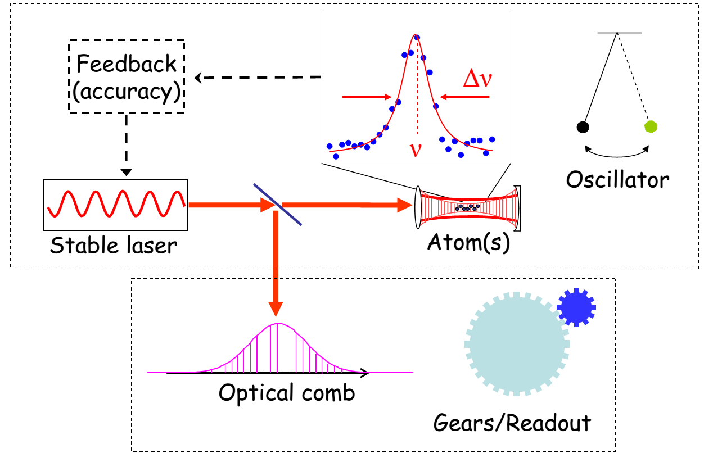
What is an atomic clock?
A simple clock has two components:
Frequency source (clock ticks)
A way to count (gears) and display the ticks (clock face)
An atomic clock has one more component:
Oscillator tuned to match atomic transition (feedback loop)
M. M. Boyd, Ph.D. thesis (2007)

Slide 4
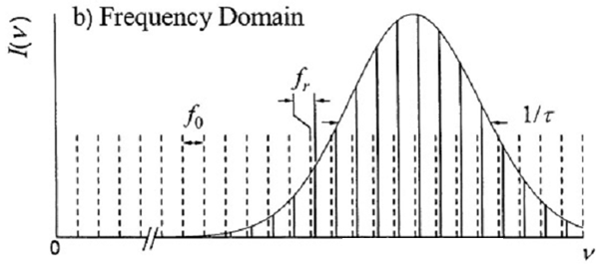
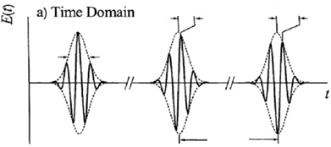












Frequency Combs
$$−Δφ_{ce}$$
$$−2Δφ_{ce}$$
$$2πf_{0}=Δφ_{ce}f_{r}$$
$$τ$$
$$1/τ$$
$$T=1/f_{r}$$
Produced by a mode-locked (pulsed) laser
Comb frequencies are $ν_{n}=n f_{r}+f_{0}$
Can determine the frequency of a cw laser $ν_{s}$
$$f_{beat1}=v_{s}−\left(nf_{r}+f_{0}\right)$$
$$f_{beat2}={2v}_{s}−\left(2nf_{r}+f_{0}\right)$$
$$ν_{n}$$
2nd laser
harmonic
$$ν_{2n}$$
$$f_{beat2}−2f_{beat1}=f_{0}$$
$$f_{beat2}−f_{beat1}=ν_{s}−nf_{r}$$
Frequency combs link optical & microwave frequencies
J. Ye & S. T. Cundiff, “Femtosecond Optical Frequency Comb Technology” (2005)

Slide 5
What makes a clock good?
Stability: consistent frequency over time
Technical & fundamental sources of instability
Accuracy: frequency shifts from systematic errors
Perturbations from environment change atom’s energy levels
Can correct these shifts if they are known
Limited by stability

Slide 6
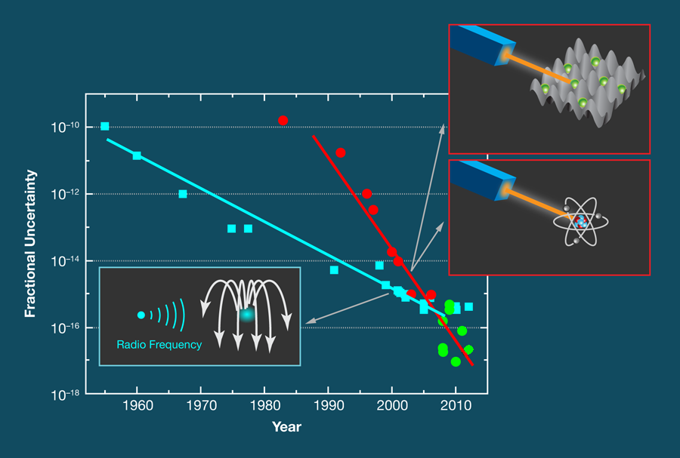
A Brief History of Time(keeping)
F. Riehle, Physics 5, 126 (2012)

Slide 7
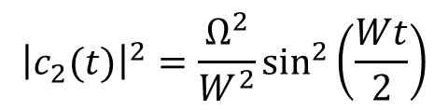
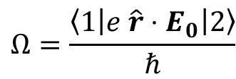

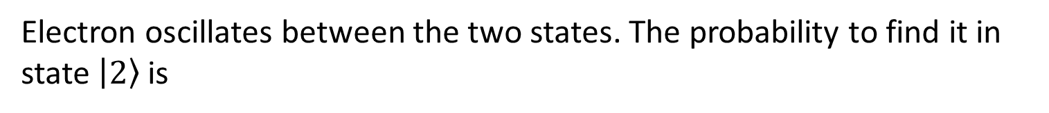

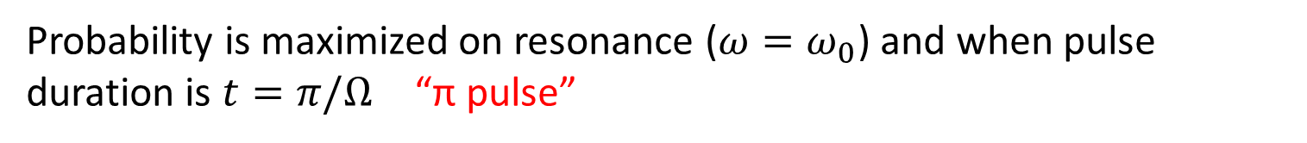
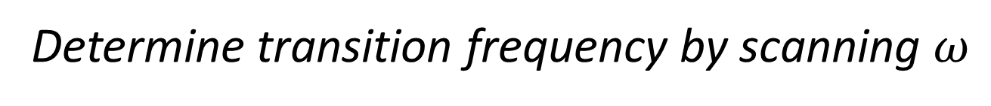


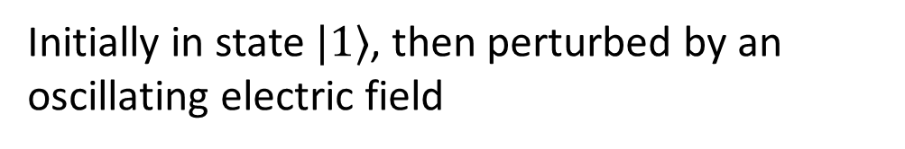





Two Level Atom
Initially in state $|1⟩$, then perturbed by an oscillating electric field
$$|2⟩$$
$$ℏω_{0}$$
$$|1⟩$$
$$E\left(t\right)=E_{0}cos⁡(ωt)$$
$${\hat{H}}_{I}\left(t\right)=e \hat{r}⋅E_{0}cos⁡(ωt)$$
Electron oscillates between the two states. The probability to find it in state $\left|2\right\rangle$ is
$${\left|c_{2}(t)\right|}^{2}=\frac{Ω^{2}}{W^{2}}\sin^{2}\left(\frac{Wt}{2}\right)$$
$${\left|c_{2}\right|}^{2}$$
“π pulse”
Frequency of oscillation = generalized Rabi frequency
$$Ω=\frac{\left\langle 1\left|e \hat{r}⋅E_{0}\right|2\right\rangle }{ℏ}$$
$$0$$
$$ω−ω_{0}$$
$$W^{2}=Ω^{2}+{\left(ω−ω_{0}\right)}^{2}$$
Probability is maximized on resonance ($ω=ω_{0}$) and when pulse duration is $t=π/Ω$ “π pulse”
Determine transition frequency by scanning $ω$

Slide 8
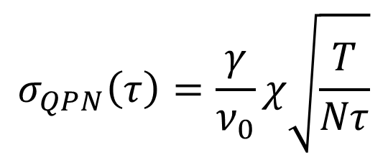


Quantum Projection Noise (QPN)
Sensitivity to detuning is zero on resonance: use steeply sloped sides to determine transition frequency
$${\left|c_{2}\right|}^{2}$$
“π pulse”
Off-resonance, the excitation pulse leaves the atom in a superposition of states
$$0$$
$$ω−ω_{0}$$
Excited state population is uncertain
Variance of excited state population leads to frequency instability
$$σ_{QPN}\left(τ\right)=\frac{γ}{ν_{0}}χ\sqrt{\frac{T}{Nτ}}$$
Probe many atoms at high frequencies!

Slide 9
Picking an Atom
Atom / transition requirements:
Able to cool to low temperatures
want forbidden transitions
Very narrow linewidth clock transition
J=0 for both states
Insensitive to stray fields
High probability of being in lower state
lower state = ground state
⁸⁷Sr (Z = 38, I = 9/2) meets these requirements

Slide 10
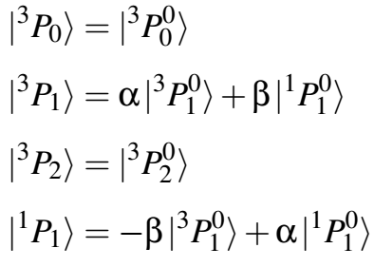
State Mixing in ⁸⁷Sr
2 valence electrons: label states as ^{2S+1}L_{J}
Only valid if spin-orbit interaction is negligible
Spin-orbit interaction is important for Sr (Z=38)
States with same J=L+S mix
“Links” ³P₁ to ground state through ¹P₁
Hyperfine interaction is also important (I=9/2 for ⁸⁷Sr)
States with same F=I+J mix
Combined effect “links” clock state (³P₀) to ground state through ¹P₁

Slide 11
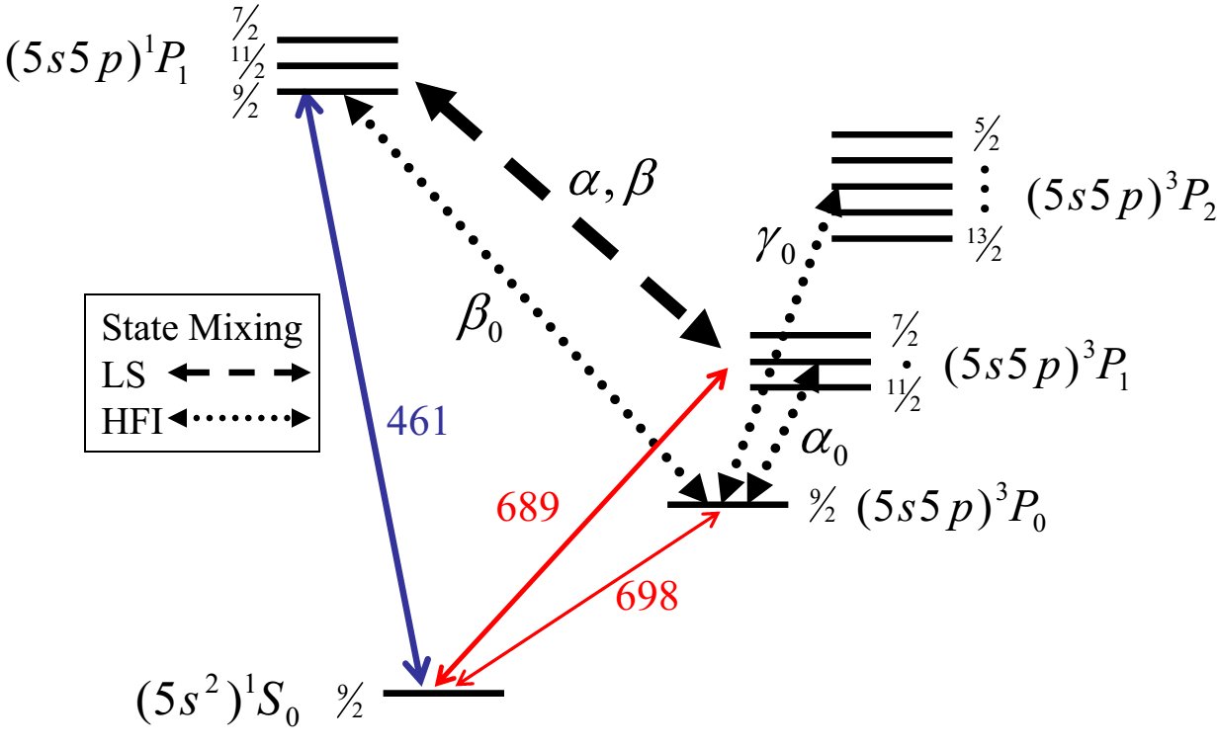
Simplified* ⁸⁷Sr Energy Diagram
*Not to scale, some states not shown
(τ=5.22ns)
(τ=21.4µs)
(τ=150s)
¹S₀ = ground state
³P₀ = clock state
¹P₁ & ³P₁ = cooling states
^{2S+1}L_{J}
M. M. Boyd, Ph.D. thesis (2007)

Slide 12
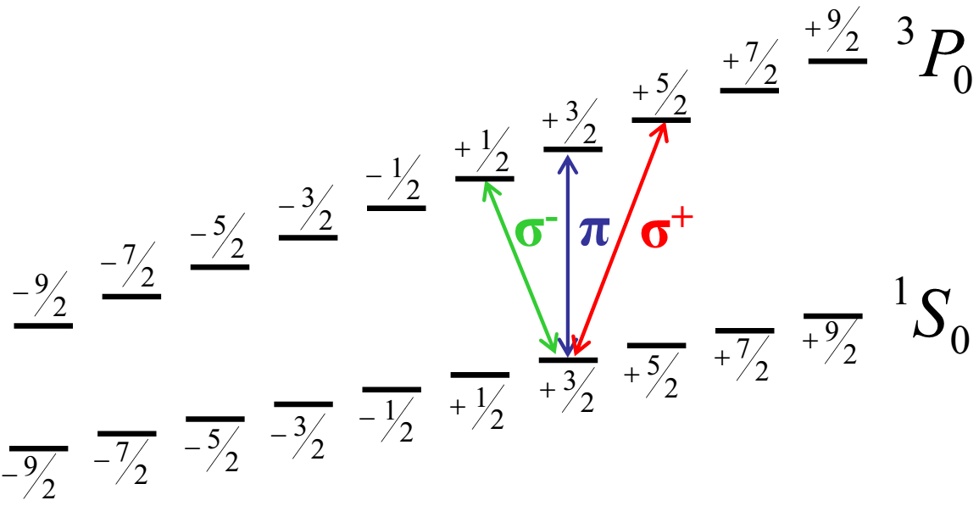
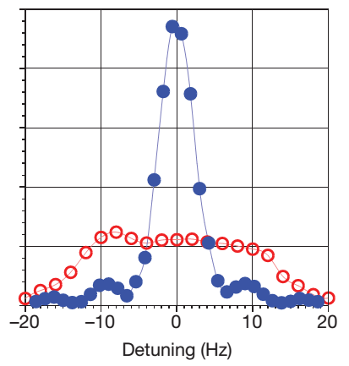

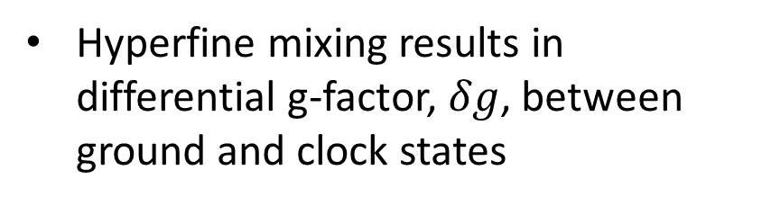
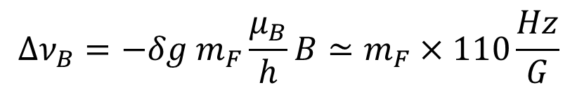


Clock transition in a magnetic field
Hyperfine mixing results in differential g-factor, $δg$, between ground and clock states
$$δg≃−6×{10}^{−5}$$
$$B≃0$$
Linear Zeeman shift of clock transition
$${Δν}_{B}=−δg{ m}_{F}\frac{μ_{B}}{h}B≃m_{F}×110\frac{Hz}{G}$$
Excitation Fraction
$$B>0$$
Can use atoms as local magnetometer
M. M. Boyd, Science 314, 1430 (2006) and
B. J. Bloom, Nature 506, 71 (2014)

Slide 13
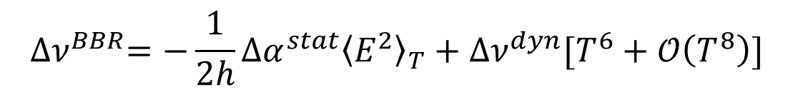
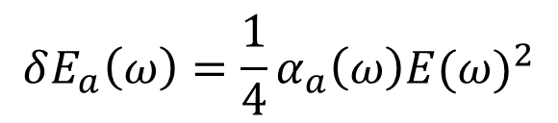
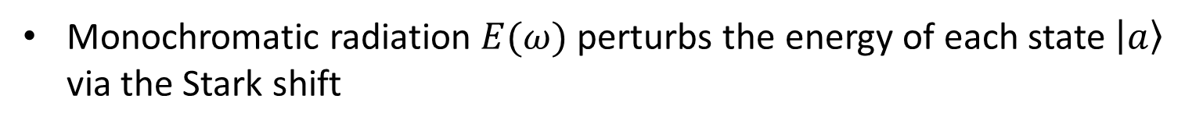
Black Body Radiation Shift: Theory
Vacuum chamber is at room temperature
Monochromatic radiation $E(ω)$ perturbs the energy of each state $\left|a\right\rangle$ via the Stark shift
$$δE_{a}\left(ω\right)=\frac{1}{4}α_{a}\left(ω\right){E(ω)}^{2}$$
Polarizability $α_{a}\left(ω\right)$ tells you how each state $\left|a\right\rangle$ reacts to the field
Electric field is weighted by the Planck distribution
$${∆ν}^{BBR}=−\frac{1}{2h}∆α^{stat}{\left\langle E^{2}\right\rangle }_{T}+∆ν^{dyn}[T^{6}+𝒪\left(T^{8}\right)]$$
static field shift due to E-field with rms-average of BBR E-field
dynamic fluctuations from the static field
Coefficients can be determined experimentally

Slide 14
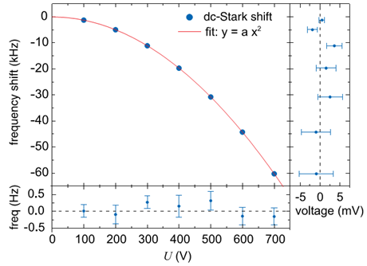
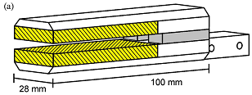
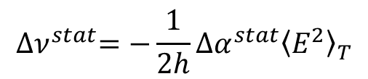
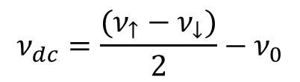

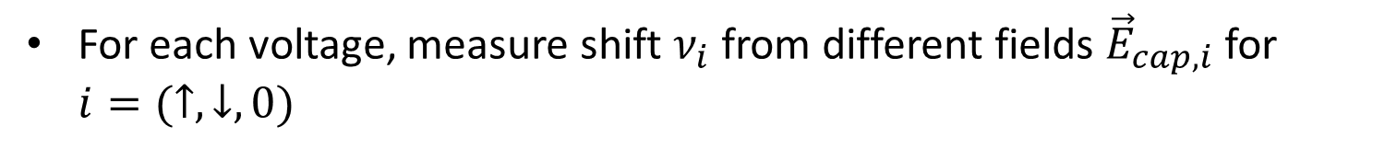
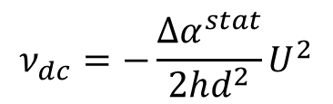
Determining the BBR Coefficients I
$${∆ν}^{stat}=−\frac{1}{2h}∆α^{stat}{\left\langle E^{2}\right\rangle }_{T}$$
$$ν_{dc}=−\frac{Δα^{stat}}{2hd^{2}}U^{2}$$
$$ν_{dc}=\frac{(ν_{↑}−ν_{↓})}{2}−ν_{0}$$
Frequency shift proportional to ${\left({{\vec{E}}_{cap}+\vec{E}}_{0}\right)}^{2}$
For each voltage, measure shift $ν_{i}$from different fields ${\vec{E}}_{cap,i}$ for $i=(↑,↓,0)$
$∆α^{stat}=4.07873\left(11\right)×{10}^{−39}$ C m²/V
T. Middelmann, PRL 109, 263004 (2012)

Slide 15
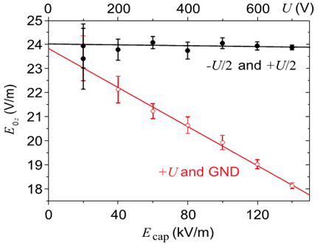

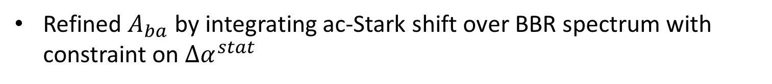
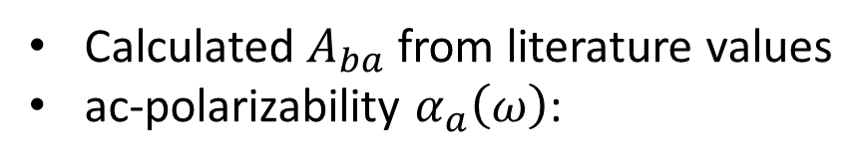
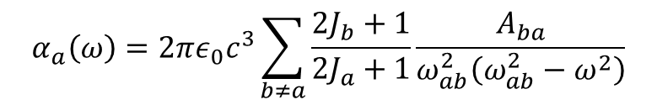

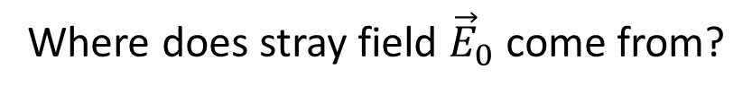

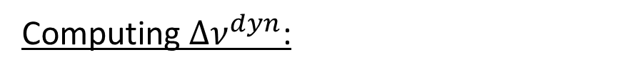
Determining the BBR Coefficients II
Where does stray field ${\vec{E}}_{0}$ come from?
Imperfections in gold deposition
Atoms located off-center within capacitor
$∆α^{stat}=4.07873\left(11\right)×{10}^{−39}$ C m²/V
Computing $∆ν^{dyn}$:
Calculated $A_{ba}$ from literature values
ac-polarizability $α_{a}\left(ω\right)$:
$$α_{a}\left(ω\right)=2πε_{0}c^{3}\sum_{b≠a}{\frac{2J_{b}+1}{2J_{a}+1}\frac{A_{ba}}{ω_{ab}^{2}\left(ω_{ab}^{2}−ω^{2}\right)}}$$
$$ν_{↑}−ν_{↓}∝E_{cap}E_{0z}$$
Refined $A_{ba}$ by integrating ac-Stark shift over BBR spectrum with constraint on $∆α^{stat}$
$∆ν^{BBR}\left(T\right)=−2.13023\left(6\right)$ Hz ${\left(\frac{T}{300 K}\right)}^{4}−147.6(23)$ mHz $\left[{\left(\frac{T}{300 K}\right)}^{6}+𝒪{\left(\frac{T}{300 K}\right)}^{8}\right]$
T. Middelmann, PRL 109, 263004 (2012)

Slide 16
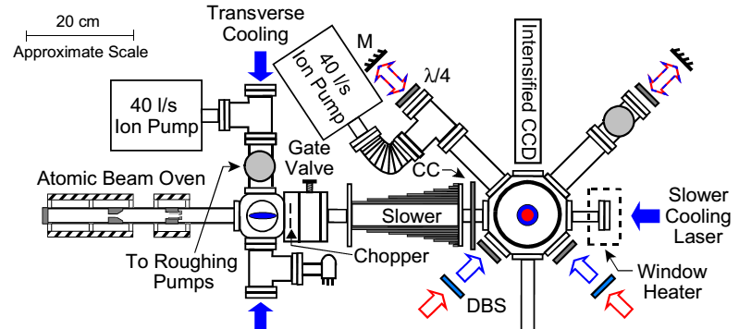
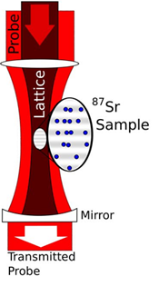
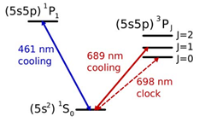
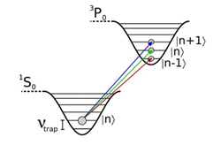
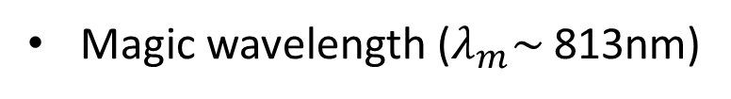
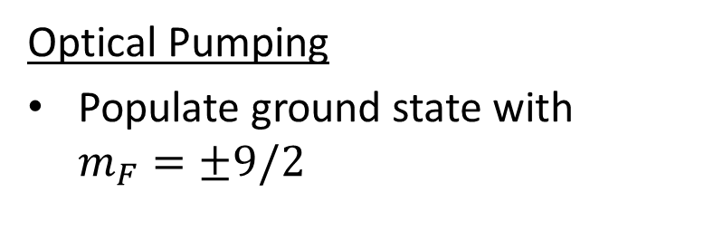
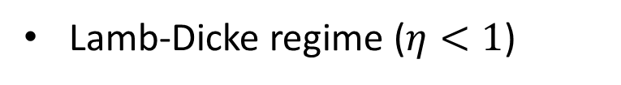
Cooling and Trapping ⁸⁷Sr
Cooling
Zeeman slower: T = 3 K
vac.
pump
vac.
pump
Magneto-Optical Traps (MOTs)
Blue MOT: T = 2.5 mK
Red MOT: T = 3 µK
Optical Lattice
Magic wavelength ($λ_{m}\sim$ 813nm)
Lamb-Dicke regime ($η<1$)
Optical Pumping
Populate ground state with $m_{F}=±9/2$
A. D. Ludlow, Ph.D. thesis (2008) and
S. Blatt, PRA 80, 052703 (2009)

Slide 17
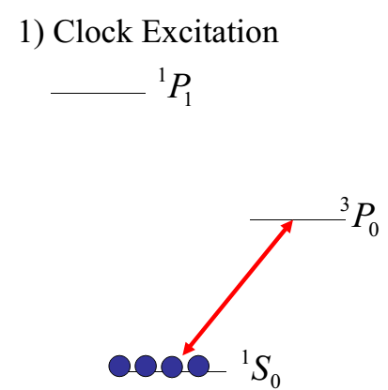
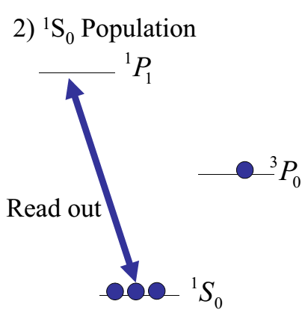
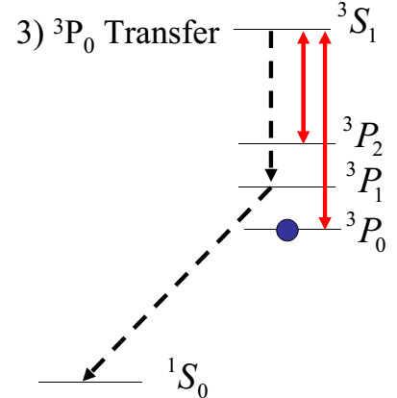
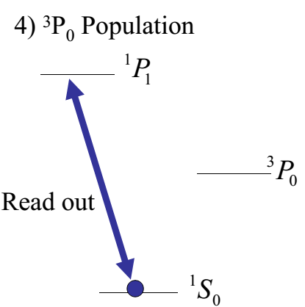
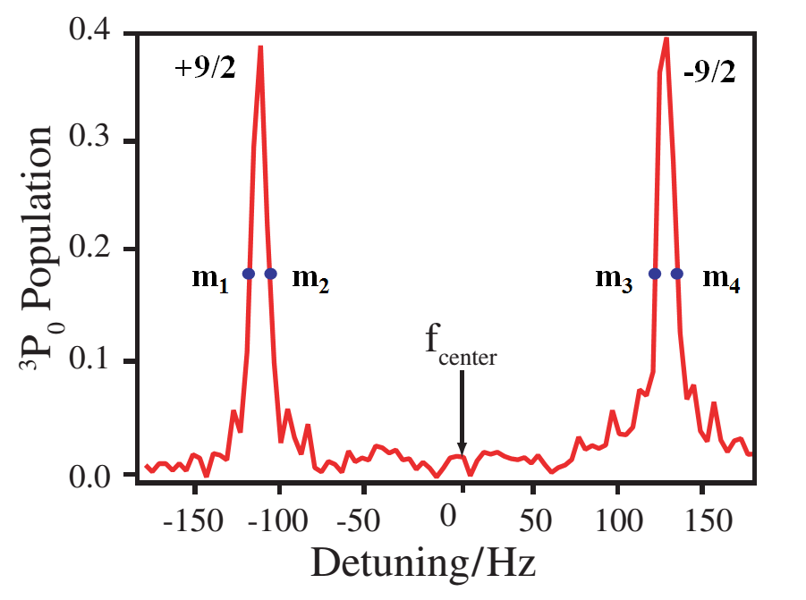
Clock Interrogation Scheme
679 &
707 nm
461 nm
461 nm
698 nm
Determine excitation fraction as a function of detuning frequency
Population measurement heats atoms out of lattice
Cooling & trapping cycle repeated for each detuning frequency
M. M. Boyd, Ph.D. thesis (2007) and
G. K. Campbell, Metrologia 45, 539 (2008)

Slide 18
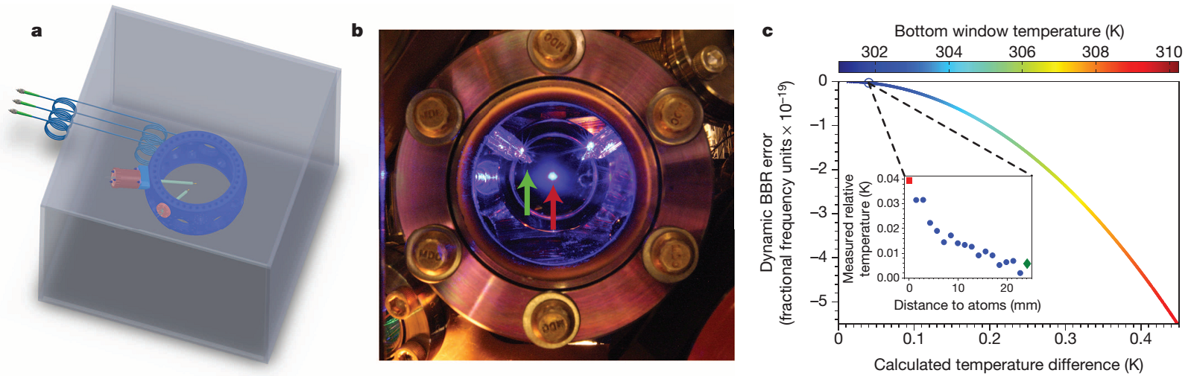
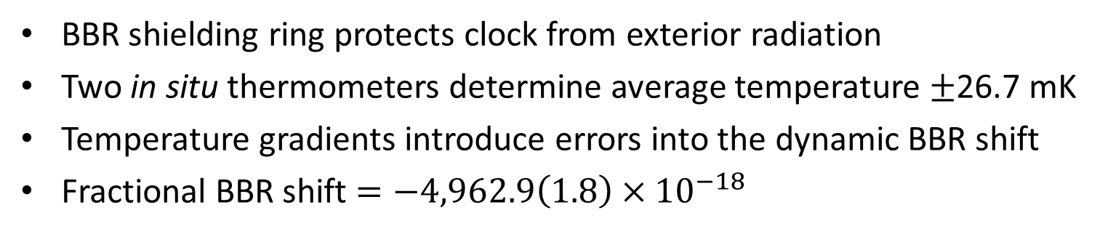
Determining the BBR Shift
BBR shielding ring protects clock from exterior radiation
Two in situ thermometers determine average temperature $±$26.7 mK
Temperature gradients introduce errors into the dynamic BBR shift
Fractional BBR shift $=−4,962.9\left(1.8\right)×{10}^{−18}$
B. J. Bloom, Nature 506, 71 (2014)

Slide 19
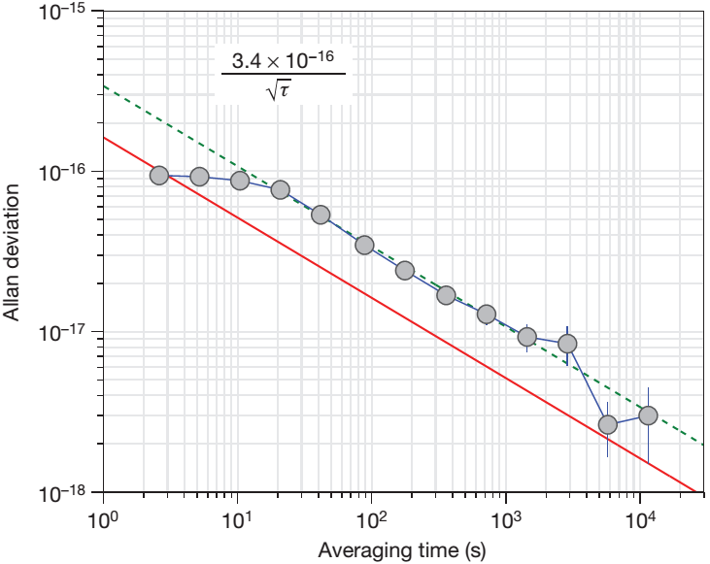
Comparing the Clocks
clock stability
quantum
projection noise
Stability of the clock approaches the limit set by QPN
B. J. Bloom, Nature 506, 71 (2014)

Slide 20
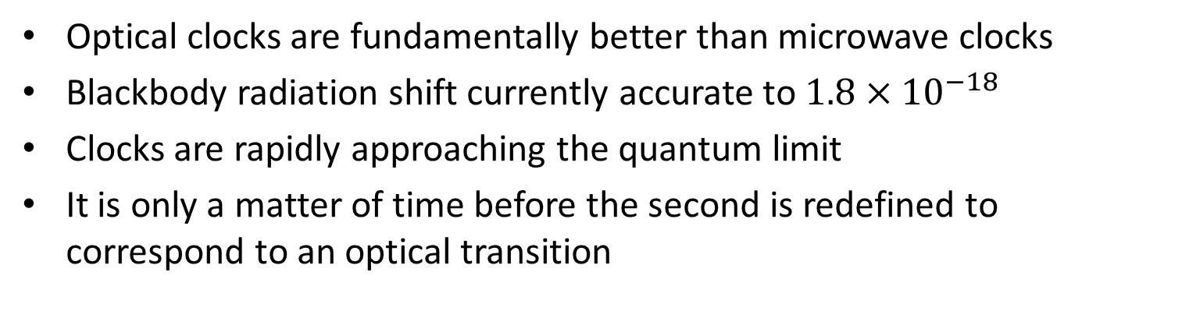
Conclusions
Optical clocks are fundamentally better than microwave clocks
Blackbody radiation shift currently accurate to $1.8×{10}^{−18}$
Clocks are rapidly approaching the quantum limit
It is only a matter of time before the second is redefined to correspond to an optical transition
Thank you for your attention!

Slide 21
Extra Slides

Slide 22
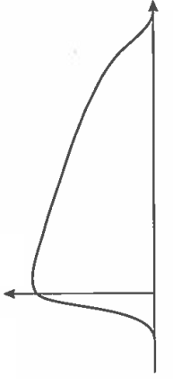
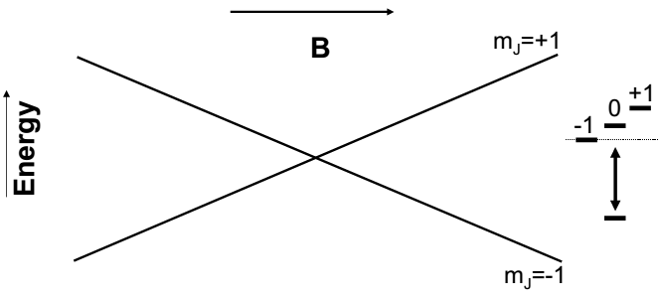




Zeeman Slower
Atoms decelerated by laser
absorbs $σ^{−}$ light from the right: ¹S₀(m_{F}=0)$→$¹P₁(m_{F}=-1)
spontaneously re-emits in random direction
Magnetic field shifts the transition so the atom is always on resonance with laser. As atom passes through slower:
Zeeman shift increases
Doppler shift decreases
B
x
$$σ^{−}$$
Atom source
Laser
$${ℏω}_{L}$$
m_{J}=0
varying-field solenoid
A. D. Ludlow, Ph.D. thesis (2008) and C. J. Foot, Atomic Physics (2011)

Slide 23







Magneto-Optical Trap (MOT)
Spatially varying magnetic field $B=ax$ ($x=0$ at trap center)
Circularly polarized light red-detuned from resonance (¹S₀-¹P₁ or ¹S₀-³P₁)
Atoms won’t scatter unless off-center from trap
$$σ^{−}$$
$$σ^{+}$$
$$σ^{−}$$
$$σ^{−}$$
$$σ^{+}$$
$$σ^{+}$$
$$T_{Doppler}=\frac{ℏγ}{2k_{B}}$$
M. M. Boyd, Ph.D. thesis (2007) and C. J. Foot, Atomic Physics (2011)

Slide 24





Optical Lattice I
Standing wave creates a spatially-dependent ac-Stark shift
$$hΔν=−\frac{1}{2}α_{i}{\left|\vec{E}\right|}^{2}$$
Polarizability
$$α_{a}\left(ω\right)=2πε_{0}c^{3}\sum_{b≠a}{\frac{2J_{b}+1}{2J_{a}+1}\frac{A_{ba}}{ω_{ab}^{2}\left(ω_{ab}^{2}−ω^{2}\right)}}$$
Ground state ¹S₀ is coupled strongest to ¹P₁ (461 nm), so $α_{g}$>0 if λ>461 nm
Clock state ³P₀ is coupled to states above and below, so $α_{g}\text{will} \text{change} \text{signs}$
$α_{i}$ for both states is positive at λ=813nm, so atoms become trapped at the anti-nodes of the standing wave
S. Blatt, PRA 80, 052703 (2009)

Slide 25





Optical Lattice II
Standing wave creates a spatially-dependent ac-Stark shift
$$hΔν=−\frac{1}{2}α_{i}{\left|\vec{E}\right|}^{2}$$
Standing wave results in a potential
U$\left(r,z\right)=−4U_{m} Exp\left[−\frac{{2r}^{2}}{w{\left(z\right)}^{2}}\right]\cos^{2}\left(\frac{2πz}{λ}\right)$
$$U_{m}∝\frac{Pα_{i}}{w{\left(z\right)}^{2}}$$
trap
depth
Gaussian radial
profile
standing wave
along z
Approximate as harmonic potential $U=\frac{1}{2}kx^{2}$ with frequency $ω=\sqrt{\frac{1}{m}\frac{δ^{2}U}{δx^{2}}}$ in each direction
$ν_{r}=\frac{1}{2πw_{0}^{2}}\sqrt{\frac{16α_{a}P}{cε_{0}Mπ}}≃$ 120 Hz
$ν_{z}=\frac{1}{2πw_{0}^{}λ}\sqrt{\frac{32πα_{a}P}{cε_{0}M}}≃$ 40 kHz
S. Blatt, PRA 80, 052703 (2009)

Slide 26


Lamb-Dicke Effect
Lambe-Dick parameter $η$
$$η=k_{z}z_{0}=\frac{1}{λ_{p}}\sqrt{\frac{h}{2Mν_{z}}}=\sqrt{\frac{ν_{recoil}}{ν_{trap}}}$$
Lambe-Dick region ($η<1$) is a strongly confined atom
Characteristic length scale of trap is $z_{0}=\sqrt{\frac{ℏ}{4πMν_{z}}}≃$40 nm
Since $ν_{z}∝\sqrt{laser power}$, can get $η<1$ by increasing power

