Slide 1
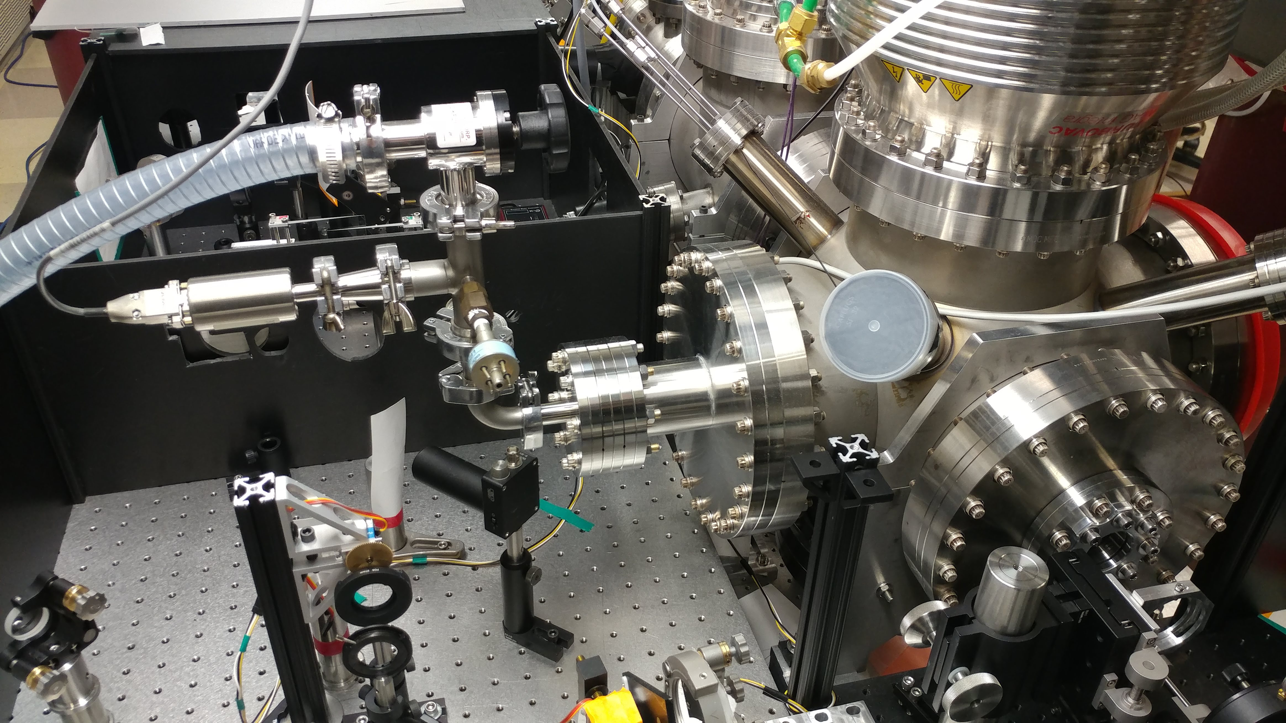
gas feedthrough
manual valve
pressure sensor
KF feedthrough

