Slide 1




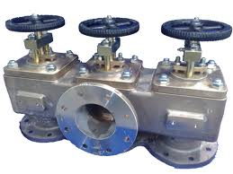
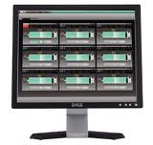
Master
Time Reference
…
Switch
Switch
Switch
Network
Node
Node
Node
…
Node
Node
sensor
actuator
database
actuator
monitoring
Nodes
: data & timing information

Slide 2

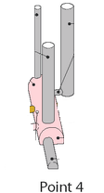
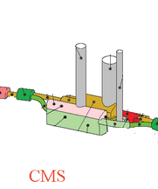
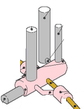
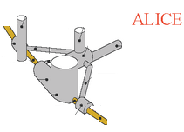
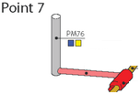
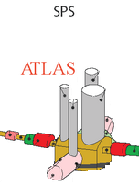
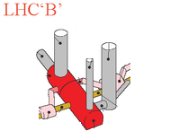
Control Room

Slide 3
Control Room

Slide 4







Control Room

Slide 5
Control Room

Slide 6
Control Room

