Slide 1




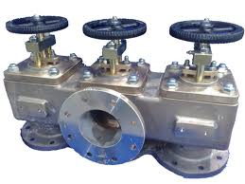
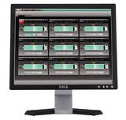
Master
Time Reference
…
Switch
Switch
Switch
Network
Node
Node
Node
…
Node
Node
sensor
actuator
database
actuator
monitoring
Nodes
: data & timing information

Slide 2

Master
Time Reference
…
Switch
Switch
Switch
Network
Node
Node
Node
…
Node
Node
sensor
actuator
database
actuator
monitoring
Nodes

Slide 3
Master
Time Reference
…
Switch
Switch
Switch
Network
Node
Node
Node
…
Node
Node
sensor
actuator
database
actuator
monitoring
Nodes
: data & timing information

Slide 4

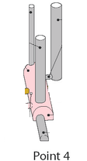
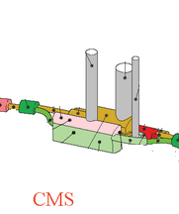
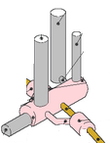
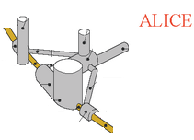
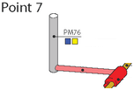
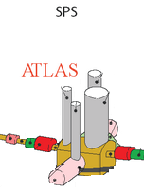
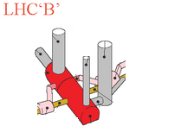
Control Room

Slide 5
Control Room

Slide 6







Control Room

Slide 7
Control Room

Slide 8
Control Room

