Slide 1
White Rabbit
PTP profile
Maciej Lipinski
CERN
Notes:
Although the OHR and the philosophy behind it are well known and endorsed by management and the Knowledge and Technology Transfer group at CERN, there are some parts of this talk which delve into domains such as how can OH be beneficial for society as a whole for which:
a) I am not mandated to represent CERN.
b) People at CERN involved in this might have different opinions.
I am therefore here representing nobody but myself, i.e. I am not on an official trip as far as CERN is concerned. I am on holidays.
Having said this, CERN is indeed a very cool place where the dissemination of information primes above economic (or other) considerations and all necessary conditions for the birth of OHR could be found.

Slide 2
Introduction
WRPTP
WRPTP
Compliance
2/10
Notes:
We will start with an introduction to the OHR, where it sits, what it is, why we are doing this and how we are doing it.
We will then move on to a description of the biggest project so far in OHR: the White Rabbit network. This project aims at achieving sub-nanosecond synchronization of over 1000 nodes linked by typical fiber lengths of 10 km using an extension of Ethernet.
Finally, we will go through some considerations on whether this effort we initiated at CERN can be of any use to society at large.

Slide 3


Introduction
What is White Rabbit ?
Intended for accelerator control and timing (GSI, CERN)
Based on well-known technologies/standards
Open Hardware and Open Software
International collaboration,
Synchronization with sub-ns accuracy over fiber:
    Precision Time Protocol (PTP) synchronization
    Synchronous Ethernet (SyncE) syntonization
    Digital Dual-Mixer Time Difference (DDMTD)
    phase detection
3/10
Notes:
All three-letter combinations for domain names are taken by (mostly) speculators so we used hw for hardware, although we still say “OHR” to refer to the repository, and not “OHWR”.

Slide 4
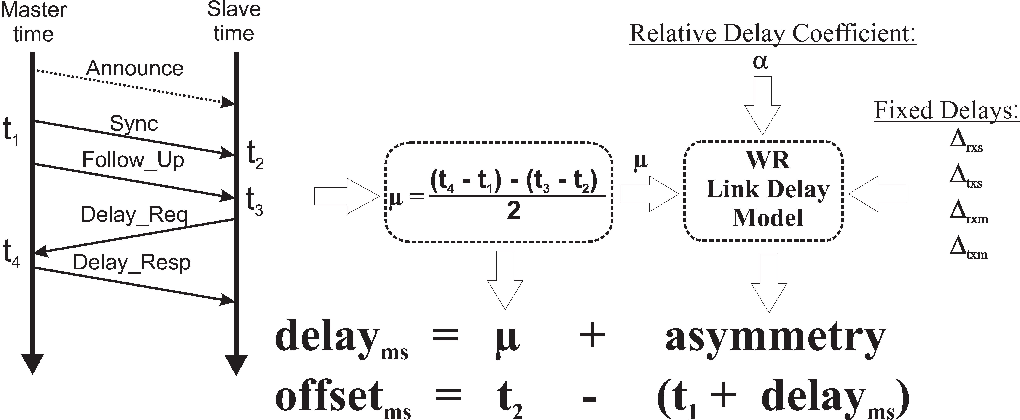
Introduction
Link Delay Model
4/10
Notes:
It could not be otherwise: the OHR is fully built using free software. The plugins which were developed are also completely public and free.

Slide 5
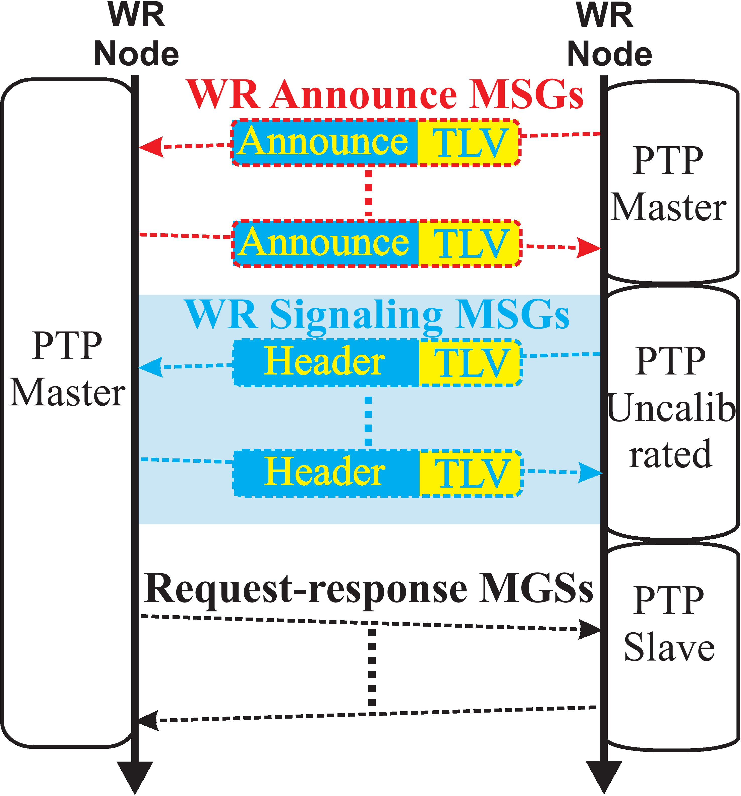
WRPTP
Exchange of WR-data
WR Type-Length-Value (WR TLV):
tlvType=ORGANIZATION_EXT
OrganizationID=CERN's OUI
WR data stored:
Additional Fields in PTP Data Sets
BackupParentDS
WR data exchange
suffixing Announce Messages
creating WR Signaling Messages
5/10
Notes:
WR is a multi-lab multi-company project to deal with the problem of distributed node synchronization at the ns level in an Ethernet environment. At this level of precision, custom switches are necessary. Switch development is currently the main focus of the project. The project aims at synchronizing up to 1000 nodes with typical fiber lengths of 10 km (CERN site). This technology has applications in all sorts of distributed control and data acquisition systems: telescope arrays, particle accelerators, power grid monitoring, etc. Even projects which don't need the ns precision can consider WR instead of other solutions (e.g. NTP) if they need a complete guarantee for an upper bound in terms of time difference between any two nodes. Another important aspect of the project is achieving determinism through the definition of several traffic types with different switching priorities.

Slide 6
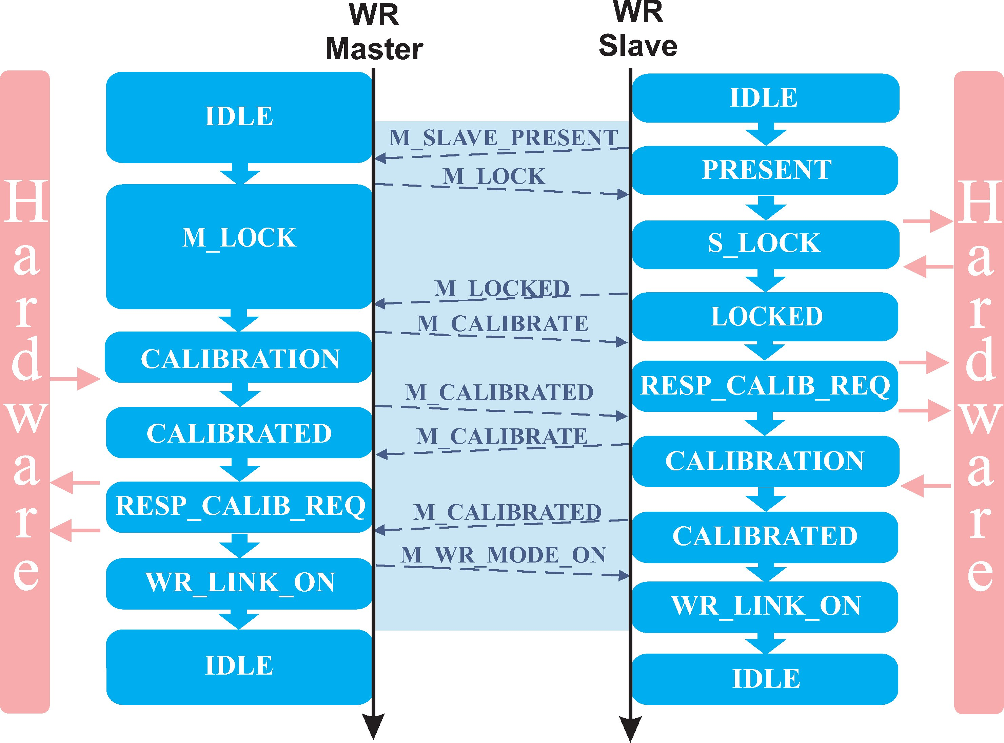
WRPTP
WR Link Setup
6/10
Notes:
A WR network is hierarchical timing-wise and flat data-wise. The first switch in the hierarchy recovers its clock from an external clock source and uses it to encode all data going to its downlink ports. The next switch layer will sense data in its uplink port(s) and extract their clock from that data. Through this mechanism, syntonization is achieved throughout the network. For synchronization we still need to account for fiber or cable-induced delays (see next slide). Data-wise it's nothing different from a normal Ethernet network. We plan to implement 802.1q support for VLANs and prioritized traffic. With the combination of perfect synchronization and determinism we can take advantage of new ways of performing control actions in a time coherent way, like sending a message to all nodes at 11:59:59.999 saying “Take acquisition data at 12:00”. A whole millisecond is taken to account for (guaranteed) worst case delay, but this delay does not need to be the same for every node in order to guarantee coherent acquisition.

Slide 7
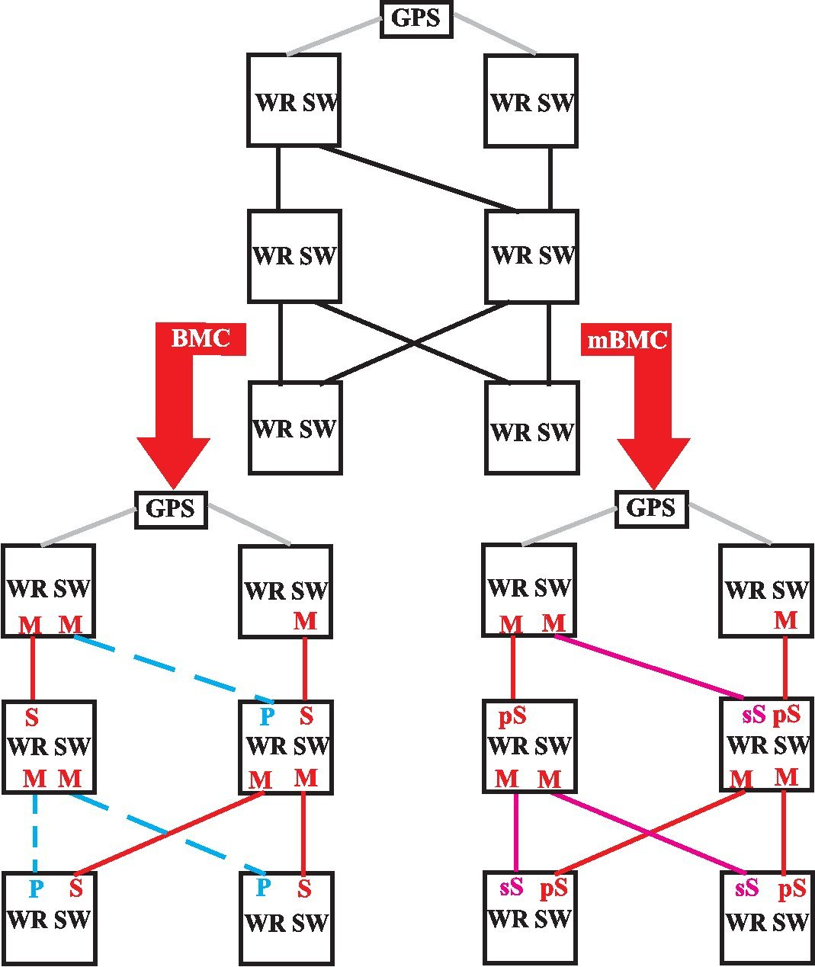
WRPTP
modified BMC (mBMC)
... forces PTP_SLAVE state instead of
PTP_PASSIVE for clockClass > 127
Many PTP SLAVE ports in a single Boundary Clock,
Active PTP SLAVE port used to synchronize and syntonize local clock.
Modifies State Decision Algorithm.
New Data Fields update.
7/10
Notes:
PTP stands for Precise Time Protocol (aka IEEE 1588). Its main purpose is to evaluate transmission delays in a network in order to establish a common distributed time base. This figure illustrates the four time tags needed by PTP to evaluate transmission delay. PTP is itself an improvement over NTP to have a system where the assumption of symmetric delay is closer to reality (by time-tagging in hardware instead of calling gettimeofday).

Slide 8
WRPTP
Compliance
WRPTP profile
WRPTP profile
profle name | White Rabbit
profile version | 1.0
profile identifier | 08-00-03-00-01-00
organization name | CERN
source identification | www.ohwr.org
master clock algorithm: | mBMC
delay mechanism: | delay request-response
transport mechanism: | IEEE 802.3
custom TLV: | WR TLVs
domain: | single domain only (value=0)
portDS.logSyncInterval: | default value 0, range: -1 to 6
defaultDS.priority1: | default value 68
8/10
Notes:
The FOSS movement started when closed software “got in the way”. The reasons for OH are very similar. Closed hardware has basically the same disadvantages as closed SW: unnecessary dependencies wrt vendors, lack of freedom to understand and modify if need be, etc. Similarly to FOSS, this lack of freedom is most important to people who could actually use that freedom, i.e. designers. The average computer user (whatever that means) is mostly happy with a Windows PC or a Mac. Similarly, the average hardware user is happy with a closed-source ADC or DSP board. Between the average user and hardware specialists there is a gradation of profiles with increasing interest in OH, which we explore in the following slides. This situation is completely analogous to the one for FOSS, once a appropriate scaling factor is applied to the absolute numbers. Notice that for hardware we are limiting considerations to hardware typically used in control and data acquisition systems. We are not talking about toasters and cars for example. I don't know of anyone whose professional life is handicapped by lack of knowledge of the internals of his toaster.
An additional argument to consider FOSS and OH on equal footing is that it is becoming easier and easier to design hardware, and hardware has become more and more programmable itself thanks to HDLs.
According to wikipedia, Linux users represent less than 2% of the total desktop/laptop users: http://en.wikipedia.org/wiki/Usage_share_of_operating_systems. This does not keep it from being the best OS out there. Once your developer community is bigger than your needs or bigger than what can actually be reasonably managed, size is not a problem anymore.
If our sphere of action was only that of publicly funded labs and schools it would already be largely sufficient. Anything in addition will only make things easier.

Slide 9
WRPTP
Compliance
WRPTP requirements
H/W requirements:
SyncE
Constant rx/tx latencies
Support of rx/tx latencies measurement
Sufficient timestamps precision
Implementation requirements
Issue/handle WR Announce and Signaling Message
non-preemptive WR Finite State Machine
WR data set and WR-specific data fields
SYNCHRONIZATION_FAULT transition
MASTER_CLOCK_SELECTED transition
communication with H/W
9/10
Notes:
These two problems are quite real if your sphere of action is the whole world of HW development, but we don't believe that this holistic approach is either possible or desirable.
If we reduce our action field to the (very big) subset of competent, publicly-funded (directly or indirectly) designers, then these two problems disappear. The fact that making HW takes money is a fact of life, completely unrelated to whether the design should be open or not. If you don't have money to build hardware, you are not in the hardware manufacturing community by definition. You can be a developer, but not a manufacturer.
Now that leaves us with a single problem: what about skilled developers outside of this community? Work on FOSS tools for HW design is the only answer I have at the moment. We absolutely need this to unleash these great design resources. But as I said, getting organized on the publicly-financed side would be already a game-changing decision.

Slide 10

The End
Thank you
Notes:
The advantages of OH are most obvious for hardware developers. Here is a quick list:
- Great learning tool for technologies you don't master.
- Avoiding unnecessary work if someone has designed what you need (or almost).
- If your role is to give support to others for that HW (as is ours at CERN), your life supporting black boxes can be quite complicated...
- Having your work reviewed increases its quality. In fact the mere fact of publishing your work pushes you to be better.

