Slide 1

Reliability in a White Rabbit Network
Maciej Lipinski, Javier Serrano, Tomasz Wlostowski
BE-CO-HT@CERN, Geneva, Switzerland
Cesar Prados
GSI, Darmstadt, Germany
WEMMU007

Slide 2
What is White Rabbit?
Accelerator's control and timing (GSI, CERN)
Based on well-known technologies/standards
(Ethernet, PTP, SyncE)
Open Hardware and Open Software
International collaboration
Ethernet with extra features:
transparent, high-accuracy time distribution (sub-ns)
low-latency, deterministic data delivery
High reliability

Slide 3
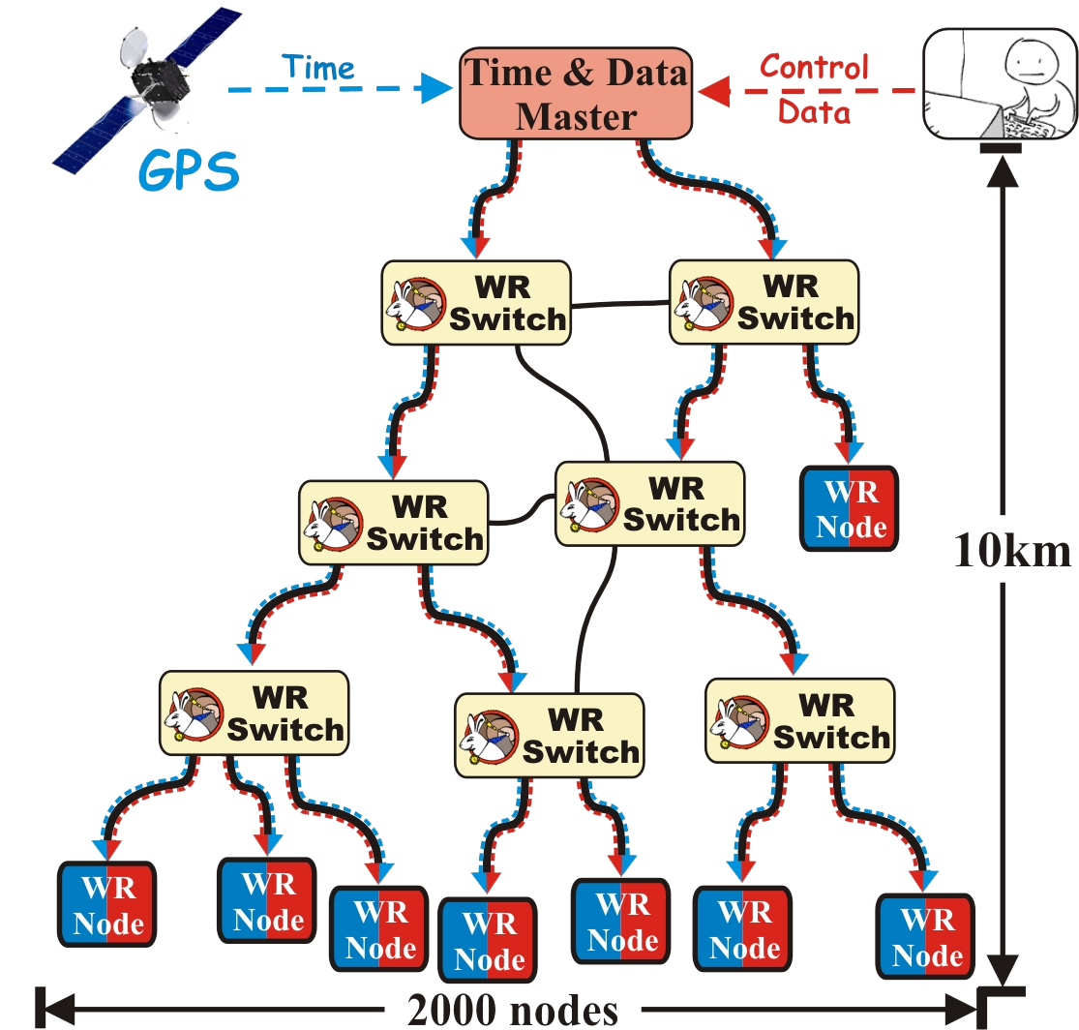
White Rabbit Network (WRN)
WRN is functional if …
... it provides all its services
to all its clients at any time.
Sub-nanosecond time synchronization
Deterministic Control Data delivery

Slide 4
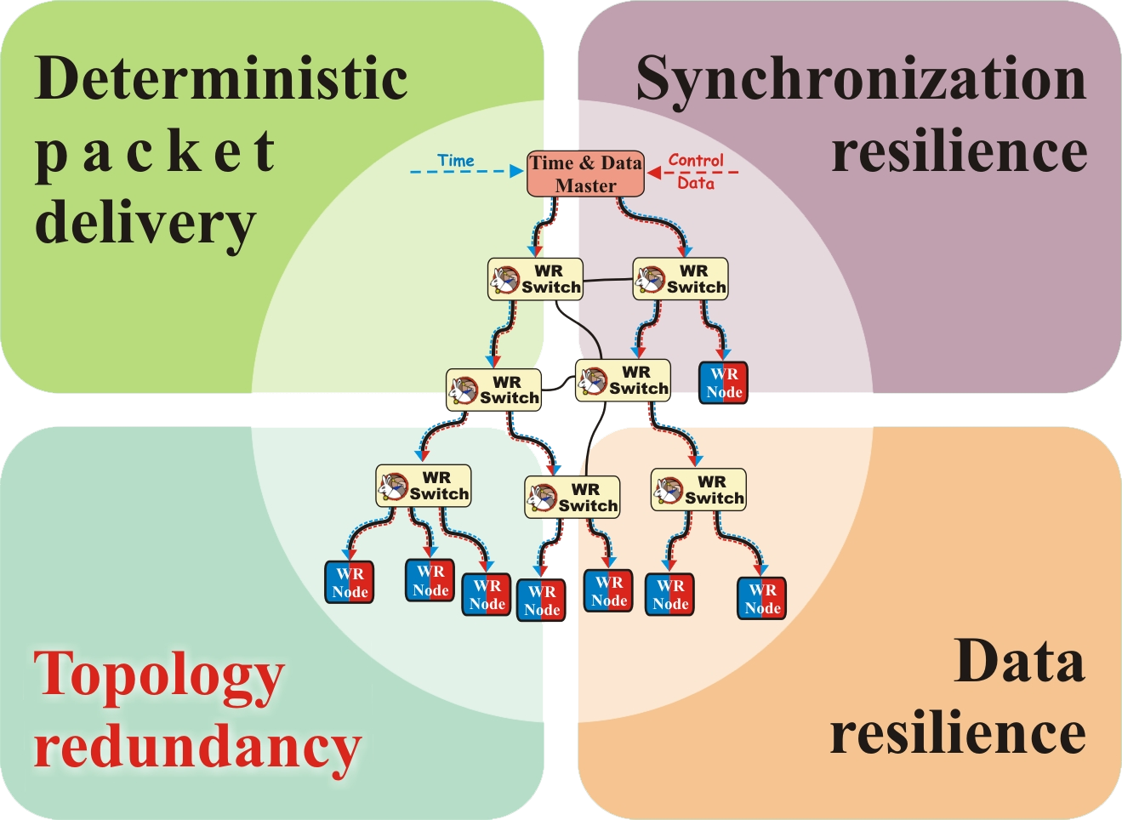
Reliability in a White Rabbit Network

