Slide 1
The Higher Education Landscape
A presentation to the
University of San Francisco Budget Forum, February 2020
Greg Dubrow, Director of Institutional Research,
San Francisco State University

Slide 2



About me:
Since November 2018, Director of IR at SF State
Director of Research & Policy Analysis/Enrollment Analytics at
UC Berkeley Office of Undergraduate Admissions, 2005 to 2018
Asst. Professor, Florida International Univ, Miami FL 2001 to 2005
Ph.D. in Higher Education, University of Pennsylvania
@greg_dubrow
Greg Dubrow
greg-dubrow

Slide 3
What are the major trends affecting the higher education landscape in the US today, particularly traditional liberal arts colleges?
Changing demographics impacting enrollments
Affordability
What social/political threats are on the horizon that colleges should start addressing?

Slide 4
California High School Graduates

Slide 5
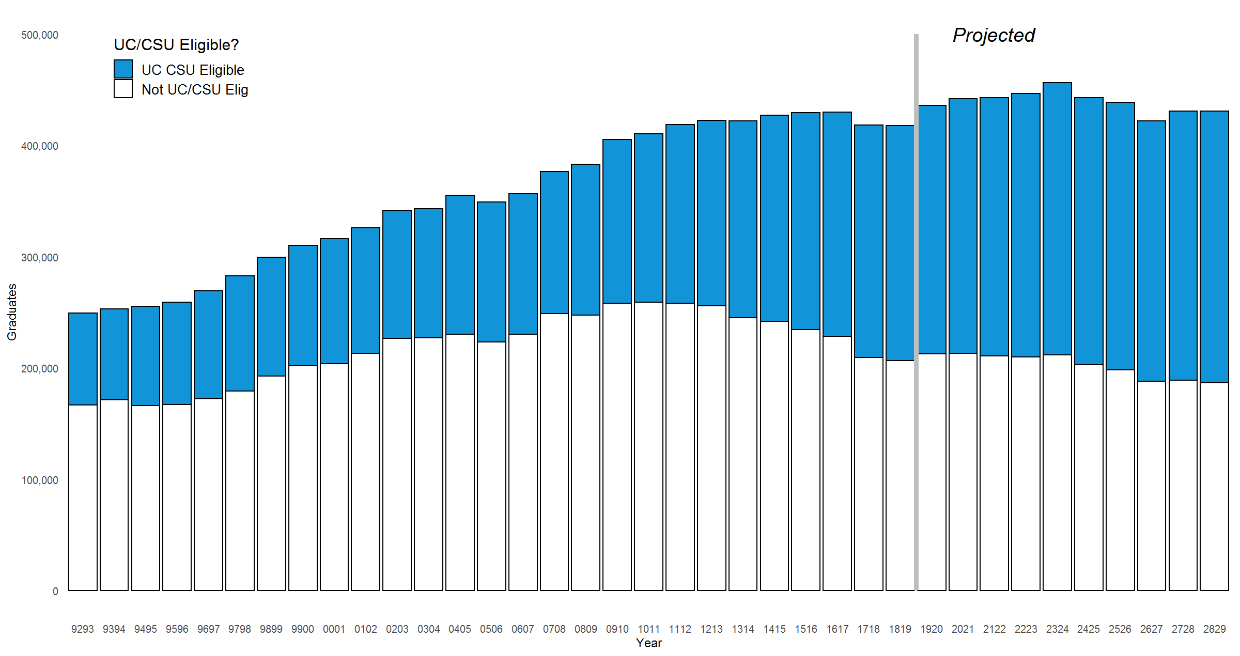
California Public High School Graduates
1993 to 2029 (projected)
Projected total enrollments 2019-20 onward from CA Dept of Finance
Projections based on migration/immigration & school-continuation rate models
UC/CSU eligibility projections by author using modest assumptions from most recent three year period

Slide 6
California Public High School Graduates
1993 to 2029 (projected)
67% increase in grads from 1993 to 2018
UC/CSU eligibility 33% in 1993, 50% in 2018
Data sources:
Actual: CA Dept of Education.
Projections: CA Dept of Finance
Grads expected to peak in 2023, then decline slightly

Slide 7
Factors affecting K-12 enrollment and graduation:
Birth rates
Immigration
Emigration in/out of state
Housing costs
More resources:
CA Department Ed Data & statistics: https://www.cde.ca.gov/ds/
National Center for Education Statistics: https://nces.ed.gov/
Public Policy Institute of California - https://www.ppic.org/

Slide 8
USF Enrollment

Slide 9
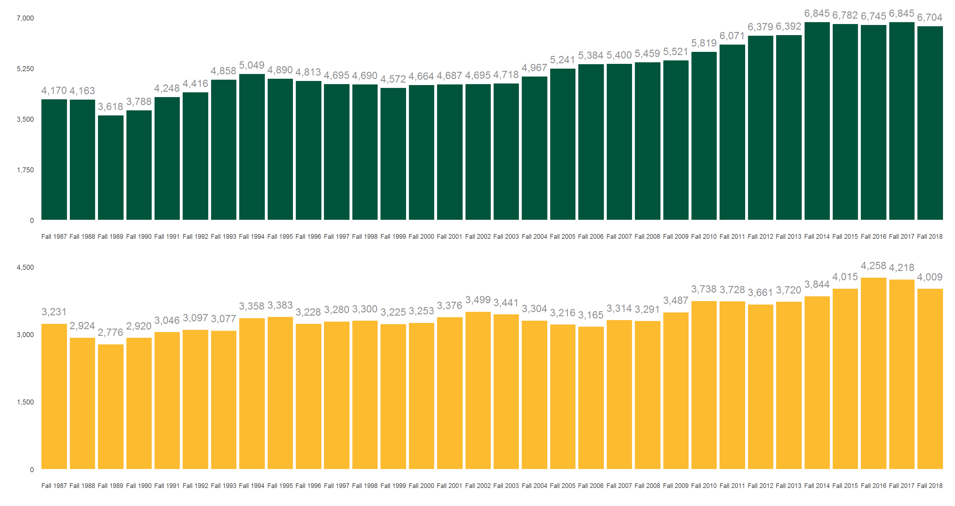
Total Enrollment at USF – 1987 to 2018
Undergraduate students
Graduate students
Sources: IPEDS & Delta Cost Project

Slide 10
Total Enrollment at USF – 1987 to 2018
Undergraduate enrollment have increased by 60% since 1987.
Graduate enrollments fluctuating over time, over 4,000 since 2016.
Ratio of undergraduate::graduate enrollments steady over time, generally +/- 2% points from 60%.
With 63% of new students coming from California, high school enrollments here will have most impact.
Western Interstate Commission for Higher Education (WICHE) projects HS grads from all western states to peak in 2024 at 862,000, then decline for a few years, rebounding again around 2032. (Knocking at the College Door, https://knocking.wiche.edu)
During 1980s the Gen X population drop mitigated by increased college-going rates – what will happen this time?

Slide 11
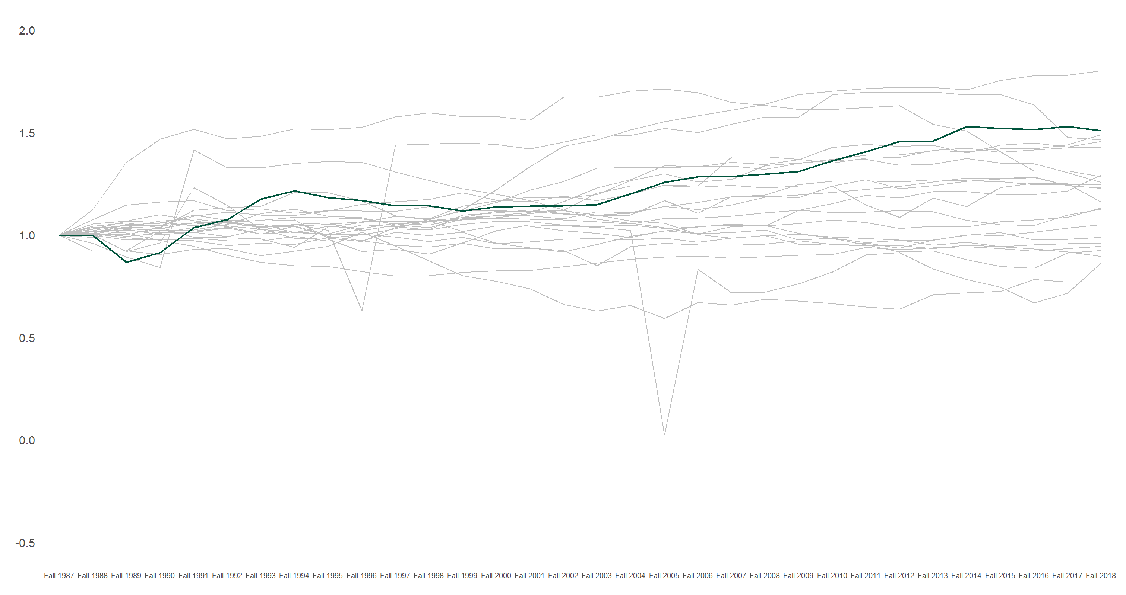
Jesuit College Undergraduate Enrollment (Indexed) – 1987 to 2018
Green line is USF
Gonzaga University ↓
Regis University – doubled 1987 to 2006, has since reduced enrollment ↓
St. Louis University
Loyola University in New Orleans, Fall of Hurricane Katrina
Sources: IPEDS & Delta Cost Project

Slide 12
College Affordability

Slide 13
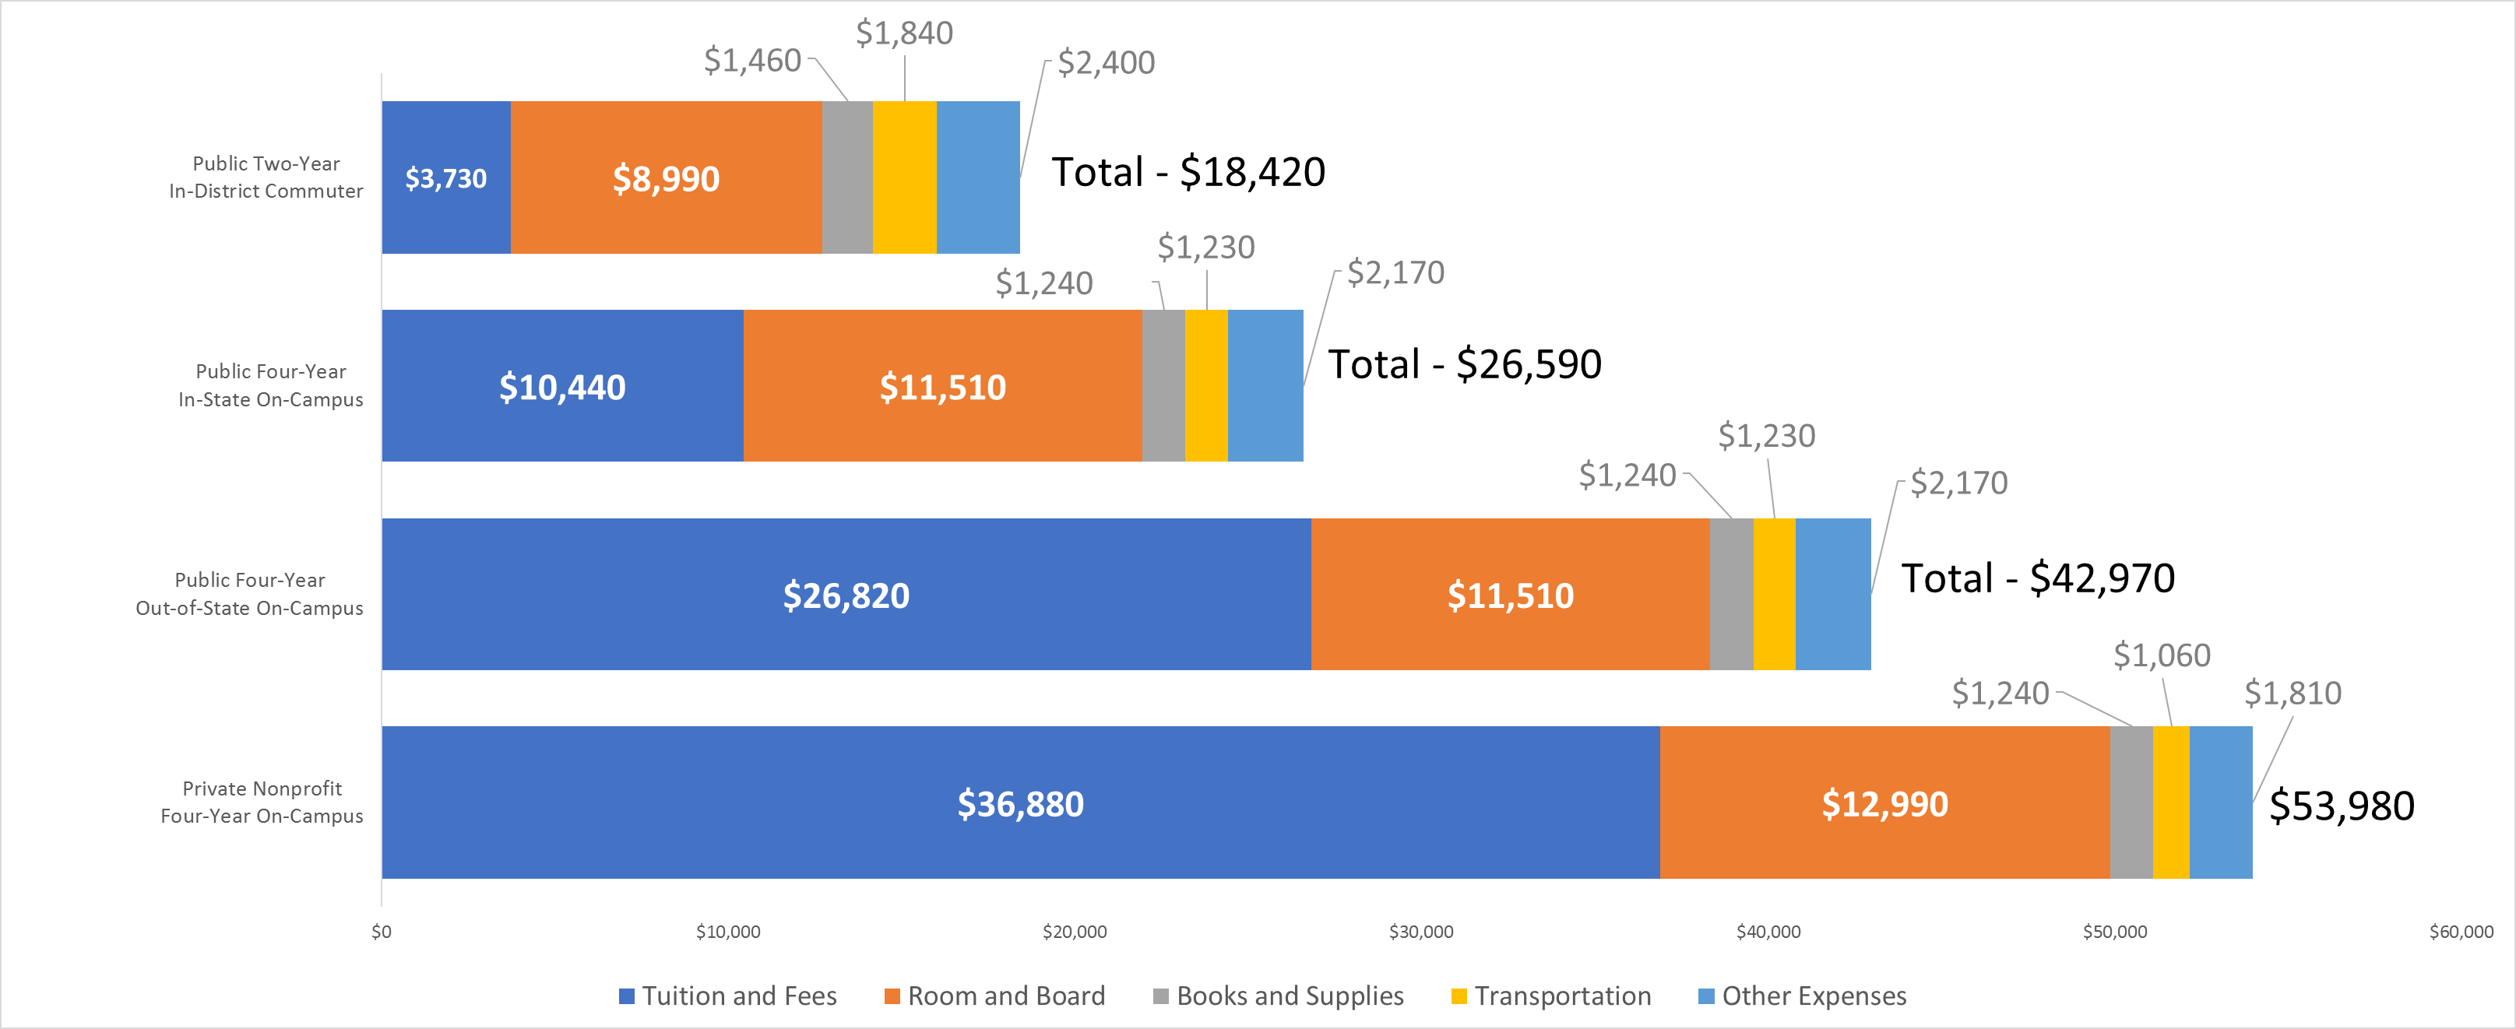
Average Estimated Full-Time Undergraduate Budgets (Enrollment-Weighted) by Sector, 2019-20
Source: College Board, NCES

Slide 14
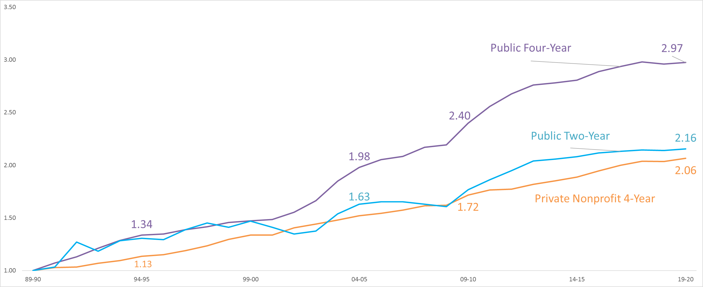
Inflation-Adjusted Published Tuition and Fees
1989-90 to 2019-20 (Indexed 1989-90 = 1.0)
Source: College Board, NCES

Slide 15
Average Tuition & Fees by Sector (current $)
Source: College Board, NCES

Slide 16
Tuition, Aid & Affordability Concerns
Cost-of-attendance outpacing family income:
16% income increase 1989 to 2018 vs tuition gains from prior charts
Pressures on middle-income students
Cost, debt & other metrics (College Scorecard)

Slide 17
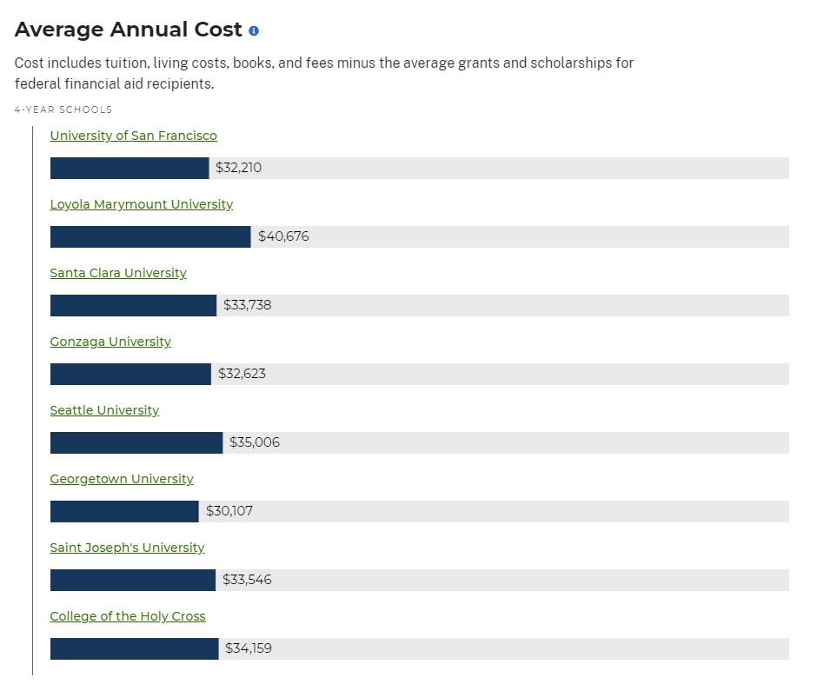
Source: College Scorecard
collegescorecard.ed.gov/

Slide 18
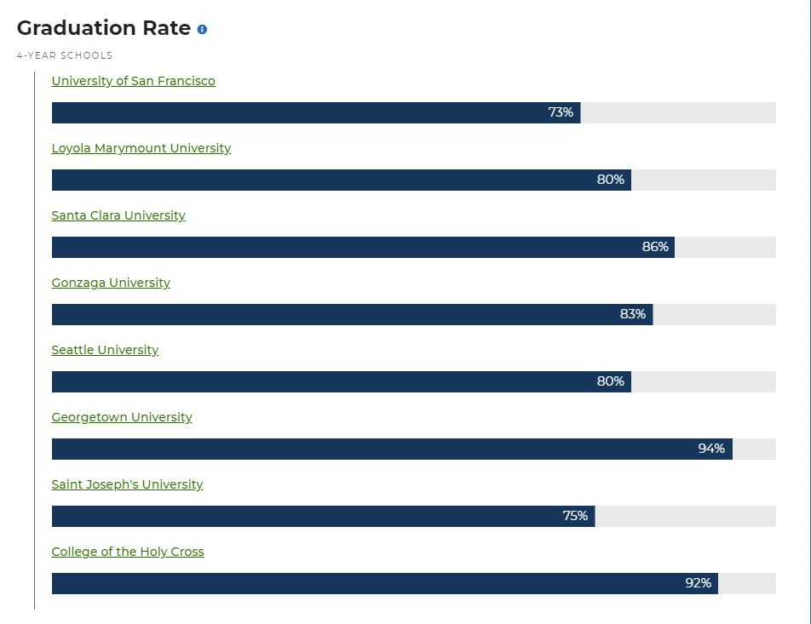
Source: College Scorecard
collegescorecard.ed.gov/
Students graduating within 200% of expected time

Slide 19
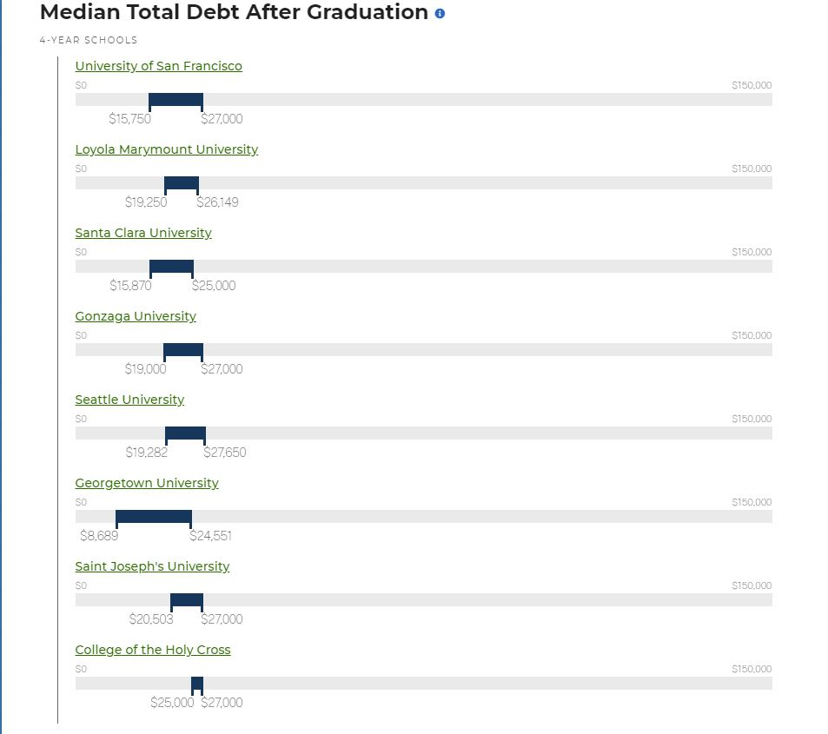
Source: College Scorecard
collegescorecard.ed.gov/

Slide 20
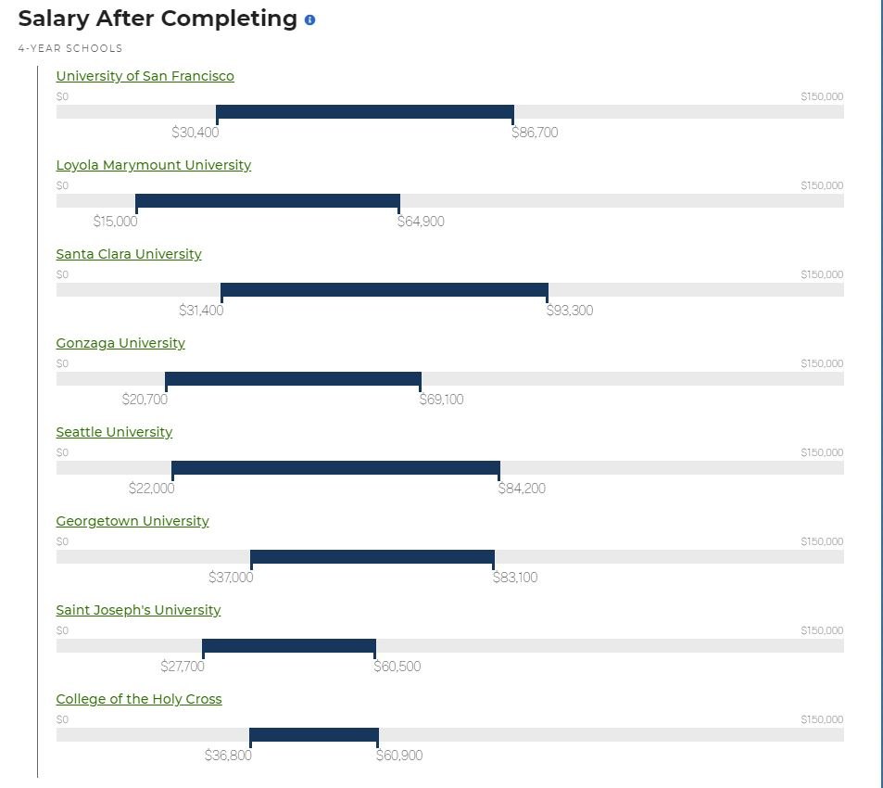
Source: College Scorecard
collegescorecard.ed.gov/

Slide 21
Social & political trends

Slide 22
International student enrollment – immigration policy & climate
Cost of attendance, especially for publics. What happens to appropriations if next recession is as bad as 2008-09
For privates, what happens to demand in a tight economy
For public institutions relying on International & out-of-state, is there a maximum cost-of-attendance point
Competition from boot-camp and other credentialing programs

Slide 23
Further Discussion
If I had the time…

Slide 24
Tuition discounting and affect on budget & enrollment planning
Retention & graduation rates
Endowments and budget stability
…and much, much more…

Slide 25
What questions do you have?

Slide 26
Thank you!
@greg_dubrow
Greg Dubrow
greg-dubrow

